Slide 1
Managing Database Storage Structures

Slide 2
Objectives
After completing this lesson, you should be able to:
  Describe the storage of table row data in blocks
  Create and manage tablespaces
  Obtain tablespace information
Notes:
Oracle Database 12c: Admin, Install and Upgrade Accelerated 10 - <number>

Slide 3
How Table Data Is Stored
Columns
Blocks
Table A
Table B
Rows
Segment
Segment
Table
Tablespace
Row piece
Extent
Notes:
When a table is created, a segment is created to hold its data. A tablespace contains a collection of segments.
Logically, a table contains rows of column values. A row is ultimately stored in a database block in the form of a row piece. It is called a row piece because, under some circumstances, the entire row may not be stored in one place. This happens when an inserted row is too large to fit into a single block (chained row) or when an update causes an existing row to outgrow the available free space of the current block (migrated row). Row pieces are also used when a table has more than 255 columns. In this case the pieces may be in the same block (intra-block chaining) or across multiple blocks.
Oracle Database 12c: Admin, Install and Upgrade Accelerated 10 - <number>

Slide 4
Database Block: Contents
Block header
Growth
Free space
Row data
Notes:
Block header: The block header contains the segment type (such as table or index), data block address, table directory, row directory, and transaction slots of approximately 23 bytes each, which are used when modifications are made to rows in the block. The block header grows downward from the top.
Row data: This is the actual data for the rows in the block. Row data space grows upward from the bottom.
Free space: Free space is in the middle of the block, enabling the header and the row data space to grow when necessary. Row data takes up free space as new rows are inserted or as columns of existing rows are updated with larger values.
Examples of events that cause header growth:
Row directories that need more row entries
More transaction slots required than initially configured
Initially, the free space in a block is contiguous. However, deletions and updates may fragment the free space in the block. The free space in the block is coalesced by the Oracle server when necessary.
Oracle Database 12c: Admin, Install and Upgrade Accelerated 10 - <number>

Slide 5
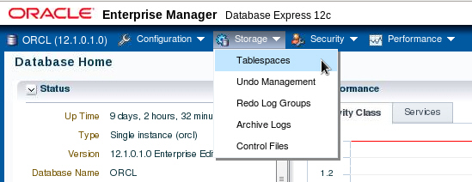
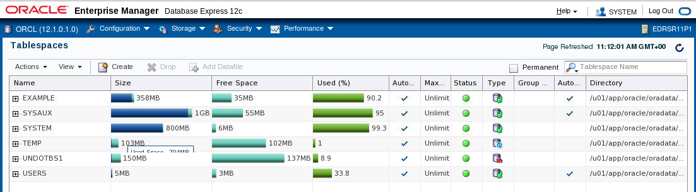
Exploring the Storage Structure
Notes:
You can easily view the storage structures of your database through Enterprise Manager Database Express. Detailed information about each structure can be obtained by selecting the structure in the Storage menu.
Oracle Database 12c: Admin, Install and Upgrade Accelerated 10 - <number>

Slide 6
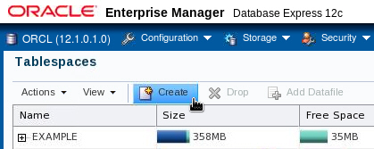
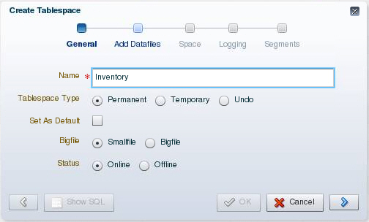
Creating a New Tablespace
Notes:
1. Expand the Storage menu and then select Tablespaces.
2. Click Create.
3. Enter a name for the tablespace.
4. In the Tablespace Type field, select Permanent.
Permanent tablespaces store permanent database objects that are created by the system or users.
5. In the Bigfile field, select Smallfile. Bigfile tablespaces are used with extremely large databases, in which ASM or other logical volume managers support the striping or redundant array of independent disks (RAID) and dynamically extensible logical volumes.
6. In the Status field, select Online.
Online means that users can read and write to the tablespace after it is created. This is the default.
7. Click the blue arrow to add data files to the tablespace.
Oracle Database 12c: Admin, Install and Upgrade Accelerated 10 - <number>

Slide 7
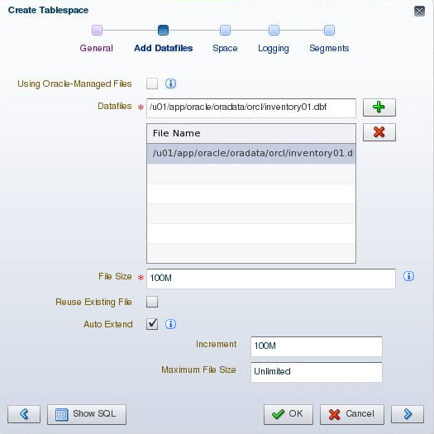
Creating a New Tablespace
Notes:
A tablespace must have at least one file.
8. On the Add Datafiles page, enter a file directory and file name for the data file.
9. Enter the desired file size.
10. Select “Auto Extend” to automatically extend the data file when it is full and specify an increment amount in the Increment field. This causes the data file to extend automatically each time it runs out of space. It is limited, of course, by the physical media on which it resides. Leave Maximum File Size as Unlimited or enter a maximum size.
11. Click the blue arrow to continue.
Oracle Database 12c: Admin, Install and Upgrade Accelerated 10 - <number>

Slide 8
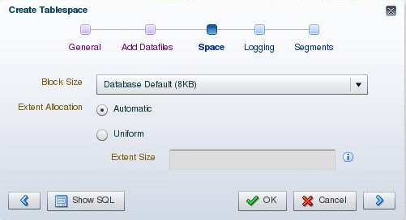
Creating a New Tablespace
Notes:
Block Size: This field shows the block size that is used for the tablespace being created.
Extent Allocation: The extents can be allocated in one of the following two ways:
Automatic: Also called autoallocate, it specifies that the sizes of the extents in the tablespace are system managed. You cannot specify Automatic for a temporary tablespace.
Uniform: It specifies that the tablespace is managed with uniform extents of a size that you specify. The default size is 1 MB. All extents of temporary tablespaces are uniform. You cannot specify Uniform for an undo tablespace.
Oracle Database 12c: Admin, Install and Upgrade Accelerated 10 - <number>

Slide 9
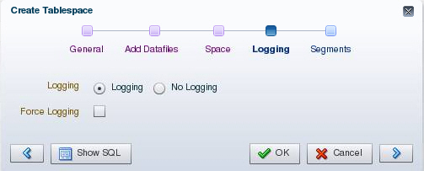
Creating a New Tablespace
Notes:
Logging: The LOGGING clause sets the default logging value for any segment created in the tablespace. Changes made to objects in the tablespace are written to the redo log. If logging is not enabled, any direct loads using SQL*Loader and direct load INSERT operations are not written to the redo log, and the objects are thus unrecoverable in the event of data loss. When an object is created without logging enabled, you must back up those objects if you want them to be recoverable. Choosing not to enable logging can have a significant impact on the ability to recover objects in the future. Use with caution. For more details about the logging clause, see the Oracle Database SQL Reference.
Note: If FORCE LOGGING mode is in effect for the database, it takes precedence over the tablespace logging setting. The database can be put into FORCE LOGGING mode at the time of database creation or after database creation using the ALTER DATABASE FORCE LOGGING command.
Oracle Database 12c: Admin, Install and Upgrade Accelerated 10 - <number>

Slide 10
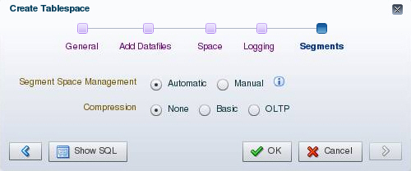
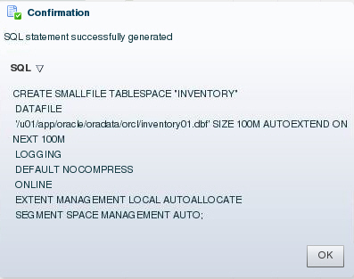
Creating a New Tablespace
Notes:
Segment Space Management: Segment space management can be specified as:
Automatic: The Oracle Database server uses bitmaps to manage the free space in segments. The bitmap describes the status of each data block in a segment with respect to the amount of space in the block that is available for inserting rows. As more or less space becomes available in a data block, the new state is reflected in the bitmap. With bitmaps, the Oracle database manages free space more automatically. As a result, this form of space management is called Automatic Segment Space Management (ASSM).
Manual: This specifies that you want to use free lists for managing free space in segments. Free lists are lists of data blocks that have space available for inserting rows. This form of managing space in segments is called manual segment space management because of the need to specify and tune the PCTUSED, FREELISTS, and FREELIST GROUPS storage parameters for schema objects created in the tablespace. This is supported for backward compatibility; it is recommended that you use ASSM.
Oracle Database 12c: Admin, Install and Upgrade Accelerated 10 - <number>

Slide 11
Notes:
Compression Options: Data segment compression is disabled by default. Enabling data segment compression can save disk space usage, reduce memory use in the buffer cache, and speed up query execution during reads. There is, however, a cost in CPU overhead for data loading and DML. It is especially useful in online analytical processing (OLAP) systems, where there are lengthy read-only operations, but can also be used in online transaction processing (OLTP) systems.
For more details about when to use the compression clause, see the Oracle Database Administrator’s Guide.
Oracle Database 12c: Admin, Install and Upgrade Accelerated 10 - <number>

Slide 12
Overview of Tablespaces Created by Default
  EXAMPLE (optional)
  SYSAUX
  SYSTEM
  TEMP
  UNDOTBS1
  USERS
Notes:
The following tablespaces are created by default when you create an Oracle database:
SYSAUX: This is an auxiliary tablespace to the SYSTEM tablespace. Some components and products that used the SYSTEM tablespace or their own tablespaces in earlier releases of Oracle Database now use the SYSAUX tablespace.
SYSTEM: The SYSTEM tablespace is used by the Oracle server to manage the database. It contains the data dictionary and tables that contain administrative information about the database. These are all contained in the SYS schema and can be accessed only by the SYS user or other administrative users with the required privilege.
TEMP: Your temporary tablespace is used when you execute a SQL statement that requires the creation of temporary segments (such as a large sort or the creation of an index). Just as each user is assigned a default tablespace for storing created data objects, each user is assigned a temporary tablespace. The best practice is to define a default temporary tablespace for the database, which is assigned to all newly created users unless otherwise specified. In the preconfigured database, the TEMP tablespace is specified as the default temporary tablespace. This means that if no temporary tablespace is specified when the user account is created, Oracle Database assigns this tablespace to the user.
Oracle Database 12c: Admin, Install and Upgrade Accelerated 10 - <number>

Slide 13
Notes:
UNDOTBS1: This is the undo tablespace used by the database server to store undo information. If a database uses Automatic Undo Management, then it can only use a single undo tablespace at any given time. This tablespace is created at database creation time.
USERS: This tablespace is used to store user objects and data. If no default tablespace is specified when a user is created, then the USERS tablespace is the default tablespace for all objects created by that user. For the SYS and SYSTEM users, the default permanent tablespace is SYSTEM.
The EXAMPLE tablespace contains the sample schemas that can be installed when you create the database. The sample schemas provide a common platform for examples. Oracle documentation and courseware contain examples based on the sample schemas.
Note: To simplify administration, it is common to have a tablespace for indexes alone.
Oracle Database 12c: Admin, Install and Upgrade Accelerated 10 - <number>

Slide 14
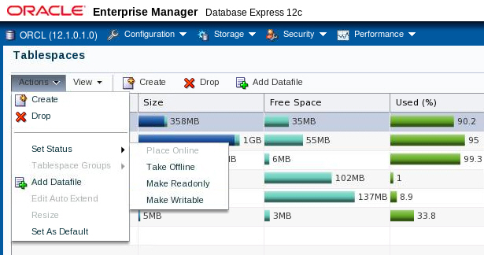
Altering a Tablespace
Notes:
After you create a tablespace, you can alter it in several ways as the needs of your system change.
Changing the status: A tablespace can be in one of three different statuses or states. Any of the following three states may not be available because their availability depends on the type of tablespace.
Read Write: The tablespace is online and can be read from and written to.
Read Only: Specify read-only to place the tablespace in transition read-only mode. In this state, existing transactions can be completed (committed or rolled back), but no further data manipulation language (DML) operations are allowed on objects in the tablespace. The tablespace is online while in the read-only state. You cannot make the SYSTEM or SYSAUX tablespaces read-only.
Note: The undo and temporary tablespaces cannot be made read-only.
Offline: You can take an online tablespace offline so that this portion of the database is temporarily unavailable for general use. The rest of the database is open and available for users to access data. When you take it offline, you can use the following options:
Normal: A tablespace can be taken offline normally if no error conditions exist for any of the data files of the tablespace. Oracle Database ensures that all data is written to disk by taking a checkpoint for all data files of the tablespace as it takes them offline.
Oracle Database 12c: Admin, Install and Upgrade Accelerated 10 - <number>

Slide 15
Notes:
Temporary: A tablespace can be taken offline temporarily even if there are error conditions for one or more files of the tablespace. Oracle Database takes the data files (which are not already offline) offline, performing checkpointing on them as it does so. If no files are offline, but you use the Temporary clause, media recovery is not required to bring the tablespace back online. However, if one or more files of the tablespace are offline because of write errors, and you take the tablespace offline temporarily, the tablespace requires recovery before you can bring it back online.
Immediate: A tablespace can be taken offline immediately without Oracle Database taking a checkpoint on any of the data files. When you specify Immediate, media recovery for the tablespace is required before the tablespace can be brought online. You cannot take a tablespace offline immediately if the database is running in NOARCHIVELOG mode.
Note: System tablespaces may not be taken offline.
Oracle Database 12c: Admin, Install and Upgrade Accelerated 10 - <number>

Slide 16
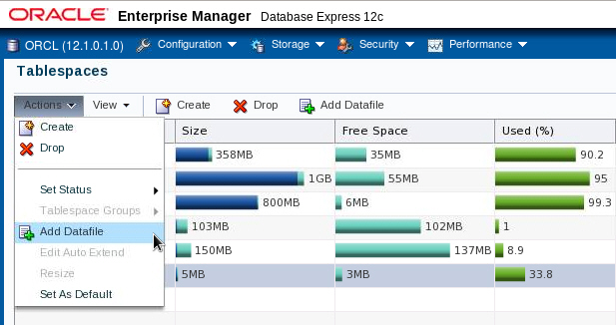
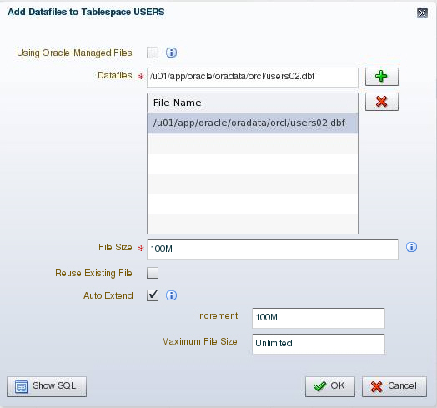
Adding a Data File to a Tablespace
Notes:
Changing the size: You can add space to an existing tablespace by either adding data files to the tablespace or changing the size of an existing data file. To add a new data file to the tablespace, click Add. Then enter the information about the data file on the Add Datafile page.
Note: You cannot add additional data files to bigfile tablespaces.
Oracle Database 12c: Admin, Install and Upgrade Accelerated 10 - <number>

Slide 17
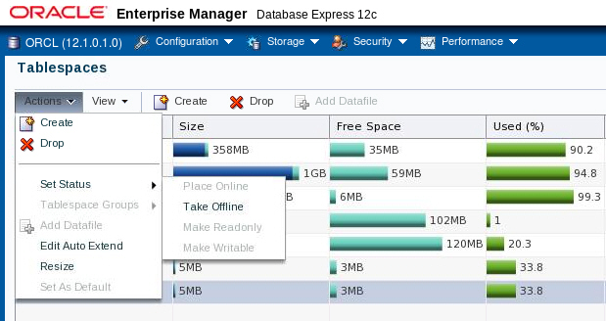
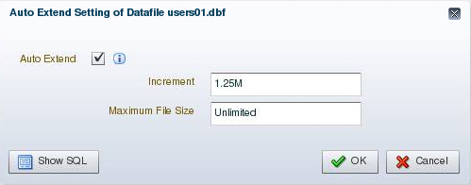
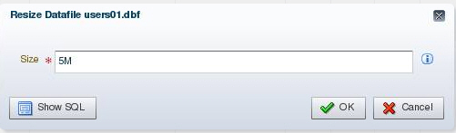
Making Changes to a Data File
Notes:
You can change settings of a data file by expanding the tablespace on the Tablespaces page, selecting the data file, and selecting the appropriate task in the Actions menu.
To take a data file offline, select “Take Offline” from the “Set Status” menu.
To change the size of an existing data file:
1. Expand the tablespace on the Tablespaces page and select the data file.
2. Select Resize in the Actions menu.
3. Then, on the Edit Datafile page, you can change the size of the data file. You can make the tablespace either larger or smaller. However, you cannot make a data file smaller than the used space in the file; if you try to do so, you get the following error:
ORA-03297: file contains used data beyond requested RESIZE value
Oracle Database 12c: Admin, Install and Upgrade Accelerated 10 - <number>

Slide 18
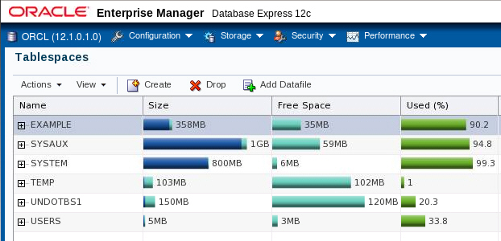
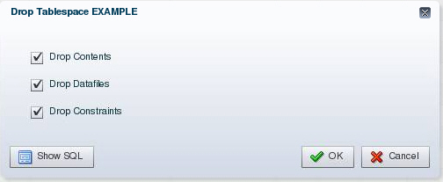
Dropping Tablespaces
Notes:
You can drop a tablespace and its contents (the segments contained in the tablespace) from the database if the tablespace and its contents are no longer required. You must have the DROP TABLESPACE system privilege to drop a tablespace.
When you drop a tablespace, the file pointers in the control file of the associated database are removed. If you are using Oracle Managed Files (OMF), the underlying operating system files are also removed. Otherwise, without OMF, you can optionally direct the Oracle server to delete the operating system files (data files) that constitute the dropped tablespace. If you do not direct the Oracle server to delete the data files at the same time that it deletes the tablespace, you must later use the appropriate commands of your operating system if you want them to be deleted.
You cannot drop a tablespace that contains active segments. For example, if a table in the tablespace is currently being used, or if the tablespace contains undo data that is needed to roll back uncommitted transactions, you cannot drop the tablespace. It is best to take the tablespace offline before dropping it.
Oracle Database 12c: Admin, Install and Upgrade Accelerated 10 - <number>

Slide 19
Viewing Tablespace Information
SQL> SELECT tablespace_name, status, contents, logging,
2 extent_management, allocation_type,
3 segment_space_management
4 FROM dba_tablespaces;
TABLESPACE_NAME STATUS CONTENTS LOGGING EXTENT_MAN ALLOCATIO SEGMEN
--------------- ------- --------- -------- ---------- --------- -----
SYSTEM ONLINE PERMANENT LOGGING LOCAL SYSTEM MANUAL
SYSAUX ONLINE PERMANENT LOGGING LOCAL SYSTEM AUTO
UNDOTBS1 ONLINE UNDO LOGGING LOCAL SYSTEM MANUAL
TEMP ONLINE TEMPORARY NOLOGGING LOCAL UNIFORM MANUAL
USERS ONLINE PERMANENT LOGGING LOCAL SYSTEM AUTO
EXAMPLE ONLINE PERMANENT NOLOGGING LOCAL SYSTEM AUTO
SQL> SELECT file_name, file_id, tablespace_name
2 FROM dba_data_files;
FILE_NAME FILE_ID TABLESPACE_NAME
------------------------------------------ ---------- ----------------
/u01/app/oracle/oradata/orcl/system01.dbf 1 SYSTEM
/u01/app/oracle/oradata/orcl/sysaux01.dbf 3 SYSAUX
/u01/app/oracle/oradata/orcl/users01.dbf 6 USERS
/u01/app/oracle/oradata/orcl/example01.dbf 2 EXAMPLE
/u01/app/oracle/oradata/orcl/undotbs01.dbf 4 UNDOTBS1
Notes:
Tablespace and data file information can also be obtained by querying the following:
Tablespace information:
DBA_TABLESPACES
V$TABLESPACE
Data file information:
DBA_DATA_FILES
V$DATAFILE
Temp file information:
DBA_TEMP_FILES
V$TEMPFILE
Oracle Database 12c: Admin, Install and Upgrade Accelerated 10 - <number>

Slide 20
Oracle Managed Files (OMF)
Specify file operations in terms of database objects rather than file names.
Parameter | Description
DB_CREATE_FILE_DEST | Defines the location of the default file system directory for data files and temporary files
DB_CREATE_ONLINE_LOG_DEST_n | Defines the location for redo log files and control file creation
DB_RECOVERY_FILE_DEST | Default location for the fast recovery area
Example:
SQL> ALTER SYSTEM
2 SET DB_CREATE_FILE_DEST='/u01/app/oracle/oradata';
SQL> CREATE TABLESPACE tbs_1;
Notes:
Oracle Managed Files eliminate the need for you to directly manage the operating system files in an Oracle database. You specify operations in terms of database objects rather than file names. The database internally uses standard file system interfaces to create and delete files as needed for the following database structures:
Tablespaces
Redo log files
Control files
Archived logs
Block change tracking files
Flashback logs
RMAN backups
A database can have a mixture of Oracle-managed and unmanaged files. The file system directory specified by either of these parameters must already exist; the database does not create it. The directory must also have permissions for the database to create the files in it.
The example shows that after DB_CREATE_FILE_DEST is set, the DATAFILE clause can be omitted from a CREATE TABLESPACE statement. The data file is created in the location specified by DB_CREATE_FILE_DEST. When you create a tablespace as shown, default values are assigned to all parameters.
Oracle Database 12c: Admin, Install and Upgrade Accelerated 10 - <number>

Slide 21
Notes:
Oracle-managed files have a specific naming format. For example, on Linux- and UNIX-based systems the following format is used:
<destination_prefix>/o1_mf_%t_%u_.dbf
Do not rename an Oracle-managed file. The database identifies an Oracle-managed file based on its name. If you rename the file, the database is no longer able to recognize it as an Oracle-managed file and will not manage the file accordingly.
The following example sets the default location for data file creations to /u01/oradata and then creates a tablespace tbs_1 with a data file in that location.
SQL> ALTER SYSTEM SET DB_CREATE_FILE_DEST = '/u01/oradata';
SQL> CREATE TABLESPACE tbs_1;
By default, Oracle-managed data files, including those for the SYSTEM and SYSAUX tablespaces, are 100 MB and auto-extensible.
Note: By default, ASM uses OMF files, but if you specify an alias name for an ASM data file at tablespace creation time or when adding an ASM data file to an existing tablespace, then that file will not be OMF.
Oracle Database 12c: Admin, Install and Upgrade Accelerated 10 - <number>

Slide 22
Quiz
A database can have a mixture of Oracle-managed and unmanaged files.
  True
  False
Notes:
Answer: a
Oracle Database 12c: Admin, Install and Upgrade Accelerated 10 - <number>

Slide 23

Enlarging the Database
You can enlarge the database in the following ways:
  Create a new tablespace.
  Add a data file to an existing smallfile tablespace.
  Increase the size of a data file.
  Provide for the dynamic growth of a data file.
Database
SYSTEM
tablespace
INVENTORY
tablespace
Notes:
These activities can be performed with Enterprise Manager or with SQL statements. The size of the database can be described as the sum of all of its tablespaces.
Oracle Database 12c: Admin, Install and Upgrade Accelerated 10 - <number>

Slide 24


Moving or Renaming an Online Data File
1
File System Storage
2
ASM Storage
MOVE
ONLINE
Tablespace HR: 3 data files
Tablespace HR: Diskgroup A
1
ASM Storage
2
File System Storage
MOVE
ONLINE
Tablespace APP: Diskgroup B
Tablespace APP: 3 data files
Notes:
You can rename or move an online data file from one kind of storage system to another while the database is opened and accessing the file.
Queries and DML and DDL operations can be performed while the data file is being moved, including the following:
SELECT statements against tables and partitions
Creation of tables and indexes
Rebuilding of indexes
Note: If objects are compressed while the data file is moved, the compression remains the same.
Oracle Database 12c: Admin, Install and Upgrade Accelerated 10 - <number>

Slide 25
Moving or Renaming an Online Data File
  Relocating an online data file:
  Copying a data file from a file system to ASM:
  Renaming an online data file:
  ALTER DATABASE MOVE DATAFILE '/disk1/myexample01.dbf'
  TO '/disk2/myexample01.dbf';
  ALTER DATABASE MOVE DATAFILE '/disk1/myexample01.dbf'
  TO '+DiskGroup2' KEEP;
  ALTER DATABASE MOVE DATAFILE '/disk1/myexample1.dbf'
  TO '/disk1/myexample01.dbf';
Notes:
You do not have to shut down the database or take the data file offline while you move a data file to another location, disk, or storage system.
The TO clause can be omitted only when an Oracle-managed file is used. In this case, the DB_CREATE_FILE_DEST parameter should be set to indicate the new location.
If the REUSE option is specified, the existing file is overwritten.
If the KEEP clause is specified, the old file will be kept after the move operation. The KEEP clause is not allowed if the source file is an Oracle-managed file.
Use the V$SESSION_LONGOPS view to display ongoing online move operations. Each ongoing operation has one row. The state transition of a successful online move operation is usually NORMAL to COPYING to SUCCESS and finally to NORMAL.
Oracle Database 12c: Admin, Install and Upgrade Accelerated 10 - <number>

Slide 26
Summary
In this lesson, you should have learned how to:
  Describe the storage of table row data in blocks
  Create and manage tablespaces
  Obtain tablespace information
Notes:
Oracle Database 12c: Admin, Install and Upgrade Accelerated 10 - <number>

Slide 27
Practice 10
  10-1: Viewing Database Storage Structure Information
  10-2: Creating a Tablespace
Notes:
Oracle Database 12c: Admin, Install and Upgrade Accelerated 10 - <number>

