Slide 1
Backup and Recovery: Configuration

Slide 2
Objectives
After completing this lesson, you should be able to:
  Configure the fast recovery area
  Multiplex the control file
  Multiplex redo log files
  Configure ARCHIVELOG mode
Notes:
Oracle Database 12c: Admin, Install and Upgrade Accelerated 16 - <number>

Slide 3
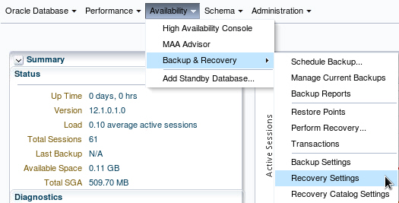
Configuring for Recoverability
To configure your database for maximum recoverability, you must:
  Schedule regular backups
  Multiplex control files
  Multiplex redo log groups
  Retain archived copies of redo logs
Notes:
To provide the best protection for your data, you must:
Schedule regular backups: Most media failures require that you restore the lost or damaged file from backup.
Multiplex control files: All control files associated with a database are identical. Recovering from the loss of a single control file is not difficult; recovering from the loss of all control files is much more challenging. Guard against losing all control files by having at least two copies.
Multiplex redo log groups: To recover from instance or media failure, redo log information is used to roll data files forward to the last committed transaction. If your redo log groups rely on a single redo log file, the loss of that file means that data is likely to be lost. Ensure that there are at least two copies of each redo log group; if possible, each copy should be under different disk controllers.
Retain archived copies of redo logs: If a file is lost and restored from backup, the instance must apply redo information to bring that file up to the latest SCN contained in the control file. With the default setting, the database can overwrite redo information after it has been written to the data files. Your database can be configured to retain redo information in archived copies of the redo logs. This is known as placing the database in ARCHIVELOG mode.
You can perform configuration tasks in Enterprise Manager Cloud Control or by using the SQL command line.
Oracle Database 12c: Admin, Install and Upgrade Accelerated 16 - <number>

Slide 4
Configuring the Fast Recovery Area
  Fast recovery area:
    Strongly recommended for simplified backup storage management
    Storage space (separate from working database files)
    Location specified by the DB_RECOVERY_FILE_DEST parameter
    Size specified by the DB_RECOVERY_FILE_DEST_SIZE parameter
    Large enough for backups, archived logs, flashback logs, multiplexed control files, and multiplexed redo logs
    Automatically managed according to your retention policy
  Configuration of the fast recovery area includes specifying the location, size, and retention policy.
Notes:
The fast recovery area is a space that is set aside on disk to contain archived logs, backups, flashback logs, multiplexed control files, and multiplexed redo logs. A fast recovery area simplifies backup storage management and is strongly recommended. You should place the fast recovery area on storage space that is separate from the location of your database data files and primary online log files and control file.
The amount of disk space to allocate for the fast recovery area depends on the size and activity levels of your database. As a general rule, the larger the fast recovery area, the more useful it is. Ideally, the fast recovery area should be large enough for copies of your data and control files and for flashback, online redo, and archived logs needed to recover the database with the backups kept based on the retention policy. (In short, the fast recovery area should be at least twice the size of the database so that it can hold one backup and several archived logs.)
Space management in the fast recovery area is governed by a backup retention policy. A retention policy determines when files are obsolete, which means that they are no longer needed to meet your data recovery objectives. The Oracle Database server automatically manages this storage by deleting files that are no longer needed.
Oracle Database 12c: Admin, Install and Upgrade Accelerated 16 - <number>

Slide 5
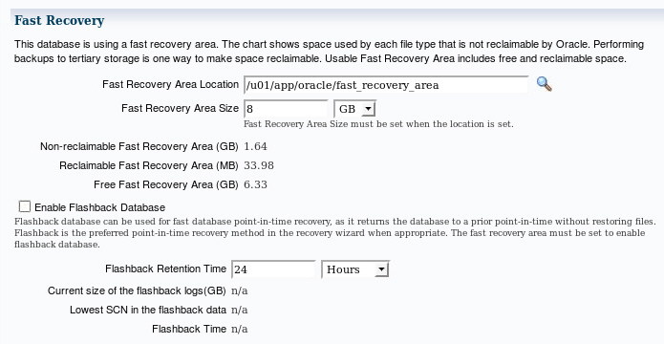
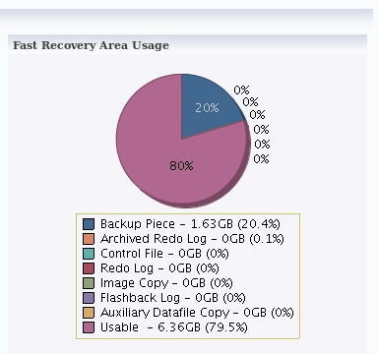
Monitoring the Fast Recovery Area
Notes:
If you have configured your archived logs to be written to this location, it is important to monitor this space to ensure that it does not reach its capacity. If the instance is unable to create an archived log because of lack of space, it pauses until the administrator corrects the situation.
In Enterprise Manager Cloud Control, select Availability > Backup & Recovery > Recovery Settings. On this page, you can:
Verify how much of the fast recovery area has been consumed
Specify the location of the fast recovery area
Specify the size of the fast recovery area
Configure Flashback Database
Specify the retention time
The retention time determines when files are obsolete (that is, when they are no longer needed to meet your data recovery objectives). The Oracle Database server automatically manages this storage, deleting files that are no longer needed. You can back up the recovery area so that Oracle Recovery Manager (RMAN) can fail over to other archived redo log destinations if the archived redo log in the fast recovery area is inaccessible or corrupted.
Periodically copying backups to tape frees space in the fast recovery area for other files, but retrieving files from tape causes longer database restoration and recovery times.
Oracle Database 12c: Admin, Install and Upgrade Accelerated 16 - <number>

Slide 6
Multiplexing Control Files
To protect against database failure, your database should have multiple copies of the control file.
 | ASM Storage | File System Storage
Best Practice | One copy on each disk group (such as +DATA and +FRA) | At least two copies, each on separate disk (at least one on separate disk controller)
Steps to create additional control files | No additional control file copies required | 1. Alter the SPFILE with the ALTER SYSTEM SET control_files command. 2. Shut down the database. 3. Copy control file to a new location. 4. Open the database and verify the addition of the new control file.
Notes:
A control file is a small binary file that describes the structure of the database. It must be available for writing by the Oracle server whenever the database is mounted or opened. Without this file, the database cannot be mounted, and recovery or re-creation of the control file is required. Your database should have a minimum of two control files on different storage devices to minimize the impact of a loss of one control file.
The loss of a single control file causes the instance to fail because all control files must be available at all times. However, recovery can be a simple matter of copying one of the other control files. The loss of all control files is slightly more difficult to recover from but is not usually catastrophic.
Oracle Database 12c: Admin, Install and Upgrade Accelerated 16 - <number>

Slide 7
Notes:
Adding a Control File
If you are using ASM as your storage technique, then as long as you have two control files, one in each disk group (such as +DATA and +FRA), then you should not require further multiplexing. In a database using Oracle Managed Files (OMF)—such as a database using ASM storage—all additional control files must be created as part of a recovery process using RMAN (or through Enterprise Manager).
In a database using regular file system storage, adding a control file is a manual operation:
1. Alter the SPFILE with the following command specifying the appropriate location of your files:
ALTER SYSTEM SET control_files =
'/u01/app/oracle/oradata/orcl/control01.ctl' ,
'/u02/app/oracle/oradata/orcl/control02.ctl' ,
'/u03/app/oracle/oradata/orcl/control03.ctl' SCOPE=SPFILE;
2. Shut down the database instance.
3. Use an operating system command to copy an existing control file to the location you select for your new file.
4. Open the database.
Note: More information about using RMAN is provided in the Oracle Database 12c: Backup and Recovery Workshop and in product documentation.
Oracle Database 12c: Admin, Install and Upgrade Accelerated 16 - <number>

Slide 8
Redo Log Files
Multiplex redo log groups to protect against media failure and loss of data. This increases database I/O. It is suggested that redo log groups have:
  At least two members (files) per group
  Each member:
    On a separate disk or
    controller if using
    file system storage
    In a separate disk group
    (such as +DATA and +FRA)
    if using ASM
+DATA
Member a
Member a
Member a
+FRA
Member b
Member b
Member b
Group 1
Group 2
Group 3
Note: Multiplexing redo logs may impact overall database performance.
Notes:
Redo log groups are made up of one or more redo log files. Each log file in a group is a duplicate of the others. Oracle Corporation recommends that redo log groups have at least two files per group. If using file system storage, then each member should be distributed on separate disks or controllers so that no single equipment failure impacts an entire log group. If you are using ASM storage, then each member should be in a separate disk group, such as +DATA and +FRA.
The loss of an entire current log group is one of the most serious media failures because it can result in loss of data. The loss of a single member of a multiple-member log group is trivial and does not affect database operation (other than causing an alert to be published in the alert log). Recovery from the loss of an entire log group requires advanced recovery techniques and is discussed in the course titled Oracle Database 12c: Backup and Recovery Workshop.
Remember that multiplexing redo logs may heavily influence database performance because a commit cannot complete until the transaction information has been written to the logs. You must place your redo log files on your fastest disks served by your fastest controllers. If possible, do not place any other database files on the same disks as your redo log files (unless you are using ASM). Because only one group is written to at a given time, there is no performance impact in having members from several groups on the same disk.
Oracle Database 12c: Admin, Install and Upgrade Accelerated 16 - <number>

Slide 9
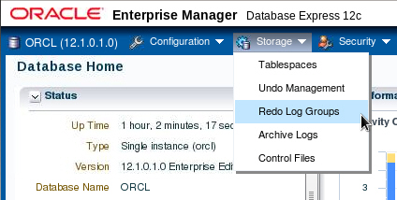
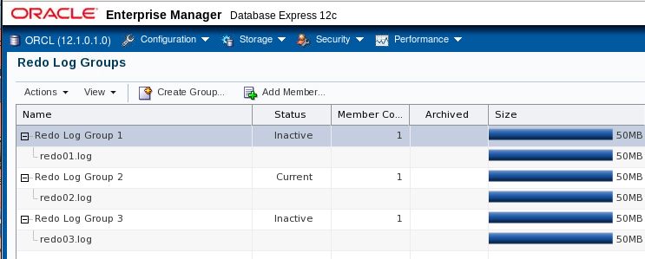
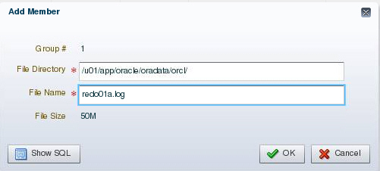
Multiplexing the Redo Log
Notes:
You can multiplex your redo log by adding a member to an existing log group. To add a member to a redo log group (with open database and no impact on user performance), perform the following steps in Enterprise Manager Database Express:
1. Select Storage > Redo Log Groups.
2. Select a group and click Add Member.
3. The Add Redo Log Member page appears.
4. For File System storage, enter the file name and the file directory. Click OK.
Repeat these steps for every existing group that you want to multiplex. An example showing the SQL syntax of adding a redo log member to redo log group 1 (using ASM) is shown here:
SQL> ALTER DATABASE ADD LOGFILE MEMBER '+DATA' TO GROUP 1;
When you add the redo log member to a group, the member’s status is marked as INVALID (as can be seen in the V$LOGFILE view). This is the expected state because the new member of the group has not yet been written to. When a log switch occurs and the group containing the new member becomes CURRENT, the member’s status changes to null.
Oracle Database 12c: Admin, Install and Upgrade Accelerated 16 - <number>

Slide 10
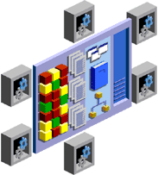
Creating Archived Redo Log Files
To preserve redo information, create archived copies of redo log files by performing the following steps:
  Specify archived redo log file-naming convention.
  Specify one or more archived redo log file locations.
  Place the database in ARCHIVELOG mode.
Archiver
(ARCn)
Online redo
log files
Archived
redo log files
Notes:
The Oracle Database server treats the online redo log groups as a circular buffer in which to store transaction information, filling one group and then moving on to the next. After all groups have been written to, the Oracle Database server begins overwriting information in the first log group.
To configure your database for maximum recoverability, you must instruct the Oracle Database server to make a copy of the online redo log group before allowing it to be overwritten. These copies are known as archived redo log files.
To facilitate the creation of archived redo log files:
1. Specify a naming convention for your archived redo log files.
2. Specify a destination or destinations for storing your archived redo log files.
3. Place the database in ARCHIVELOG mode.
Note: Steps 1 and 2 are not necessary if you are using a fast recovery area.
The destination should exist before placing the database in ARCHIVELOG mode. When a directory is specified as a destination, there should be a slash at the end of the directory name.
Oracle Database 12c: Admin, Install and Upgrade Accelerated 16 - <number>

Slide 11

Archiver (ARCn) Process
Archiver (ARCn):
  Is an optional background process
  Automatically archives online redo log files when the database is in ARCHIVELOG mode
  Preserves a record of all changes made to the database
SGA
Redo log buffer
LGWR
Log Writer
Copies of Redo log
files
Redo log
files
ARCn
Archiver process
Notes:
ARCn is an optional background process. However, it is crucial to the recovery of a database after the loss of a disk. When an online redo log group gets filled, the Oracle Database server begins writing to the next online redo log group. The process of switching from one online redo log group to another is called a log switch. The ARCn process initiates archiving of the filled log group at every log switch. It automatically archives the online redo log group before the log group can be reused so that all the changes made to the database are preserved. This enables recovery of the database to the point of failure even if a disk drive is damaged.
One of the important decisions that a DBA must make is whether to configure the database to operate in ARCHIVELOG mode or in NOARCHIVELOG mode.
In NOARCHIVELOG mode, the online redo log files are overwritten each time a log switch occurs.
In ARCHIVELOG mode, inactive groups of filled online redo log files must be archived before they can be used again.
Note
ARCHIVELOG mode is essential for most backup strategies.
If the archived redo log file destination fills up or cannot be written to, the database will eventually come to a halt. Remove archived redo log files from the archived redo log file destination and the database will resume operations.
Oracle Database 12c: Admin, Install and Upgrade Accelerated 16 - <number>

Slide 12
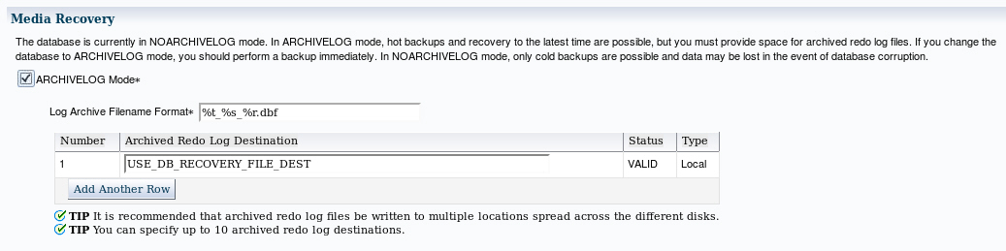
Archived Redo Log Files:
Naming and Destinations
Specify naming and archive destination information on the Recovery Settings page. If using file system storage, then it is recommended that you add multiple locations across different disks.
Notes:
To configure archived redo log file names and destinations by using Enterprise Manager Cloud Control, select Availability > Backup & Recovery > Recovery Settings.
Each archived redo log file must have a unique name to avoid overwriting older log files. Specify the naming format as shown in the slide. To help create unique file names, Oracle Database allows several wildcard characters in the name format:
%s: Includes the log sequence number as part of the file name
%t: Includes the thread number as part of the file name
%r: Includes the resetlogs ID to ensure that the archive log file name remains unique (even after certain advanced recovery techniques that reset log sequence numbers)
%d: Includes the database ID as part of the file name
The format should include %s, %t, and %r as best practice (%d can also be included if multiple databases share the same archive log destination).
By default, if the fast recovery area is enabled, then USE_DB_RECOVERY_FILE_DEST is specified as an archived redo log file destination. Archived redo log files can be written to as many as ten different destinations. Destinations may be local (a directory) or remote (an Oracle Net alias for a standby database).
Oracle Database 12c: Admin, Install and Upgrade Accelerated 16 - <number>

Slide 13

Notes:
Click Add Another Row to add further destinations. To change recovery settings, you must be connected as SYSDBA, SYSOPER, or SYSBACKUP.
Note: If you do not want archives sent to this location, delete USE_DB_RECOVERY_FILE_DEST.
Oracle Database 12c: Admin, Install and Upgrade Accelerated 16 - <number>

Slide 14
Configuring ARCHIVELOG Mode
To place the database in ARCHIVELOG mode, perform the following steps:
  Using Enterprise Manager Cloud Control:
    On the Recovery Settings page, select “ARCHIVELOG Mode” and click Apply. The database can be set to ARCHIVELOG mode only from the MOUNT state.
    Restart the database instance by clicking “Yes” when prompted.
  Using SQL commands:
    Mount the database.
    Issue the ALTER DATABASE ARCHIVELOG command.
    Open the database.
Notes:
Placing the database in ARCHIVELOG mode prevents redo logs from being overwritten until they have been archived.
In Enterprise Manager Cloud Control, select Availability > Backup & Recovery > Recovery Settings. Select “ARCHIVELOG Mode” and click Apply. The database instance must be restarted after making this change.
To issue the SQL command to put the database in ARCHIVELOG mode, the database must be in MOUNT mode. If the database is currently open, you must shut it down cleanly (not abort), and then mount it as shown in the following example:
shutdown immediate
startup mount
alter database archivelog;
alter database open;
With the database in NOARCHIVELOG mode (the default), recovery is possible only until the time of the last backup. All transactions made after that backup are lost.
In ARCHIVELOG mode, recovery is possible until the time of the last commit. Most production databases are operated in ARCHIVELOG mode.
Note: Back up your database after switching to ARCHIVELOG mode because your database is recoverable only from the first backup taken in that mode.
Oracle Database 12c: Admin, Install and Upgrade Accelerated 16 - <number>

Slide 15
Quiz
Which parameters configure the fast recovery area?
  FLASH_RECOVERY_AREA_SIZE
  DB_RECOVERY_FILE_DEST
  FLASH_RECOVERY_AREA_LOC
  DB_RECOVERY_FILE_DEST_SIZE
Notes:
Answer: b, d
Oracle Database 12c: Admin, Install and Upgrade Accelerated 16 - <number>

Slide 16
Summary
In this lesson, you should have learned how to:
  Configure the fast recovery area
  Multiplex the control file
  Multiplex redo log files
  Configure ARCHIVELOG mode
Notes:
Oracle Database 12c: Admin, Install and Upgrade Accelerated 16 - <number>

Slide 17
Practice 16
16-1: Configuring Your Database for Recovery
Notes:
Oracle Database 12c: Admin, Install and Upgrade Accelerated 16 - <number>

