Slide 1
Performing Database Backups

Slide 2
Objectives
After completing this lesson, you should be able to:
  Create consistent database backups
  Back up your database without shutting it down
  Create incremental backups
  Automate database backups
  Manage backups
Notes:
Oracle Database 12c: Admin, Install and Upgrade Accelerated 17 - <number>

Slide 3



Backup Solutions: Overview
Data files
User-managed OS backup
Fast recovery area or other disk areas
Image copies
Backup pieces
Archive log files
RMAN
Backup to disk
Backup data
Backup to SBT channel
Backup with third-party media manager
RMAN
Control
file
Target database
Media Management
(Example: Oracle Secure Backup)
Oracle
Secure
Backup
Backup to Tape
Non database files
Notes:
Recovery Manager (RMAN) is the recommended method of backing up your Oracle database. You can use it to back up to disk or to a system backup to tape (SBT) channel. Oracle recommends that disk backups be stored in the fast recovery area (FRA).
Oracle Secure Backup complements existing functionality by adding backup to tape and backup of file system data. It interacts transparently with RMAN. Third-party media managers can also be used to back up to tape.
User-managed backups are non-RMAN backups, for example, using an OS utility. They are often based on scripts that a DBA must write. This option is being phased out because it is more labor intensive.
Oracle Database 12c: Admin, Install and Upgrade Accelerated 17 - <number>

Slide 4

Oracle Secure Backup
  Oracle Secure Backup and RMAN provide an
  end-to-end backup solution for Oracle environments:
    Centralized tape backup management for file system data and the Oracle database
    Most well-integrated media management layer for RMAN backups
    Backup of any data anywhere on the network
  A single technical support resource for the entire backup solution expedites problem resolution.
  This ensures reliable data protection at lower cost and complexity.
Notes:
Oracle’s current backup and recovery product for the database is Recovery Manager. Oracle Secure Backup complements existing functionality in the following ways:
Complete backup solution: Oracle Secure Backup provides data protection for the database and nondatabase data to protect the entire Oracle environment.
Media management: Oracle Secure Backup provides the media management layer for RMAN database backups to tape. Before Oracle Secure Backup, customers had to purchase expensive third-party media management products offering integration with RMAN tape backups.
Backup anywhere on the network: Oracle Secure Backup backs up data from multiple network-attached computer systems to tertiary storage resources on the network. Oracle Secure Backup supports diverse configurations of servers, clients, Network Attached Storage (NAS) servers, and tertiary storage devices and protects network storage environments.
The combination of RMAN and Oracle Secure Backup provides an end-to-end backup solution that is entirely within the Oracle product stack. This solution makes better customer support possible because Oracle Corporation is responsible for the entire backup solution.
Oracle Database 12c: Admin, Install and Upgrade Accelerated 17 - <number>

Slide 5
User-Managed Backup
A user-managed scenario:
  Is a manual process of tracking backup needs and status
  Typically uses your own written scripts
  Requires that database files be put in the correct mode for backup
  Relies on operating system commands to make backups of files
Notes:
A user-managed backup can be performed interactively. However, most often it entails the writing of scripts to perform the backup. There are several scenarios that can be run, and scripts must be written to handle them.
Some of the actions that scripts must take:
Querying V$DATAFILE to determine the data files that need to be backed up and their current state
Querying V$LOGFILE to identify the online redo log files
Querying V$CONTROLFILE to identify the control file to back up
Placing each tablespace in online backup mode
Querying V$BACKUP to see what data files are part of a tablespace that has been placed in online backup mode
Issuing operating system copy commands to copy the data files to the backup location
Bringing each tablespace out of online backup mode
Oracle Database 12c: Admin, Install and Upgrade Accelerated 17 - <number>

Slide 6

Understanding Backup Terminology
  Backup strategy may include:
    Entire database (whole)
    Portion of the database (partial)
  Backup type may indicate inclusion of:
    All data blocks within your chosen files (full)
    Only information that has changed since a previous backup (incremental)
      Cumulative (changes since last level 0)
      Differential (changes since last incremental)
  Backup mode may be:
    Offline (consistent, cold)
    Online (inconsistent, hot)
Database
Control files
Online redo log files
Data files
Notes:
Whole database backup: Includes all data files and at least one control file (Remember that all control files in a database are identical.)
Partial database backup: May include zero or more tablespaces and zero or more data files; may or may not include a control file
Full backup: Makes a copy of each data block that contains data and that is within the files being backed up
Incremental backup: Makes a copy of all data blocks that have changed since a previous backup. Oracle Database supports two levels of incremental backup (0 and 1). A level 1 incremental backup can be one of two types: cumulative or differential. A cumulative backup backs up all changes since the last level 0 backup. A differential backup backs up all changes since the last incremental backup (which could be either a level 0 or level 1 backup). Change Tracking with RMAN supports incremental backups.
Offline backups (also known as “cold” or consistent backup): Are taken while the database is not open. They are consistent because, at the time of the backup, the system change number (SCN) in data file headers matches the SCN in the control files.
Online backups (also known as “hot” or inconsistent backup): Are taken while the database is open. They are inconsistent because, with the database open, there is no guarantee that the data files are synchronized with the control files.
Oracle Database 12c: Admin, Install and Upgrade Accelerated 17 - <number>

Slide 7
Understanding Types of Backups
Backups may be stored as:
  Image copies
  Backup sets
Data file #1
Data file #1 | Data file #2
Data file #3 | Data file #4
Data file #5 | Data file #6
Data file #2
Data file #3
Backup set
(Binary, compressed files in Oracle proprietary format)
Data file #4
Data file #5
Data file #6
Image copies
(Duplicate data and log files in OS format)
Notes:
Image copies: Are duplicates of data or archived log files (similar to simply copying the files by using operating system commands)
Backup sets: Are collections of one or more binary files that contain one or more data files, control files, server parameter files, or archived log files. With backup sets, empty data blocks are not stored, thereby causing backup sets to use less space on the disk or tape. Backup sets can be compressed to further reduce the space requirements of the backup.
Image copies must be backed up to the disk. Backup sets can be sent to the disk or directly to the tape.
The advantage of creating a backup as an image copy is improved granularity of the restore operation. With an image copy, only the file or files need to be retrieved from your backup location. With backup sets, the entire backup set must be retrieved from your backup location before you extract the file or files that are needed.
The advantage of creating backups as backup sets is better space usage. In most databases, 20% or more of the data blocks are empty blocks. Image copies back up every data block, even if the data block is empty. Backup sets significantly reduce the space required by the backup. In most systems, the advantages of backup sets outweigh the advantages of image copies.
Oracle Database 12c: Admin, Install and Upgrade Accelerated 17 - <number>

Slide 8
RMAN Backup Types
  A full backup contains all used data file blocks.
  A level 0 incremental backup is equivalent to a full backup that has been marked as level 0.
  A cumulative level 1
  incremental backup contains
  only blocks modified since the
  last level 0 incremental
  backup.
  A differential level 1
  incremental backup contains
  only blocks modified since the
  last incremental backup.
Full, or “level 0
incremental backup”
Cumulative
incremental backup
Differential
incremental backup
Notes:
Full Backups
A full backup is different from a whole database backup. A full data file backup is a backup that includes every used data block in the file. RMAN copies all blocks into the backup set or image copy, skipping only those data file blocks that are not part of an existing segment. For a full image copy, the entire file contents are reproduced exactly. A full backup cannot be part of an incremental backup strategy; it cannot be the parent for a subsequent incremental backup.
Incremental Backups
An incremental backup is either a level 0 backup, which includes every block in the data files except blocks that have never been used, or a level 1 backup, which includes only those blocks that have been changed since a previous backup was taken. A level 0 incremental backup is physically identical to a full backup. The only difference is that the level 0 backup (as well as an image copy) can be used as the base for a level 1 backup, but a full backup can never be used as the base for a level 1 backup.
Incremental backups are specified using the INCREMENTAL keyword of the BACKUP command. You specify INCREMENTAL LEVEL [0 | 1].
Oracle Database 12c: Admin, Install and Upgrade Accelerated 17 - <number>

Slide 9
Notes:
RMAN can create multilevel incremental backups as follows:
Differential: Is the default type of incremental backup that backs up all blocks changed after the most recent incremental backup at either level 1 or level 0
Cumulative: Backs up all blocks changed after the most recent backup at level 0
Examples
To perform an incremental backup at level 0, use the following command:
RMAN> BACKUP INCREMENTAL LEVEL 0 DATABASE;
To perform a differential incremental backup, use the following command:
RMAN> BACKUP INCREMENTAL LEVEL 1 DATABASE;
To perform a cumulative incremental backup, use the following command:
RMAN> BACKUP INCREMENTAL LEVEL 1 CUMULATIVE DATABASE;
RMAN makes full backups by default if neither FULL nor INCREMENTAL is specified. Unused block compression causes never-written blocks to be skipped when backing up data files to backup sets, even for full backups.
A full backup has no effect on subsequent incremental backups, and is not considered part of any incremental backup strategy, although a full image copy backup can be incrementally updated by applying incremental backups with the RECOVER command.
Note: It is possible to perform any type of backup (full or incremental) of a database that is in NOARCHIVELOG mode—if, of course, the database is not open. Note also that recovery is limited to the time of the last backup. The database can be recovered to the last committed transaction only when the database is in ARCHIVELOG mode.
Oracle Database 12c: Admin, Install and Upgrade Accelerated 17 - <number>

Slide 10
Using Recovery Manager (RMAN)
  Provides a powerful control and scripting language
  Includes a published API that enables interface with most popular backup software
  Backs up data, control, archived redo log, and server parameter files
  Backs up files to disk or tape
  Is integrated with Enterprise Manager Cloud Control
Notes:
RMAN is the component of the Oracle Database server that is used to perform backup and recovery operations. It can be used to make consistent and inconsistent backups, perform incremental and full backups, and back up either the whole database or a portion of it.
RMAN uses its own powerful job control and scripting language, as well as a published API that interfaces RMAN with many popular backup software solutions.
RMAN can store backups on the disk for quick recovery or place them on the tape for long-term storage. For RMAN to store backups on the tape, you must either use Oracle Secure Backup or configure an interface to the tape device known as a media management library (MML).
Enterprise Manager Cloud Control provides a graphical interface to the most commonly used RMAN functionality. Advanced backup and recovery operations are accessible through RMAN’s command-line client. For more information about advanced RMAN capabilities, see the course titled Oracle Database 12c: Backup and Recovery Workshop or consult the Oracle Backup and Recovery User’s Guide.
Oracle Database 12c: Admin, Install and Upgrade Accelerated 17 - <number>

Slide 11
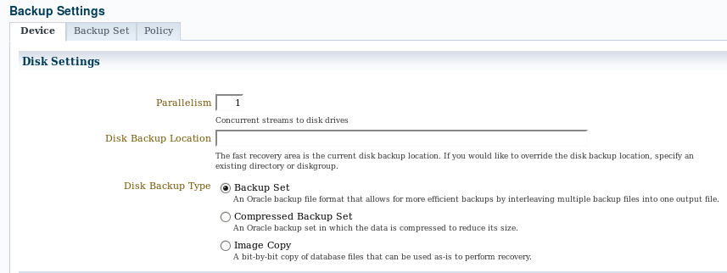
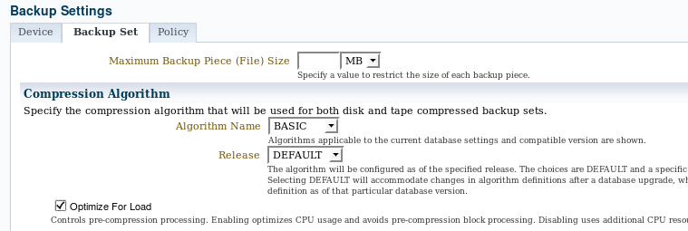
Configuring Backup Settings
Notes:
By using RMAN commands or the Enterprise Manager Cloud Control interface, you can manage the persistent backup settings that are used for creating backups. In Enterprise Manager Cloud Control, select Availability > Backup & Recovery > Backup Settings. There are separate settings for disk and tape. Tape settings depend on the media management library capabilities. Disk settings include:
Parallelism: How many separate streams of backup information do you want to create? The best setting for parallelism depends on your hardware. As hardware resources increase, the appropriate degree of parallelism also increases. Generally, you want to set your parallelism to the number of disks that your disk backup location is striped over. For tape backup, you want to set your parallelism to the same number of tape drives that you have.
Disk backup location: Where should backups be stored? The default is the fast recovery area. If you change this, click Test Disk Backup to verify that RMAN can write to the new location.
Disk backup type: Select Backup Set, Compressed Backup Set, or Image Copy.
Click the Backup Set tab to set the maximum file size of backup pieces, specify the compression algorithm to be used for compressed backup sets, and specify redundancy for tape backups. Host credentials are required to save changes to the backup settings.
Oracle Database 12c: Admin, Install and Upgrade Accelerated 17 - <number>

Slide 12
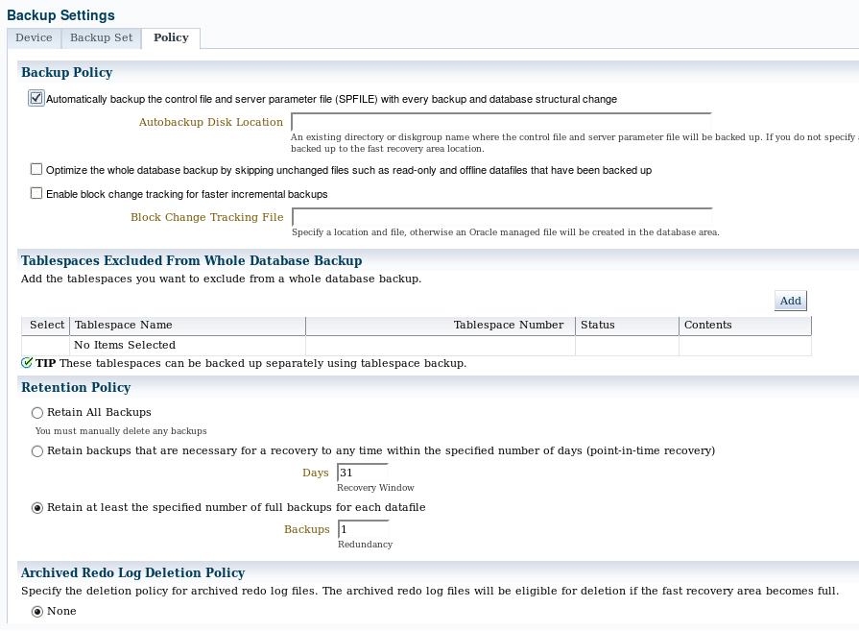

Configuring Backup Settings
Best practice
Backup
pieces
Change
tracking
file
Recovery area
Data files
Notes:
Click the Policy tab to:
Automatically back up the control file and server parameter file (SPFILE) with each backup. You can also specify a location for these backups if you do not want them to go to the fast recovery area.
Optimize backups by not backing up files that exactly match a file that is already part of the retained backups. This setting enables you to skip read-only and offline data files.
Enable block change tracking and specify a location for the tracking file. If you intend to create incremental backups, this setting can decrease the time required to choose which blocks to include in the incremental backup.
Exclude tablespaces from a whole database backup. Some administrators choose not to back up tablespaces containing data or objects that can be easily re-created (such as indexes or data that is batch-loaded frequently).
Specify a retention policy: How long should RMAN keep your backups? If you are using the fast recovery area to store backups, RMAN automatically deletes old backups to make room for new ones (if the retention policy allows it). By default, only the last backup is retained. The retention policy can be specified as a number of backups or a number of days.
Oracle Database 12c: Admin, Install and Upgrade Accelerated 17 - <number>

Slide 13
Oracle-Suggested Backup
  Provides an out-of-the-box backup strategy based on the backup destination
  Sets up a recovery window for backup management
  Schedules recurring and immediate backups:
    Full backup
    + daily incremental
    = new “full” backup
    + daily archived logs for recovery
Notes:
Enterprise Manager Cloud Control makes it easy for you to set up an Oracle-suggested backup strategy that protects your data and provides efficient recoverability to any point in the preceding 24 hours, and possibly as far back as 48 hours, depending on when the last backup was created. The Oracle-suggested strategy uses the incremental backup and incrementally updated backup features, providing faster recoverability than is possible when applying database changes from the archived redo log files.
Because these backups on disk are retained, you can always perform a full database recovery or a point-in-time recovery to any time within the past 24 hours, at the minimum. The recovery time could reach back as far as 48 hours. This is because just before a backup is taken on a given day, the backup from the beginning of day n–1 still exists.
Oracle Database 12c: Admin, Install and Upgrade Accelerated 17 - <number>

Slide 14
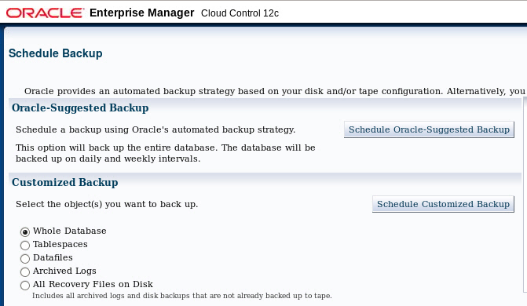
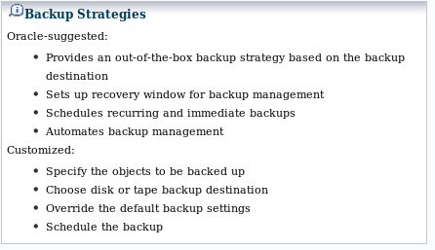
Selecting a Backup Strategy
Notes:
To establish an Oracle-suggested strategy, navigate to the database home page > Availability > Backup & Recovery > Schedule Backup. The Backup Strategies section enables you to select from the Oracle-suggested backup and Customized backup strategies. The Oracle-suggested strategy takes a full database copy as the first backup. Because it is a whole database backup, you might want to consider taking this at the period of least activity. After that, an incremental backup to disk is taken every day. Optionally, a weekly tape backup can be made, which backs up all recovery-related files.
By clicking Schedule Customized Backup, you gain access to a wider range of configuration options. Select the objects that you want to back up—the whole database (the default) or individual tablespaces, data files, archived logs, or any Oracle backups currently residing on the disk (to move them to the tape).
Both strategies enable you to set up encrypted backups.
Oracle Database 12c: Admin, Install and Upgrade Accelerated 17 - <number>

Slide 15
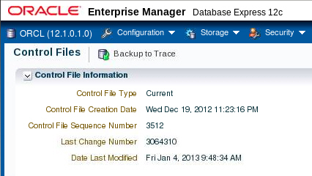
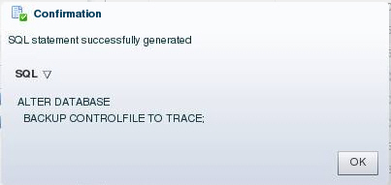
Backing Up the Control File to a Trace File
  Control files can be backed up to a trace file, generating a SQL command to re-create the control file.
  Control file trace backups may be used to recover from loss of all control files.
Notes:
In Enterprise Manager Database Express, select Storage > Control Files to manage your database’s control files. Control files have an additional backup option; they may be backed up to a trace file. A control file trace backup contains the SQL statement required to re-create the control files in the event that all control files are lost.
Although it is very unlikely that a properly configured database (with multiple copies of the control file placed on separate disks and separate controllers) would lose all control files at the same time, it is possible. Therefore, you should back up the control file to a trace file after each change to the physical structure of the database (adding tablespaces or data files, or adding additional redo log groups).
Trace copies of the control file can be created by using Enterprise Manager Database Express, Enterprise Manager Cloud Control, or by using the following SQL command:
ALTER DATABASE BACKUP CONTROLFILE TO TRACE
The trace backup is created in the location specified by the DIAGNOSTIC_DEST initialization parameter. For example, in this course the trace file for the orcl database is found in the /u01/app/oracle/diag/rdbms/orcl/orcl/trace directory and will have a file name such as orcl_ora_924.trc.
Oracle Database 12c: Admin, Install and Upgrade Accelerated 17 - <number>

Slide 16
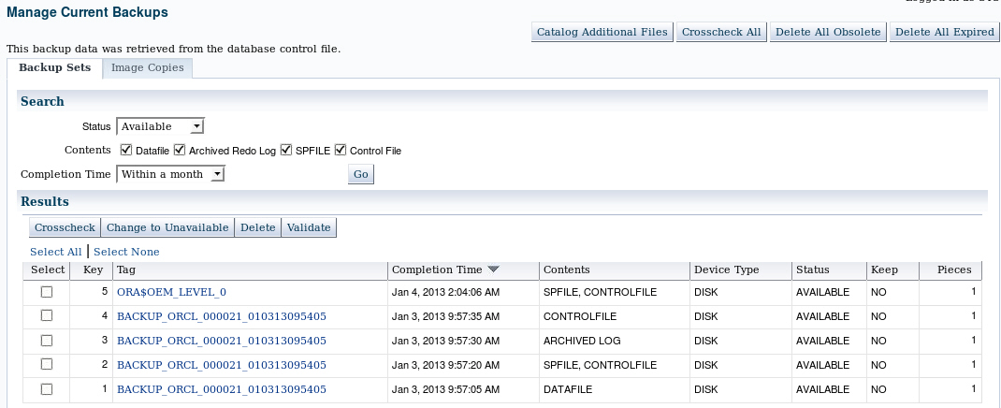
Managing Backups
Notes:
In Enterprise Manager Cloud Control, select Availability > Backup & Recovery > Manage Current Backups to manage your existing backups. On this page, you can see when a backup was completed, where it was created (disk or tape), and whether it is still available.
At the top of the Manage Current Backups page, four buttons enable you to work with existing backups:
Catalog Additional Files: Although RMAN (working through Enterprise Manager) is the recommended way to create backups, you might have image copies or backup sets that were created by some other means or in some other environment with the result that RMAN is not aware of them. This task identifies those files and adds them to the catalog.
Crosscheck All: RMAN can automatically delete obsolete backups, but you can also delete them by using operating system commands. If you delete a backup without using RMAN, the catalog does not know whether the backup is missing until you perform a cross-check between the catalog and what is really there.
Delete All Obsolete: This deletes backups older than the retention policy.
Delete All Expired: This deletes the catalog listing for any backups that are not found when the cross-check is performed as described previously.
Oracle Database 12c: Admin, Install and Upgrade Accelerated 17 - <number>

Slide 17



Using RMAN Commands to Create Backups
1
$ rman target /
RMAN> CONFIGURE …
RMAN> BACKUP DATABASE PLUS ARCHIVELOG;
2
3
Control
file
Control files
Archived redo
log file
SPFILE
Data files
Notes:
1. In a terminal session, start RMAN and connect to the target database.
2. Execute configuration commands:
CONFIGURE DEFAULT DEVICE TYPE TO disk;
CONFIGURE DEVICE TYPE DISK BACKUP TYPE TO COPY;
CONFIGURE CONTROLFILE AUTOBACKUP ON;
3. A whole database backup is a copy of all data files and the control file. You can optionally include the server parameter file (SPFILE) and archived redo log files. Using RMAN to make an image copy of all the database files simply requires mounting or opening the database, starting RMAN, and entering the BACKUP command shown in the slide.
Optionally, you can supply the DELETE INPUT option when backing up archive log files.
That causes RMAN to remove the archive log files after backing them up. This is useful especially if you are not using a fast recovery area, which would perform space management for you, deleting files when space pressure grows. In that case, the command in the slide would look like the following:
RMAN> BACKUP DATABASE PLUS ARCHIVELOG DELETE INPUT;
You can also create a backup (either a backup set or image copies) of previous image copies of all data files and control files in the database by using the following command:
RMAN> BACKUP COPY OF DATABASE;
Oracle Database 12c: Admin, Install and Upgrade Accelerated 17 - <number>

Slide 18
Quiz
Using the change-tracking feature, an image copy backup performed by RMAN can skip blocks that have not changed since the last backup.
  True
  False
Notes:
Answer: b
Oracle Database 12c: Admin, Install and Upgrade Accelerated 17 - <number>

Slide 19
Summary
In this lesson, you should have learned how to:
  Create consistent database backups
  Back up your database without shutting it down
  Create incremental backups
  Automate database backups
  Manage backups and view backup reports
Notes:
Oracle Database 12c: Admin, Install and Upgrade Accelerated 17 - <number>

Slide 20
Practice 17
  17-1: Backing Up the Control File
  17-2: Configuring Automatic Backups of the Control File and SPFILE
  17-3: Creating a Whole Database Backup
Notes:
Oracle Database 12c: Admin, Install and Upgrade Accelerated 17 - <number>

