Slide 1
Performing Database Maintenance

Slide 2
Objectives
After completing this lesson, you should be able to:
  Manage the Automatic Workload Repository (AWR)
  Use the Automatic Database Diagnostic Monitor (ADDM)
  Describe and use the advisory framework
  Set alert thresholds
  Use server-generated alerts
  Use automated tasks
Notes:
Oracle Database 12c: Admin, Install and Upgrade Accelerated 20 - <number>

Slide 3
Database Maintenance
Automatic
Automated
tasks
Proactive
Reactive
Advisory
framework
Server alerts
Critical errors
Automatic
Workload Repository
Automatic
Diagnostic Repository
Efficient
Data warehouse
of the database
Automatic collection
of important statistics
Direct memory
access
Notes:
Proactive database maintenance is made easy by the sophisticated infrastructure of the Oracle database, including the following main elements:
The Automatic Workload Repository (AWR) is a built-in repository in each Oracle database.
At regular intervals, the Oracle database server makes a snapshot of all its vital statistics and workload information and stores this data in the AWR. The captured data can be analyzed by you, by the database server itself, or by both.
Using automated tasks, the database server performs routine maintenance operations, such as regular backups, refreshing optimizer statistics, and database health checks.
Reactive database maintenance includes critical errors and conditions discovered by database health checkers:
For problems that cannot be resolved automatically and require administrators to be notified (such as running out of space), the Oracle database server provides server-generated alerts. The Oracle database server, by default, monitors itself and sends out alerts to notify you of problems. The alerts notify you and often also provide recommendations on how to resolve the reported problem.
Recommendations are generated from several advisors, each of which is responsible for a subsystem. For example, there are memory, segment, and SQL advisors.
Oracle Database 12c: Admin, Install and Upgrade Accelerated 20 - <number>

Slide 4
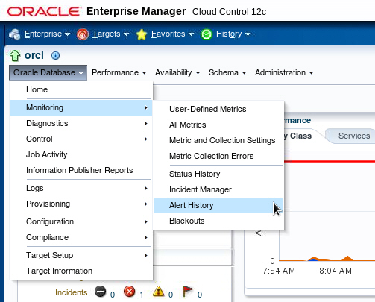
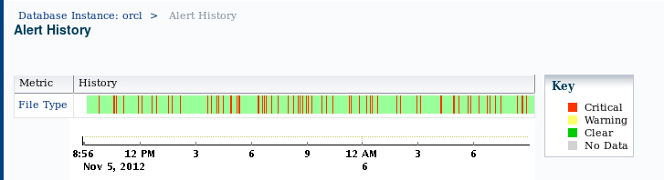
Viewing the Alert History
Notes:
The Alert History page displays a chart that shows the alert history of the current database in segments of time that you designate. An alert indicates a potential problem: either a warning or critical threshold for a monitored metric, or an indication that a target is no longer available. Click the metric name listed on the Alert History page to get detailed statistics, graphs, and actual time stamps for each alert.
Oracle Database 12c: Admin, Install and Upgrade Accelerated 20 - <number>

Slide 5

Terminology
  Statistics: Data collections providing database and object detail
    Optimizer statistics: Used by query optimizer
    Database statistics: Used for performance
  Metric: Rate of change in a cumulative statistic
  Threshold: A boundary value against which metric values are compared
  Automatic Workload Repository (AWR): Infrastructure for data gathering, analysis, and solutions recommendations
  AWR Baseline: A set of AWR snapshots for performance comparison
Notes:
Statistics are collections of data that provide more details about the database and the objects in it. Optimizer statistics are used by the query optimizer to choose the best execution plan for each SQL statement. Database statistics provide information for performance monitoring.
The Automatic Workload Repository (AWR) provides services to internal Oracle server components to collect, process, maintain, and use performance statistics for problem detection and self-tuning purposes. Active Session History (ASH) is the history of recent session activity stored in the AWR.
AWR snapshots include database statistics and metrics, application statistics (transaction volumes, response time), operating system statistics, and other measures. An AWR baseline is a set of AWR snapshots collected over a period of time. The baseline is used for performance comparison, either current performance versus the baseline or one baseline compared to another.
The System Moving Window baseline is collected by default. The System Moving Window baseline is a changing set of snapshots that include the last eight days of snapshots by default. This baseline becomes valid after sufficient data has been collected and the statistics calculation occurs. The statistics calculation is scheduled for every Saturday at midnight by default.
Oracle Database 12c: Admin, Install and Upgrade Accelerated 20 - <number>

Slide 6

Automatic Workload Repository (AWR): Overview
  Built-in repository of performance information
  Snapshots of database metrics taken every 60 minutes and retained for eight days
  Foundation for all self-management functions
In-memory
statistics
60 minutes
MMON
Snapshots
SGA
AWR
Notes:
The AWR is the infrastructure that provides services to Oracle Database components to collect, maintain, and use statistics for problem detection and self-tuning purposes. You can view it as a data warehouse for database statistics, metrics, and so on.
Every 60 minutes (by default), the database automatically captures statistical information from the SGA and stores it in the AWR in the form of snapshots. These snapshots are stored on disk by a background process called Manageability Monitor (MMON). By default, snapshots are retained for eight days. You can modify both the snapshot interval and the retention intervals.
The AWR contains hundreds of tables, all belonging to the SYS schema and stored in the SYSAUX tablespace. Oracle recommends that the repository be accessed only through Enterprise Manager or the DBMS_WORKLOAD_REPOSITORY package to work with the AWR. Direct data manipulation language (DML) commands against the repository tables are not supported.
Oracle Database 12c: Admin, Install and Upgrade Accelerated 20 - <number>

Slide 7
AWR Infrastructure
External clients
EM
SQL*Plus
…
SGA
Efficient
in-memory
statistics
collection
V$
DBA_*
AWR
snapshots
MMON
ADDM
Self-tuning
component
…
Self-tuning
component
Internal clients
Notes:
The AWR infrastructure has two major parts:
An in-memory statistics collection facility that is used by Oracle Database components to collect statistics. These statistics are stored in memory for performance reasons. Statistics stored in memory are accessible through dynamic performance (V$) views.
The AWR snapshots that represent the persistent portion of the facility. AWR snapshots are accessible through data dictionary views and Enterprise Manager.
Statistics are stored in persistent storage for several reasons:
The statistics need to survive instance crashes.
Some analyses need historical data for baseline comparisons.
A memory overflow can occur. When old statistics are replaced by new ones because of memory shortage, the replaced data can be stored for later use.
The memory version of the statistics is transferred to disk on a regular basis by the MMON background process. With the AWR, the Oracle database server provides a way to capture historical statistics data automatically without DBA intervention.
Oracle Database 12c: Admin, Install and Upgrade Accelerated 20 - <number>

Slide 8



Automatic Workload Repository
MMON
ADDM finds
top problems.
SYSAUX
SGA
6:00 AM
Snapshot 1
In-memory
statistics
7:00 AM
Snapshot 2
8:00 AM
Snapshot 3
9:00 AM
Snapshot 4
9:30 AM
Notes:
The Automatic Workload Repository (AWR) is a collection of persistent system performance statistics owned by SYS. The AWR resides in the SYSAUX tablespace.
A snapshot is a set of performance statistics captured at a certain time and stored in the AWR. Each snapshot is identified by a snapshot sequence number (SNAP_ID) that is unique in the AWR. By default, snapshots are generated every 60 minutes. You can adjust this frequency by changing the snapshot INTERVAL parameter. Because the database advisors rely on these snapshots, be aware that adjustment of the interval setting can affect diagnostic precision. For example, if the INTERVAL is set to four hours, you may miss transient events that would be noticeable in 60-minute intervals.
You can use the DBMS_WORKLOAD_REPOSITORY.MODIFY_SNAPSHOT_SETTINGS stored procedure or Enterprise Manager to change the settings that control snapshot collection.
You can take manual snapshots by using Enterprise Manager or the DBMS_WORKLOAD_REPOSITORY.CREATE_SNAPSHOT stored procedure. Taking manual snapshots is supported in conjunction with the automatic snapshots that the system generates. Manual snapshots are expected to be used when you want to capture the system behavior at two specific points in time that do not coincide with the automatic schedule.
Oracle Database 12c: Admin, Install and Upgrade Accelerated 20 - <number>

Slide 9
Notes:
Statspack is a bundled utility that provides a subset of the collection and reporting capability of the AWR. However, there is no supported path to migrate Statspack data into the workload repository. Also, the workload repository is not compatible with the Statspack schema. Statspack is not accessible through Enterprise Manager; it requires setup, and does not have automatic retention settings, or automatic purge. The Statspack utility does provide scripts for setup, automatic snapshot collection, and reporting. Statspack snapshots can be marked for retention, as part of a Statspack baseline, or purged with provided scripts.
Statspack is documented in the $ORACLE_HOME/rdbms/admin/spdoc.txt file.
Oracle Database 12c: Admin, Install and Upgrade Accelerated 20 - <number>

Slide 10

AWR Baselines
Relevant period
in the past
DBMS_WORKLOAD_REPOSITORY.CREATE_BASELINE ( -
start_snap_id IN NUMBER,
end_snap_id IN NUMBER,
baseline_name IN VARCHAR2);
Notes:
An AWR baseline is a set of AWR snapshots. This is usually a set of snapshot data for an important period that you tag and retain in the AWR. A baseline is defined on a pair of snapshots; the snapshots are identified by their snapshot sequence numbers (SNAP_IDs) or a start and end time. Each snapshot set has starting and ending snapshots and includes all the snapshots in between. Snapshot sets are used to retain snapshot data. Therefore, by default, snapshots belonging to snapshot sets are retained until the snapshot sets are dropped. You can specify an expiration value to indicate the number of days that the snapshot will be retained.
A baseline is identified by a user-supplied name. Execute the CREATE_BASELINE procedure to create a baseline from a set of snapshots, and specify a name and a pair of snapshot identifiers. A baseline identifier that is unique for the life of a database is assigned to the newly created baseline. Usually, you set up baselines from representative periods in the past, to be used for comparisons with current system behavior. You can also set up threshold-based alerts by using baselines from Enterprise Manager. You can set the expiration time (in number of days) with the expiration parameter of this procedure. The default is NULL, meaning “never expire.”
You can get the SNAP_IDs directly from DBA_HIST_SNAPSHOT, or from Enterprise Manager.
Note: For more information about the DBMS_WORKLOAD_REPOSITORY package, see the Oracle Database PL/SQL Packages and Types Reference guide.
Oracle Database 12c: Admin, Install and Upgrade Accelerated 20 - <number>

Slide 11
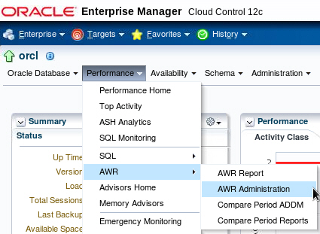
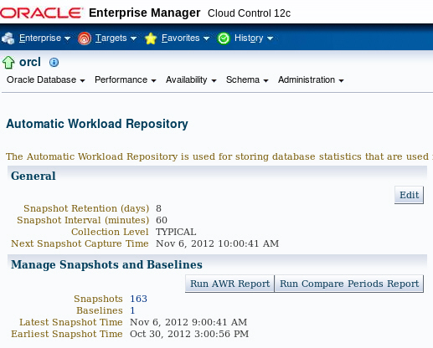
Accessing the AWR Page
Notes:
In Enterprise Manager Cloud Control, navigate to the Automatic Workload Repository page by expanding the Performance menu, selecting AWR and then selecting AWR Administration.
On the Automatic Workload Repository page, click Edit to change the settings.
On the Automatic Workload Repository page, you can:
Edit the workload repository settings
Look at detailed information about created snapshots and manually create new ones
Create AWR baselines
Generate an AWR report
Oracle Database 12c: Admin, Install and Upgrade Accelerated 20 - <number>

Slide 12
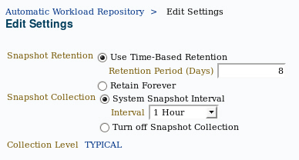
Managing the AWR
  Retention period
    Default: Eight days
    Consider storage needs
  Collection interval
    Default: 60 minutes
    Consider storage needs
    and performance impact
  Collection level
    Basic (disables most ADDM functionality)
    Typical (recommended)
    All (adds additional SQL tuning information to snapshots)
Notes:
AWR settings include retention period, collection interval, and collection level. Remember that decreasing any of these settings affects the functionality of components that depend on the AWR, including the advisors.
Increasing the settings can provide improved advisor recommendations—but at the cost of the space that is required to store the snapshots and the performance expended in collecting the snapshot information.
Consider setting collection level to ALL when tuning a new application. The ALL setting collects SQL execution plans and timing statistics that enhance the recommendations of the SQL advisors. When tuning is complete, this setting should be returned to the TYPICAL setting.
Oracle Database 12c: Admin, Install and Upgrade Accelerated 20 - <number>

Slide 13


Statistic Levels
STATISTICS_LEVEL
BASIC
TYPICAL
ALL
Self-tuning
capabilities disabled
Recommended
default value
Additional statistics
for manual
SQL diagnostics
Notes:
The STATISTICS_LEVEL initialization parameter controls the capture of a variety of statistics and various advisors, including the automatic maintenance tasks. The automatic maintenance tasks include gathering optimizer statistics. The STATISTICS_LEVEL parameter can be set to the following levels:
BASIC: The computation of AWR statistics and metrics is turned off. The automatic optimizer statistics task is disabled, as are all advisors and server-generated alerts.
TYPICAL: Major statistics that are required for database self-management are collected. They represent what is typically needed to monitor Oracle database behavior. This includes automatic gathering of statistics to reduce the likelihood of poorly performing SQL statements due to stale or invalid statistics.
ALL: All possible statistics are captured. This level of capture adds timed OS statistics and plan execution statistics. These statistics are not needed in most cases and should not be enabled for best performance; they are sometimes needed for specific diagnostics tests.
Oracle recommends that the default value of TYPICAL be set for the STATISTICS_LEVEL initialization parameter. Setting the value to BASIC disables the automatic gathering of optimizer statistics.
Oracle Database 12c: Admin, Install and Upgrade Accelerated 20 - <number>

Slide 14
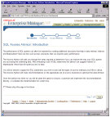


Automatic Database
Diagnostic Monitor (ADDM)
  Runs after each AWR snapshot
  Monitors the instance; detects bottlenecks
  Stores results in the AWR
Snapshots
EM
ADDM
ADDM results
AWR
Notes:
Unlike the other advisors, the ADDM runs automatically after each AWR snapshot. Each time a snapshot is taken, the ADDM performs an analysis of the period corresponding to the last two snapshots. The ADDM proactively monitors the instance and detects most bottlenecks before they become a significant problem.
In many cases, the ADDM recommends solutions for detected problems and even quantifies the benefits for the recommendations.
Some common problems that are detected by the ADDM:
CPU bottlenecks
Poor Oracle Net connection management
Lock contention
Input/output (I/O) capacity
Undersizing of database instance memory structures
High-load SQL statements
High PL/SQL and Java time
High checkpoint load and cause (for example, small log files)
The results of each ADDM analysis are stored in the AWR and are also accessible through Enterprise Manager.
Oracle Database 12c: Admin, Install and Upgrade Accelerated 20 - <number>

Slide 15
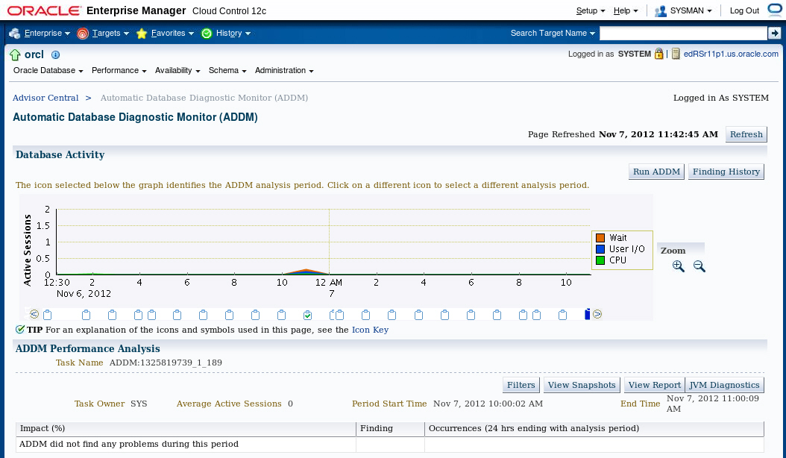
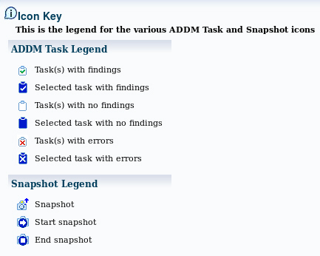
ADDM Findings in
Enterprise Manager Cloud Control
Notes:
You can use Enterprise Manager Cloud Control to view ADDM findings. Select Advisors Home in the Performance menu. Select an ADDM autorun on the Advisors Central page.
On the Automatic Database Diagnostic Monitor (ADDM) page, you see the detailed findings for the latest ADDM run. Database Time represents the sum of the nonidle time spent by sessions in the database for the analysis period. A specific impact percentage is given for each finding. The impact represents the time consumed by the corresponding issue compared with the database time for the analysis period.
Click the View Report button to get details about the performance analysis in the form of a text report.
Oracle Database 12c: Admin, Install and Upgrade Accelerated 20 - <number>

Slide 16
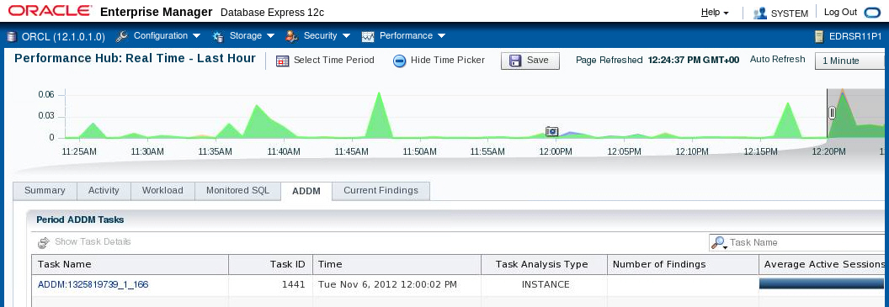
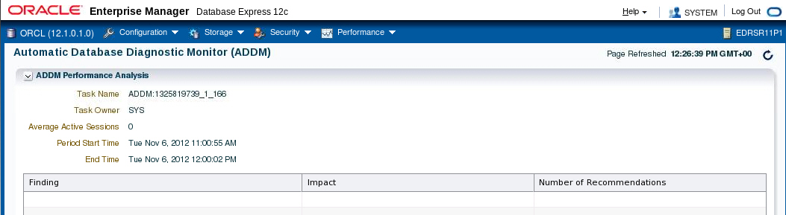
ADDM Findings in
Enterprise Manager Database Express
Notes:
You can also use Enterprise Manager Database Express to view ADDM information. Select Performance Hub from the Performance menu. Click the ADDM tab. Select a task to view detailed information.
Oracle Database 12c: Admin, Install and Upgrade Accelerated 20 - <number>

Slide 17
Advisory Framework
ADDM
SQL Tuning Advisor
Buffer Cache
Advisor
PGA
Advisor
SQL Access Advisor
Shared Pool
Advisor
Memory Advisor
Java Pool
Advisor
SGA
Advisor
Streams Pool
Advisor
Segment Advisor
Space
Undo Advisor
Backup
MTTR Advisor
Notes:
Advisors provide you with useful feedback about resource utilization and performance for their respective server components. For example, the Memory Advisor provides a recommended value for the MEMORY_TARGET initialization parameter, which controls the total amount of memory used by the Oracle database instance.
By building on the data captured in the AWR, the ADDM enables the Oracle Database server to diagnose its own performance and determine how identified problems can be resolved. ADDM runs automatically after each AWR statistics capture. It can potentially call other advisors.
Here are the major benefits that are provided by the advisor infrastructure:
All advisors use a uniform interface.
All advisors have a common data source and results storage by using the workload repository.
Not all advisors are shown in the slide (for example, the Data Recovery Advisor and the SQL Repair Advisor are not listed).
Automatic Database Diagnostic Monitor (ADDM)
The ADDM is a server-based expert that reviews database performance every 60 minutes. Its goal is to detect possible system bottlenecks early and recommend fixes before system performance degrades noticeably.
Oracle Database 12c: Admin, Install and Upgrade Accelerated 20 - <number>

Slide 18
Notes:
Memory Advisors
The Memory Advisor is actually a collection of several advisory functions that help determine the best settings for the total memory used by the database instance. The System Global Area (SGA) has a set of advisors for the shared pool, database buffer cache, Java pool, and streams pool. The Java pool and streams pool advisors are not exposed on the Enterprise Manager Memory Advisor page. There is an advisor for the Program Global Area (PGA). In addition to the advisory functions, this advisor provides a central point of control for the large pool and the Java pool.
Mean-Time-To-Recover (MTTR) Advisor
Using the MTTR Advisor, you set the length of time required for the database to recover after an instance crash.
Segment Advisor
This advisor looks for tables and indexes that consume more space than they require. The advisor checks for inefficient space consumption at the tablespace or schema level and produces scripts to reduce space consumption where possible.
SQL Access Advisor
This advisor analyzes all SQL statements that are issued in a given period and suggests the creation of additional indexes or materialized views that will improve performance.
SQL Tuning Advisor
This advisor analyzes an individual SQL statement and makes recommendations for improving its performance. Recommendations may include actions, such as rewriting the statement, changing the instance configuration, or adding indexes.
Undo Management Advisor
With the Undo Management Advisor, you can determine the undo tablespace size that is required to support a given retention period. Undo management and the use of the advisor is covered in the lesson titled “Managing Undo Data.”
Data Recovery Advisor
This advisor automatically diagnoses persistent data failures, presents repair options to the user, and executes repairs at the user’s request. The purpose of the Data Recovery Advisor is to reduce the mean time to recover (MTTR) and provide a centralized tool for automated data repair.
SQL Repair Advisor
You run the SQL Repair Advisor after a SQL statement fails with a critical error that generates a problem in the Automatic Diagnostic Repository. The advisor analyzes the statement and, in many cases, recommends a patch to repair the statement. If you implement the recommendation, the applied SQL patch circumvents the failure by causing the query optimizer to choose an alternative execution plan for future executions. This is done without changing the SQL statement itself.
Oracle Database 12c: Admin, Install and Upgrade Accelerated 20 - <number>

Slide 19
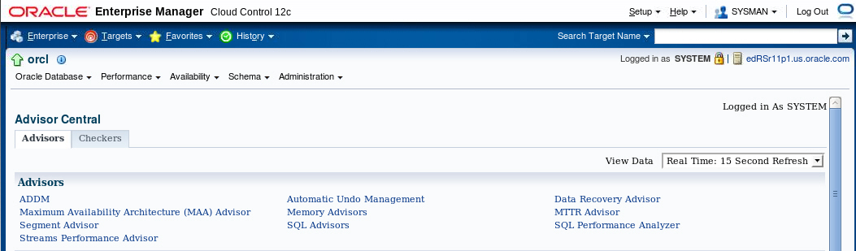
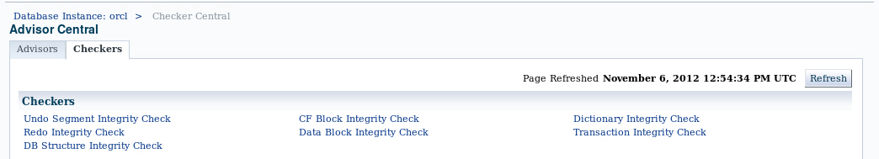
Viewing the Advisor Central Page in
Enterprise Manager Cloud Control
Notes:
The Advisor Central page is the main page of all advisors. You can reach this page by selecting Advisors Home in the Performance menu. It is also possible to have access to advisors in certain contexts.
On the Advisors tab of the Advisor Central page, you can see all the advisor tasks that are registered in the workload repository. You can also filter this list by advisor type and for predefined time periods.
The Checkers tab of the Advisor Central page enables you to schedule various database integrity checkers. You can see all the checker runs by name, type, or time period.
Some advisors are described in greater detail in the lessons titled “Managing Undo Data,” “Managing Performance,” “Managing Performance: SQL Tuning,” and “Backup and Recovery Concepts.”
Note: Use the Change Default Parameters page to change the default expiration (in days) for all future tasks. You can also use this page to change the parameters of some important advisors.
Oracle Database 12c: Admin, Install and Upgrade Accelerated 20 - <number>

Slide 20
Using Packages to Invoke the Advisors
Package Name | Advisor Name
DBMS_ADDM | Automatic Database Diagnostic Monitor (DBMS_ADDM)
DBMS_ADVISOR | SQL Access Advisor and Segment Advisor
DBMS_COMPRESSION | Compression Advisor
DBMS_SQLDIAG | SQL Repair Advisor
DBMS_SQLPA | SQL Performance Analyzer
DBMS_SQLTUNE | SQL Tuning Advisor
Notes:
The DBMS_ADVISOR package contains all constants and procedure declarations for all advisor modules. However, some of the advisors have their own separate packages. Oracle recommends that you use the advisor-specific package rather than DBMS_ADVISOR for the following advisors:
Automatic Database Diagnostic Monitor (DBMS_ADDM)
SQL Performance Analyzer (DBMS_SQLPA)
SQL Repair Advisor (DBMS_SQLDIAG)
SQL Tuning Advisor (DBMS_SQLTUNE)
Compression Advisor (DBMS_COMPRESSION.GET_COMPRESSION_RATIO)
You can use DBMS_ADVISOR and the other advisor packages to execute tasks from the command line.
To execute advisor procedures, you must be granted the ADVISOR privilege. The ADVISOR privilege permits full access to the advisor procedures and views.
Note: For more information about all the procedures found in the advisor packages, refer to the Oracle Database PL/SQL Packages and Types Reference.
Oracle Database 12c: Admin, Install and Upgrade Accelerated 20 - <number>

Slide 21

Automated Maintenance Tasks
Autotask maintenance process:
  Maintenance Window opens.
  Autotask background process schedules jobs.
  Scheduler initiates jobs.
  Resource Manager limits impact of Autotask jobs.
Default Autotask maintenance jobs:
  Gathering optimizer statistics
  Automatic Segment Advisor
  Automatic SQL Advisor
Notes:
By analyzing the information stored in the AWR, the database server can identify the need to perform routine maintenance tasks, such as optimizer statistics refresh. The automated maintenance tasks infrastructure enables the Oracle Database server to automatically perform such operations. It uses the Scheduler to run such tasks in predefined maintenance windows.
By default, the weekday maintenance windows start at 10:00 PM and last four hours. On Saturday and Sunday, the maintenance window starts at 6:00 AM and lasts for 20 hours. All attributes of the maintenance windows are customizable, including the start and end times, frequency, days of the week, and so on. In addition, the impact of automated maintenance tasks on normal database operations can be limited by associating a Database Resource Manager resource plan to the maintenance window.
Examples of maintenance:
Optimizer statistics are automatically refreshed by using the automatic maintenance task infrastructure.
The Automatic Segment Advisor has default jobs, which run in the maintenance window.
When creating a database with the DBCA, you can initiate regular database backups.
Oracle Database 12c: Admin, Install and Upgrade Accelerated 20 - <number>

Slide 22
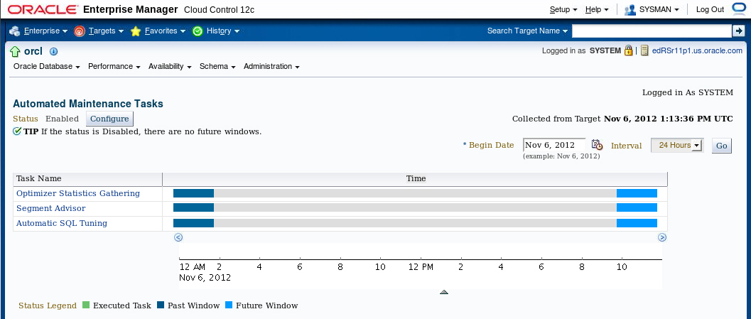
Automated Maintenance Tasks
Notes:
To access the Automated Maintenance Task page, expand the Administration menu and select Automated Maintenance Tasks in the Oracle Scheduler submenu. On this page, you can view the automated maintenance task schedule and recent history. From here, you can drill down to details on some tasks. Click Configure to go to the Automated Maintenance Tasks Configuration page. A task executes in a window. The graph shows the last window in which a task was executed and the next window in which the task is scheduled to be executed.
Note: The default windows for tasks are shown in the example. When the maintenance window closes, the Scheduler terminates the optimizer statistics–gathering job by default. The remaining objects are then processed in the next maintenance window.
Oracle Database 12c: Admin, Install and Upgrade Accelerated 20 - <number>

Slide 23
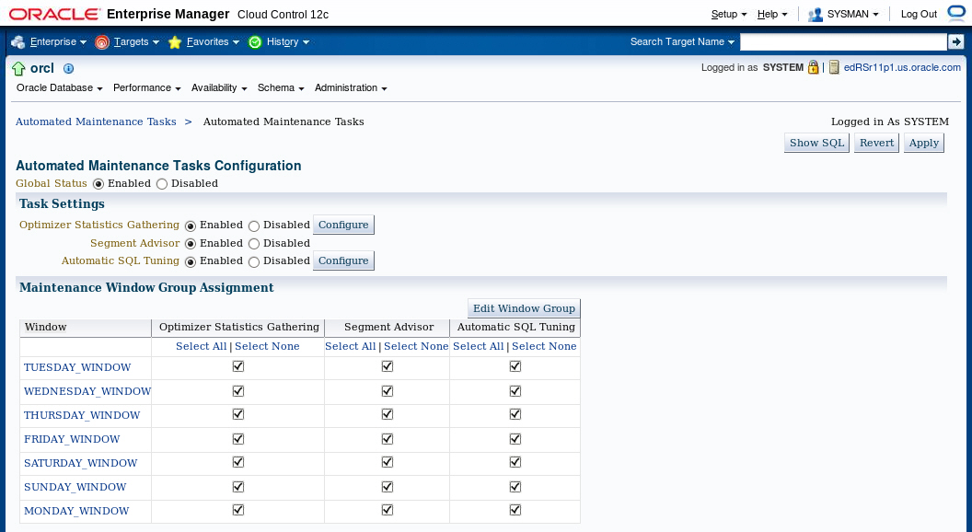
Automated Maintenance Tasks Configuration
Notes:
On the Automated Maintenance Tasks Configuration page, you can enable and disable automatic maintenance tasks—all at once, by individual tasks, or by particular windows. You can also configure the settings that are used for optimizer statistics gathering and the job control parameters for the automatic SQL Tuning Advisor.
Select the window name to view or edit the window schedule.
Click Edit Window Group to add and remove windows in the window group.
Oracle Database 12c: Admin, Install and Upgrade Accelerated 20 - <number>

Slide 24




Server-Generated Alerts
Enterprise Manager
Server
alerts
queue.
Oracle
instance
Metric exceeds
threshold.
AWR
Notes:
Alerts are notifications of when a database is in an undesirable state and needs your attention. By default, the Oracle Database server provides alerts via Enterprise Manager. Optionally, Enterprise Manager can be configured to send an email message to the administrator about problem conditions as well as display alert information on the console.
You can also set thresholds on many of the pertinent metrics for your system. Oracle Database proactively notifies you if the database deviates sufficiently from normal readings to reach those thresholds. An early notification of potential problems enables you to respond quickly and, in many cases, resolve issues before users even notice them.
Approximately, 60 metrics are monitored by default, among which are:
Broken Job Count
Database Time Spent Waiting (%)
Dump Area Used (%)
SQL Response Time (%) compared to baseline
Tablespace Used (%)
Generic Incident
A few additional key metrics can provide early problem notification:
Average File Read Time (centiseconds)
Response Time (per transaction)
Wait Time (%)
Oracle Database 12c: Admin, Install and Upgrade Accelerated 20 - <number>

Slide 25
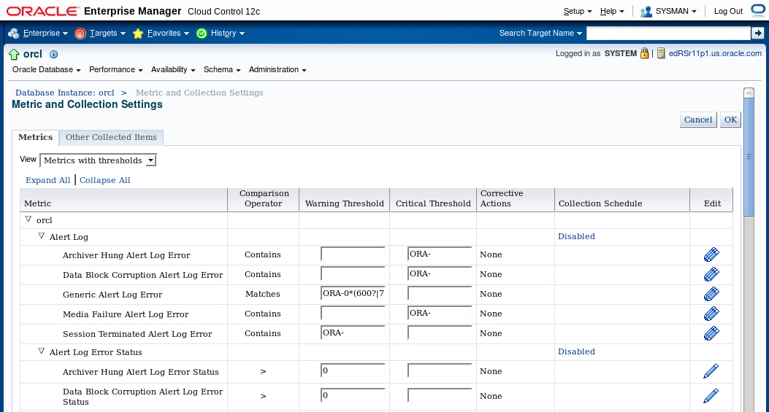
Setting Metrics Thresholds
Notes:
To access the Metric and Collection Settings page, expand the Oracle Database menu and select Metric and Collection Settings from the Monitoring submenu.
Enter your desired warning and critical threshold values for the metric. The appropriate alerts appear when the database reaches your specified values.
The thresholds that are already set appear in the “Metrics with thresholds” list. By default, approximately 60 metrics have preset thresholds; you may change these as needed. The “All metrics” list shows the metrics that do not have thresholds set.
Click the Edit icon to access a page where you can specify additional corrective actions for either warning or critical thresholds.
Click a Collection Schedule link to change the scheduled collection interval. Be aware that each schedule affects a group of metrics.
Oracle Database 12c: Admin, Install and Upgrade Accelerated 20 - <number>

Slide 26

Reacting to Alerts
  If necessary, you should gather more input (for example, by running ADDM or another advisor).
  Investigate critical errors.
  Take corrective measures.
  Acknowledge alerts that are not automatically cleared.
Notes:
When you receive an alert, follow the recommendations that it provides. Or you can consider running the ADDM (or another advisor as appropriate) to obtain more detailed diagnostics of system or object behavior.
Alerts and incidents are generated for critical errors. Critical errors usually generate incidents that are collected into problems. You use the Support Workbench to investigate and possibly report the problem to Oracle Support.
Most alerts (such as “Out of Space”) are cleared automatically when the cause of the problem disappears. However, other alerts (such as Generic Alert Log Error) are sent to you for notification and must be acknowledged by you. After taking the necessary corrective measures, you acknowledge an alert by clearing or purging it. Clearing an alert sends the alert to the Alert History, which is accessible from the Monitoring submenu. Purging an alert removes it from the Alert History.
Oracle Database 12c: Admin, Install and Upgrade Accelerated 20 - <number>

Slide 27
Alert Types and Clearing Alerts
Metric based
Threshold
(stateful)
alerts
97% Critical
Cleared
85% Warning
Cleared
MMON
DBA_OUTSTANDING_ALERTS
DBA_ALERT_HISTORY
Resumable
Session
Suspended
Recovery Area
Low On
Free Space
Snapshot
Too Old
Nonthreshold (stateless)
alerts
Alert
Event based
Notes:
There are two kinds of server-generated alerts: threshold and nonthreshold.
Most server-generated alerts are configured by setting a warning and critical threshold values on database metrics. You can define thresholds for more than 120 metrics, including the following:
Physical Reads Per Sec
User Commits Per Sec
SQL Service Response Time
Except for the Tablespace Space Usage metric, which is database related, the other metrics are instance related. Threshold alerts are also referred to as stateful alerts, which are automatically cleared when an alert condition clears. Stateful alerts appear in DBA_OUTSTANDING_ALERTS and, when cleared, go to DBA_ALERT_HISTORY.
Other server-generated alerts correspond to specific database events, such as ORA-* errors, “Snapshot too old” errors, Recovery Area Low On Free Space, and Resumable Session Suspended. These are non-threshold-based alerts, also referred to as stateless alerts. Stateless alerts go directly to the history table.
Oracle Database 12c: Admin, Install and Upgrade Accelerated 20 - <number>

Slide 28
Quiz
Stateless alerts, such as SNAPSHOT TOO OLD can be found in the dictionary view DBA_OUTSTANDING_ALERTS.
  True
  False
Notes:
Answer: b
Oracle Database 12c: Admin, Install and Upgrade Accelerated 20 - <number>

Slide 29
Summary
In this lesson, you should have learned how to:
  Manage the Automatic Workload Repository (AWR)
  Use the Automatic Database Diagnostic Monitor (ADDM)
  Describe and use the advisory framework
  Set alert thresholds
  Use server-generated alerts
  Use automated tasks
Notes:
Oracle Database 12c: Admin, Install and Upgrade Accelerated 20 - <number>

Slide 30
Practice 20
20-1: Database Maintenance
Notes:
Oracle Database 12c: Admin, Install and Upgrade Accelerated 20 - <number>

