Slide 1
Upgrading to Oracle Database 12c

Slide 2
Objectives
After completing this lesson, you should be able to:
  Upgrade the database to Oracle Database 12c by using the Database Upgrade Assistant (DBUA)
  Perform a manual upgrade to Oracle Database 12c by using scripts and tools
  Migrate a non-CDB database to a CDB database
Notes:
Oracle Database 12c: Admin, Install and Upgrade Accelerated 25 - <number>

Slide 3
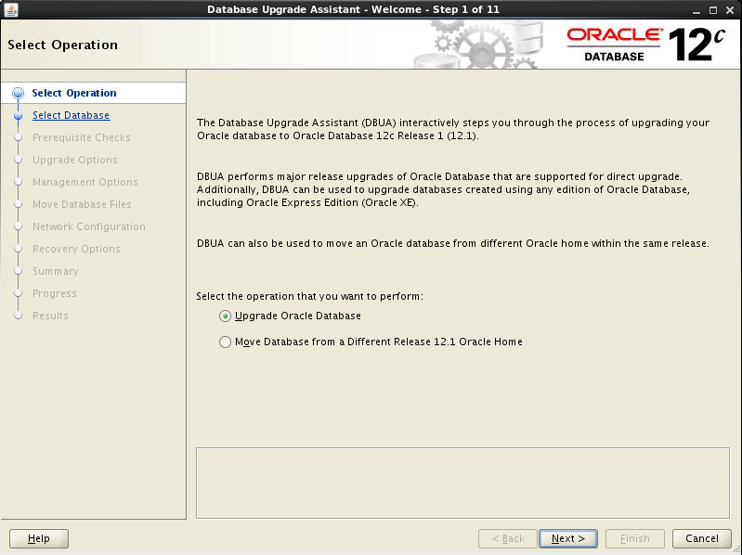
Upgrading by Using the Database Upgrade Assistant (DBUA)
  You can use the Database Upgrade Assistant (DBUA) to:
    Upgrade to Oracle Database 12c
    Move a database from an existing 12c Oracle home
  DBUA includes a GUI interface and silent mode
Notes:
The DBUA guides you through the upgrade process and configures a database for the new release. The DBUA automates the upgrade process and makes appropriate recommendations for configuration options, such as tablespaces and redo logs.
The DBUA also supports a silent mode of operation. Silent mode enables you to use a single statement for the upgrade.
Oracle Database 12c: Admin, Install and Upgrade Accelerated 25 - <number>

Slide 4
Key DBUA Features
  Provides for recoverability:
    Performs a backup of the database before upgrade
    Can restore the database after upgrade (if needed)
  Runs all the necessary scripts to perform the upgrade
  Displays the upgrade progress at a component level
  Performs configuration checks by executing the preupgrd.sql script
Notes:
Before starting the upgrade process, it is strongly recommended that you back up your existing database, although the DBUA can perform a backup during the preupgrade stage.
If you use the DBUA to back up your database, it creates a copy of all your database files in the directory that you specify. The DBUA automatically performs this cold backup after it shuts down the database and before it begins performing the upgrade procedure. However, the cold backup does not compress your database files and the backup directory must be a valid file system path. In addition, the DBUA creates a batch file in the specified directory. You can use this batch file to restore the database files if needed.
During the upgrade, the DBUA automatically modifies or creates new required tablespaces and invokes the appropriate upgrade scripts. While the upgrade is running, the DBUA shows the upgrade progress for each component. It then creates new configuration files (parameter and listener files) in the new Oracle home. The DBUA provides a comprehensive summary of the preupgrade checks when finished.
Oracle Database 12c: Admin, Install and Upgrade Accelerated 25 - <number>

Slide 5
Key DBUA Features
  Creates or updates configuration files:
    Creates init.ora and SPFILE in the new Oracle home
    Updates network configurations
    Uses OFA-compliant locations
    Updates the Oracle Internet Directory database information
  Oracle Enterprise Manager:
    DBUA allows you to register a database with Enterprise Manager Cloud Control
    Configure port for Enterprise Manager Database Express
  Provides logging and tracing:
    Writes detailed trace and logging files to
    $ORACLE_BASE/cfgtoollogs/dbua/<sid>/upgradeNN
Notes:
During the upgrade, the DBUA automatically modifies or creates a new init.ora and server parameter file (SPFILE) in the new Oracle home directory. In addition, it updates the network configurations, creates the required tablespaces, and invokes the appropriate upgrade scripts. While the upgrade is running, the DBUA shows the upgrade progress for each component. The DBUA writes detailed trace and log files in $ORACLE_BASE/cfgtoollogs/dbua/<sid>/upgradeNN and produces a complete HTML report for later reference.
Oracle Database 12c: Admin, Install and Upgrade Accelerated 25 - <number>

Slide 6
Key DBUA Features
  Minimizes down time:
    Recompiles packages in parallel
    Does not require user interaction after upgrade starts
  Supports security features
    Locks new users in the upgraded database
  Supports Real Application Clusters:
    Upgrades all nodes
    Upgrades all configuration files
Notes:
After completing the preupgrade steps, the DBUA automatically archives redo logs and disables archiving during the upgrade phase.
To enhance security, the DBUA automatically locks the new user accounts in the upgraded database.
The DBUA is fully compliant with the Oracle RAC environments. In RAC environments, the DBUA upgrades all the database and configuration files on all nodes in the cluster.
Oracle Database 12c: Admin, Install and Upgrade Accelerated 25 - <number>

Slide 7
Manually Upgrading to Oracle Database 12c
  Execute the Pre-Upgrade Information Tool (preupgrd.sql).
  Back up the source database.
  Prepare the new Oracle home.
  Log in to SQL*Plus and shut down the database instance.
  Log in to SQL*Plus in the Oracle Database 12c home and execute the STARTUP UPGRADE command.
  Execute the Parallel Upgrade Utility (catctl.pl).
  Restart the database instance.
  Execute the Post Upgrade Status Tool (utlu121s.sql).
  Execute additional scripts (catuppst.sql and utlrp.sql).
Notes:
As an alternative to using DBUA, you can manually upgrade to Oracle Database 12c by performing the following steps:
Run the Preupgrade Information Tool by executing the preupgrd.sql script in SQL*Plus. This script analyzes your database and generates scripts that you can use to fix problems. You must execute this script prior to running the Parallel Upgrade Utility or the catctl.pl upgrade script will terminate with errors.
Back up your database by using Recovery Manager (RMAN).
Prepare the new Oracle home by copying configuration files and modifying the initialization parameter file.
Log in to SQL*Plus and shut down the database instance.
Set the environment variables for the Oracle Database 12c Oracle home and log in to SQL*Plus. Execute the STARTUP UPGRADE command. The UPGRADE keyword enables you to open the database before it is upgraded. The command also causes logons to be restricted to only AS SYSDBA sessions, disables system triggers, and performs additional operations that prepare the environment for the upgrade.
6. At the operating system prompt, run the Parallel Upgrade Utility by executing the catctl.pl script from the new Oracle home. This utility provides parallel upgrade options that reduce downtime. The script can also be executed in serial mode.
Oracle Database 12c: Admin, Install and Upgrade Accelerated 25 - <number>

Slide 8
Notes:
Log in to SQL*Plus again and restart the database instance. You must restart the instance because the catctl.pl script shut down the instance.
Run the Post-Upgrade Status Tool by executing the utlu121s.sql script. The script provides a summary of the upgrade operation.
9. Execute the catuppst.sql script to perform additional upgrade operations. This script is run at this time because it does not require the database to be in UPGRADE mode. Execute the utlrp.sql script to recompile PL/SQL and Java code.
Oracle Database 12c: Admin, Install and Upgrade Accelerated 25 - <number>

Slide 9

Migrating a Pre-12.1 or 12.1 Non-CDB to CDB
CDB CDB1
There are two methods: A, and B
A1) Upgrade an existing pre-12.1
non-CDB to 12c
A2) Plug non-CDB into a CDB
OR
B1) Pre-create a PDB in a CDB
B2) Use 11g expdp / 12c impdp
or
Use 9i or 10g exp / 12c imp
or
Replication between non-CDB
and PDB
Datafiles/
Tempfiles
root
Control
files
Redo log
files
B1
PDB1
Data files
B2
imp/impdp
A2
Dump file
Replication
XML file
exp/expdp
ORCL
Datafiles
Control
files
Redo log
files
12c
exp/expdp
A1
Datafiles
ORCL
B2
Control
files
Redo log
files
9i, 10g, 11g
Notes:
There are two methods to migrate a non-CDB 11g database to a CDB.
The first method "A", consists of two steps:
A1) Upgrade the 11g database (or any other previous Oracle Database release) to 12c non-CDB
A2) Plug the 12c non-CDB into a CDB. Use the DBMS_PDB.DESCRIBE procedure to generate the XML file to plug the data files into the CDB as a new PDB. This is the fastest solution.
The second method, "B", consists of two steps:
B1) Pre-create a PDB in the CDB from the seed PDB. This operation establishes an Oracle Database 12c dictionary in the newly created PDB.
B2) Use Data Pump Export and Import (or the original Export and Import) or replication to load the 9i, 10g, and 11g data into the newly created PDB of the CDB.
Oracle Database 12c: Admin, Install and Upgrade Accelerated 25 - <number>

Slide 10
Plugging a Non-CDB Database into a CDB
Multitenant Container Database CDB1
Three possible methods:
  TTS or TDB or full export/import
  XML file definition with DBMS_PDB
  Replication
Entities are created in the new PDB:
  Tablespaces: SYSTEM, SYSAUX
  A full catalog
  Common users: SYS, SYSTEM
  A local administrator (PDBA)
  A new default service
Datafiles/
Tempfiles
root
Control
files
Redo log
files
Create
PDB2
from
ORCL
PDB$SEED
Datafiles / Tempfiles
Datafiles
PDB2
impdp TTS
Plug
Dump file
XML file
Replication
expdp TTS
DBMS_PDB
Datafiles
ORCL
Control
files
Redo Log
files
Notes:
There are three possible methods to plug a non-CDB database into a CDB.
Whichever method is used, the non-CDB must be in a transactionally consistent state and opened in restricted mode.
It is appropriate to use Oracle Data Pump when:
Both source and target databases are different endian.
The source character set is not equal to the target character set , and is not a binary subset of the target.
Either use transportable tablespace (TTS), full conventional export / import, or full transportable database (TDB) provided that any user-defined object resides in a single user-defined tablespace. A Data Pump full transportable database does not support movement of XDB or AWR repositories. Only user-generated XML schemas are moved.
In other cases, using the DBMS_PDB package is the easiest option. The DBMS_PDB package constructs an XML file describing the non-CDB data files to plug into the CDB as a PDB. This method requires that the non-CDB is an Oracle 12c database.
If the DBMS_PDB package is not used, export/import is usually simpler than using GoldenGate replication, but export/import might require more down time during the switch from the non-CDB to the PDB.
Oracle Database 12c: Admin, Install and Upgrade Accelerated 25 - <number>

Slide 11
Summary
In this lesson, you should have learned how to:
  Upgrade the database to Oracle Database 12c by using the Database Upgrade Assistant (DBUA)
  Perform a manual upgrade to Oracle Database 12c by using scripts and tools
  Migrate a non-CDB database to a CDB database
Notes:
Oracle Database 12c: Admin, Install and Upgrade Accelerated 25 - <number>

Slide 12
Practice 25
  25-1: Upgrading a Database by Using DBUA
  25-2: Exporting a Non-CDB Application (OPTIONAL)
  25-3: Plugging a Non-CDB into a CDB
Notes:
Oracle Database 12c: Admin, Install and Upgrade Accelerated 25 - <number>

