Slide 1
Migrating Data by Using Oracle Data Pump

Slide 2
Objectives
After completing this lesson, you should be able to migrate data by using Oracle Data Pump.
Notes:
Oracle Database 12c: Admin, Install and Upgrade Accelerated C - <number>

Slide 3
Oracle Data Pump: Overview
As a server-based facility for high-speed data and metadata movement, Oracle Data Pump:
  Is callable via DBMS_DATAPUMP
  Provides the following tools:
    expdp
    impdp
    GUI interface in Enterprise Manager Cloud Control
  Provides four data movement methods:
    Data file copying
    Direct path
    External tables
    Network link support
  Detaches from and re-attaches to long-running jobs
  Restarts Data Pump jobs
Notes:
Oracle Data Pump enables high-speed data and metadata loading and unloading of Oracle databases. The Data Pump infrastructure is callable via the DBMS_DATAPUMP PL/SQL package. Thus, custom data movement utilities can be built by using Data Pump.
Oracle Database provides the following tools:
Command-line export and import clients called expdp and impdp, respectively
Export and import interface in Enterprise Manager Cloud Control
Data Pump automatically decides the data access methods to use; these can be either direct path or external tables. Data Pump uses direct path load and unload when a table’s structure allows it and when maximum single-stream performance is desired. However, if there are clustered tables, referential integrity constraints, encrypted columns, or several other items, Data Pump uses external tables rather than direct path to move the data.
The ability to detach from and re-attach to long-running jobs without affecting the job itself enables you to monitor jobs from multiple locations while they are running. All stopped Data Pump jobs can be restarted without loss of data as long as the metainformation remains undisturbed. It does not matter whether the job is stopped voluntarily or involuntarily due to a crash.
Oracle Database 12c: Admin, Install and Upgrade Accelerated C - <number>

Slide 4
Data Pump Export and Import Clients: Overview
expdp
client
Database
link
Source
Target
Data Pump
job
Server
process
Database
Database
Master
table
Dump
file set
Dump
file set
Master
table
“Network mode”
Server
process
Data Pump
job
impdp
client
Notes:
Data Pump Export is a utility for unloading data and metadata into a set of operating system files called dump file sets. Data Pump Import is used to load metadata and data stored in an export dump file set into a target system.
The Data Pump API accesses its files on the server rather than on the client.
These utilities can also be used to export from a remote database directly to a dump file set, or to load the target database directly from a source database with no intervening files. This is known as network mode. This mode is particularly useful to export data from a read-only source database.
At the center of every Data Pump operation is the master table (MT), which is a table created in the schema of the user running the Data Pump job. The MT maintains all aspects of the job. The MT is built during a file-based export job and is written to the dump file set as the last step. Conversely, loading the MT into the current user’s schema is the first step of a file-based import operation and is used to sequence the creation of all objects imported.
Note: The MT is the key to Data Pump’s restart capability in the event of a planned or unplanned stopping of the job. The MT is dropped when the Data Pump job finishes normally.
Oracle Database 12c: Admin, Install and Upgrade Accelerated C - <number>

Slide 5

Data Pump Utility: Interfaces and Modes
  Data Pump Export and Import interfaces:
    Command line
    Parameter file
    Interactive command line
    Enterprise Manager Cloud Control
  Data Pump Export and Import modes:
    Full
    Schema
    Table
    Tablespace
    Transportable tablespace
    Transportable database
Notes:
You can interact with Data Pump Export and Import by using one of the following interfaces:
Command-line interface: Enables you to specify most of the export parameters directly on the command line
Parameter file interface: Enables you to specify all command-line parameters in a parameter file. The only exception is the PARFILE parameter.
Interactive-command interface: Stops logging to the terminal and displays the export or import prompts, where you can enter various commands. This mode is enabled by pressing Ctrl + C during an export operation that is started with the command-line interface or the parameter file interface. Interactive-command mode is also enabled when you attach to an executing or stopped job.
GUI interface: Select Schema > Database Export/Import. In the menu select the export or import operation you want to execute.
Data Pump Export and Import provide different modes for unloading and loading different portions of the database. The mode is specified on the command line by using the appropriate parameter. The available modes are listed in the slide and are the same as in the original export and import utilities.
Oracle Database 12c: Admin, Install and Upgrade Accelerated C - <number>

Slide 6




Migrating by Using Oracle Data Pump
To migrate to Oracle Database 12c by using Oracle Data Pump:
  Export data from the source database
  Install Oracle Database 12c and create a database
  Import data into the new Oracle Database 12c database
export
import
Notes:
You can use Oracle Dump Export and Import to migrate your database to Oracle Database 12c. This method provides the following advantages:
The database can remain available for user access during the upgrade. If a consistent snapshot of the database is required, the database must operate in restricted mode or must otherwise be protected from changes when the export executes.
The upgraded database can be created on a different operating system or hardware platform.
The database can be restructured as part of the import. You can create new tablespaces or modify existing tables, tablespaces, or partitions to be populated by imported data.
Oracle Database 12c: Admin, Install and Upgrade Accelerated C - <number>

Slide 7
Importing by Using a Network Link
  Use Data Pump Import with a database link for a full database import
  User performing the Export must have the DATAPUMP_EXP_FULL_DATABASE role
  User performing the Import must have the DATAPUMP_IMP_FULL_DATABASE role
impdp import_user NETWORK_LINK=db_link FULL=Y
Notes:
Data Pump Import can be used with a database link to perform a full database import. When you use this method, no intermediate dump files are created.
The user performing the export must be granted the DATAPUMP_EXP_FULL_DATABASE role. Specify this user when the database link is created.
The user performing the import must be granted the DATAPUMP_IMP_FULL_DATABASE role.
Oracle Database 12c: Admin, Install and Upgrade Accelerated C - <number>

Slide 8
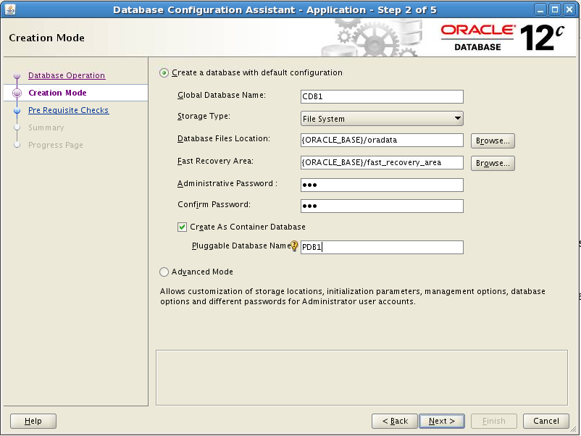
Creating a Container Database by Using DBCA
Notes:
Another way to migrate a non-CDB database to a CDB is to create a multitenant container database and then import the database. To create a CDB by using DBCA, select “Create As Container Database.”
You also must provide a pluggable database name in the “Pluggable Database Name” field. If you select “Advanced Mode” you can create an empty CDB with only the root and seed containers.
In Advanced Mode, you can register the CDB with Enterprise Manager Cloud Control, configure the CDB for Enterprise Manager Database Express, and set passwords for the SYS and SYSTEM users.
Oracle Database 12c: Admin, Install and Upgrade Accelerated C - <number>

Slide 9

Creating a New PDB from PDB$SEED
Multitenant Container Database CDB1
    Copies the data files from PDB$SEED data files
    Creates SYSTEM, SYSAUX tablespaces
    Creates a full catalog including metadata pointing to Oracle supplied objects
    Creates common users:
      Superuser SYS
      SYSTEM
    Creates a local user (PDBA) granted local PDB_DBA role
    Creates a new default service
Data files/
Tempfiles
root
Control
files
Redo log
files
SYSTEM
UNDO
SYSAUX
USERS
TEMP
PDB$SEED
Data files
SYSTEM
SYSAUX
Create
PDB1
from
PDB$SEED
PDB1
Data files
SYSTEM
SYSAUX
Notes:
The creation of a new PDB from the seed is nearly instantaneous. The operation copies the data files from the READ ONLY seed PDB to the target directory defined in the CREATE PLUGGABLE DATABASE statement.
It creates tablespaces such as SYSTEM to store a full catalog including metadata pointing to Oracle-supplied objects, SYSAUX for local auxiliary data.
It creates default schemas and common users that exist in seed PDB, SYS who continues to have all superuser privileges, and SYSTEM who can administer the PDB.
It creates a local user (the PDBA) granted a local PDB_DBA role. Until the PDB SYS user grants privileges to the local PDB_DBA role, the new PDBA cannot perform any other operation than connecting to the PDB.
A new default service is also created for the PDB.
Oracle Database 12c: Admin, Install and Upgrade Accelerated C - <number>

Slide 10
Exporting from a Non-CDB and
Importing into a PDB
    Export PRODDB with FULL clause:
    Create PDBC if it does not exist in CDB1:
    Open PDBC
    Create a Data Pump directory in PDBC
    Copy the dumpfile to the directory
    Create same PRODDB tablespaces in PDBC for new local users objects
    Import into PDBC with FULL and REMAP clauses:
PRODDB
$ expdp system@PRODDB FULL=Y DUMPFILE=proddb.dmp
Non-CDB
export
SQL> CONNECT sys@CDB1
SQL> CREATE PLUGGABLE DATABASE
2 PDBC USING pdb$seed;
Dump
file
import
CDB1
PDBA
PDBB
PDBC
CDB
$ impdp system@PDBC FULL=Y DUMPFILE=proddb.dmp
Notes:
To export data from a non-CDB and import it into a PDB of a CDB, perform the steps as described in the slide.
The example in the slide describes how to perform a conventional full database export from the non-CDB and a conventional full database import into the PDB. You can also perform a full transportable, a tablespace, schema, or table-level export and import.
The tablespace export and import can be of either type: conventional or transportable.
The users exported from the non-CDB database are re-created as local users in the PDB.
The tablespaces for the new local users and objects must be created in the PDB before the import.
Oracle Database 12c: Admin, Install and Upgrade Accelerated C - <number>

Slide 11
Summary
In this lesson, you should have learned how to:
  Migrate data by using Oracle Data Pump
Notes:
Oracle Database 12c: Admin, Install and Upgrade Accelerated C - <number>

Slide 12
Practice C
  C-1: Performing a Transportable Tablespace Import
  C-2: Importing a Non-CDB Application into a CDB
Notes:
Oracle Database 12c: Admin, Install and Upgrade Accelerated C - <number>

