Slide 1
Installing Oracle Grid Infrastructure for a Standalone Server

Slide 2
Objectives
After completing this lesson, you should be able to:
  Install Oracle Grid Infrastructure for a standalone server
  Upgrade an existing Oracle Grid Infrastructure installation
  Use ASMCA to upgrade an existing Oracle Automatic Storage Management (ASM) instance
Notes:
Oracle Database 12c: Admin, Install and Upgrade Accelerated D - <number>

Slide 3
Overview of Oracle Grid Infrastructure for a Standalone Server
  Provides the infrastructure to include your single-instance database in an enterprise grid architecture
  Oracle Grid Infrastructure for a standalone server includes:
    Oracle Restart
    Oracle Cluster Synchronization Services (CSS)
    Oracle Automatic Storage Management (ASM)
  Infrastructure products are combined into a single set of binaries that is installed into an Oracle Grid Infrastructure (Oracle Restart) home.
  Oracle Grid Infrastructure for a standalone server should be installed before you install and create a database.
Notes:
Oracle Grid Infrastructure for a standalone server provides the infrastructure to include your single-instance database in an enterprise grid architecture. The Oracle Grid Infrastructure home includes Oracle Restart and Oracle Automatic Storage Management (Oracle ASM) software.
When you install Oracle Grid Infrastructure for a standalone server, the Oracle Universal Installer (OUI) configures a single-node version of Oracle Cluster Synchronization Services (CSS). CSS is a daemon process that enables synchronization between an Oracle ASM instance and the database instances that rely on it for database file storage. The CSS daemon is installed in and runs from the Oracle Grid Infrastructure home.
You should install Oracle Grid Infrastructure for a standalone server before you install and create the Oracle database. Otherwise, you will need to manually register the database with Oracle Restart.
Oracle Database 12c: Admin, Install and Upgrade Accelerated D - <number>

Slide 4
Oracle Restart
Oracle Restart implements a high availability solution for stand-alone Oracle databases.
  Can monitor and restart the following components:
    Database instances
    Oracle Net listener
    Database services
    Automatic Storage Management (ASM) instance
    ASM disk groups
    Oracle Notification Services (ONS/eONS)
  Runs periodic check operations to monitor the health of the components
Notes:
Oracle Restart is designed to improve the availability of your Oracle Database. It implements a high availability solution for single instance (nonclustered) environments only. For Oracle Real Application Cluster (Oracle RAC) environments, the functionality to automatically restart components is provided by Oracle Clusterware. Oracle Restart can monitor the health and automatically restart the following components:
Database instances
Oracle Net listener
Database services
ASM instance
ASM disk groups
Oracle Notification Services (ONS/eONS): Service for sending Fast Application Notification (FAN) events to integrated clients upon failover. The eONS is used by Oracle Enterprise Manager to receive notification of change in status of components managed by Oracle Restart.
Restarting an ASM disk group means mounting it. The ability to restart ONS is applicable only in Oracle Data Guard installations for automatic failover of connections between primary and standby databases through FAN.
Oracle Database 12c: Admin, Install and Upgrade Accelerated D - <number>

Slide 5
Notes:
Oracle Restart ensures that the components are started in the proper order, in accordance with component dependencies. If a component must be shut down, it ensures that the dependent components are cleanly shut down first.
Note: Oracle Restart runs out of the Oracle Grid Infrastructure home and is dependent on Oracle Cluster Synchronization Services (CSS).
Oracle Database 12c: Admin, Install and Upgrade Accelerated D - <number>

Slide 6
ASM Storage Components
ASM
Oracle
Database
Data file
ASM file
ASM
disk group
ASM
extent
File system
ASM allocation
unit
ASM disk
Notes:
The diagram illustrates the relationships between an Oracle Database data file and the ASM storage components. The crow’s foot notation represents a one-to-many relationship. An Oracle Database data file has a one-to-one relationship with either a file stored on the operating system in a file system or an ASM file.
An Oracle ASM disk group is a collection of one or more Oracle ASM disks managed as a logical unit. The data structures in a disk group are self-contained using some of the space for metadata needs. Oracle ASM disks are the storage devices provisioned to an Oracle ASM disk group and can be physical disk or partitions, a Logical Unit Number (LUN) from a storage array, a logical volume (LV), or a network-attached file. Each ASM disk is divided into many ASM allocation units, the smallest contiguous amount of disk space that ASM allocates. When you create an ASM disk group, you can set the ASM allocation unit size to 1, 2, 4, 8, 16, 32, or 64 MB depending on the disk group compatibility level. One or more ASM allocation units form an ASM extent. An Oracle ASM extent is the raw storage used to hold the contents of an Oracle ASM file. An Oracle ASM file consists of one or more file extents. Variable extent sizes of 1*AU size, 4*AU size, and 16*AU size are used for supporting very large ASM files.
Oracle Database 12c: Admin, Install and Upgrade Accelerated D - <number>

Slide 7
Configuring Storage for Oracle
Automatic Storage Management (ASM)
To configure storage for use by Oracle ASM:
  Determine the number of devices and the amount of free disk space that you require
  Create DAS or SAN disk partitions for Oracle ASM
  Configure storage device path persistence by some means:
    Oracle ASMLIB, only on some Linux operating systems
    udev (device file naming scheme) on all Linux operating systems
    OS-specific device management
Notes:
To identify the storage requirements for using Oracle ASM, you must determine the number of devices and the amount of free disk space that you require. You need to determine whether you want to use Oracle ASM for Oracle Database files (data files, control files, and redo log files), recovery files, or both. You need to choose the Oracle ASM redundancy level to use for each Oracle ASM disk group that you create. The redundancy level determines how Oracle ASM mirrors files in the disk group and determines the number of disks and amount of disk space that is required.
In order to use a DAS or SAN disk in Oracle ASM, the disk must have a partition table. Oracle recommends creating exactly one partition for each disk.
Oracle recommends that you use Oracle Automatic Storage Management library driver (Oracle ASMLIB) for device persistence, where it is available. Oracle ASMLIB simplifies the configuration and management of block disk devices by eliminating the need to rebind block disk devices used with Oracle ASM each time the system is restarted. With Oracle ASMLIB, you define the range of disks you want to have made available as Oracle ASM disks. Oracle ASMLIB maintains permissions and disk labels that are persistent on the storage device, so that the label is available even after an operating system upgrade.
Refer to the Oracle Database Installation Guide for detailed information about these configuration tasks.
Oracle Database 12c: Admin, Install and Upgrade Accelerated D - <number>

Slide 8

Oracle Grid Infrastructure Installation:
System Requirements
  Memory requirements for Linux:
    4 GB for the ASM instance and Oracle Restart
    Swap space:
      4 GB – 16 GB RAM, swap space = RAM
      16 GB + RAM, swap space = 16 GB
  Disk space requirements for Linux:
    6.9 GB disk space
    1 GB of disk space in the /tmp directory
Notes:
A standard Oracle Grid Infrastructure for standalone server installation requires a minimum of 4 GB RAM.
The amount of swap space required is dependent on the amount of RAM:
Between 4 GB and 16 GB: Swap space should be equal to the size of the RAM
More than 16 GB: 16 GB
At least 6.9 GB of disk space is required for the installation and at least 1 GB of space in the /tmp directory is required.
Oracle Database 12c: Admin, Install and Upgrade Accelerated D - <number>

Slide 9
Creating Operating System Groups and Users
Create custom configuration groups and users based on job role separation:
  Groups:
    Oracle Inventory group (oinstall)
    Oracle Grid Infrastructure groups for job role separation:
      OSDBA (asmdba)
      OSASM (asmadmin)
      OSOPER (asmoper)
  Users (software owners):
    Oracle Grid Infrastructure/Oracle Restart: grid
Notes:
When you install Oracle software on a system for the first time, the Oracle Universal Installer (OUI) creates a file named oraInst.loc. This file identifies the Oracle Inventory group (typically, oinstall) and the path of the Oracle Inventory directory.
If you have an existing central Oracle Inventory, you should use that Oracle Inventory for all Oracle software installations. Ensure that all Oracle software users that will perform installations have permissions to write to this directory.
Create the following operating system groups:
OSDBA: Administrative access to Oracle ASM instances
OSASM: Granted SYSASM privileges to administer Oracle ASM
OSOPER: Granted SYSOPER privileges (limited administrative privileges)
Oracle recommends that you create separate software owners for Oracle Database and Oracle Grid Infrastructure for a standalone server. Typically, the owner for Oracle Grid Infrastructure is named grid. The grid user must be a member of the Oracle Inventory group (oinstall), the OSDBA (asmdba) group, and the OSDBA group for each database.
Oracle Database 12c: Admin, Install and Upgrade Accelerated D - <number>

Slide 10
Types of Installations
  Software-only installation
    Copies the binaries to the specified location
    Requires manual configuration
  Installation Oracle Grid Infrastructure, followed by an installation of Oracle Database
    Database is added to the Oracle Restart configuration and is automatically restarted when required
  Installation of Oracle Grid Infrastructure following the installation of Oracle Database
    Requires you to manually add the database, the listener, the Oracle ASM instance, and other components to the Oracle Restart configuration
  Upgrade of Oracle Grid Infrastructure and Oracle ASM
Notes:
You can perform the following types of installations:
Software-only installation to install the software binaries for Oracle Restart and Automatic Storage Management. Manual configuration is required to enable the software after this type of installation.
Installation of Oracle Grid Infrastructure for a standalone server with a new database installation. With this type of installation, the database is automatically added to the Oracle Restart configuration and is automatically restarted when required. Perform the following steps:
Install Oracle Grid Infrastructure for a standalone server to install Oracle Restart and Oracle ASM.
Configure Oracle ASM with at least one disk group.
Install Oracle Database and use ASM disk groups for the database files.
Installation of Oracle Grid Infrastructure for a standalone server on a host with an existing database. Perform the following steps:
Select “Configure Oracle Grid Infrastructure for a Standalone Server” as the installation option when you install Oracle Grid Infrastructure.
2. Manually add the database, the listener, the Oracle ASM instance, all Oracle ASM disk groups, and any database services to the Oracle Restart configuration.
Oracle Database 12c: Admin, Install and Upgrade Accelerated D - <number>

Slide 11
Notes:
Upgrade of Oracle Grid Infrastructure and Oracle Automatic Storage Management (ASM): If you have an earlier release of Oracle ASM on your system, the OUI automatically defaults to upgrade mode.
Oracle Database 12c: Admin, Install and Upgrade Accelerated D - <number>

Slide 12
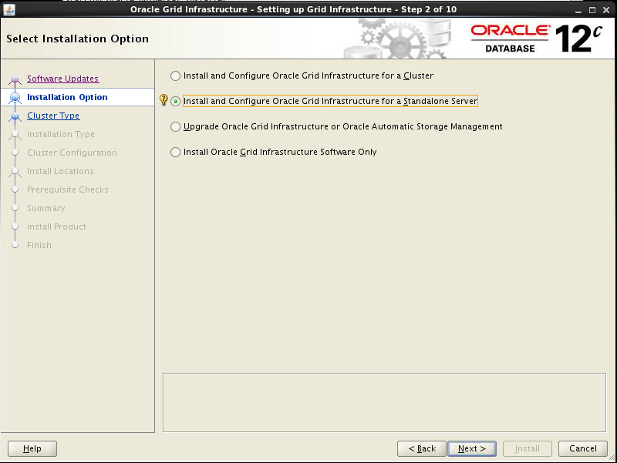
Installing the Oracle Grid Infrastructure for Standalone Server
Notes:
To install the Oracle Grid Infrastructure software by using the Oracle Universal Installer (OUI), log on to your computer as a member of the administrative group that is authorized to install the Oracle software and to create and manage the database. Enter ./runInstaller from the relevant directory on the Oracle Database 12c installation media or download directory to start the OUI.
On the Download Software Updates page you can supply My Oracle Support credentials so that the OUI can download updates for the installation. You can also specify that the OUI use software updates that you have previously downloaded or skip the updates completely.
The next page that is displayed is the Select Installation Option page, as shown in the screenshot. Select the option appropriate to your situation and click Next to proceed with your installation.
Oracle Database 12c: Admin, Install and Upgrade Accelerated D - <number>

Slide 13
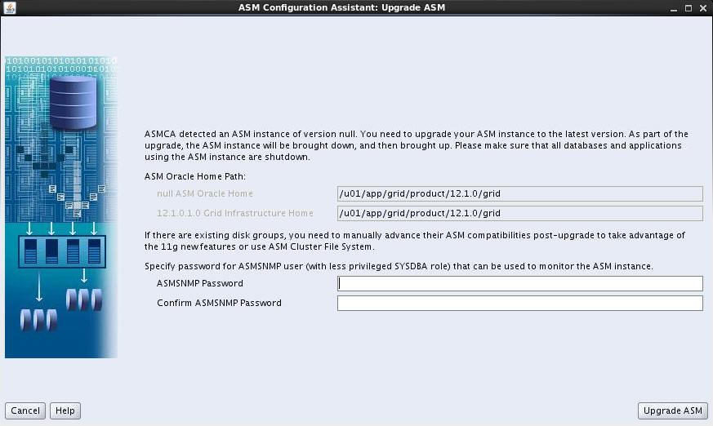
Upgrading Existing Oracle ASM Instances
Use ASMCA to upgrade an existing ASM installation
Notes:
If you have an Oracle ASM installation from an earlier release installed on your server, or in an existing Oracle Restart installation, you can use Oracle Automatic Storage Management Configuration Assistant (Oracle ASMCA) to upgrade the existing Oracle ASM instance to 12c, and subsequently configure disk groups, Oracle ASM volumes and Oracle ASM file systems.
After the installation of the Oracle Grid Infrastructure Software only, Oracle ASMCA detects that there is a prior Oracle ASM version installed in another Oracle ASM home. After installing the Oracle ASM 12c binaries, you can start Oracle ASMCA to upgrade the existing Oracle ASM instance.
Note: An Oracle ASM instance should be upgraded by using OUI. OUI automatically defaults to upgrade mode when it detects an Oracle ASM instance at a previous release level.
Oracle Database 12c: Admin, Install and Upgrade Accelerated D - <number>

Slide 14
Summary
In this lesson, you should have learned how to:
  Install Oracle Grid Infrastructure for a Standalone Server
  Upgrade an existing Oracle Grid Infrastructure installation
  Use ASMCA to upgrade an existing Oracle Automatic Storage Management (ASM) instance
Notes:
Oracle Database 12c: Admin, Install and Upgrade Accelerated D - <number>

