Slide 1
Working with Oracle Support

Slide 2
Objectives
After completing this lesson, you should be able to:
  Work with My Oracle Support
  Search My Oracle Support
  Log service requests (SRs)
  Manage patches
    Apply a patch
    Stage a patch
  Use the Enterprise Manager Cloud Control Support Workbench
Notes:
Oracle Database 12c: Admin, Install and Upgrade Accelerated F - <number>

Slide 3
Working with Oracle Support
  Oracle Support Services (OSS) provides 24×7 solution support.
  Support is delivered in the following ways:
    My Oracle Support website
    Telephone
    Oracle Direct Connect (ODC) remote diagnostic tool
  The Customer Support Identifier (CSI) number is used to track the software and support that are licensed to each customer.
Notes:
Oracle Support Services (OSS) provides 24×7 solution support to all Oracle customers throughout the world. OSS has support centers around the globe to provide this coverage whenever it is required, 365 days a year.
Support is delivered to Oracle customers through the My Oracle Support Web site, on the telephone, and by using the Oracle Direct Connect (ODC) remote diagnostic tool.
After purchasing Oracle software, customers are provided with a Customer Support Identifier (CSI) number. This number is used to track the software and support licensed to each customer. The CSI number provides access to all the available patches, documentation, and troubleshooting information on My Oracle Support. The CSI number enables customers to log a service request (SR) with OSS.
Note: Service requests were formerly called technical assistance requests (TARs).
Oracle Database 12c: Admin, Install and Upgrade Accelerated F - <number>

Slide 4
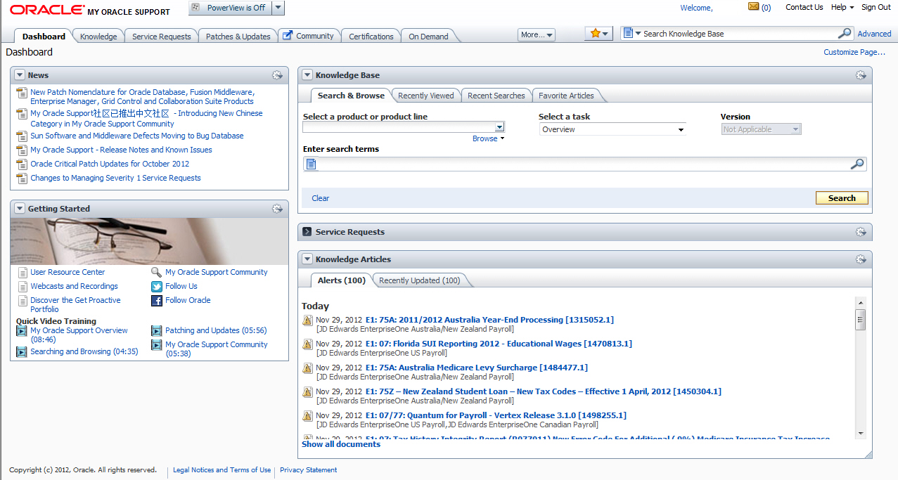
Using My Oracle Support
Notes:
To register for My Oracle Support, go to http://myoraclesupport.oracle.com/ and click the “New User? Register here” link. At the prompt, enter your CSI number and answer a few basic questions. After registering, you are ready to use My Oracle Support. Note that each CSI number has an administrator designated by the customer who controls new-user access to My Oracle Support. Customers must designate this individual, and then new users must work with this individual to create new accounts and grant appropriate My Oracle Support access.
My Oracle Support has a variety of tools and methods available for researching problems.
Searching for answers on My Oracle Support through the standard and advanced search engines is relatively straightforward. A common problem is that too many results are returned. The following are some simple steps that can improve the quality and relevance of search results:
Use full and exact error text when performing your search. For example, ORA-1400: mandatory (NOT NULL) column returns more relevant answers than ORA-1400.
When researching errors in Oracle E-Business Suite, enter the name of the code as part of the search criteria. For example, APXINWKB ORA-1400: mandatory (NOT NULL) column returns fewer and better results than if you supply only the error message.
Oracle Database 12c: Admin, Install and Upgrade Accelerated F - <number>

Slide 5
Notes:
You can use the Knowledge tab to access the Knowledge Browser if you prefer a drilldown method of searching for information rather than searching by keyword. The Knowledge Browser provides easy-to-use access to OSS’s most frequently used technical content.
The Knowledge Browser is organized to provide up-to-date information at your fingertips:
Recent announcements and information in the Featured News and Articles section
Information by product category
Case studies
Tools and training
Online documentation
Electronic technical reference manuals (eTRMs)
Oracle Integration Repository
Customer Knowledge Exchange
My Oracle Support Forums (Forums) enables you to interact with other Oracle customers to share ideas and discuss Oracle products. You can use My Oracle Support Forums to find out how other customers perform complex tasks or meet various business requirements with Oracle products. You should not use Forums as a substitute for logging an SR.
Customers can use the patch engine to search for patches by using a variety of methods. The following are the most common patch searches:
Patch Number: If you know the patch number, you can enter it.
Latest Consolidated Patch: You can use this when upgrading to determine the latest patches for the products you are using.
Includes File: When a problem is encountered in a specific piece of code, a patch is often available to fix the issue. For this reason, support representatives often recommend that customers apply a patch to update code to the most current version available for the release. You can find and apply the latest versions of Oracle software by identifying the name and version of the code and then using the patch search utility to find out whether a more current version of the code is available.
Note: For detailed information about performing these searches, refer to My Oracle Support Technical Note 166650.1 (“Working Effectively with Global Customer Support”).
You can use the BUGs link to search the BUG database when researching issues. A variety of methods are available for searching the BUG database.
Oracle Database 12c: Admin, Install and Upgrade Accelerated F - <number>

Slide 6
Researching an Issue
To research an issue on My Oracle Support, perform the following steps:
  Perform a keyword search.
  Review the documentation.
  Use the self-service toolkits.
  Use the automated diagnostic tests and business flows.
  Search for applicable patches.
  Log a service request (SR).
Notes:
My Oracle Support provides several resources that can be used to research an issue. The following steps outline basic troubleshooting techniques that use My Oracle Support resources:
1. Keyword search: Most issues can be resolved quickly and easily by using the keyword search utility on My Oracle Support. Effective searches can provide much information about a specific problem and its solutions.
2. Documentation: If keyword searching fails to yield a solution, you should review the documentation to ensure that setup problems are not the root cause. Setup issues account for more than one-third of all service requests; it is always good to review setups early in the troubleshooting process. Documentation consists of user guides and implementation manuals published in PDF format as well as product README files and installation notes published in HTML. Both of these document types are available on My Oracle Support and can be accessed through the self-service toolkits for each product.
Oracle Database 12c: Admin, Install and Upgrade Accelerated F - <number>

Slide 7
Notes:
3. Self-service toolkits: Self-service toolkits (SSTKs) provide a wealth of information about each product. In most cases, they contain FAQs, patch listings, and other helpful information that can assist you in researching and troubleshooting the issues that you are facing. Because SSTKs contain the most frequently used content about each product, you should reference them periodically to identify known issues before they cause problems within your environment.
4. Diagnostics and flows: Many recent innovations in Oracle Support Services have been in the area of automated diagnostic tests and business flows. Tests and flows have been created for you to check the setup of your system or gather information about a problem. In the case of diagnostic tests, this can be done by running a Java or SQL script. The output of these tests can help you in resolving issues and can also help Oracle Support Services identify the cause of your problem if it becomes necessary to log a service request.
5. Patches and BUGs: There are times when BUGs are found in Oracle products, and patches are required to correct the problem. When troubleshooting a problem, you should review your system to see whether patches are available to provide you with a more recent release of the product. With the patch search tool, you can search for patches that contain specific files. Searching for the latest code and patching your environment to the most recent version improves the troubleshooting process by eliminating existing BUGs that could be possible candidates for the problem. You should also leverage the BUG search engine to see whether a BUG has been logged for your issue but not yet fixed.
6. Logging a service request (SR): When all self-service options fail, it may become necessary to engage a support representative to assist in resolving your issue.
Oracle Database 12c: Admin, Install and Upgrade Accelerated F - <number>

Slide 8
Logging Service Requests
  Log an SR by clicking the Service Request tab on the My Oracle Support home page.
  My Oracle Support performs searches based on the CSI number and SR profile.
  Provide the following information when logging an SR:
    Explanation of the issue, including error messages
    Steps taken to troubleshoot the issue
    Software version
    Steps required to reproduce the problem
    Business impact of the issue
Notes:
You may research an issue on My Oracle Support, but may be unable to locate a solution. In this case, you should log a service request (SR) through My Oracle Support. You can log an SR by clicking the Service Request tab on the My Oracle Support home page.
The first step in creating an SR is the selection of a CSI number and SR profile. After the required profile information has been submitted, My Oracle Support gathers some specifics about the problem, including the problem type, error message, brief summary of the issue, and language preference. My Oracle Support performs a search by using this information and attempts to find a solution.
The search conducted during this phase may provide different results than the searches you have performed earlier. Both searches retrieve notes and BUGs from the same database; however, the search engines and weighting are slightly different. Because the search results can differ, it is important that the search results are reviewed during the SR creation process, even if previous searches have been conducted by using the My Oracle Support search engine.
Oracle Database 12c: Admin, Install and Upgrade Accelerated F - <number>

Slide 9
Notes:
If the search results fail to resolve the issue, the SR creation process continues with a series of questions and requests for information. After the questions are answered, the SR is submitted electronically and routed to a support representative who analyzes the issue further. Any files, screenshots, or other additional information must be uploaded immediately after the SR is logged by using the upload utility provided in the SR section of My Oracle Support.
You must ensure that the following items are clearly documented in the SR. By providing the following information, you can equip the support representative effectively to prioritize and work on the issue:
Clear explanation of the problem, including exact error messages
Explanation of the steps taken to troubleshoot the problem and the findings
Exact versions of the software
Steps required to reproduce the problem
Business impact of this issue, including milestones, dates, and costs
Each SR is assigned a unique identifier called an SR number. When you log an SR, My Oracle Support provides you with the SR number (or your support representative advises you about the SR number if you log the SR by telephone). The support representative subsequently receives the SR in his or her queue through an automated allocation process that Oracle Support Services uses to distribute all phone- and web-sourced service requests. This automated process ensures that all SRs are assigned to the support representative who is best able to work on the specific issue that is being reported.
Note: For more information, refer to My Oracle Support Technical Note 166650.1 (“Working Effectively with Global Customer Support”).
Oracle Database 12c: Admin, Install and Upgrade Accelerated F - <number>

Slide 10
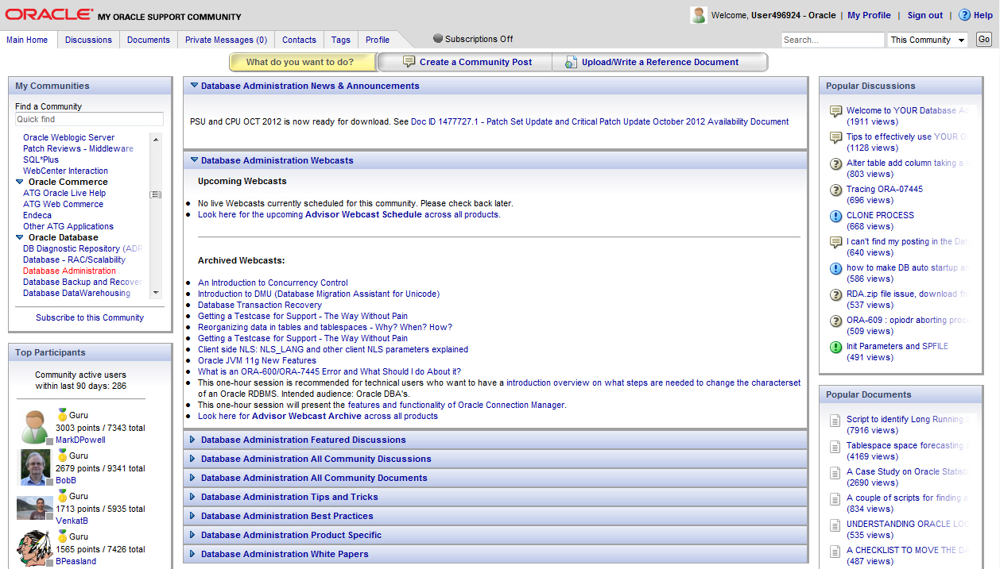
Accessing My Oracle Support Community
Notes:
My Oracle Support Community is a multi-channel interactive community for sharing information, posting questions and answers, and providing suggestions about Oracle products, services, and related technologies.
If you have access to My Oracle Support you are automatically a member. There is no additional registration required.
Oracle Database 12c: Admin, Install and Upgrade Accelerated F - <number>

Slide 11


Managing Patches
Kinds of patches
  Interim patches
    For specific issues
    No regression testing
  Security Patch Updates (SPUs)
    Critical security issues
    Regression testing
    Does not advance version number
  Patch Set Updates (PSUs)
  Patch releases
Notes:
You can apply different kinds of patches at different times for different reasons.
Interim patches (also known as one-off or one-of patches) are created to solve a specific problem. They do not go through a full regression test. Interim patches are typically installed with the opatch utility. The Enterprise Manager Patching Wizard can help automate the patching process by downloading, applying, and staging the patches. This wizard uses the opatch utility in the background.
Security Patch Updates (SPU) patches—formally, Critical Patch Update (CPU) patches—are cumulative, which means fixes from previous Oracle security alerts and critical patch updates are included.
Patch Set Update (PSU) patches include Security Patch Updates (SPU) and dependent non-security patches. PSU patches are cumulative. It is not required to have previous security patches applied before applying PSU patches. However, you must be on the stated patch set level. PSU patches are for a specific patch release level (such as 10.2.0.3). PSU patches are installed with the opatch utility or through EM Patching Wizard. PSU patches are issued quarterly. PSU patches and interim patches can also be removed from your system with opatch rollback -id <patch id>.
Oracle does extensive testing of Patch Set Updates with its own applications, as well as running regression tests for the PSUs themselves. To verify that a patch has been applied, query the inventory with opatch -lsinventory and see if the patch is listed.
Oracle Database 12c: Admin, Install and Upgrade Accelerated F - <number>

Slide 12
Applying a Patch Release
  Patch releases are fully tested product fixes that:
    Affect only the software residing in your Oracle home on installation
    Contain individual bug fixes
    Carry version numbers
  To apply a patch:
    Determine your Oracle software environment.
    Set your My Oracle Support login credentials.
    Stage the patch release.
Notes:
Software management involves keeping your Oracle software up-to-date with the latest product fixes. Periodically, Oracle issues patch releases (product fixes) for its software. Patch releases are fully tested product fixes. Application of a patch release affects only the software residing in your Oracle home, with no upgrade or change to the database.
Patches are individual bug fixes. Patch sets are a collection of bug fixes up to the time of the patch set release. All patch and patch set releases carry version numbers. For example, 11.1.0.3 is an available patch set for Oracle Database 11g Release 11.1.0.2. Every patch or patch set also has a patch number to identify it. Every patch release has an associated README file that describes its bug fixes. The README also has instructions for manually applying the patch.
Enterprise Manager enables you to find the latest patch release on the My Oracle Support website and download it to your Oracle home.
Oracle Database 12c: Admin, Install and Upgrade Accelerated F - <number>

Slide 13
Enterprise Manager Cloud Control:
My Oracle Support Integration
  Enterprise Manager Cloud Control automatically alerts users to new critical patches.
  The Enterprise Manager Cloud Control patch wizard can be used to select an interim patch.
  You can review the patch’s README file from within Enterprise Manager Cloud Control.
  You can download the selected patches from My Oracle Support into the Enterprise Manager Cloud Control patch cache.
Notes:
Oracle Enterprise Manager Cloud Control significantly facilitates software patching with its built-in My Oracle Support integration. Enterprise Manager Cloud Control automatically alerts users to new critical patches and flags all systems that require a specific patch. You can invoke the Enterprise Manager Cloud Control patch wizard to determine what interim patches are available for installation. Alternatively, you can use the patch wizard to select an interim patch and determine whether any of your systems require that patch. You can review the patch details and README patch notes directly from within Enterprise Manager Cloud Control.
You can use the patch wizard to download interim patches from My Oracle Support into the Enterprise Manager Cloud Control patch cache, eliminating the need for repeated downloads. You can stage appropriate patches on the destination system or systems for manual application at a later time. To further automate the patching process, you can also provide a customizable patch application script that is executed on the destination system at a user-defined time by the resident Enterprise Manager Cloud Control agents. As patches are applied to a system, the corresponding Oracle Universal Installer (OUI) inventory is automatically updated to keep track of the systems’ correct patch level.
Oracle Database 12c: Admin, Install and Upgrade Accelerated F - <number>

Slide 14
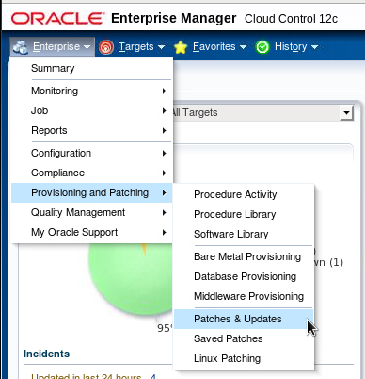
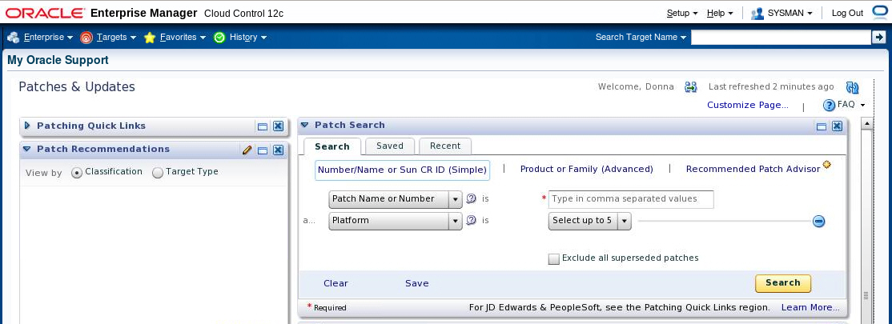
Using the Patch Advisor
Notes:
In Enterprise Manager Cloud Control, you can access the Patches & Updates page by expanding Enterprise and selecting Patches & Updates in the Provisioning and Patching menu. Note that this menu is at the Enterprise, not database target level.
In the Patch Search section, you can search for patches by patch number and name, you can search for all patches for a specific product, and you can invoke the Patch Advisor. The Patch Advisor enables you to search for recommended patches for specified products and combinations of products.
Refer to the Enterprise Manager Cloud Control documentation and online help for additional information. You may also want to attend the Using Oracle Enterprise Manager Cloud Control 12c course for detailed information about using Enterprise Manager Cloud Control.
Oracle Database 12c: Admin, Install and Upgrade Accelerated F - <number>

Slide 15

Online Patching: Overview
For a bug fix or diagnostic patch on a running Oracle instance, online patching provides the ability to do the following:
  Install
  Enable
  Disable
Notes:
Online patching provides the ability to install, enable, and disable a bug fix or diagnostic patch on a live, running Oracle instance. Using online patching is the recommended solution for avoiding down time when applying online patches. Oracle provides the capability to perform online patching with any Oracle database using the opatch command-line utility. Online patches can be provided when the changed code is small in scope and complexity (for example, with diagnostic patches or small bug fixes).
Oracle Database 12c: Admin, Install and Upgrade Accelerated F - <number>

Slide 16
Installing an Online Patch
  Applying an online patch does not require instance shutdown, relinking of the Oracle binary, or instance restart.
  OPatch can be used to install or uninstall an online patch.
  OPatch detects conflicts between two online patches, as well as between an online patch and a conventional patch.
  To determine if a patch is an online patch:
opatch query -is_online_patch <patch location>
OR
opatch query <patch location> -all
Notes:
Unlike traditional patching mechanisms, applying an online patch does not require instance shutdown or restart.
Similar to traditional patching, you can use OPatch to install an online patch.
You can determine whether a patch is an online patch by using the following commands:
opatch query -is_online_patch <patch location> or
opatch query <patch location> -all
Note: The patched code is shipped as a dynamic/shared library, which is then mapped to memory by each Oracle process.
Oracle Database 12c: Admin, Install and Upgrade Accelerated F - <number>

Slide 17
Benefits of Online Patching
  No down time and no interruption of business
  Extremely fast installation and uninstallation times
  Integration with OPatch:
    Conflict detection
    Listed in patch inventory
    Works in RAC environment
  Persistence across instance shutdown and startup
Notes:
You do not have to shut down your database instance while you apply the online patch. Unlike conventional patching, online patching enables fast installation and uninstallation. Because online patching uses OPatch, you get all the benefits that you already have with conventional patching that uses OPatch. It does not matter how long or how many times you shut down your database—an online patch always persists across instance shutdown and startup.
Oracle Database 12c: Admin, Install and Upgrade Accelerated F - <number>

Slide 18
Conventional Patching and Online Patching
Conventional Patches
Online Patches
Require down time to apply
or remove
Do not require down time to apply or remove
Are installed and uninstalled
via OPatch
Are installed and uninstalled
via OPatch
Persist across instance startup and shutdown
Persist across instance startup
and shutdown
Take several minutes to install or uninstall
Take only a few seconds to install or uninstall
Notes:
Conventional patching basically requires a shutdown of your database instance.
Online patching does not require any down time. Applications can keep running while you install an online patch. Similarly, online patches that have been installed can be uninstalled with no down time.
Oracle Database 12c: Admin, Install and Upgrade Accelerated F - <number>

Slide 19
Online Patching Considerations
  Some extra memory is consumed.
    Exact amount depends on the size of the patch and number of concurrently running Oracle processes
    Minimum amount of memory: Approximately one OS page per running Oracle process
  There may be a small delay (a few seconds) before every Oracle process installs or uninstalls an online patch.
  Not all bug fixes and diagnostic patches are available as an online patch.
  Use online patches in situations when down time is not feasible.
  When down time is possible, you should install all relevant bug fixes as conventional patches.
Notes:
One operating system (OS) page is typically 4 KB on Linux x86 and 8 KB on Solaris SPARC64. With an average of approximately one thousand Oracle processes running at the same time, this represents around 4 MB of extra memory for a small online patch.
A vast majority of diagnostic patches are available as online patches. For bug fixes, it really depends on their nature. Not every bug fix or diagnostic patch is available as an online patch. But the long-term goal of the online-patching facility is to provide online-patching capabilities for Critical Patch Updates.
Note: You must uninstall the online patch before applying the conventional patch.
Oracle Database 12c: Admin, Install and Upgrade Accelerated F - <number>

Slide 20
Quiz
Which of the following statements are true about online patches?
  Can be installed using OPatch
  Require down time to apply
  Persist across instance startup and shutdown
  Do not require down time to remove
Notes:
Answer: a, c, d
Oracle Database 12c: Admin, Install and Upgrade Accelerated F - <number>

Slide 21







Using the Support Workbench
1
View critical
error alerts in
Enterprise Manager.
7
Close incidents.
2
View problem
details.
6
Track the service
request and
implement repairs.
3
Gather additional
diagnostic
information.
4
Package and upload
diagnostic data
to Oracle Support.
Create a
service request.
5
Notes:
Using the Enterprise Manager Cloud Control Support Workbench, you can investigate, report, and (in some cases) resolve a problem by performing the following general steps:
1. On the Database Home page in Enterprise Manager, review critical error alerts. View the details by selecting an alert.
2. Examine the problem details and view a list of all incidents that were recorded for the problem. Display findings from any health checks that were automatically run.
3. (Optional) Run additional health checks and invoke the SQL Test Case Builder, which gathers all required data related to a SQL problem and packages the information in a way that enables the problem to be reproduced at Oracle Support.
4. Create a service request with My Oracle Support and (optionally) record the service request number with the problem information.
5. Invoke the Incident Packaging Service, which packages all gathered diagnostic data for a problem and (optionally) uploads the data to Oracle Support. You can edit the data to remove sensitive information before uploading.
6. You can maintain an activity log for the service request in the Support Workbench. Run Oracle advisors to help repair SQL failures or corrupted data.
7. Set the status for one, some, or all incidents for the problem to be closed.
Oracle Database 12c: Admin, Install and Upgrade Accelerated F - <number>

Slide 22
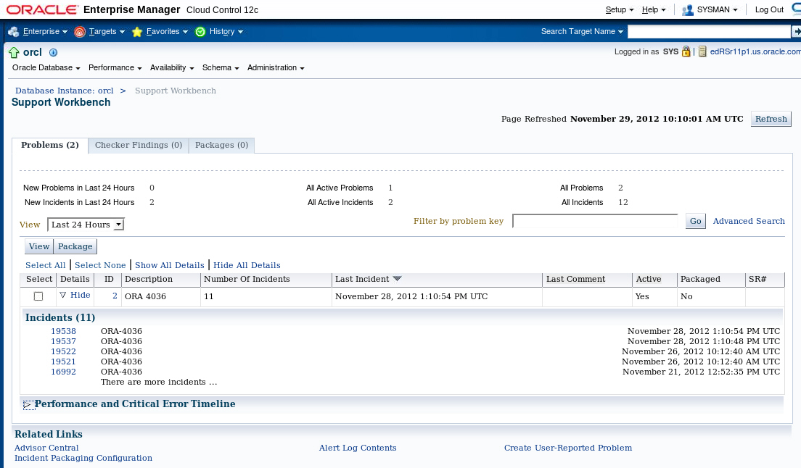
Accessing the Support Workbench
Click to access the Problem Details page.
Notes:
You can access the Support Workbench page directly by expanding the Oracle Database menu, and then selecting Support Workbench in the Diagnostics submenu.
Note: The tasks described in this section are all performed in Enterprise Manager Cloud Control. You can also accomplish all of these tasks with the ADRCI command-line utility. See the Oracle Database Utilities guide for more information about the ADRCI utility.
Oracle Database 12c: Admin, Install and Upgrade Accelerated F - <number>

Slide 23
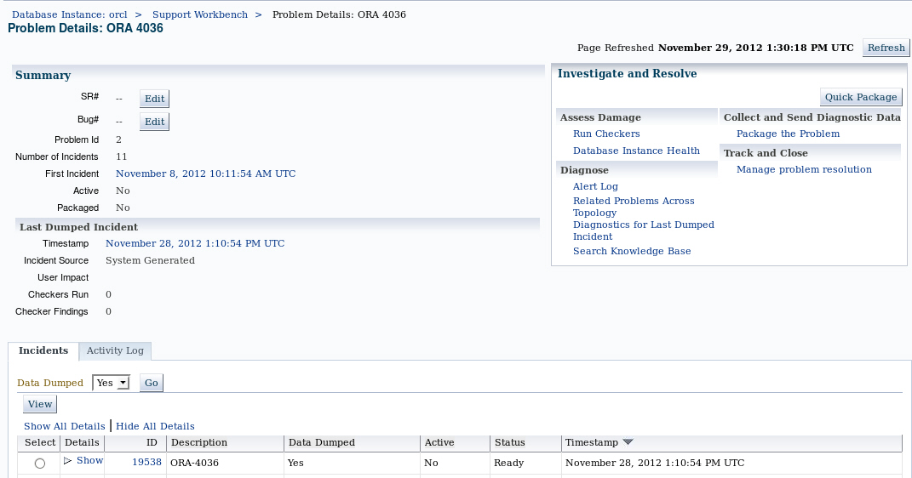
Viewing Problem Details
Click to access the Incident Details page.
Notes:
On the Problems subpage on the Support Workbench page, click the ID of the problem that you want to investigate. This takes you to the corresponding Problem Details page.
On this page, you can see all incidents that are related to your problem. You can associate your problem with a My Oracle Support service request and bug number. In the “Investigate and Resolve” section of the page, you see a Self Service subpage that has direct links to the operations that you can perform for this problem. In the same section, the Oracle Support subpage has direct links to My Oracle Support.
The Activity Log subpage shows you the system-generated operations that have occurred on your problem so far. This subpage enables you to add your own comments while investigating the problem.
On the Incidents subpage, you can click a related incident ID to access the corresponding Incident Details page.
Oracle Database 12c: Admin, Install and Upgrade Accelerated F - <number>

Slide 24
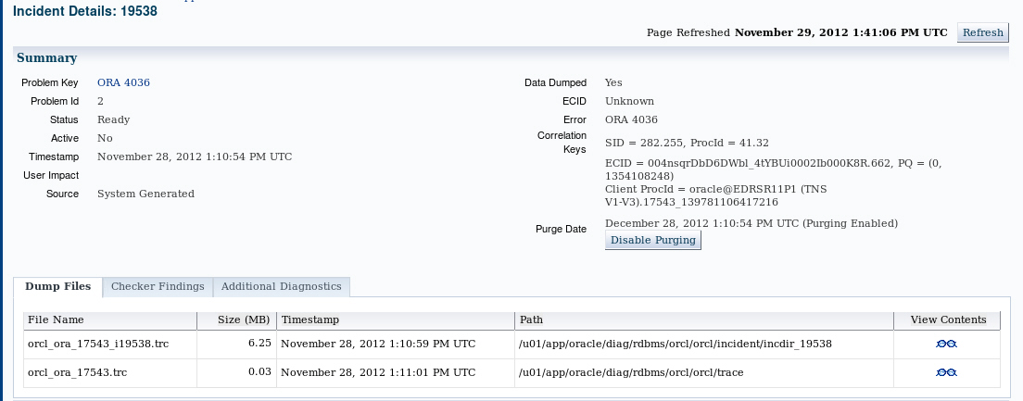
Viewing Incident Details
Notes:
When you access the Incident Details page, the Dump Files subpage lists all corresponding dump files. You can then click the eyeglass icon for a particular dump file to visualize the file content with its various sections.
On the Incident Details page, click Checker Findings to view the Checker Findings subpage. This page displays findings from any health checks that were automatically run when the critical error was detected. You will usually have the opportunity to select one or more findings and invoke an advisor to fix the issue.
Oracle Database 12c: Admin, Install and Upgrade Accelerated F - <number>

Slide 25
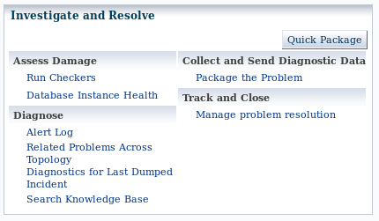
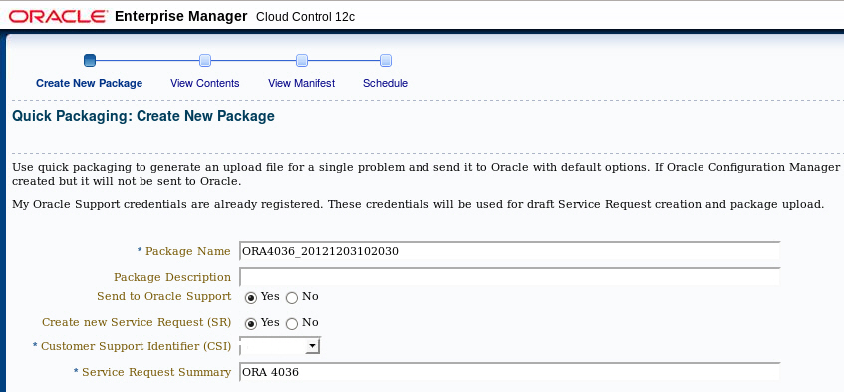
Packaging and Uploading Diagnostic Data to Oracle Support
Notes:
The Support Workbench provides two methods for creating and uploading an incident package: the Quick Packaging method and the Advanced Packaging method. The example in the slide shows how to use Quick Packaging.
Quick Packaging is a more automated method with minimum steps. You select a single problem, provide an incident package name and description, and then schedule the incident package upload, either immediately or at a specified date and time. The Support Workbench automatically places diagnostic data related to the problem into the incident package, finalizes the incident package, creates the ZIP file, and then uploads the file. With this method, you do not have the opportunity to add, edit, or remove incident package files or add other diagnostic data such as SQL test cases.
If you have not registered with My Oracle Support, a link will appear so that you can register. You must register with My Oracle Support to send the package to Oracle Support.
Oracle Database 12c: Admin, Install and Upgrade Accelerated F - <number>

Slide 26
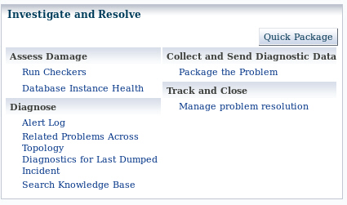
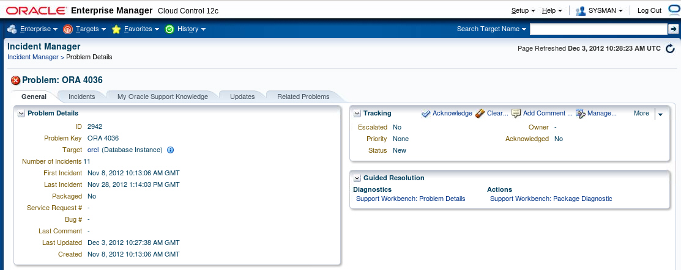
Tracking the Service Request and Implementing Repairs
Notes:
After uploading diagnostic information to Oracle Support, you can perform various activities to track the service request and implement repairs. Among these activities are the following:
Add an Oracle bug number to the problem information. On the Problem Details page, click the Edit button that is adjacent to the Bug# label. This is for your reference only.
Add comments to the problem activity log:
1. Access the Problem Details page for the problem.
2. Click Activity Log to display the Activity Log subpage.
3. In the Comment field, enter a comment and then click Add Comment.
Your comment is recorded in the activity log.
Respond to a request by Oracle Support to provide additional diagnostics. Your Oracle Support representative can provide instructions for gathering and uploading additional diagnostics.
Oracle Database 12c: Admin, Install and Upgrade Accelerated F - <number>

Slide 27
Summary
In this lesson, you should have learned how to:
  Use the Support Workbench
  Work with Oracle Support
  Search My Oracle Support
  Log service requests
  Manage patches
    Apply a patch release
    Stage a patch release
Notes:
Oracle Database 12c: Admin, Install and Upgrade Accelerated F - <number>

