Slide 1
Your Learning

Slide 2
Overview
This appendix provides:
  Cheat sheets:
    DOS/ Unix Commands
    vi Editor
  Further training options
  Personalized, additional resources
Notes:
This appendix provides a few “cheat sheets” that might be helpful during the course.
It also adds details about further training options.
Your instructor might suggest additional resources for your learning.
See also appendix B for more information on Using Enterprise Manager Cloud Control.
Oracle Database 12c: Backup and Recovery Workshop A - <number>

Slide 3
Some DOS/Unix Commands
Notes:
DOS/Unix Commands, a brief starter:
DOS UNIX English
dir ll list long (name, date, size, owner, etc)
dir/w ls list wide (no details)
dir/s locate find a file anywhere
del rm delete or remove files
copy cp copy file1 to file2
move mv move file1 to file2
ren mv rename file1 to file2
cd pwd print working directory
cd .. cd .. change directory UP one level
cd \ cd / change directory to TOP level (root)
C-A-D ps -ef process statistics (often used with grep)
top dynamic list of top processes by percent
md mkdir make directory
rd rmdir remove directory
edit vi full-screen character-based editor (see below)
more more list a file and pause (space/enter to continue)
tail -20 file1 list the last 20 lines of a file
type cat list a file and don't pause
strings same as cat but for files with binary chars
set set display all environment variables such as $HOME
help man manual (help) pages
find grep find a word in a line in a larger list of lines
prompt PS1='$PWD >' change the prompt to include current dir
logoff su - switch user (usually to Super User)
chkdsk df -h how much free space is left on disk (in GB)
(n/a) which file1 finds executables along paths
ver uname –a version of operating system software
Remember: Everything in UNIX is case-sensitive.
To change to a "ReallyLongDirectoryName“, type "cd Rea*".
Oracle Database 12c: Backup and Recovery Workshop A - <number>

Slide 4

Editor Commands
Notes:
Gedit
gedit is a visual wysiwyg editor. The first time gedit runs, it needs the &:
gedit filename &
then you can use:
gedit filename
Vi Commands
Command Description
:wq write, quit
:q! quit, no save
[esc] get out of current mode back to command mode
a append mode
A Append mode at end of current line
dd delete current line
i insert mode (can also insert line feeds)
o insert blank line below cursor
p paste buffer after cursor
r replace single character
:s/a/b/ substitute (change) "a" to "b"
. repeat last substitution
u undo last change
Y yank (copy) current line
x delete single character
dd delete whole line
Oracle Database 12c: Backup and Recovery Workshop A - <number>

Slide 5

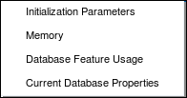
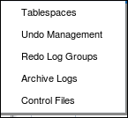


Enterprise Manager Database Express Menus
http://<hostname>:<port>em
Notes:
Enter your URL, then a valid Oracle username and password.
To display the hostname in Linux: hostname --long
The port is by default 5500.
In Oracle classrooms, you may use SYS as User Name, oracle_4U as Password, acting as sysdba.
The slide shows Enterprise Manager Database Express (EM Express) menus for:
Configuration
Storage
Security
Performance
Oracle Database 12c: Backup and Recovery Workshop A - <number>

Slide 6









Request Handling in EM Express
EM Express Servlet
Authenticates and validates the request
Serves the request by executing queries inside the database
Writes the output to the response stream
Oracle Web Server
EM Express
Servlet
Web Browser
Shared Servers
Request
Listener
Dispatcher
Notes:
This slide provides an overview of how EM Express handles requests.
Oracle Database 12c: Backup and Recovery Workshop A - <number>

Slide 7
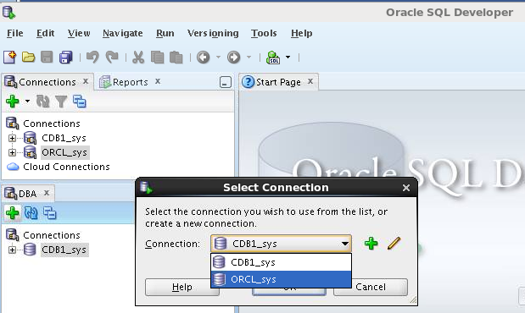
Oracle SQL Developer: Connections
Perform DBA operations in the DBA navigator using DBA connections:
Notes:
Oracle SQL Developer is a tool that allows stand-alone graphical browsing and development of database schema objects, as well as execution of database administrative tasks.
SQL Developer enables users with database administrator privileges to view and edit certain information relevant to DBAs and perform DBA operations. To perform DBA operations, use the DBA navigator, which is similar to the Connections navigator in that it has nodes for all defined database connections. If the DBA navigator is not visible, select View, then DBA. You should add only connections for which the associated database user has DBA privileges or at least privileges for the desired DBA navigator operations on the specified database.
Oracle Database 12c: Backup and Recovery Workshop A - <number>

Slide 8
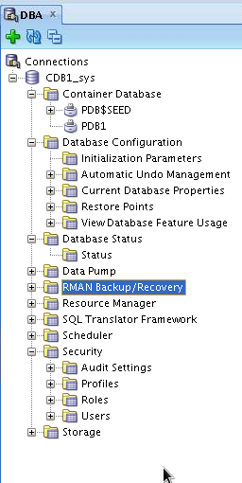
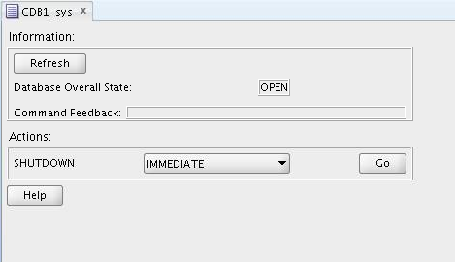

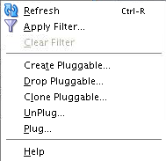
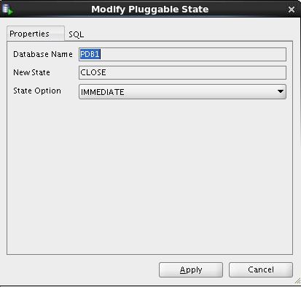
Oracle SQL Developer: DBA Actions
Performing DBA tasks through DBA navigator:
Notes:
The DBA operations that can be performed are the following:
Pluggable database startup/shutdown
Database configuration: Initialization Parameters, Automatic Undo Management, Current Database Properties, Restore Points, View Database Feature Usage
Database status view
Data Pump Export and Import jobs
RMAN Backup/Recovery actions
Resource Manager configuration
Scheduler setting
Security configuration like audit settings, profiles, roles, users
Storage configuration for archive logs, control files, data files, redo log groups, tablespaces, temporary tablespace groups
Oracle Database 12c: Backup and Recovery Workshop A - <number>

Slide 9
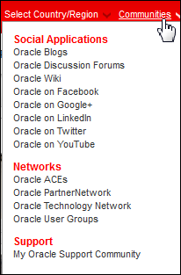
Continuing Your Learning
  Documentation
  Oracle Technology Network (OTN)
    Oracle Database > High Availability
    Oracle communities on Social Applications
  Oracle University training courses
  Oracle University self studies
  Oracle Learning Library (OLL)
  My Oracle Support (MOS)
  YouTube videos on the Oracle Leaning channel
Notes:
Documentation:
Oracle Database Backup and Recovery User's Guide
Oracle Database Backup and Recovery Reference
Oracle Technology Network (OTN): http://www.oracle.com/technetwork/index.html
Oracle University training courses:
Oracle Database 12c: Managing Multitenant Architecture
Oracle Database 12c: RAC Administration
Oracle Database 12c: Data Guard Administration
Oracle Database 12c: Security
Oracle Enterprise Manager Cloud Control 12c: Advanced Configuration Workshop
Oracle Database 12c: Performance Tuning
Oracle University self studies: Oracle Database 12c New Features series
Oracle Learning Library (OLL): https://www.oracle.com/goto/oll
Search with “backup” or any other topic that interests you, such as MAA (Maximum Availability Architecture)
Oracle Database 12c: Backup and Recovery Workshop A - <number>

Slide 10
Further Information
For more information about topics that are not covered in this course, refer to the following:
  Other Oracle University Oracle Database 12c ILT courses
  Oracle Database 12c: New Features Self Studies
    A comprehensive series of self-paced online courses covering all new features in detail
    Demonstrations for all topics covered in self-paced online courses:
    http://www.oracle.com/goto/oll
  Oracle By Example series: Oracle Database 12c
    http://www.oracle.com/technology/obe/demos/admin/demos.html
    http://www.oracle.com/technology/obe/start/index.html
  Oracle OpenWorld events
    http://www.oracle.com/openworld/index.html
Notes:
For more information about topics that are not covered in this course, refer to the following:
Oracle University Oracle Database 12c instructor-led courses
Oracle Database 12c: New Features self-paced online courses
Oracle By Example series: Oracle Database 12c
Oracle OpenWorld events
Oracle Database 12c: Backup and Recovery Workshop A - <number>

Slide 11
Suggested Oracle University ILT Courses
  Enterprise Manager Cloud Control
    Using Oracle Enterprise Manager Cloud Control 12c
    Oracle Enterprise Manager Cloud Control 12c: Install and Upgrade
    Oracle Enterprise Manager Cloud Control 12c: Advanced Configuration
    Oracle Enterprise Manager Cloud Control 12c: Cloud Management workshop
  Installation and Upgrade
    Oracle Database 12c: Install and Upgrade workshop
Notes:
Suggested Additional Courses
To obtain more information about the key cloud computing technologies used by the Oracle products and other new Oracle Database features, follow additional training from Oracle University.
Oracle Database 12c: Backup and Recovery Workshop A - <number>

Slide 12
Suggested Oracle University ILT Courses
  Real Application Cluster
    Oracle Database 12c: High Availability New Features Ed 1.
    Oracle Database 12c: Manage Clusterware Workshop
    Oracle Database 12c: Manage ASM Workshop
    Oracle Database 12c: RAC Administration Workshop
  Security
    Oracle Database 12c: Security
  Performance
    Oracle Database 12c: Performance Tuning Workshop
  Exadata
    Exadata Database Machine Administration Workshop Ed1
Notes:
Suggested Additional Courses
To obtain more information about the key cloud computing technologies used by the Oracle products and other new Oracle Database features, follow additional training from Oracle University.
Oracle Database 12c: Backup and Recovery Workshop A - <number>

