Slide 1
Using Enterprise Manager Cloud Control

Slide 2
Objectives
After completing this lesson, you should be able to:
  Describe the different components of Cloud Control
  Explain the architecture of Cloud Control
  List the target types managed by Cloud Control
  Explore the Oracle Enterprise Manager Cloud Control interface
Notes:
Note
For a complete understanding of Oracle Enterprise Manager Cloud Control and Database Express installation and usage, refer to the following guides in the Oracle documentation:
Oracle Enterprise Manager Cloud Control Basic Installation Guide 12c Release 1
Oracle Enterprise Manager Cloud Control Advanced Installation and Configuration Guide 12c Release 1
Oracle Enterprise Manager Cloud Control Administrator's Guide 12c Release 1
Oracle Enterprise Manager Licensing Information 12c Release 1
Oracle Database 12c: Backup and Recovery Workshop B - <number>

Slide 3
Key Challenges for Administrators
As the composition of the data center broadens into the cloud environment, the challenges to manage it also increase. The key challenges for managing a data center include:
  Monitoring performance and availability
  Resolving problems quickly
  Containing operating costs
  Aligning IT with business priorities
Notes:
As the data center grows with the growth in business, so do the challenges. An administrator is faced with challenges that include:
Monitoring high levels of performance and availability of applications
Identifying and resolving problems quickly and effectively
Enabling IT professionals to use resources effectively, thereby reducing costs
Aligning IT with business priorities to ensure that businesses are agile enough to meet the changing needs
Oracle Database 12c: Backup and Recovery Workshop B - <number>

Slide 4

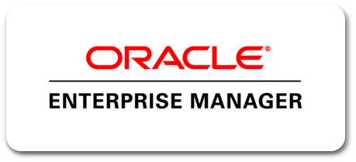
Enterprise Manager Cloud Control
All the topics are covered in the Oracle Enterprise Manager Cloud Control New Features self-study series.
Enterprise-Ready Framework
Applications Management
Cloud Management
Middleware Management
Chargeback and Capacity Planning
Database Management
Exadata and Exalogic Management
Application Quality Management
Configuration Management
Provisioning and Patching
This course uses some of the Oracle Enterprise Manager Cloud Control features.
Notes:
Key Objectives in Enterprise Manager Cloud Control Design
Designing a management framework that is capable of providing next-generation functionality
Enhancing application-to-disk manageability
Providing a complete enterprise private cloud solution
Enterprise Manager Cloud Control includes the following features:
Enterprise-Ready Framework: Provides modular and extensible architecture, target plug-ins, self-updateable entities, integrated Support Workbench, and centralized incident console
Cloud Management: Provides complete cloud lifecycle management
Chargeback and Capacity Planning: Provides chargeback based on target types, and uses Automatic Workload Repository (AWR) Warehouse to consolidate AWR reports from multiple databases across the enterprise
Exadata and Exalogic Management: Provides an integrated view of the hardware and software in an Exadata machine, and complete lifecycle management for Exalogic systems
Configuration Management: Provides an integrated set of tools, agent-less discovery, integration with My Oracle Support, and custom configuration capabilities
Oracle Database 12c: Backup and Recovery Workshop B - <number>

Slide 5
Notes:
Provisioning and Patching: Provides profiles for provisioning known configurations, user-defined deployment procedures, and a software library integrated with self-updating capabilities
Application and Quality Management: Database Replay, Application Server Replay, Real Application Testing integrated with Data Masking, and test database management including Application Data Model
Database Management: Provides management of Oracle Database systems, including performance management and change lifecycle management. Some aspects of Database Management are covered in detail in this course.
Middleware Management: Provides management of Fusion Middleware systems
Applications Management: Provides management of Fusion Applications
Note: For a complete understanding of Oracle Enterprise Manager Cloud Control usage, refer to the following sources of information:
Using Oracle Enterprise Manager Cloud Control course
Oracle Enterprise Manager Cloud Control: Install and Upgrade course
Oracle Enterprise Manager Cloud Control New Features Self-Study series
Oracle Enterprise Manager 12c demonstrations under Oracle Learning Library (URL www.oracle.com/goto/oll )
Oracle Database 12c: Backup and Recovery Workshop B - <number>

Slide 6



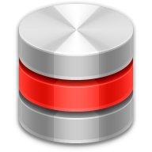










Cloud Control Components
Oracle Management Agent
Target specific plug-in
Managed Hosts
Oracle Management Service
Cloud Control Console
Oracle Management Repository
Notes:
Enterprise Manager Cloud Control is composed of four main components as illustrated:
The Oracle Management Repository (OMR)
The Oracle Management Service (OMS)
The Oracle Management Agent (OMA or agent) with target-specific plug-ins
The Cloud Control Console
The Oracle Management Agent runs on hosts, gathering metric data about those host environments as well as using plug-ins to monitor availability, configuration, and performance and to manage targets running on the host. The agents communicate with the Oracle Management Service to upload metric data collected by them and their plug-ins. In turn, the OMS stores the data it collects in the Oracle Management Repository where it can be accessed by the OMS for automated and manual reporting and monitoring. The OMS also communicates with the agents to orchestrate the management of their monitored targets. As well as coordinating the agents, the OMS runs the Cloud Control Console web pages that are used by administrators and users to report on, monitor, and manage the computing environment that is visible to Cloud Control via the agents and their plug-ins.
Oracle Database 12c: Backup and Recovery Workshop B - <number>

Slide 7

Components and Communication Flow
Cloud Control
Application
Push via SSH
7788 / 7801
4889 / 4900
WebLogic
Server
HTTP / HTTPS
HTTP / HTTPS
Administrator
OMA
OMS
3872 / 3872
Oracle Management Agent(s)
JDBC
1521
OMR
Oracle Management Repository
Notes:
The communication flow between the Cloud Control components is illustrated using directional arrows. Communication between the Agent and the OMS, and the OMS and the console is bi-directional. All the ports shown and listed in the slide are default values that can be changed during installation, either by the installer as it searches for available ports, or explicitly by you. You can also change ports after installation.
The Agent uploads data to the OMS via HTTP on port 4889 or via HTTPS on port 4900. (Designed to be able to work with WAN.)
The OMS communicates with the Agent via HTTP or HTTPS on port 3872.
The reason for the separate ports for OMS to OMA communications is that they can communicate asynchronously and simultaneously to one another.
The OMS communicates with the OMR via JDBC on port 1521. Although the OMR will return data to the OMS, this is not considered to be a separate communication between the two; hence, the flow is shown to be unidirectional from OMS to OMR.
Cloud Control console users access the Cloud Control webpages via HTTPS on port 7801 or via HTTP on port 7788.
Knowing the ports used in your Cloud Control installation is important, especially if you are managing hosts behind firewalls or where other network restrictions apply, because communication will need to be allowed on these ports and in the directions shown.
Oracle Database 12c: Backup and Recovery Workshop B - <number>

Slide 8
Oracle Management Repository
The Oracle Management Repository (OMR):
  Resides in an Oracle database
  Includes schema objects belonging to SYSMAN
  Must be installed in a pre-existing database
  Can be installed in a RAC database
  Note: Uses a restricted-use license of the Oracle Database
Notes:
The OMR is installed in an Oracle database as a group of approximately 4,000 schema objects belonging to the SYSMAN user stored in three tablespaces: MGMT_ECM_DEPOT_TS, MGMT_TABLESPACE, and MGMT_AD4J_TS. These schema objects contain information about Enterprise Manager Cloud Control users and administrators, targets and applications that are monitored and managed by Enterprise Manager Cloud Control, and groups, systems, incidents, and other Enterprise Manager Cloud Control artifacts. The OMR is created during installation in a preexisting database, and for scalability requirements can be installed in a Real Application Clusters (RAC) database. In this case, customers must license the second node for the database, and both nodes require an Oracle Real Application Clusters license.
The database used to house the OMR should not be used for any other applications for the following reasons:
Enterprise Manager Cloud Controls usage of the database should not have to compete with any other usage.
Using the OMR database for other applications may restrict your ability to upgrade and patch the OMR schema and database as required
Enterprise Manager Cloud Control includes a restricted-use database license that can be used for the OMR only
Note: Refer to Oracle Enterprise Manager Licensing Information 12c Release 1, Section Enterprise Manager Restricted-Use License.
Oracle Database 12c: Backup and Recovery Workshop B - <number>

Slide 9
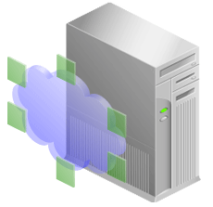

Controlling the Enterprise Manager Cloud Control Framework
WebLogic
EM
Repository
OMS
Agents
Component Control Utilities
Repository | OMS | Agent
sqlplus or srvctl | emctl | emctl
lsnrctl
Notes:
Each component of the Enterprise Manager Cloud Control framework has its own utility or utilities that can be used to monitor, start, and stop the component. In many cases, these utilities also provide some capability to configure the component beyond the simple start-and-stop functionality.
RAC databases require the use of the Server Control commands; for single instances, there is a choice between SQL*Plus and Server Control. Server Control is usable when Oracle Restart is installed and the database is registered with the OLR.
To start and stop the listener, either use the Server Control utility or the lsnrctl command.
Examples:
srvctl stop database -d orcl -o immediate
srvctl start database -d orcl -o open
Oracle Database 12c: Backup and Recovery Workshop B - <number>

Slide 10

Starting the Enterprise Manager Cloud Control Framework
To start the Cloud Control framework, perform the following steps:
  Start the repository database listener.
  Start the repository database instance.
  Start the OMS.
  Start the agent on the OMS/repository server.
  Start the agents on the managed servers.
WebLogic
EM
OMS
OHS
Repository
Agents
Notes:
To start the whole Enterprise Manager Cloud Control framework, follow the steps below:
1. Start the repository listener:
$ORACLE_HOME/bin/lsnrctl start
2. Start the repository database instance:
$ORACLE_HOME/bin/sqlplus / as sysdba
SQL> startup
Start the OMS (including OHS and WebLogic Managed Server):
$OMS_HOME/bin/emctl start oms
4. Start the agent (on OMS/repository host):
$AGENT_HOME/bin/emctl start agent
5. Start the agent on the managed servers:
$AGENT_HOME/bin/emctl start agent
Note: Use the SRVCTL command if you have a RAC instance for the repository.
Oracle Database 12c: Backup and Recovery Workshop B - <number>

Slide 11

Stopping the Enterprise Manager Cloud Control Framework
To stop the Enterprise Manager Cloud Control framework, perform the following steps:
  Stop the agents on managed servers.
  Stop the agent on the OMS/repository server.
  Stop the OMS.
  Stop the repository database instance.
WebLogic
EM
Agents
OHS
OMS
Repository
Notes:
To stop the whole Enterprise Manager Cloud Control framework, follow the steps below:
1. Stop the agent on the managed servers:
$AGENT_HOME/bin/emctl stop agent
2. Stop the agent (on OMS/repository host):
$AGENT_HOME/bin/emctl stop agent
3. Stop the OMS (including OHS and WebLogic Managed Server):
$OMS_HOME/bin/emctl stop oms
4. Stop the repository database instance:
$ORACLE_HOME/bin/sqlplus / as sysdba
SQL> shutdown immediate
Note: Use the SRVCTL command if you have a RAC instance for the repository.
Oracle Database 12c: Backup and Recovery Workshop B - <number>

Slide 12

Different Target Types
Enterprise Manager Cloud Control can monitor, administer, maintain, and manage many different types of targets including:
  Oracle Databases
  Oracle Database Listener
  Oracle Fusion Middleware products
  Oracle Application Server
  Oracle WebLogic Server
  Oracle applications, including E-Business Suite,
  SOA, Siebel, and PeopleSoft
  Exadata and Exalogic
  Cloud Control Components: OMR and OMS
  Third-party products
OMA
DB
Managed
Target
Host
Notes:
Targets are the entities that Enterprise Manager Cloud Control manages. To do so, it uses target-type specific plug-ins and host-specific agents.
Enterprise Manager Cloud Control can monitor, administer, maintain, and manage different types of targets as listed in the slide. As your environment changes, you can add and remove targets from Enterprise Manager Cloud Control as needed. The commonly used Oracle targets (including Enterprise Manager Cloud Control components, such as the OMR and OMS) are predefined as part of the base Enterprise Manager Cloud Control product, but Enterprise Manager Cloud Control has an open API that enables you to create custom targets.
Oracle Database 12c: Backup and Recovery Workshop B - <number>

Slide 13





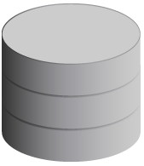

Target Discovery
Server A
Host target information
Auto Discovery executed by OMA
Third-party Applications
OMA
E-Business Suite
Guided Discovery
Application
servers
Listeners
Databases
Notes:
After the Agent has been installed on a host, it needs to look for targets that it can manage. As an Enterprise Manager Cloud Control administrator, you can guide that process from the Enterprise Manager Cloud Control console pages. Guided discovery allows you to nominate a family of target types that you want to search for, such as database and listeners, and then the agents where you want that search to be executed. If any new targets are discovered, the appropriate plug-in will be pushed from the OMS if it is not already installed on the agent, the target will be recorded in the OMR, and monitoring will begin.
You can also configure auto discovery to run at regular intervals and get an agent to search for known targets unattended, allowing you to review the results at a later stage and promote discovered targets to become managed targets.
Oracle Database 12c: Backup and Recovery Workshop B - <number>

Slide 14
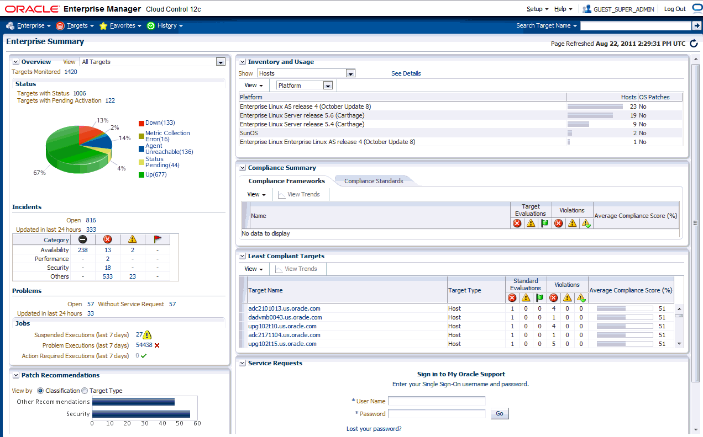
Enterprise Manager Cloud Control
Notes:
The image in the slide is of the Enterprise Summary page of Oracle Enterprise Manager Cloud Control. The user interface (UI) functionality includes:
Information displayed in graphs and tables
Summary information with drilldown capability to relevant details
User-selected home page from a predefined set, or based on any page in the console
Menu-driven navigation
Global target search
History and favorites
Customizable target home pages (per-user basis)
Oracle Database 12c: Backup and Recovery Workshop B - <number>

Slide 15
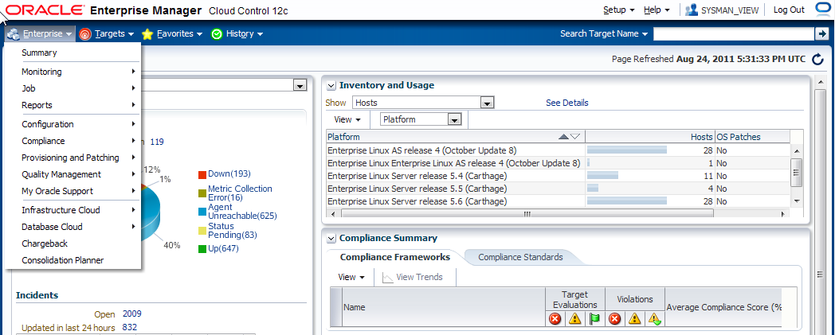
User Interface
Setting your home page:
  Predefined home page based on roles
  Any page
Menu-based navigation:
Make any page a favorite for quick access.
Notes:
User Interface Enhancements
The user interface in Enterprise Manager Cloud Control has been rewritten in Application Development Framework (ADF). When you log in to the new UI, use drop-down menus to navigate from one place to another in the product.
Choose your own home page: When you first log in to Enterprise Manager, you are provided with a selection of pre-defined home pages based on roles. If you are managing databases, you can choose the database home page.
If those are not suitable, you can select any page in the UI to be your home page instead.
Mark any page as a “favorite” for quick access. Because you manage certain targets frequently, you mark these target home pages as favorites in much the same way you mark a favorite in a browser. However, because the favorites you mark in Enterprise Manager are stored in the repository, you can move from client machine to client machine and your favorites are still available to you.
For information about how to customize your Enterprise Manager Cloud Control console, follow the demonstration Oracle Enterprise Manager 12c: Console Overview and Customization under Oracle Learning Library.
Oracle Database 12c: Backup and Recovery Workshop B - <number>

Slide 16
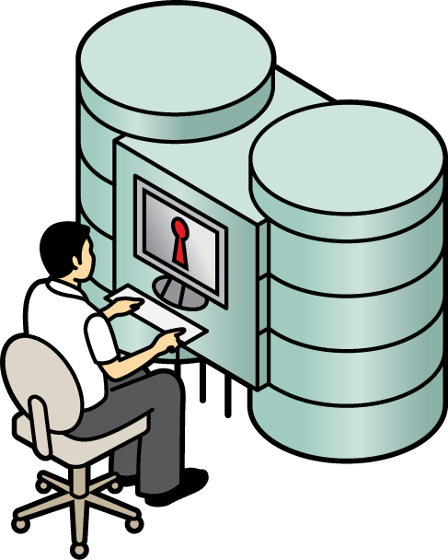
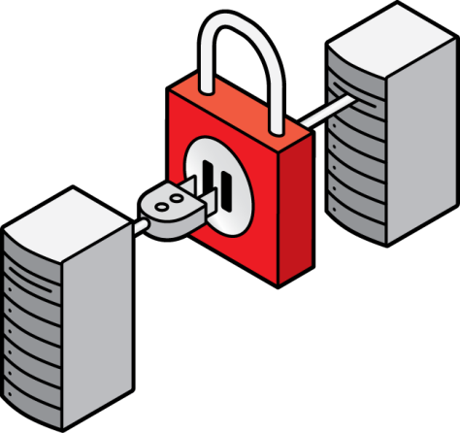

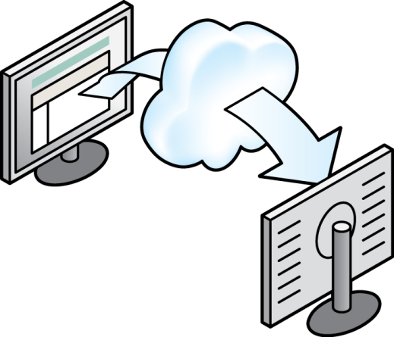
Security: Overview
Enterprise Manager
Enterprise Manager Cloud Control Authentication
Target Authentication
Enterprise Manager Cloud
Control Authorization
Credential Management
Notes:
Enterprise Ready Framework: Security
The Enterprise Manager security system can be divided into four parts (as shown in the graphic):
Enterprise Manager Cloud Control authentication
Enterprise Manager Cloud Control authorization and privileges
Credential management (host credentials can be defined here)
Target authentication (host credentials can be used here)
Oracle Database 12c: Backup and Recovery Workshop B - <number>

Slide 17







Managing Securely with Credentials
  Centralized credential store for ease of management
  Support for managing passwordless and strong authentication credentials
    Kerberos tickets
    SSH keys
  Reuse and sharing among users (without disclosing the sensitive content of credentials)
  Controlled and protected access
  Support for sudo/powerbroker
EM Users
Privileges
SSH Keys
Kerberos Ticket
EM User1
EM User2
Notes:
Security with Credentials
As a management tool that handles a lot of scripts and powerful actions like patching, Enterprise Manager has to work with a lot of credentials for hosts, databases, and a range of other objects. Managing all these credentials can be a real challenge.
The centralized store facilitates this task because you can name and store credentials there.
Passwordless and strong authentication credentials are supported, such as the Kerberos tickets and SSH key pairs.
Credentials can be reused and shared among users (without disclosing the sensitive content like a password). Users are granted access to these credentials by the use of privileges, and so they can be reused without knowing what the contents of the credentials themselves are.
Access to the credentials is controlled and protected by privileges.
The Enterprise Manager credential subsystem enables you to securely store credentials as preferences or operation credentials, which can then be used to perform different system management activities. Enterprise Manager also supports sudo/powerbroker–based impersonation.
Oracle Database 12c: Backup and Recovery Workshop B - <number>

Slide 18
Distinguishing Credentials
  Named credentials
  Preferred credentials
  Default credentials
  Access level:
    View: Access to use the credential
    Edit: To change the credential (including changing its name and password)
    Full: For complete access (including the ability to delete the credential)
  Usage classification: Job, collection, and monitoring
Notes:
Types of Credentials
As the Enterprise Manager administrator, you can also store credentials (username/password, a public key-private key pair, or an X509v3 certificate) as named credentials in Enterprise Manager to use when performing operations like running jobs, patching, and other system management tasks. Objects refer or point to named credentials. They are “placeholders” to facilitate, for example, the changing of passwords.
You can store, access, and modify a fixed number of username/password–based credentials as preferred credentials to simplify access to managed targets by storing target login credentials in the Management Repository.
Default credentials can be set for a particular target type and will be available for all the targets of the target type.
The three levels of access that can be granted are:
View access: To use the credentials
Edit access: To change the credentials, including changing its name and password
Full access: For complete access, including the ability to delete the named credential
Credentials can also be classified by their usage, such as job credentials (used by the job system), collection credentials, and monitoring credentials (used by OMA).
Oracle Database 12c: Backup and Recovery Workshop B - <number>

Slide 19
Notes:
Core concepts and definitions:
Credential type is the type of authentication supported by a target type. For example, a host can support a username/password–based authentication, public key authentication, or Kerberos authentication. Various authentication schemes are supported, including native agent authentication and SSH.
Credential set is a placeholder for a credential. Credential sets can be used to decouple credentials from the system that uses a credential. A credential set enables you to change its mapping to named credentials for a target without editing the system that uses the credential. For example, you could have a credential set for patching tasks.
Credential store is a logical store for all the named credentials of an Enterprise Manager administrator.
Defining credentials by:
Credential name: The credential is referenced using the name of the credential in the credential store.
Credential set: The credential is referenced using the credential set name and the target name. The lookup gets the credential associated with the credential set name and target name.
Direct value: The credential is specified by providing the values of the attributes. This reference does not refer to a credential in the credential store.
For information about how to set credentials, follow the demonstrations:
Oracle Enterprise Manager 12c: Create and Use Named Credentials under Oracle Learning Library
Oracle Enterprise Manager 12c: Create SSH Key Named Credentials under Oracle Learning Library
OBE Enterprise Ready Framework: Create and Use Credentials
Oracle Database 12c: Backup and Recovery Workshop B - <number>

Slide 20
Quiz
Which targets can be managed by using Enterprise Manager Cloud Control?
  Hosts
  Databases
  Application servers
  Web applications
  OMS and OMR
  All of the above
Notes:
Answer: f
Oracle Database 12c: Backup and Recovery Workshop B - <number>

Slide 21

Practice Overview:
Using Enterprise Manager Cloud Control
These videos cover the following topics:
  Accessing Enterprise Manager Cloud Control
  Setting the Summary page as the home page
  Adding a database instance as a new target monitored by EM CC
  Creating a new named credential
  Using the named credential
Notes:
View the “Oracle Enterprise Manager 12c: Console Overview and Customization” demonstration (unless your instructor just demonstrated those topics) (8 minutes).
Optional demonstrations about related topics are available:
Oracle Enterprise Manager 12c: Create an Enterprise Manager Administrator (6 minutes)
Oracle Enterprise Manager 12c: Create and Use Named Credentials (6 minutes)
Oracle Enterprise Manager 12c: Create SSH Key Named Credentials (3 minutes)
Oracle Enterprise Manager 12c: Discover and Promote Unmanaged Hosts and Targets
Optional Oracle By Example (OBEs) about related topics are available:
Oracle Enterprise Manager 12c Enterprise Ready Framework: Create and Use Credentials (60 minutes)
Oracle Enterprise Manager 12c Enterprise Ready Framework: Create a Super Administrator Account (5 minutes)
Oracle Database 12c: Backup and Recovery Workshop B - <number>

