Slide 1

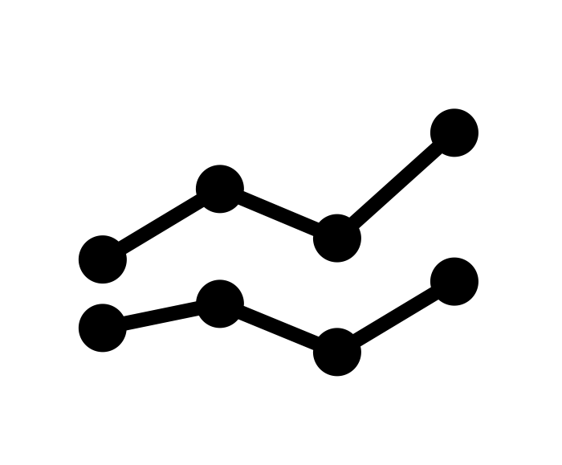






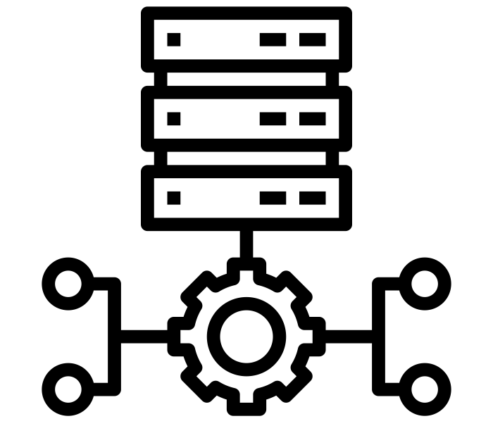


Data Scientist
Publish
Research paper
Stat modeling
Repeat
ML Engineer
Model
development
Improve
product / service
Feedback
BI Analyst / Engineer
Dashboard
visualization
KPI tracking, feedback,
storytelling, … etc.
Data collection
Data pipeline
Data Engineer
Data Analyst
Data warehousing
Data analysis
and also …
Growth Hacker Performance Marketer
Data PM

