Slide 1

Does Wikipedia Traffic for Political Candidates Forecast Polling?
DATS 6401-20 Final Project
Joseph Schultz
August 15, 2019

Slide 2
Agenda
Introduction
Data, Methods & Presentation
Initial Exploration
Checking Metrics
Results
Conclusions

Slide 3
Introduction
2020 Democratic Endorsement Race
Multi-State
States hold elections on different days, so race results are dependent
Minimum thresholds for vote share
Proportional awarding of Delegates
Previous Research: Wikipedia Traffic in Race Result Prediction
Example: https://epjdatascience.springeropen.com/articles/10.1140/epjds/s13688-016-0083-3
Core Question: Can Wikipedia candidate page traffic help predict movements in political polls?

Slide 4
Data
Polls data from fivethirtyeight (https://projects.fivethirtyeight.com/polls/)
State (and no State)
Candidate
Percent Support
Date
Wikipedia traffic data from candidate specific Wikipedia websites
Candidate
Wikipedia Traffic
Date
Additional auxiliary data pulled in for presentation & state of race graph
Delegates per State
Dates of each State’s race
Full State name to abbreviation map

Slide 5
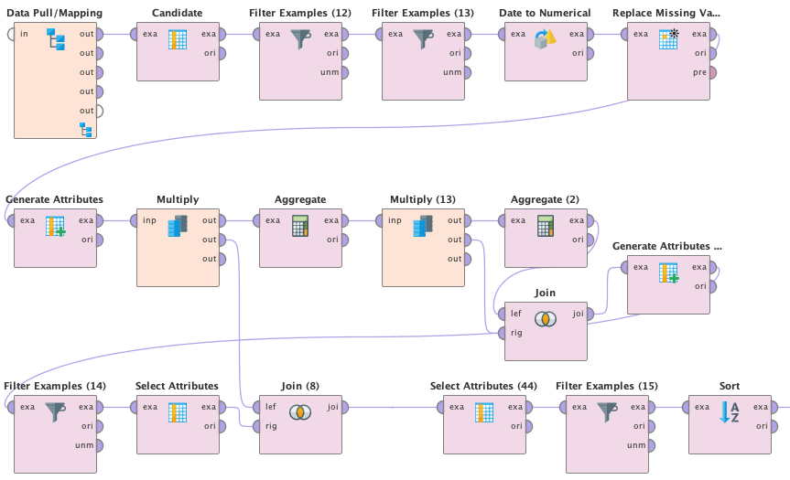
Methods
Data ETLed in RapidMiner
Data joined on Candidate & Date variables
Data cleaning/aggregation for the various data slices
Data visualized in HTML with D3 and Google Visualizations on 5 webpages
Built custom pictures for navigation bar
Added interpretation and notes above and below visualizations

Slide 6
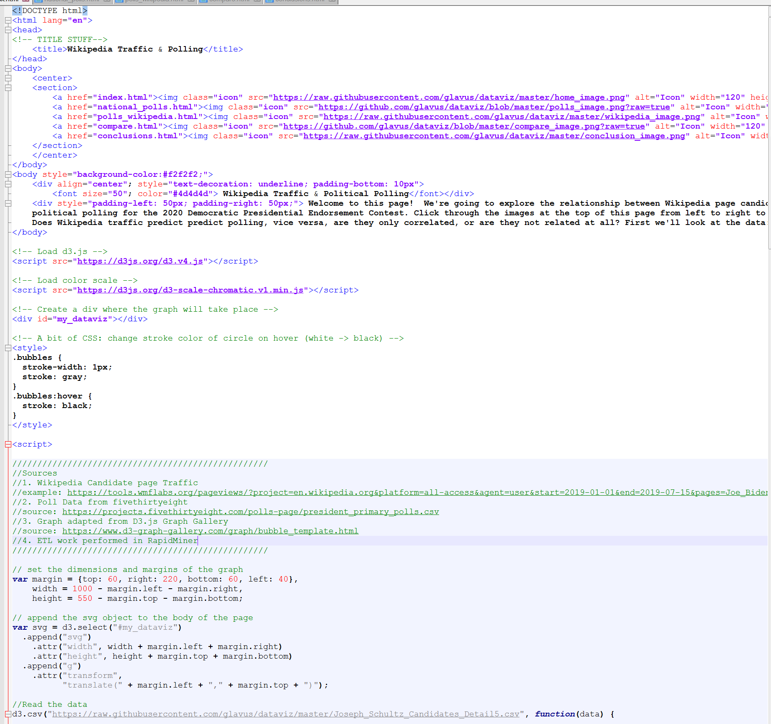
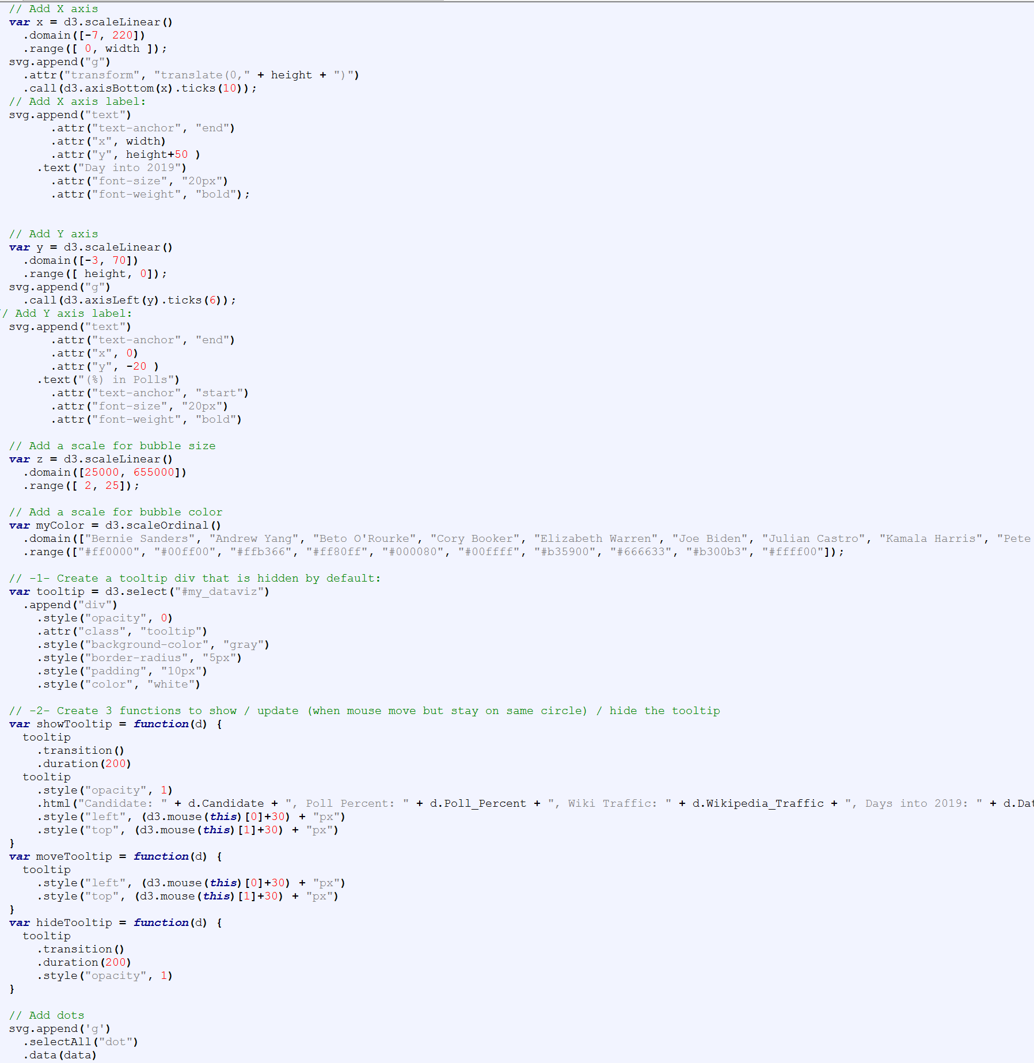
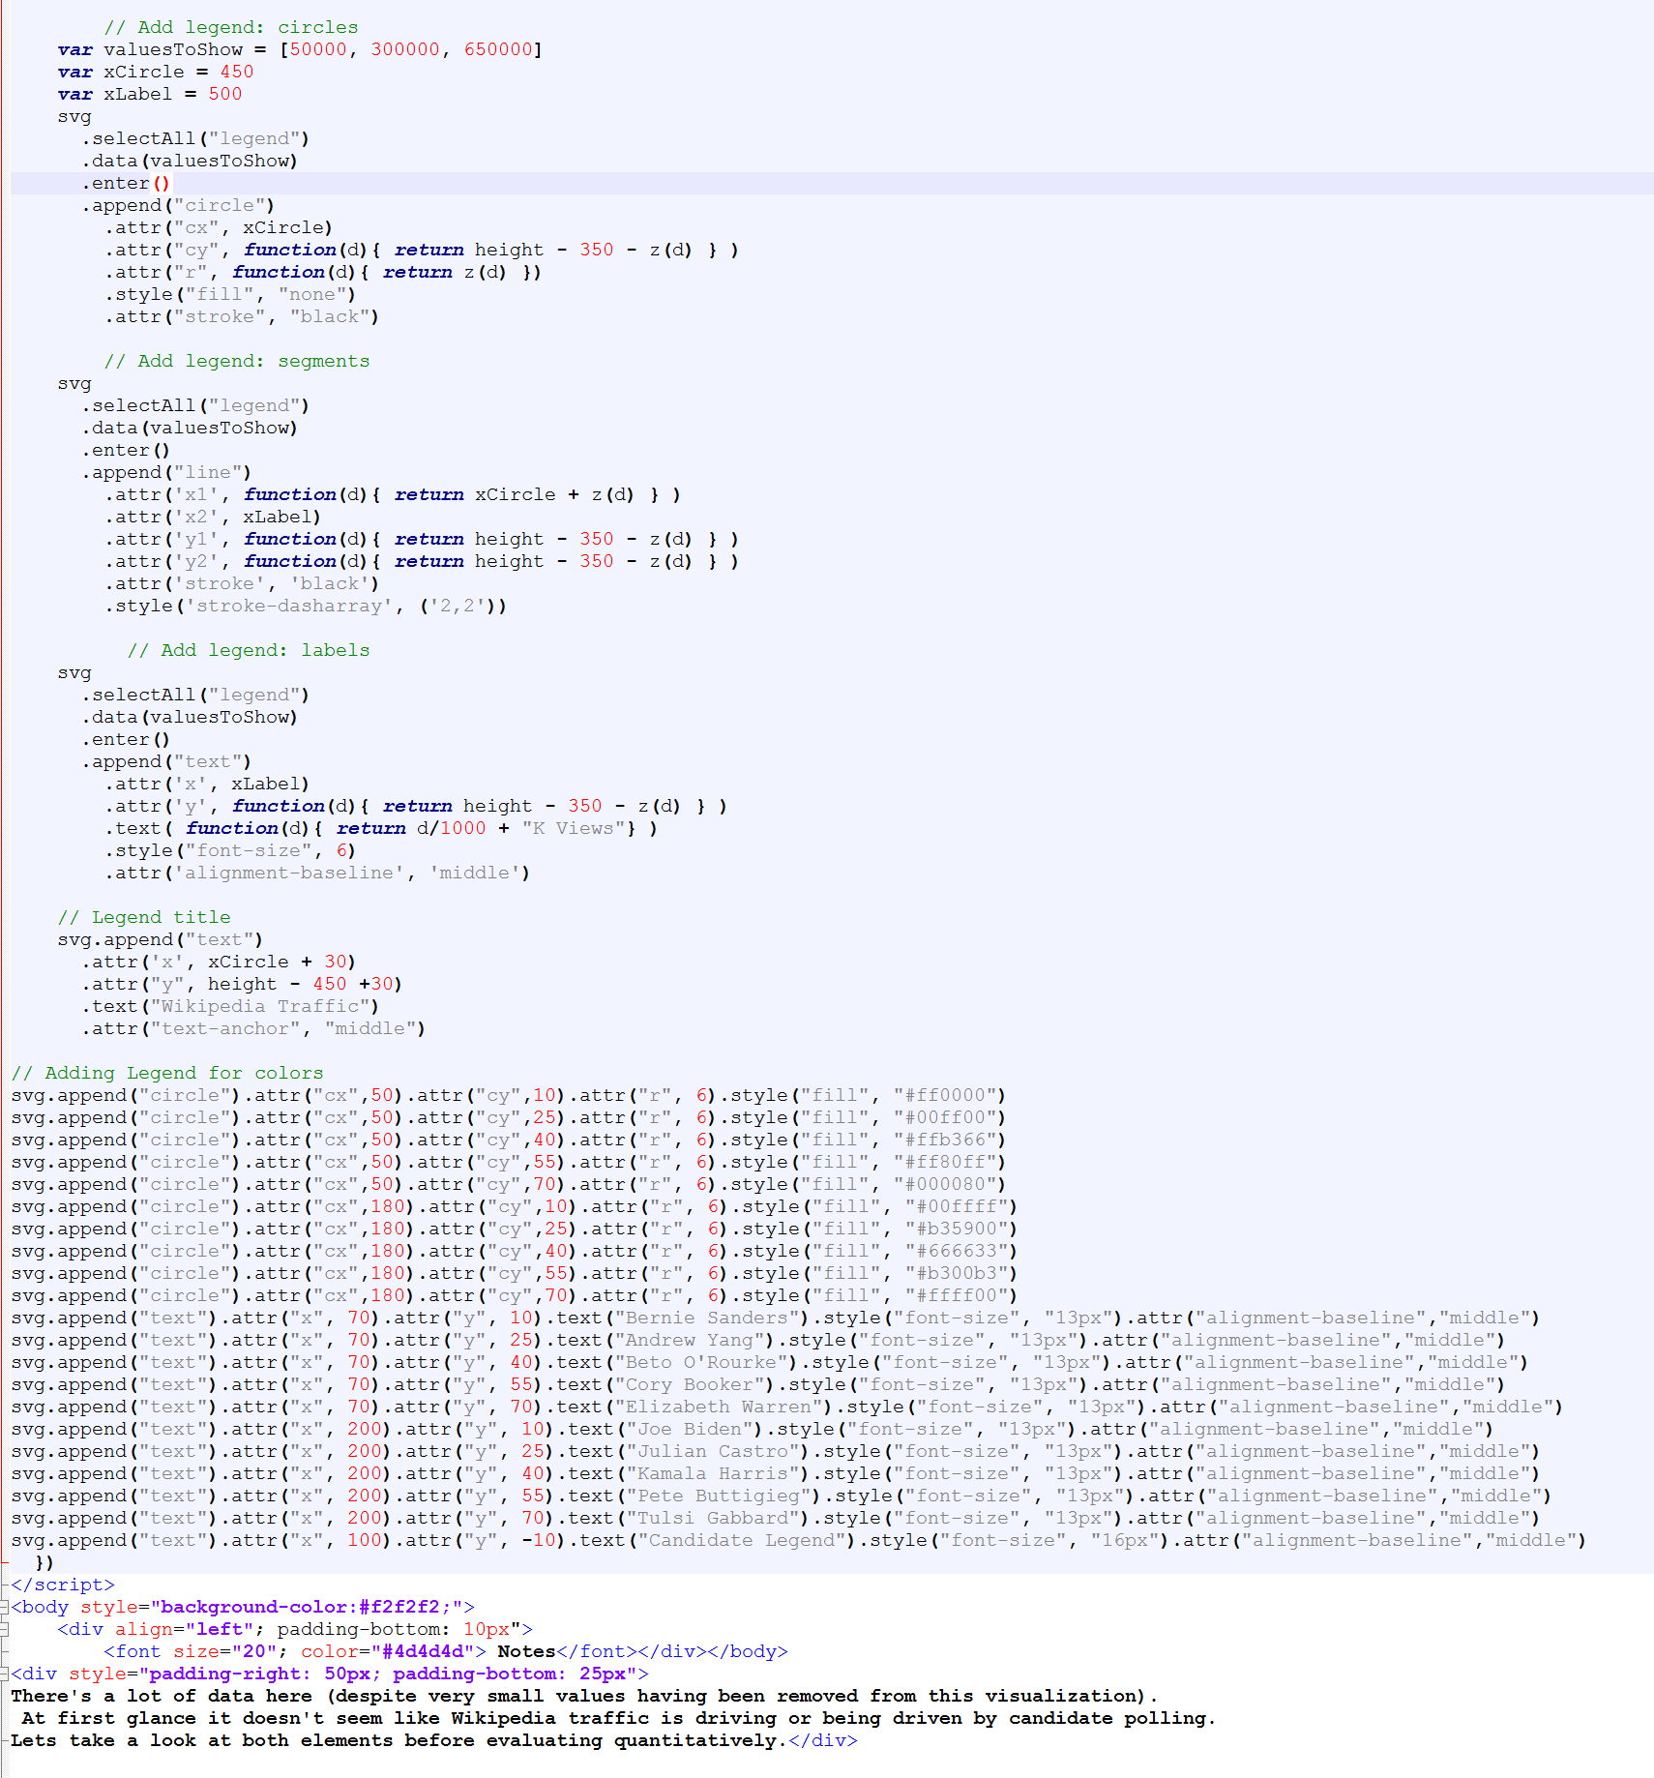
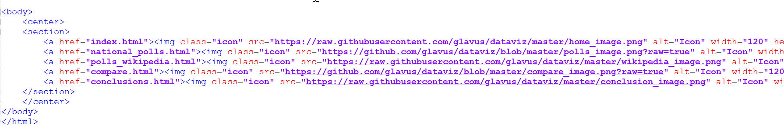
HTML Setup
Title/navigation bar
Page Introduction text
Call scripts/add disclosure notes
Define graph
Pull in data
Define axes/how data is displayed
Add legend(s)
Interpretation notes
Repeat navigation bar at bottom
All pages essentially follow the same format shown on the right
First four graphs are in D3
Last graph is a Google visualization

Slide 7
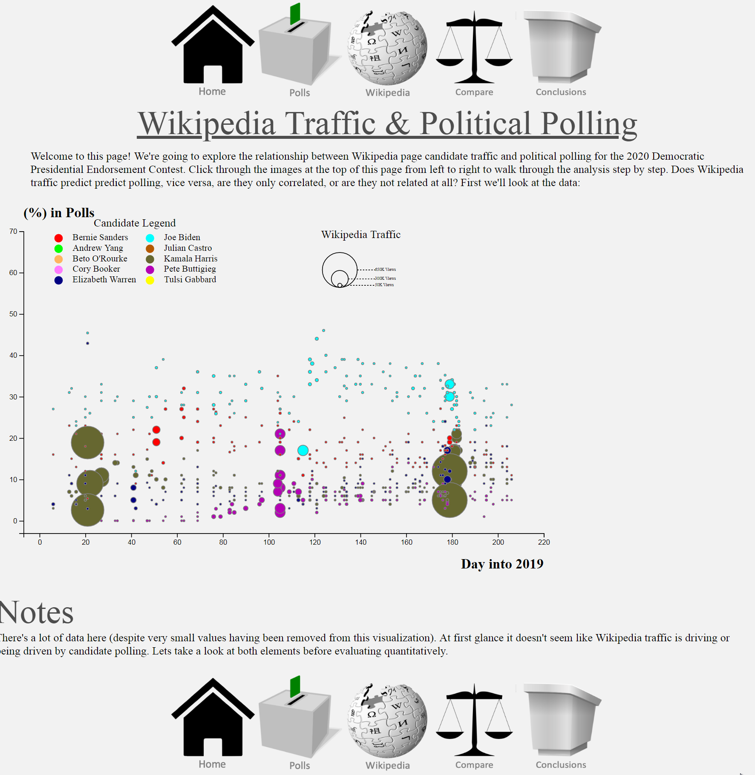
Presentation Format
Navigation bar on top and bottom
Setup for visualization under title for page
Visualization Content
Interpretative Notes
Format repeated for all 5 pages

Slide 8
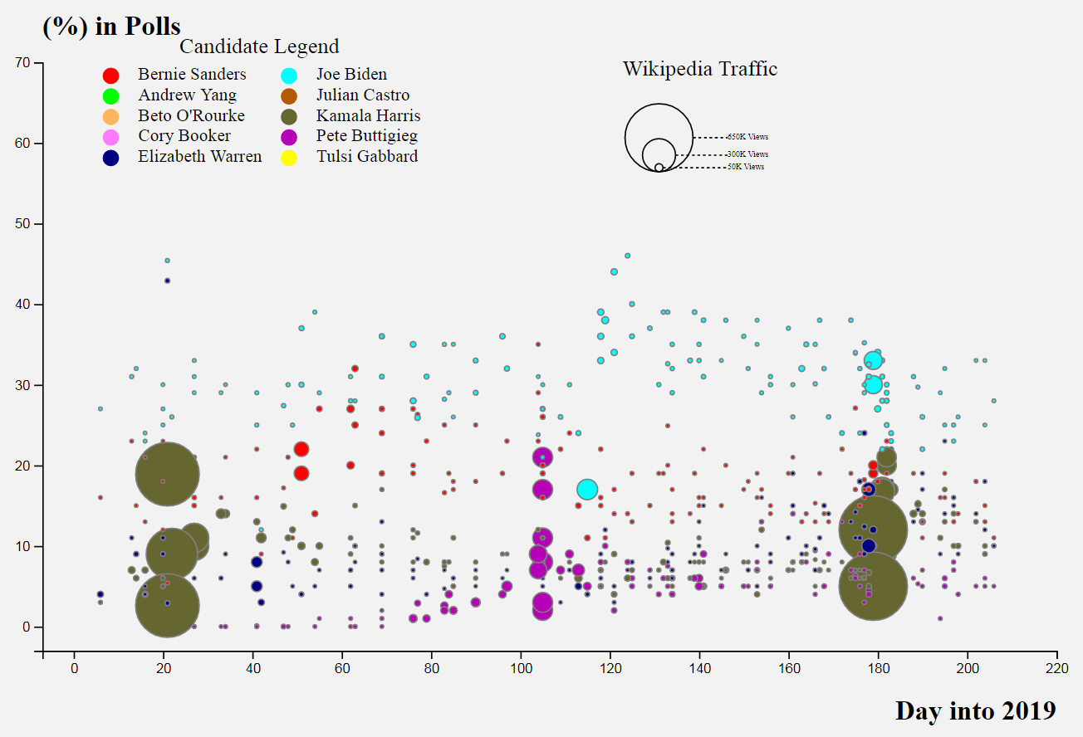
Initial Data Exploration
Graph shows Candidate, Poll %, Wikipedia Traffic & Day into 2019
Hints at events driving Wikipedia traffic by clustered results
When live, this visualization has an added pop-up below the chart showing more detailed information for each point

Slide 9
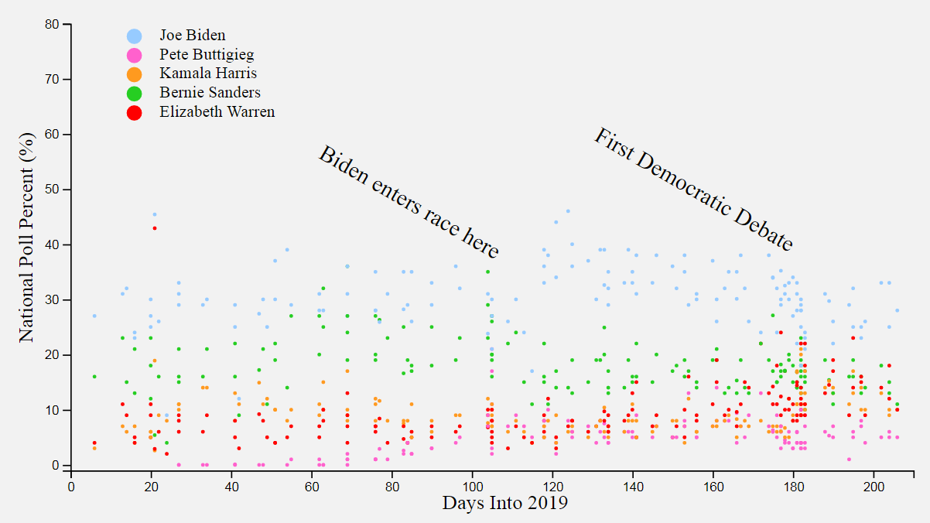
Polling Drill-Down
Events definitely help explain polling frequency
Only showing national polls
Number of candidates evaluated dropped to five

Slide 10
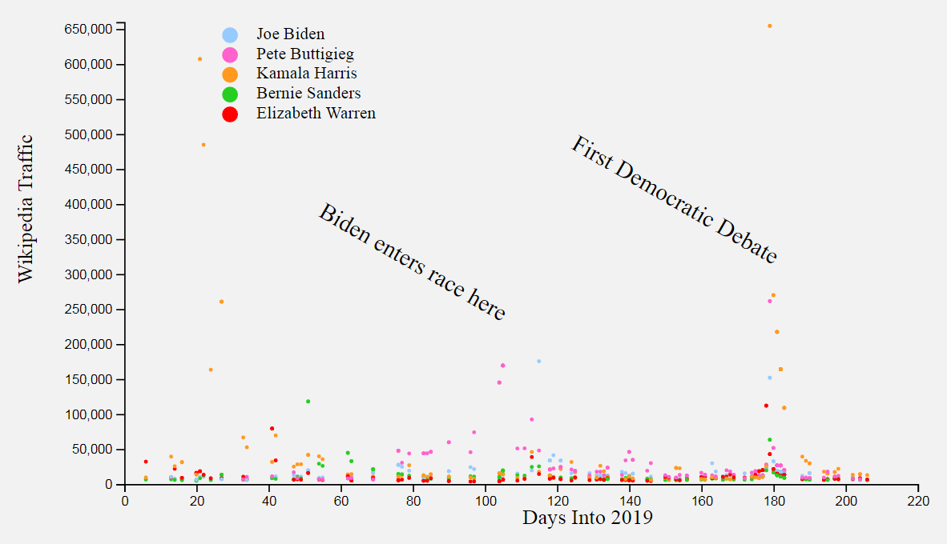
Wikipedia Traffic Drill-Down
Events definitely are driving Wikipedia page traffic
So there’s a positive correlation, but what about causation?
If there is causation, what direction?

Slide 11
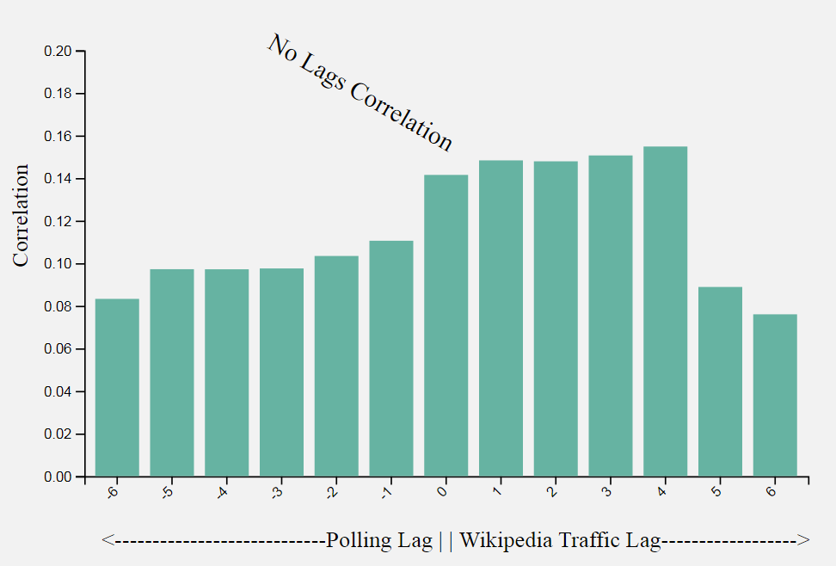
Results
Lagged both polling data and Wikipedia traffic and checked correlations in both directions
There is a noticeable spike between 0 and 4 days of Wikipedia traffic lag
Only 4 days, so not practically very helpful

Slide 12
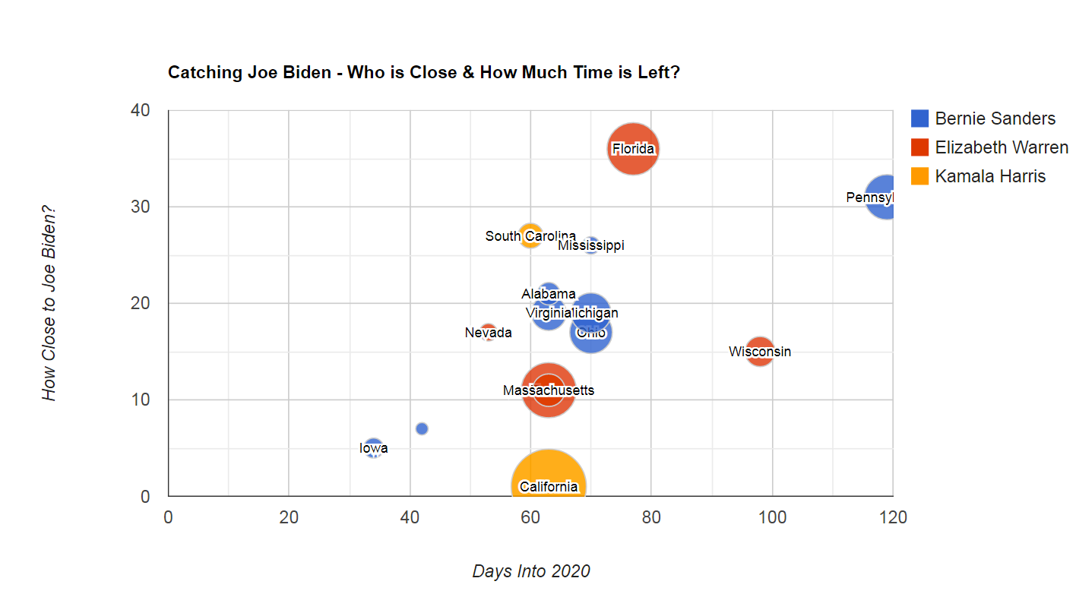
State of the 2020 Dem Endorsement Race
Originally wanted to use results to forecast polls/winner, but predictive power of Wikipedia traffic not sufficiently powerful to be practically useful
Visualization evaluates just most recent polling information

Slide 13
Thank you! Files found on Github: https://github.com/glavus/dataviz Zenodo: https://zenodo.org/record/3369314

