Slide 1
March Madness Presentation
Max, Gaurav, Nathan, Jonathan

Slide 2
How Difficult Is It To Get A Perfect Bracket?
1 in 9.2 quintillion odds!
1 in 120.2 billion if you’re qualified as “sharp” on CBB
You would have to walk around the planet 5.8 billion times to see a perfect bracket!

Slide 3
What’s The Issue?
Variance! The best teams DO NOT always win, and when there are 64 teams to pick from, the results eventually will ALWAYS stray from the mean results of past tournaments
Traveling, having an off day, mental toughness are all variables that cannot be inputted into an algorithm, so next to impossible to predict accurately

Slide 4
Goal: Show How To Maximize Your Bracket
Even though you almost certainly won’t get a perfect bracket, we can highlight trends and details to help you place in the top percentile of brackets, each year
Are three-point shooting teams better than those who don’t take many? What does long traveling do to team performance? All will be highlighted in this presentation!

Slide 5
Format: ESPN Tournament Challenge
The most popular application for people to submit their brackets onto is the ESPN Tournament Challenge (or TC) app
You can win lots of money by winning ‘bracket pools’ you enter into, or claim lots of bragging rights from your friends by understanding how to put together a good bracket!

Slide 6
How It Works
Each person can submit up to 10 brackets, with those brackets being able to enter an unlimited amount of groups
Given a percentile of where your bracket stands amongst everyone else
Typically, if you are within the ~90th percentile, you will win your group

Slide 7
Key 1: What Seeds Win The Most?

Slide 8
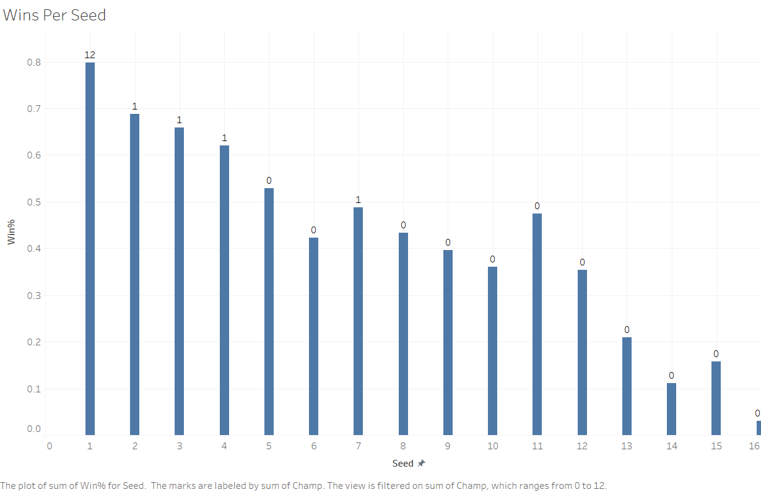

Slide 9
Key 2: Who Is the Public Picking?

Slide 10
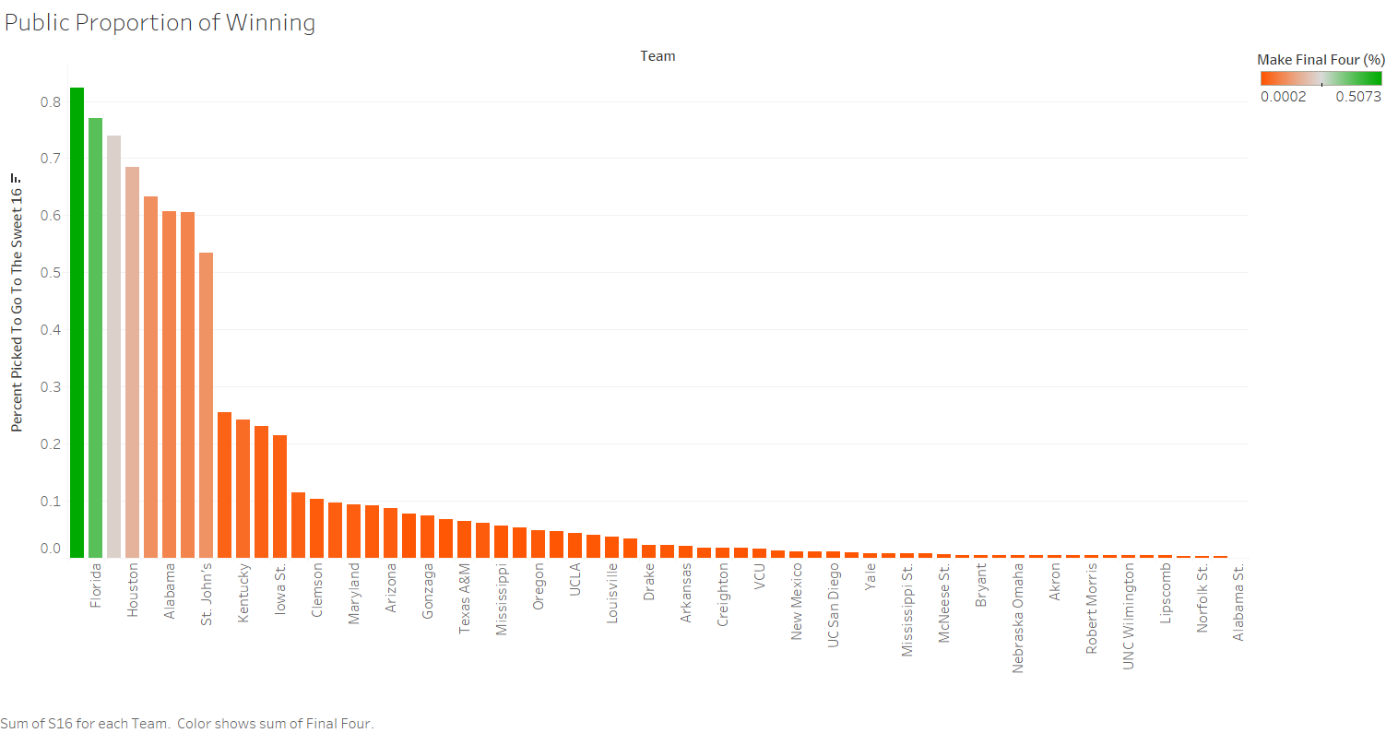

Slide 11
Takeaway #1
It’s OK to take the 1 seeds! There is always that one person who tries to get cute and pick them to lose early on to seem smart, but in reality, it is a really bad choice.
That isn’t to say you should be following everything the public is doing, as if you’re doing everything they are, how will you win?

Slide 12
Key 3: How To Differentiate Contenders

Slide 13
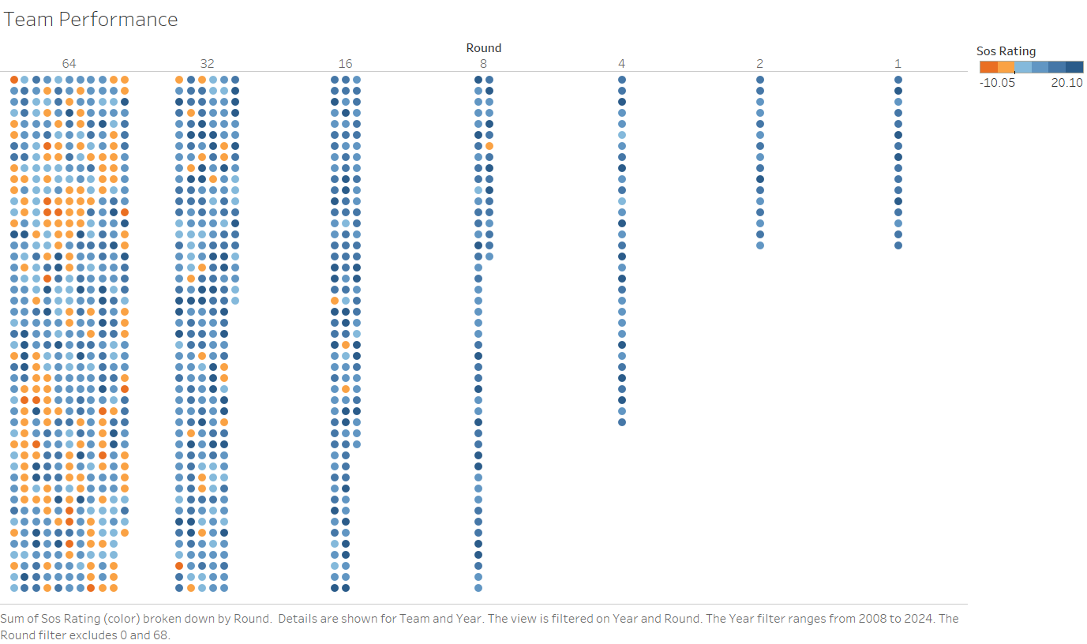

Slide 14
Takeaway #2
Strength of Schedule is extremely important when picking teams to go to the Sweet 16 and beyond! Focus on picking teams from and 8 rating and beyond, and judge based off matchup ratings.

Slide 15
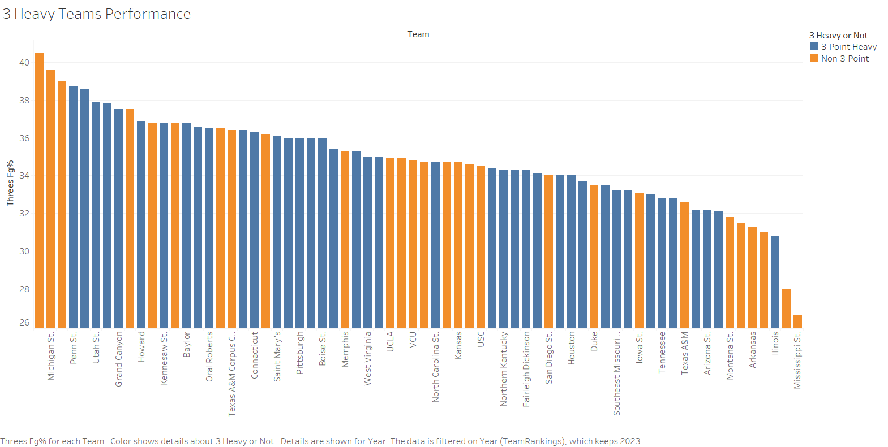

Slide 16
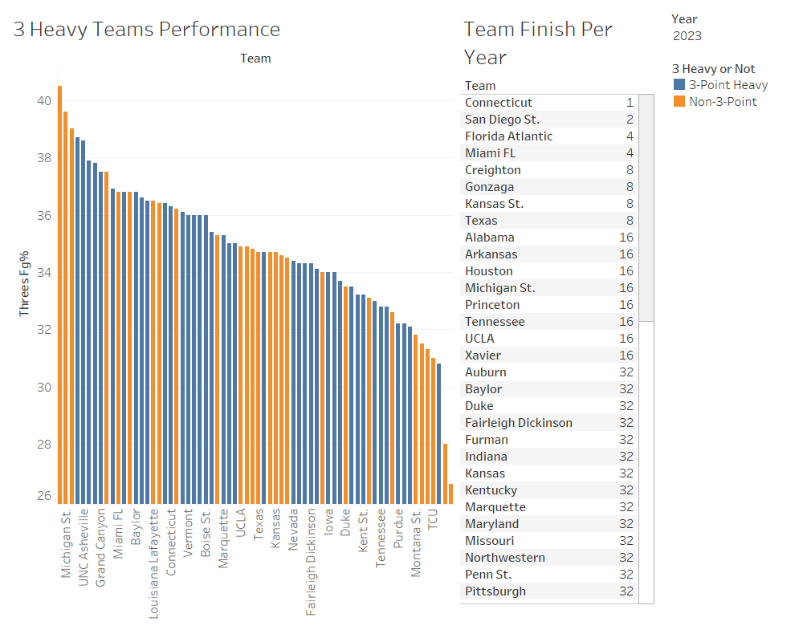

Slide 17
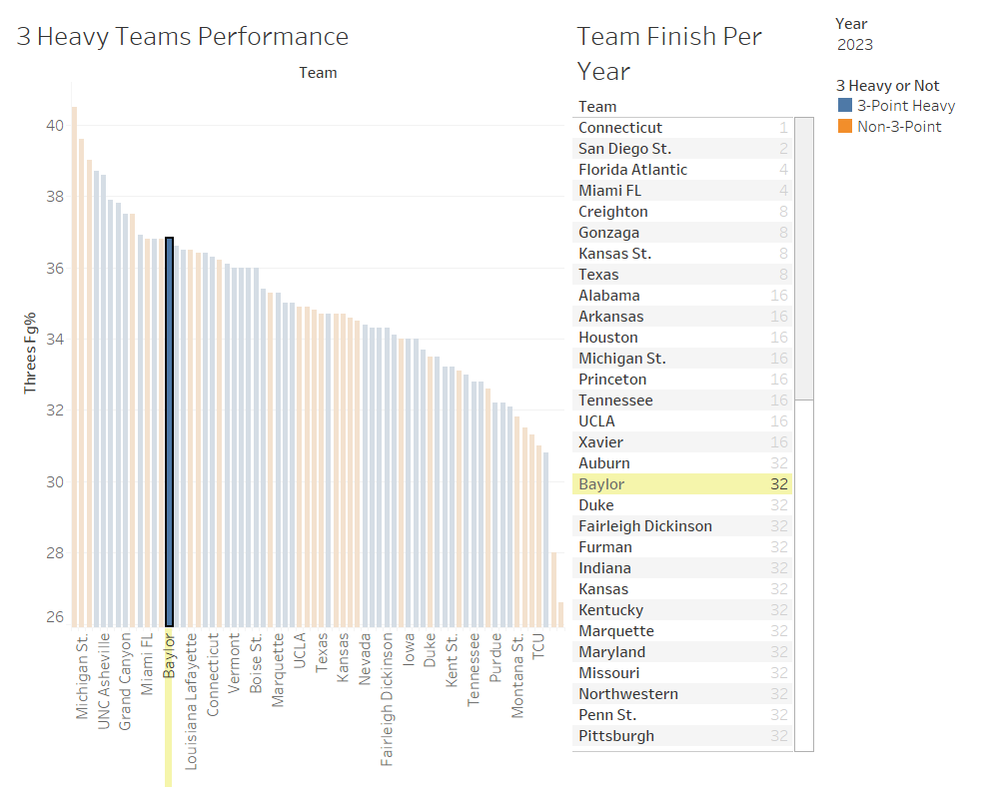

Slide 18
Takeaway #3
Value the teams who are Non 3-Point Heavy teams higher! They typically perform better in the tournament, since not as much variance in their shots going down.

Slide 19
Key 4: Coaching

Slide 20
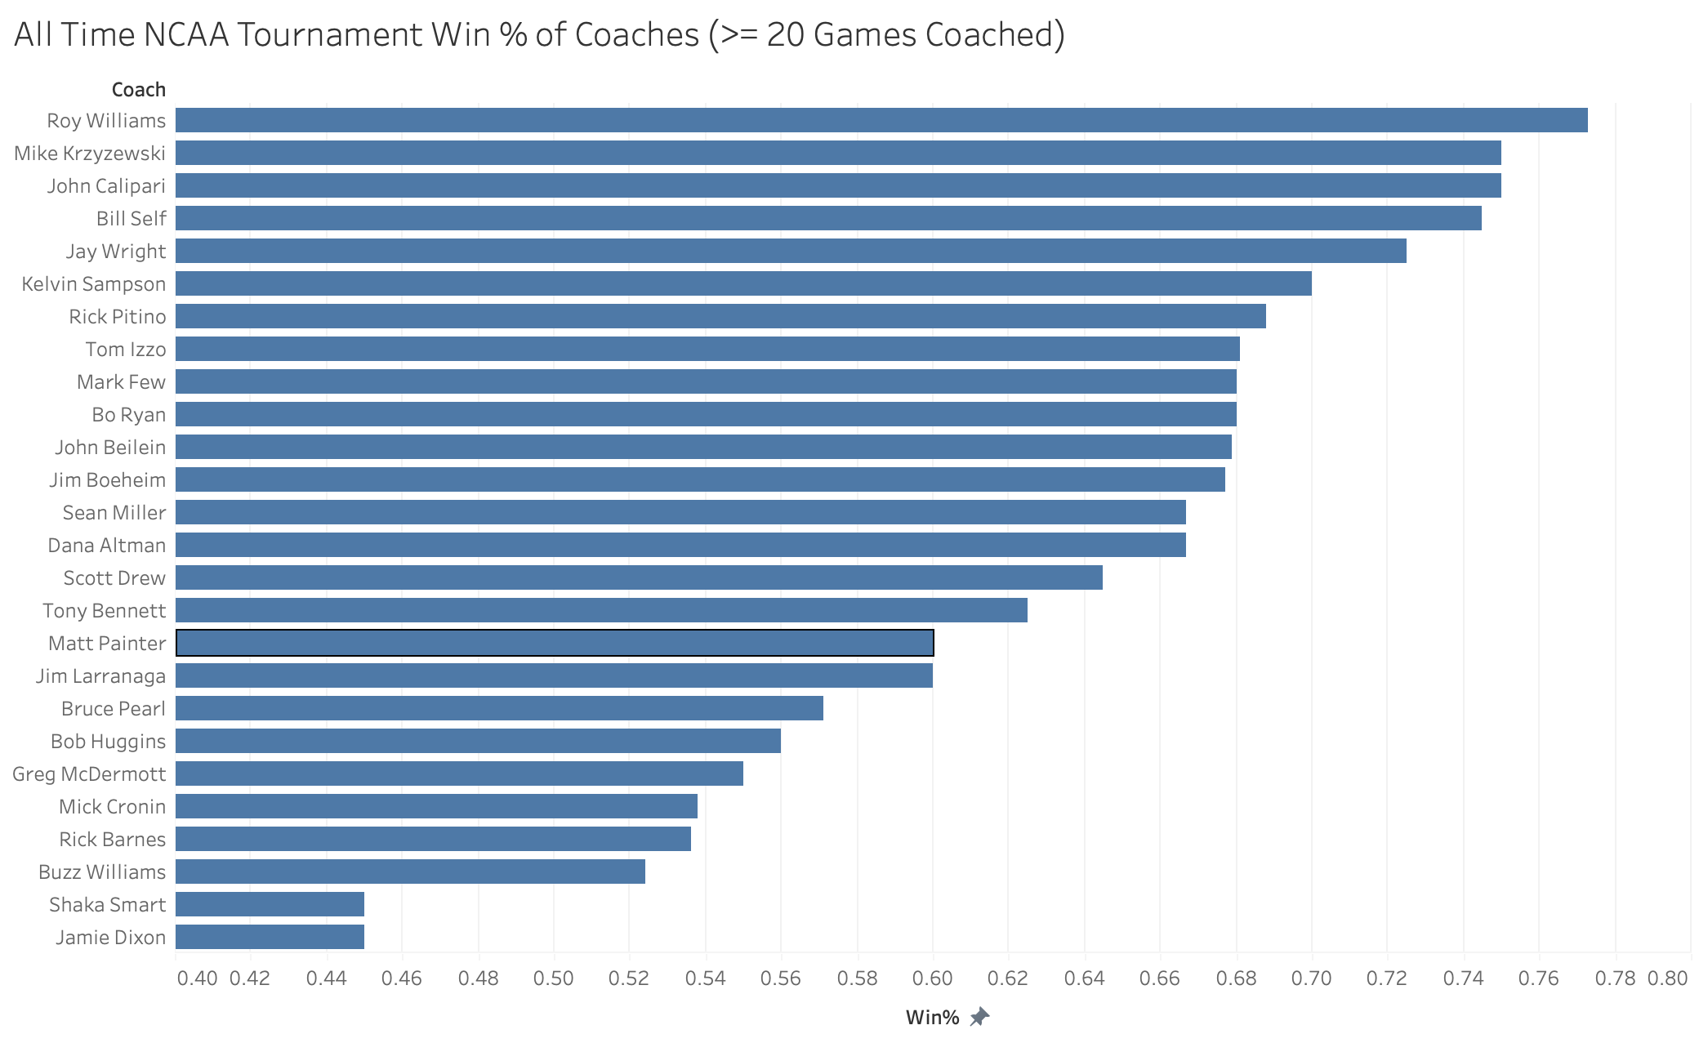
Caption

Slide 21
Takeaway #4
Picking teams whose coach has experience and a track record of performing well in the NCAA Tournament is a good strategy for determining picks. From the last visual 13 coaches took teams to this year’s tournament. 12 of those 13 won their First Round matchup. This suggests coaching experience and experience winning in the tournament are valuable things to consider when filling out a bracket.

Slide 22
Key 5: Upset Seed Difference

Slide 23
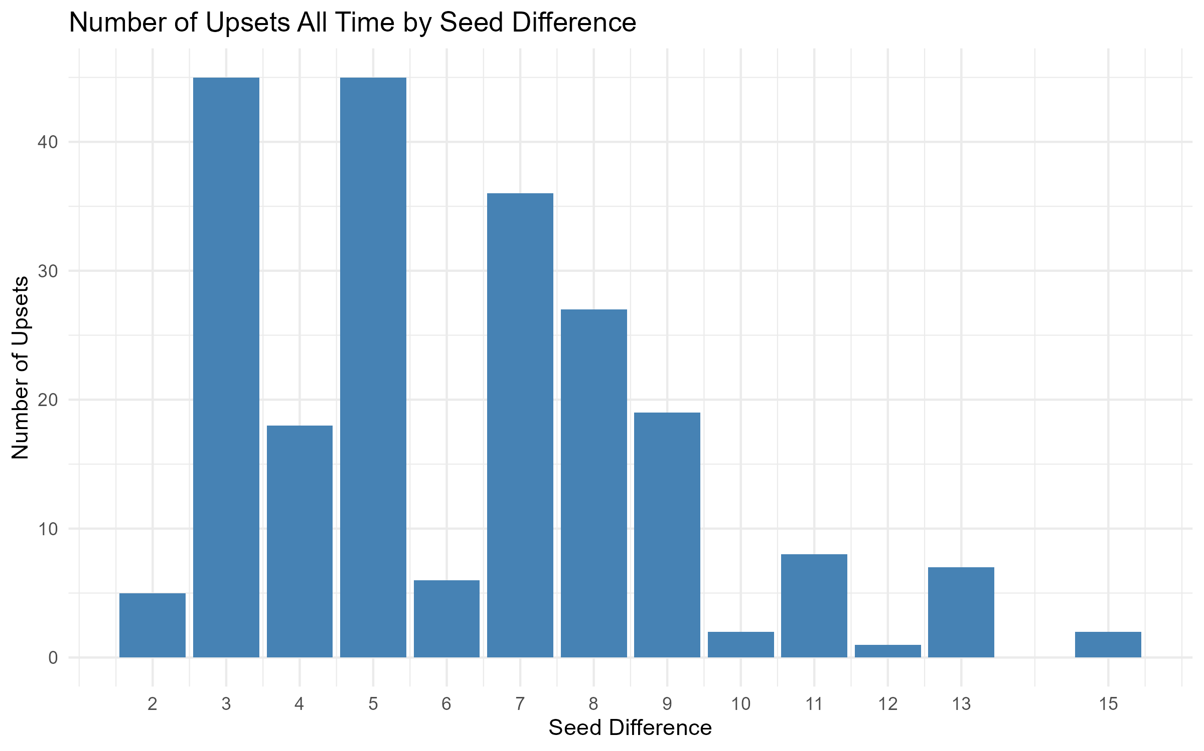

Slide 24
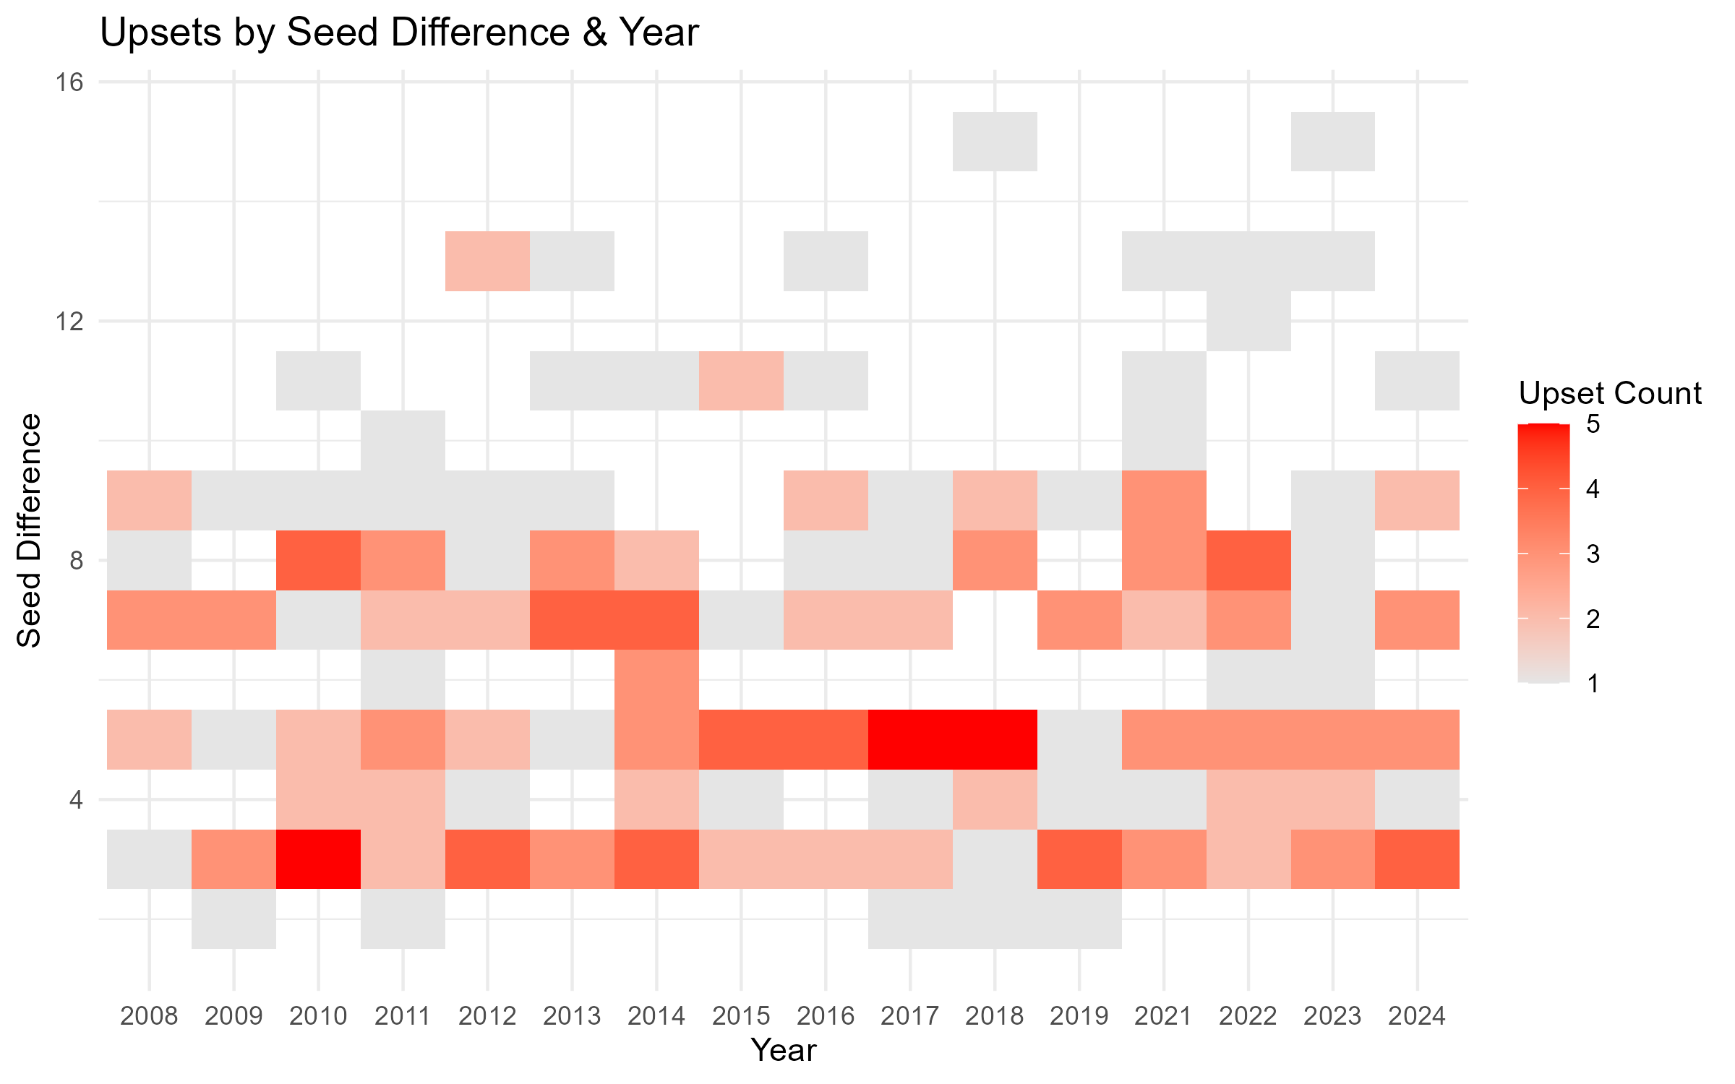

Slide 25
Takeaway #5
Upsets with a seed difference of more than 9 are rare and should likely not be considered for picks. Most upsets fall between a seed difference range of 3-9, with 3 and 5 being the most common. Upsets with a seed difference of 2 and 6 rarely occur, but this could also be due to the fact that matchups with those differences don’t occur often in the first place.

Slide 26
Key 6: Preseason Favorites vs Late Arrivers

Slide 27
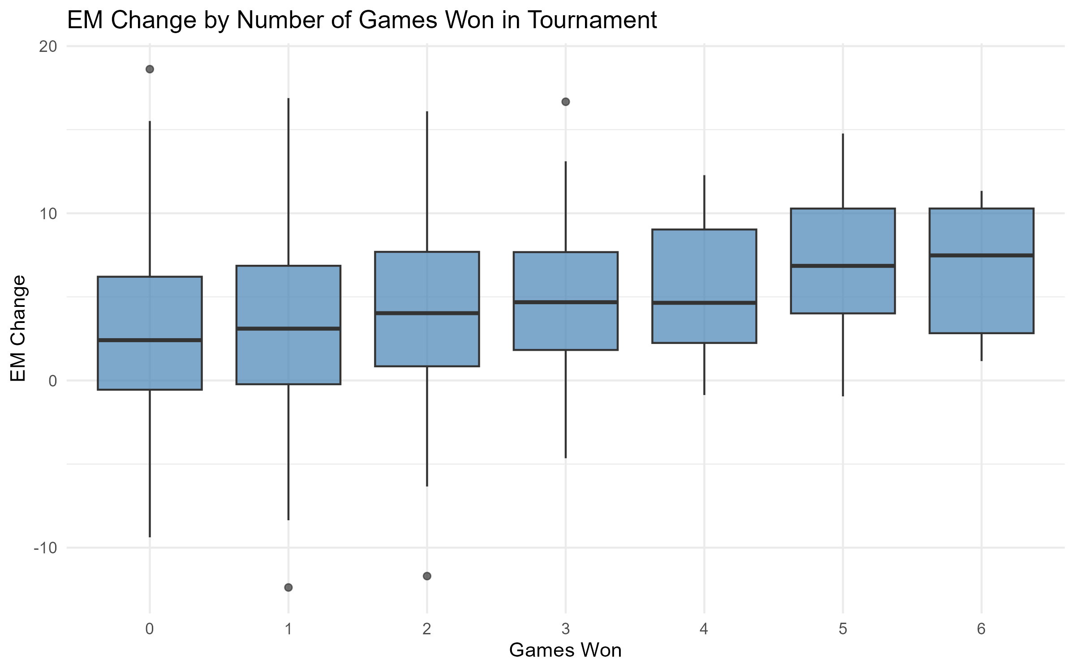

Slide 28
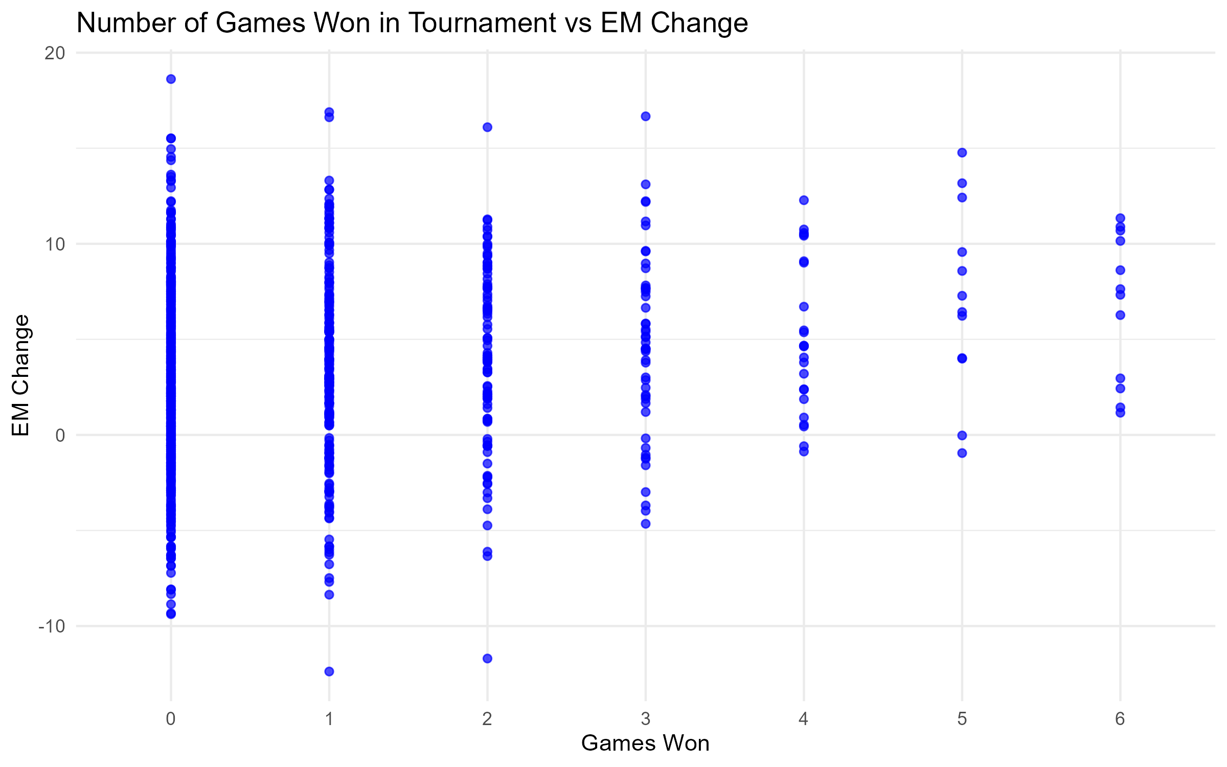

Slide 29
Takeaway #6
Teams with a higher EM (efficiency margin, a good way to measure overall team quality) change tend to make it slightly farther in the tournament. Meaning, teams that improve from preseason to the regular season are more likely to win more games in the tournament than teams that remained the same or teams that got worse.

Slide 30
Key 7: Pace of Play

Slide 31
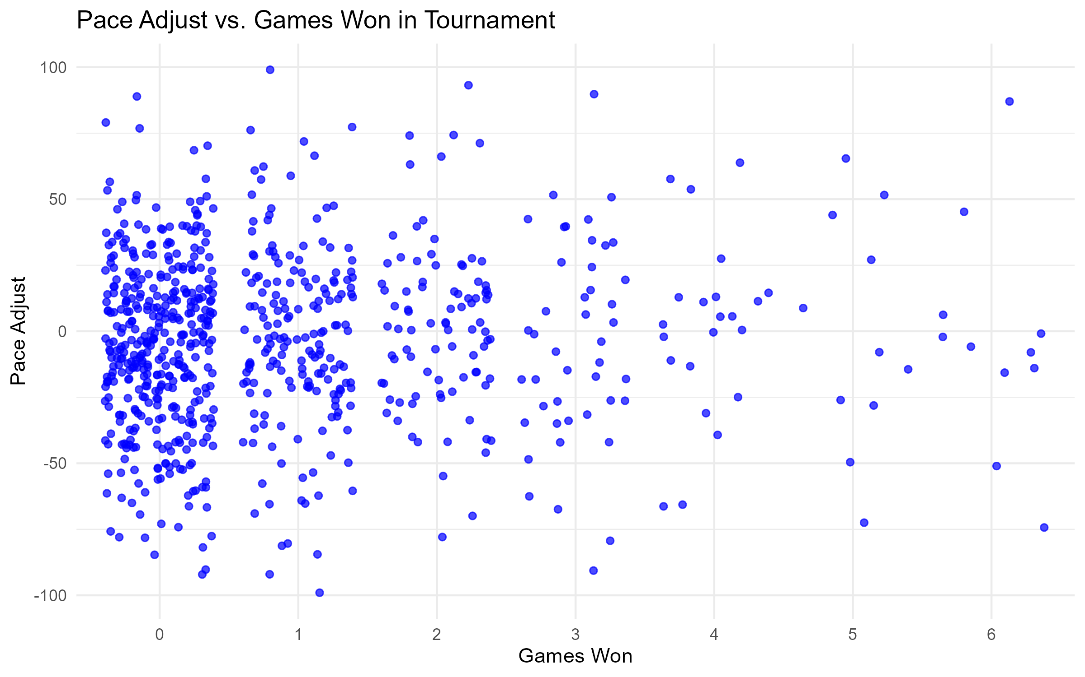

Slide 32
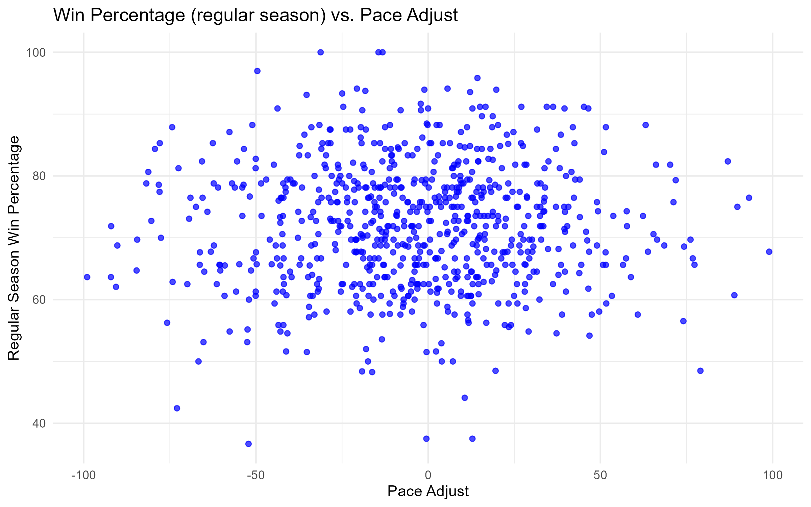

Slide 33
Takeaway #7
There is seemingly no correlation between a team’s pace of play and how far they make it into the tournament.

