Slide 1
FINAL PROJECT DEMO
Gray Code to
Binary Converter
Design • Simulation • Verification in Logisim Evolution
PROJECT TEAM
2620090062
Sambha Ritika Sripranitha
2620090066
G Laxmi Narashimha
2620090081
Palavala Venkata Sudheer Kumar Reddy
2620040047
Kandoori Shanmuk Hari Guptha
Department of ECE | Digital Design & Computer Architecture | 26EC1202E

Slide 2
OVERVIEW
Aim, Objectives & Learning Outcomes
AIM
To design, simulate and verify a 4-bit Gray Code to Binary Converter using combinational logic (XOR gates) in Logisim Evolution, following the Specification → Design → Simulation → Verification workflow.
OBJECTIVES
LEARNING OUTCOMES
▸ Understand Gray code and its one-bit-change property.
▸ Derive Boolean equations for Gray → Binary conversion.
▸ Design the converter using XOR gates.
▸ Simulate and verify in Logisim Evolution.
▸ Translate a specification into a working circuit.
▸ Apply truth-table & Boolean methods to code conversion.
▸ Verify circuit behaviour by simulation.
▸ Relate code converters to RISC-V datapath blocks.
02
26EC1202E – Digital Design & Computer Architecture

Slide 3
INTRODUCTION
Gray Code — and Why Convert It?
▸ Binary: several bits can change at once (0111 → 1000).
▸ Gray code: only ONE bit changes between successive values.
▸ No transient/ambiguous states during transitions.
▸ Used in encoders, ADCs, K-maps, digital communication.
▸ Most systems work in pure binary → Gray must be converted.
Decimal | Binary | Gray
0 | 0000 | 0000
1 | 0001 | 0001
2 | 0010 | 0011
3 | 0011 | 0010
4 | 0100 | 0110
5 | 0101 | 0111
6 | 0110 | 0101
7 | 0111 | 0100
Key observation
Gray 3 → 4 (0010 → 0110) flips only one bit; binary 3 → 4 (0111 → 1000) flips all four — the source of glitches in position sensing.
03

Slide 4
DESIGN
Conversion Logic — Boolean Equations
MSB passes through unchanged
B₃ = G₃
Each other bit = previous binary bit ⊕ Gray bit
B₂ = B₃ ⊕ G₂ B₁ = B₂ ⊕ G₁ B₀ = B₁ ⊕ G₀
G₃
B₃ = G₃
XOR
G₂
B₂ = B₃⊕G₂
XOR
G₁
B₁ = B₂⊕G₁
Worked example — G = 1011 (Gray)
B₃ = 1 B₂ = 1⊕0 = 1 B₁ = 1⊕1 = 0 B₀ = 0⊕1 = 1
B = 1101 ✔
XOR
G₀
B₀ = B₁⊕G₀
04

Slide 5
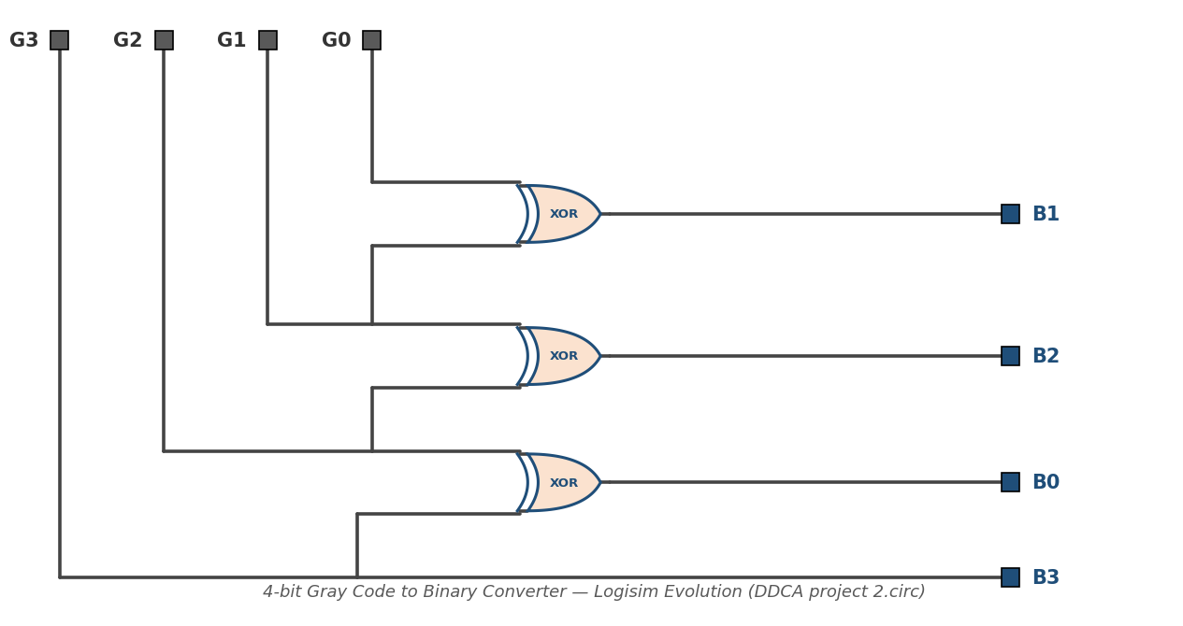
CIRCUIT DESIGN
Implementation in Logisim Evolution
▸ Inputs: pins G₃, G₂, G₁, G₀ (Gray, MSB → LSB).
▸ B₃ taken directly from G₃ — MSB needs no gate.
▸ Three 2-input XOR gates produce B₂, B₁, B₀.
▸ Each XOR chains a Gray bit with the higher binary bit.
▸ Purely combinational — no clock or memory.
DDCA project 2.circ — actual schematic
05

Slide 6
VERIFICATION
Truth Table & Simulation Results
TEST PROCEDURE
1. Apply all 16 Gray-code combinations via input pins (poke tool).
2. Observe outputs B₃–B₀ after XOR propagation delay.
3. Cross-check each output against the truth table.
All 16 cases matched — circuit verified. ✔
Dec | Gray G₃G₂G₁G₀ | Binary B₃B₂B₁B₀
0 | 0000 | 0000
1 | 0001 | 0001
2 | 0011 | 0010
3 | 0010 | 0011
4 | 0110 | 0100
5 | 0111 | 0101
6 | 0101 | 0110
7 | 0100 | 0111
8 | 1100 | 1000
9 | 1101 | 1001
10 | 1111 | 1010
11 | 1110 | 1011
12 | 1010 | 1100
13 | 1011 | 1101
14 | 1001 | 1110
15 | 1000 | 1111
SAMPLE RUN — G₃G₂G₁G₀ = 1011 (Gray)
B₃ = 1, B₂ = 1⊕0 = 1, B₁ = 1⊕1 = 0, B₀ = 0⊕1 = 1
Pins read 1101 ✔ (Decimal 13 — matches truth table)
06

Slide 7
CONCLUSION
Results, Applications & Summary
RESULTS
✔ Designed & simulated in Logisim Evolution.
✔ All 16 input combinations verified.
✔ Follows Specification → Design → Simulation → Verification.
APPLICATIONS
▸ Rotary / optical encoders — glitch-free position sensing.
▸ Analog-to-Digital Converters (ADCs).
▸ Digital communication & K-map / low-power FSM design.
SUMMARY
Gray code: one bit changes per step — safe transitions.
Converter = 1 direct line + 3 XOR gates. Minimal hardware!
Pure combinational logic — no clock, no memory.
WHAT WE LEARNT
▸ Logic equations → physical gate-level circuit.
▸ XOR: the workhorse of code-conversion & parity circuits.
▸ Simulation-based verification against a specification.
07

Slide 8
THANK YOU
Questions & Discussion are welcome!
PROJECT TEAM
2620090062
Sambha Ritika Sripranitha
2620090066
G Laxmi Narashimha
2620090081
Palavala Venkata Sudheer Kumar Reddy
2620040047
Kandoori Shanmuk Hari Guptha

