Slide 1
上海财经大学
统计与管理学院
王彤辉

Slide 2
1974~1986年间制造业中的税后利润X(亿美元)以及三月期现金利息Y(亿美元)的数据
年份 | Y | X | 年份 | Y | X
1974 | 19467 | 58747 | 1981 | 40317 | 101302
1975 | 19968 | 49135 | 1982 | 41259 | 71028
1976 | 22763 | 64159 | 1983 | 41624 | 85834
1977 | 26585 | 70366 | 1984 | 45102 | 107648
1978 | 28932 | 81148 | 1985 | 45517 | 87648
1979 | 32491 | 98698 | 1986 | 46044 | 83121
1980 | 36495 | 92579

Slide 3
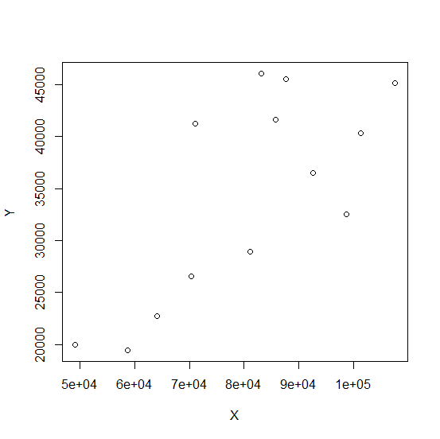

Slide 4
Call:
lm(formula = Y ~ X)
Residuals:
Min 1Q Median 3Q Max
-9340 -4570 -2607 5193 11042
Coefficients:
Estimate Std. Error t value Pr(>|t|)
(Intercept) 403.4088 9499.7777 0.042 0.96689
X 0.4197 0.1150 3.649 0.00382 **
---
Signif. codes: 0 ‘***’ 0.001 ‘**’ 0.01 ‘*’ 0.05 ‘.’ 0.1 ‘ ’ 1
Residual standard error: 6947 on 11 degrees of freedom
Multiple R-squared: 0.5477, Adjusted R-squared: 0.5065
F-statistic: 13.32 on 1 and 11 DF, p-value: 0.003825

Slide 5
Call:
lm(formula = Y ~ X + I(X^2))
Residuals:
Min 1Q Median 3Q Max
-8497.5 -5026.0 -895.2 3794.8 9283.7
Coefficients:
Estimate Std. Error t value Pr(>|t|)
(Intercept) -4.670e+04 3.991e+04 -1.170 0.269
X 1.670e+00 1.037e+00 1.611 0.138
I(X^2) -7.923e-06 6.528e-06 -1.214 0.253
Residual standard error: 6802 on 10 degrees of freedom
Multiple R-squared: 0.6057, Adjusted R-squared: 0.5269
F-statistic: 7.682 on 2 and 10 DF, p-value: 0.009528

Slide 6
Analysis of Variance Table
Response: Y
Df Sum Sq Mean Sq F value Pr(>F)
X 1 642742322 642742322 13.318 0.003825 **
Residuals 11 530876175 48261470
---
Signif. codes: 0 ‘***’ 0.001 ‘**’ 0.01 ‘*’ 0.05 ‘.’ 0.1 ‘ ’ 1

Slide 7
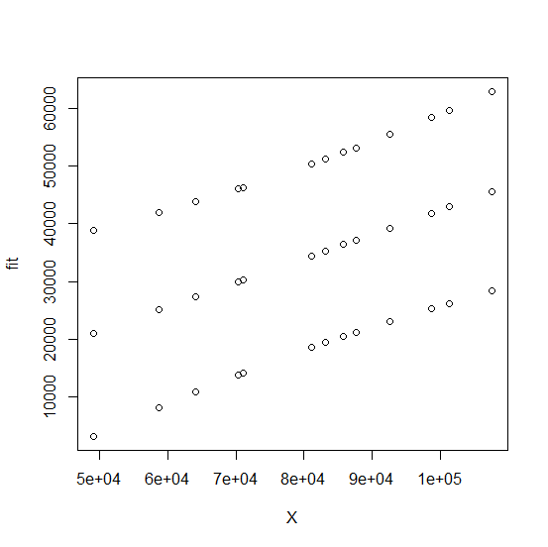
95%预测区间

Slide 8
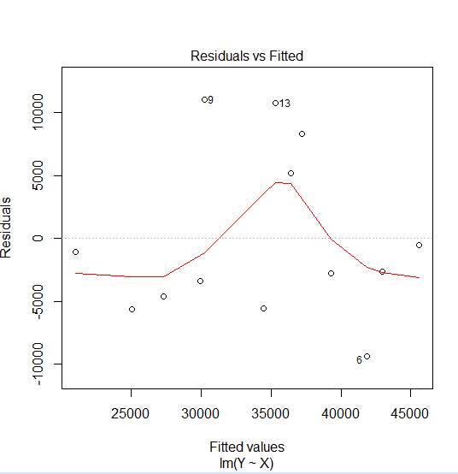

Slide 9
