Slide 1
1988年美国研究与发展( R & D )支出费用
序号 | 行业 | 销售额（X） | R & D费用支出（Y）
1 | 容器与包装 | 6375.3 | 62.5
2 | 非银行金融机构 | 11626.4 | 92.9
3 | 服务行业 | 14655.1 | 178.3
4 | 金属与采掘业 | 21896.2 | 258.4
5 | 住房与建筑业 | 26408.3 | 494.7
6 | 一般制造业 | 32405.6 | 1083
7 | 闲暇时间行业 | 35107.7 | 1620.6

Slide 2
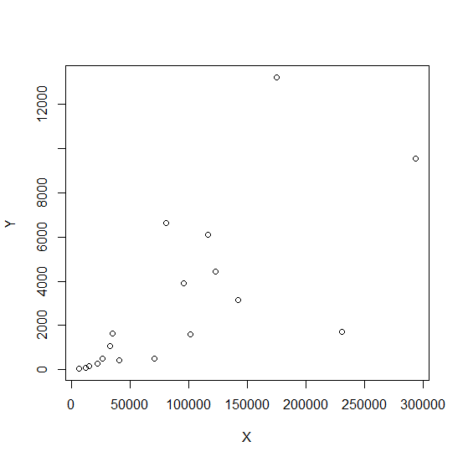

Slide 3
Call:
lm(formula = Y ~ X)
Residuals:
Min 1Q Median 3Q Max
-5845.9 -950.8 -402.3 346.4 7434.3
Coefficients:
Estimate Std. Error t value Pr(>|t|)
(Intercept) 1.929e+02 9.910e+02 0.195 0.84811
X 3.190e-02 8.329e-03 3.830 0.00148 **
---
Signif. codes: 0 ‘***’ 0.001 ‘**’ 0.01 ‘*’ 0.05 ‘.’ 0.1 ‘ ’ 1
Residual standard error: 2759 on 16 degrees of freedom
Multiple R-squared: 0.4783, Adjusted R-squared: 0.4457
F-statistic: 14.67 on 1 and 16 DF, p-value: 0.001476

Slide 4
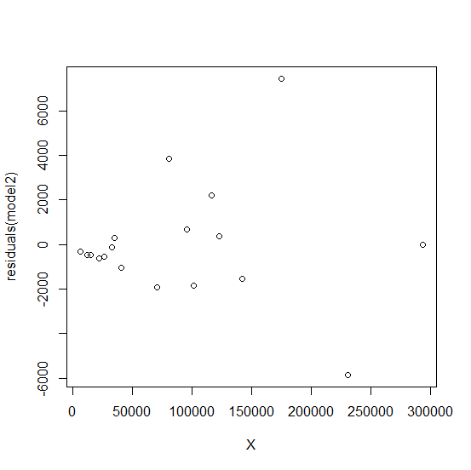

Slide 5
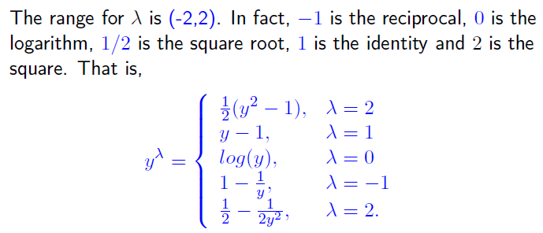

Slide 6
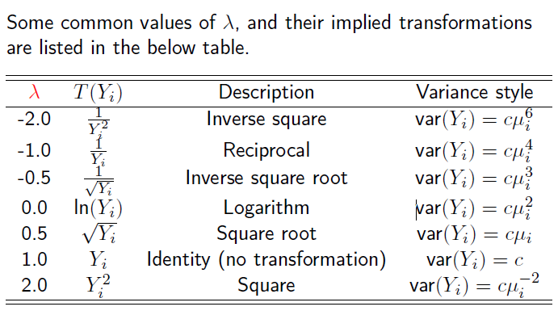

Slide 7
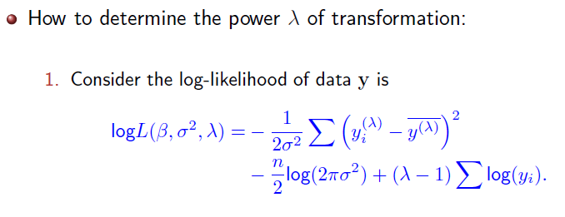

Slide 8
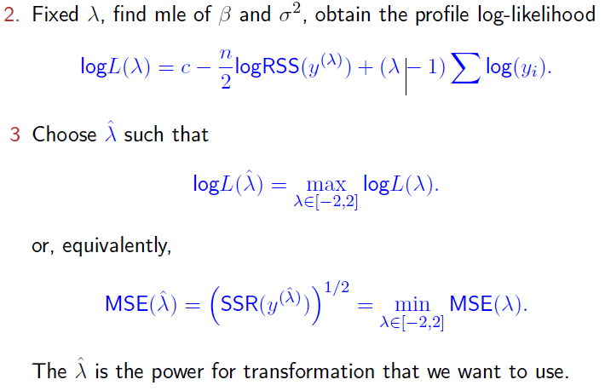

Slide 9
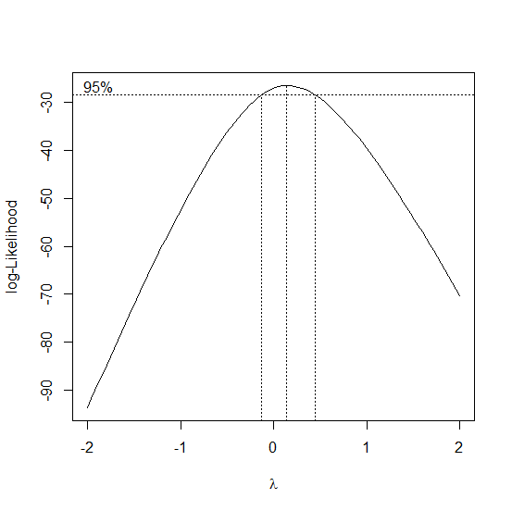

Slide 10
bcPower Transformation to Normality
Est.Power Std.Err. Wald Lower Bound Wald Upper Bound
Y 0.1158 0.1645 -0.2067 0.4383
Likelihood ratio tests about transformation parameters
LRT df pval
LR test, lambda = (0) 0.5028755 1 4.782394e-01
LR test, lambda = (1) 23.3230434 1 1.369494e-06

Slide 11
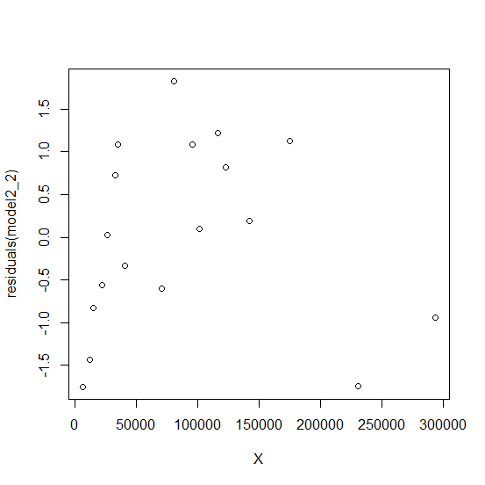

Slide 12
Call:
lm(formula = Y2 ~ X)
Residuals:
Min 1Q Median 3Q Max
-1.74854 -0.76588 0.06044 1.01508 1.82350
Coefficients:
Estimate Std. Error t value Pr(>|t|)
(Intercept) 5.790e+00 4.029e-01 14.372 1.45e-10 ***
X 1.470e-05 3.386e-06 4.342 0.000504 ***
---
Signif. codes: 0 ‘***’ 0.001 ‘**’ 0.01 ‘*’ 0.05 ‘.’ 0.1 ‘ ’ 1
Residual standard error: 1.122 on 16 degrees of freedom
Multiple R-squared: 0.541, Adjusted R-squared: 0.5123
F-statistic: 18.86 on 1 and 16 DF, p-value: 0.0005041

