Slide 1
美国1 9 6 0至1 9 8 2年期间有关数据：平均每人鸡肉消费量(Y)，每人实际(即通货膨胀调整后的)可支配收入(X1)，鸡肉的实际零售价格(X2)，猪肉实际零售价格(X3)，牛肉实际零售价格(X4)
Y | X1 | X2 | X3 | X4
27.8 | 397.5 | 42.2 | 50.7 | 78.3
29.9 | 413.3 | 38.1 | 52 | 79.2
29.8 | 439.2 | 40.3 | 54 | 79.2
30.8 | 459.7 | 39.5 | 55.3 | 79.2

Slide 2
Call:
lm(formula = ex3$Y ~ ex3$X1 + ex3$X2 + ex3$X3 + ex3$X4)
Residuals:
Min 1Q Median 3Q Max
-3.2646 -1.5850 0.2338 1.0703 3.0305
Coefficients:
Estimate Std. Error t value Pr(>|t|)
(Intercept) 37.232364 3.717695 10.015 8.73e-09 ***
ex3$X1 0.005011 0.004893 1.024 0.31936
ex3$X2 -0.611174 0.162849 -3.753 0.00146 **
ex3$X3 0.198409 0.063721 3.114 0.00600 **
ex3$X4 0.069503 0.050987 1.363 0.18965
---
Signif. codes: 0 ‘***’ 0.001 ‘**’ 0.01 ‘*’ 0.05 ‘.’ 0.1 ‘ ’ 1
Residual standard error: 1.953 on 18 degrees of freedom
Multiple R-squared: 0.9426, Adjusted R-squared: 0.9298
F-statistic: 73.87 on 4 and 18 DF, p-value: 6.434e-11

Slide 3
相关系数
X1 X2 X3 X4
X1 1.0000000 0.9316808 0.9571312 0.9858775
X2 0.9316808 1.0000000 0.9701116 0.9284689
X3 0.9571312 0.9701116 1.0000000 0.9405665
X4 0.9858775 0.9284689 0.9405665 1.0000000
特征值
84.8538629 2.2412371 0.6804256 0.2244744
VIF
52.70104

Slide 4
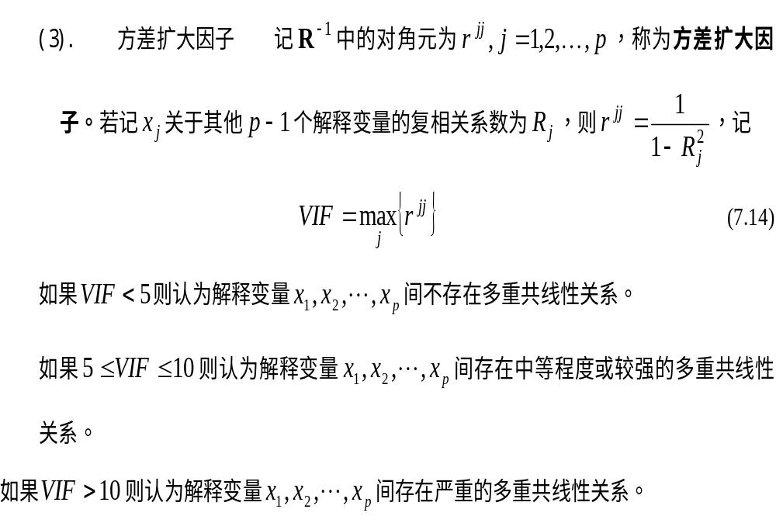

Slide 5
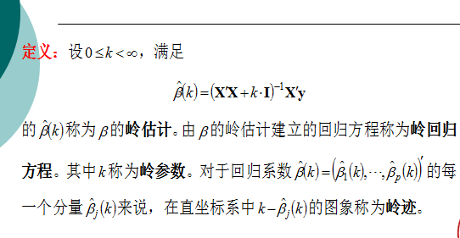
Ridge

Slide 6
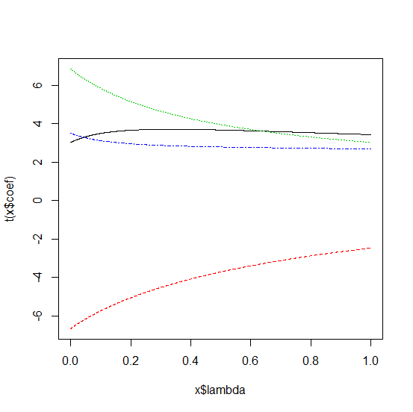
Ridge(岭迹)

Slide 7
modified HKB estimator is 0.06794296
modified L-W estimator is 0.1556778
smallest value of GCV at 0.1461
ex3$X1 ex3$X2 ex3$X3 ex3$X4
3.591045 -5.390243 5.490160 3.026003

Slide 8
主成分分析
$values
[1] 3.85699377 0.10187441 0.03092844 0.01020338
$vectors
[,1] [,2] [,3] [,4]
[1,] -0.5023364 0.4438509 -0.2230041 0.7077596
[2,] -0.4964816 -0.6160158 0.5727660 0.2144054
[3,] -0.5014019 -0.3690070 -0.7020937 -0.3456797
[4,] -0.4997602 0.5360548 0.3595453 -0.5775917

Slide 9
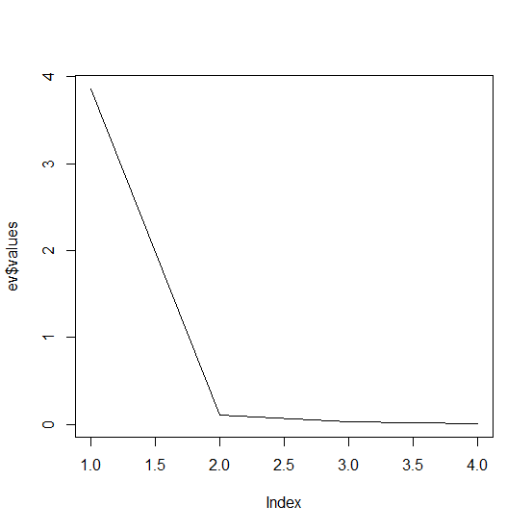
0.9642484 =3.85699377 /(3.85699377 +0.10187441 +0.03092844 +0.01020338)

Slide 10
Call:
lm(formula = ex3$Y ~ as.vector(y1))
Residuals:
Min 1Q Median 3Q Max
-4.7292 -1.9094 -0.1212 1.5744 3.7828
Coefficients:
Estimate Std. Error t value Pr(>|t|)
(Intercept) 26.967179 1.070948 25.18 < 2e-16 ***
as.vector(y1) -0.019503 0.001448 -13.46 8.46e-12 ***
---
Signif. codes: 0 ‘***’ 0.001 ‘**’ 0.01 ‘*’ 0.05 ‘.’ 0.1 ‘ ’ 1
Residual standard error: 2.431 on 21 degrees of freedom
Multiple R-squared: 0.8962, Adjusted R-squared: 0.8913
F-statistic: 181.3 on 1 and 21 DF, p-value: 8.461e-12

Slide 11
Call:
lm(formula = ex3$Y ~ as.vector(y1) + as.vector(y2))
Residuals:
Min 1Q Median 3Q Max
-4.7142 -2.2142 0.1118 1.7396 3.5582
Coefficients:
Estimate Std. Error t value Pr(>|t|)
(Intercept) 28.512143 2.621597 10.876 7.57e-10 ***
as.vector(y1) 0.004445 0.037015 0.120 0.906
as.vector(y2) 0.030338 0.046855 0.647 0.525
---
Signif. codes: 0 ‘***’ 0.001 ‘**’ 0.01 ‘*’ 0.05 ‘.’ 0.1 ‘ ’ 1
Residual standard error: 2.466 on 20 degrees of freedom
Multiple R-squared: 0.8983, Adjusted R-squared: 0.8882
F-statistic: 88.36 on 2 and 20 DF, p-value: 1.18e-10

Slide 12
Call:
lm(formula = ex3$Y ~ as.vector(y1) + as.vector(y2) + as.vector(y3))
Residuals:
Min 1Q Median 3Q Max
-3.8432 -1.9396 -0.0209 1.6222 3.8770
Coefficients:
Estimate Std. Error t value Pr(>|t|)
(Intercept) 33.39966 4.36030 7.660 3.18e-07 ***
as.vector(y1) 0.07458 0.06223 1.199 0.245
as.vector(y2) 0.06078 0.05081 1.196 0.246
as.vector(y3) -0.12021 0.08675 -1.386 0.182
---
Signif. codes: 0 ‘***’ 0.001 ‘**’ 0.01 ‘*’ 0.05 ‘.’ 0.1 ‘ ’ 1
Residual standard error: 2.411 on 19 degrees of freedom
Multiple R-squared: 0.9077, Adjusted R-squared: 0.8931
F-statistic: 62.25 on 3 and 19 DF, p-value: 5.13e-10

Slide 13
Call:
lm(formula = ex3$Y ~ as.vector(y1) + as.vector(y2) + as.vector(y3) +
+as.vector(y4))
Residuals:
Min 1Q Median 3Q Max
-3.2646 -1.5850 0.2338 1.0703 3.0305
Coefficients:
Estimate Std. Error t value Pr(>|t|)
(Intercept) 37.23236 3.71770 10.015 8.73e-09 ***
as.vector(y1) 0.16670 0.05759 2.895 0.00966 **
as.vector(y2) 0.34276 0.09465 3.621 0.00195 **
as.vector(y3) -0.46549 0.12582 -3.700 0.00164 **
as.vector(y4) -0.23622 0.07140 -3.309 0.00391 **
---
Signif. codes: 0 ‘***’ 0.001 ‘**’ 0.01 ‘*’ 0.05 ‘.’ 0.1 ‘ ’ 1
Residual standard error: 1.953 on 18 degrees of freedom
Multiple R-squared: 0.9426, Adjusted R-squared: 0.9298
F-statistic: 73.87 on 4 and 18 DF, p-value: 6.434e-11

Slide 14
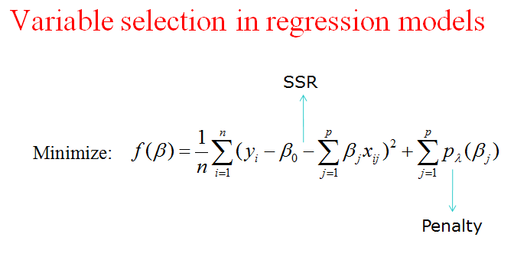
LASS0

Slide 15
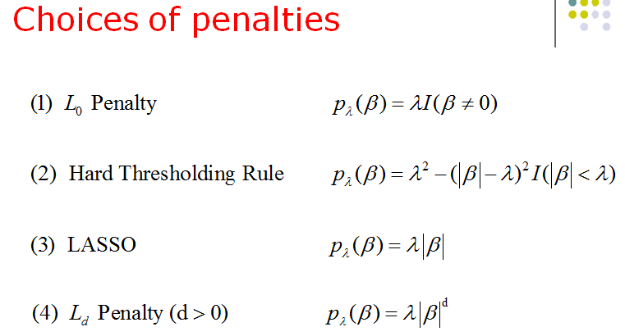
LASS0

Slide 16
