Slide 1
个性化教学体系对课程成绩的影响
GPA | TUCE | PSI | 评级
2.66 | 20 | 0 | 0
2.89 | 22 | 0 | 0
3.28 | 24 | 0 | 0
2.92 | 12 | 0 | 0
4 | 21 | 0 | 1
GPA 入学时的成绩
PSI=1 采用新的教学方式
PSI=0 旧的教学方式
TUCE 为测试入学时宏观经济学水平而举行的期初考试分数
评级=1 期末考试成绩为A

Slide 2
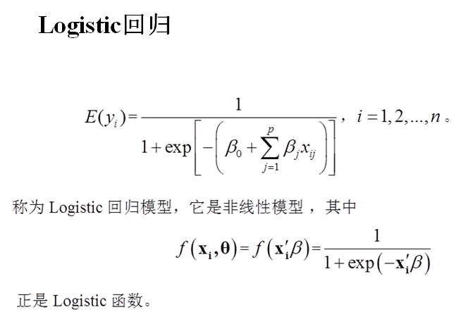

Slide 3
Call:
glm(formula = Y ~ X1 + X2 + X3, family = binomial)
Deviance Residuals:
Min 1Q Median 3Q Max
-1.9551 -0.6453 -0.2570 0.5888 2.0966
Coefficients:
Estimate Std. Error z value Pr(>|z|)
(Intercept) -13.02135 4.93127 -2.641 0.00828 **
X1 2.82611 1.26293 2.238 0.02524 *
X2 0.09516 0.14155 0.672 0.50143
X3 2.37869 1.06456 2.234 0.02545 *
---
Signif. codes: 0 ‘***’ 0.001 ‘**’ 0.01 ‘*’ 0.05 ‘.’ 0.1 ‘ ’ 1
(Dispersion parameter for binomial family taken to be 1)
Null deviance: 41.183 on 31 degrees of freedom
Residual deviance: 25.779 on 28 degrees of freedom
AIC: 33.779

Slide 4
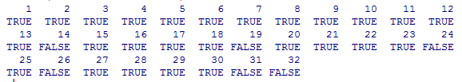

Slide 5
Call:
glm(formula = Y ~ X1 + X3, family = binomial)
Deviance Residuals:
Min 1Q Median 3Q Max
-1.8396 -0.6282 -0.3045 0.5629 2.0378
Coefficients:
Estimate Std. Error z value Pr(>|z|)
(Intercept) -11.602 4.213 -2.754 0.00589 **
X1 3.063 1.223 2.505 0.01224 *
X3 2.338 1.041 2.246 0.02470 *
---
Signif. codes: 0 ‘***’ 0.001 ‘**’ 0.01 ‘*’ 0.05 ‘.’ 0.1 ‘ ’ 1
(Dispersion parameter for binomial family taken to be 1)
Null deviance: 41.183 on 31 degrees of freedom
Residual deviance: 26.253 on 29 degrees of freedom
AIC: 32.253
Number of Fisher Scoring iterations: 5

Slide 6
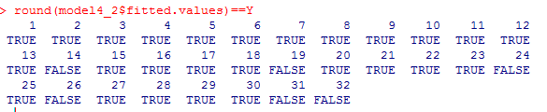

Slide 7
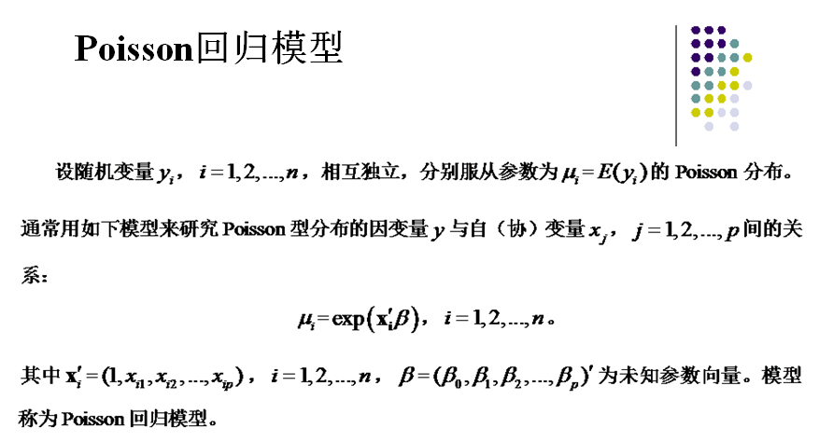

Slide 8
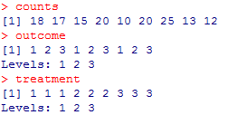

Slide 9
Coefficients:
Estimate Std. Error z value Pr(>|z|)
(Intercept) 3.045e+00 1.709e-01 17.815 <2e-16 ***
outcome2 -4.543e-01 2.022e-01 -2.247 0.0246 *
outcome3 -2.930e-01 1.927e-01 -1.520 0.1285
treatment2 1.338e-15 2.000e-01 0.000 1.0000
treatment3 1.421e-15 2.000e-01 0.000 1.0000
---
Signif. codes: 0 ‘***’ 0.001 ‘**’ 0.01 ‘*’ 0.05 ‘.’ 0.1 ‘ ’ 1
(Dispersion parameter for poisson family taken to be 1)
Null deviance: 10.5814 on 8 degrees of freedom
Residual deviance: 5.1291 on 4 degrees of freedom
AIC: 56.761

Slide 10
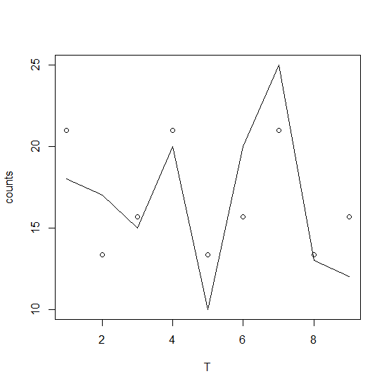

18,17,15,20,10,20,25,13,12

