Slide 1
Variable Description
M(x1) percentage of males aged 14–24 in total state population
So(x2) indicator variable for a southern state
Ed (x3) mean years of schooling of the population aged 25 years or over
Po1(x4) per capita expenditure on police protection in 1960
Po2 (x5) per capita expenditure on police protection in 1959
LF(x6) labour force participation rate of civilian urban males in the age-group 14-24
M.F(x7) number of males per 100 females
Pop(x8) state population in 1960 in hundred thousands
NW(x9) percentage of nonwhites in the population
U1(x10) unemployment rate of urban males 14–24
U2 (x11) unemployment rate of urban males 35–39
Wealth(x12) wealth: median value of transferable assets or family income
Ineq(x13) income inequality: percentage of families earning below half the median income
Prob(x14) probability of imprisonment: ratio of number of commitments to number of offenses
Time(x15) average time in months served by offenders in state prisons before their first release
Crime(Y) crime rate: number of offenses per 100,000 population in 1960

Slide 2
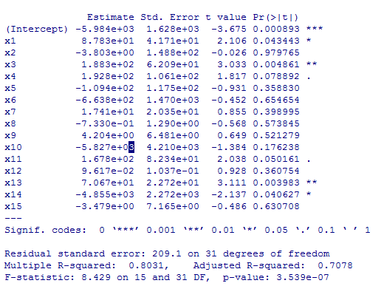

Slide 3
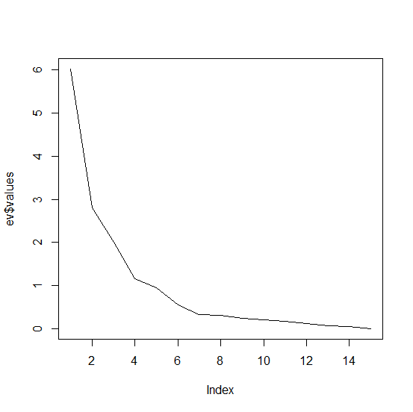
主成分

Slide 4
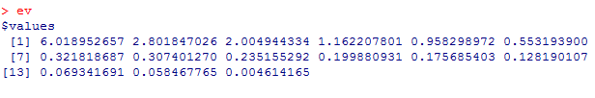
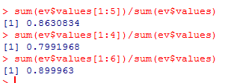
主成分

Slide 5
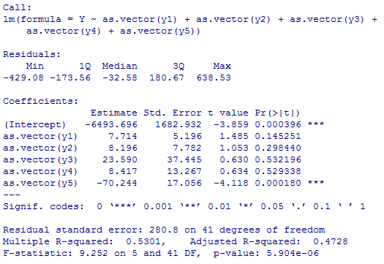
主成分

Slide 6
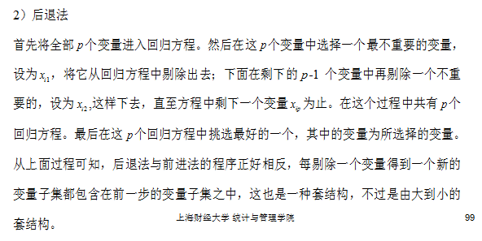
逐步回归（向后）

Slide 7
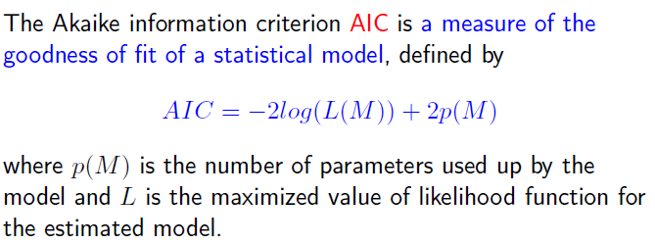
逐步回归（向后）

Slide 8
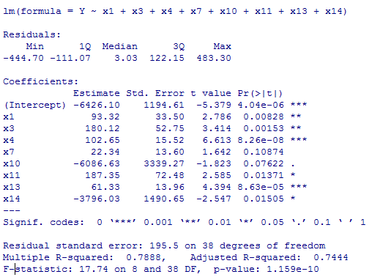
逐步回归（向后）

Slide 9
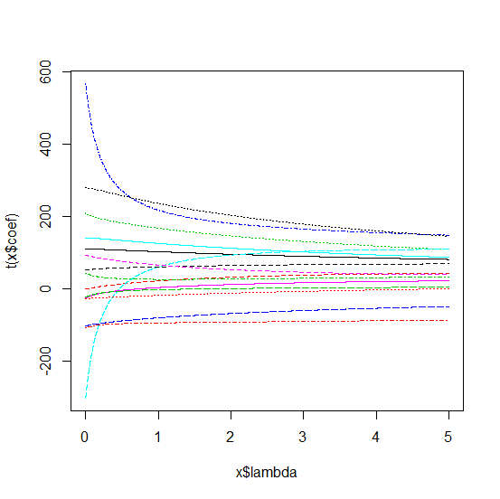
Ridge回归

Slide 10
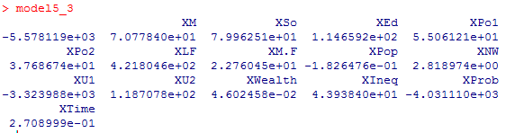
Ridge回归

Slide 11
lasso回归
见程序

