Slide 1
CASE STUDY
Supply Chain Analytics Dashboard
Turning inventory data into executive action
Erwin Glenn L. Capitan II
BI Analyst / Power BI Developer
glcapitan007@gmail.com · linkedin.com/in/erwin-glenn-capitan-ii · github.com/glcapitan

Slide 2
01 · THE ENGAGEMENT
Operations said stockouts. Finance said over-buying.
Both teams were looking at the same inventory but drawing opposite conclusions. The dashboard had to resolve the disagreement — not just visualize the data.
The retailer
The data
The mandate
Mid-size omnichannel: 40 SKUs across 4 categories (Electronics, Grocery, Household, Personal Care), 4 brands, 3 channels (stores, DCs, web).
~57K sales transactions, ~17K daily inventory snapshots, ~64K movement events. Dec 2025 – May 2027.
Build something that resolves the Ops-vs-Finance disagreement and translates findings into a 90-day action plan.
THE HEADLINE FINDING
It was an overstock problem, not a stockout problem. One SKU was at genuine stockout risk. Twenty-four were sitting on more than 90 days of cover.
Supply Chain Analytics — Case Study · Erwin Glenn L. Capitan II
2

Slide 3
02 · APPROACH
Medallion pipeline → Kimball star schema → Power BI
Bronze
Silver
Gold
Semantic
Raw ingest from source files. Schema-on-read, no transformation.
Cleaned & validated. 5-check DQ framework. Date parsing, dim integrity, movement-type normalization.
Kimball star schema. 3 dims, 4 facts, business definitions encoded (DoS, overstock thresholds). Exported as Parquet.
Power BI: 14 tables, 109 columns, 101 DAX measures. Filter-aware narrative bands on every page.
›
›
›
WHY THIS ARCHITECTURE
Pushing business logic (overstock thresholds, days-of-supply rules) into Gold keeps the DAX layer focused on measurement and presentation — not duplicated business definitions. The semantic model stays clean; analysts inherit consistent definitions.
Supply Chain Analytics — Case Study · Erwin Glenn L. Capitan II
3

Slide 4
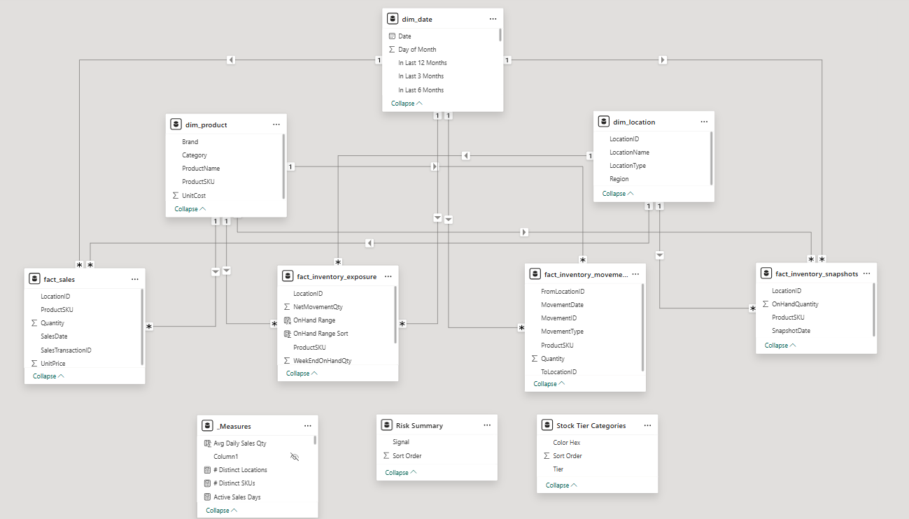
03 · DATA MODEL
Kimball star schema
dim_date
14
109
101
5 folders
Tables
Columns
DAX Measures
Sales / Inv / Stock / Mov / Narr
Supply Chain Analytics — Case Study · Erwin Glenn L. Capitan II
4

Slide 5
04 · THE DASHBOARD
Four pages, four audiences, one consistent skeleton
PAGE 1
PAGE 2
PAGE 3
PAGE 4
Executive Overview
Sales Analysis
Inventory Analysis
Movements Analysis
Leadership · weekly review
Merchandising · Commercial
Inventory Planning
Operations · Logistics
"What is the overall business risk?"
"What drives revenue?"
"Where is cash trapped?"
"Is replenishment aligned with demand?"
SHARED PAGE SKELETON
Filters at top → narrative band (filter-aware describe-and-prescribe) → KPI strip → primary chart row → supporting visuals → methodology footer.
Visual consistency is intentional: a user who learns one page can navigate any of them. The narrative band updates as filters change, so the text reflects what's specifically true for the current selection — not generic boilerplate.
Supply Chain Analytics — Case Study · Erwin Glenn L. Capitan II
5

Slide 6
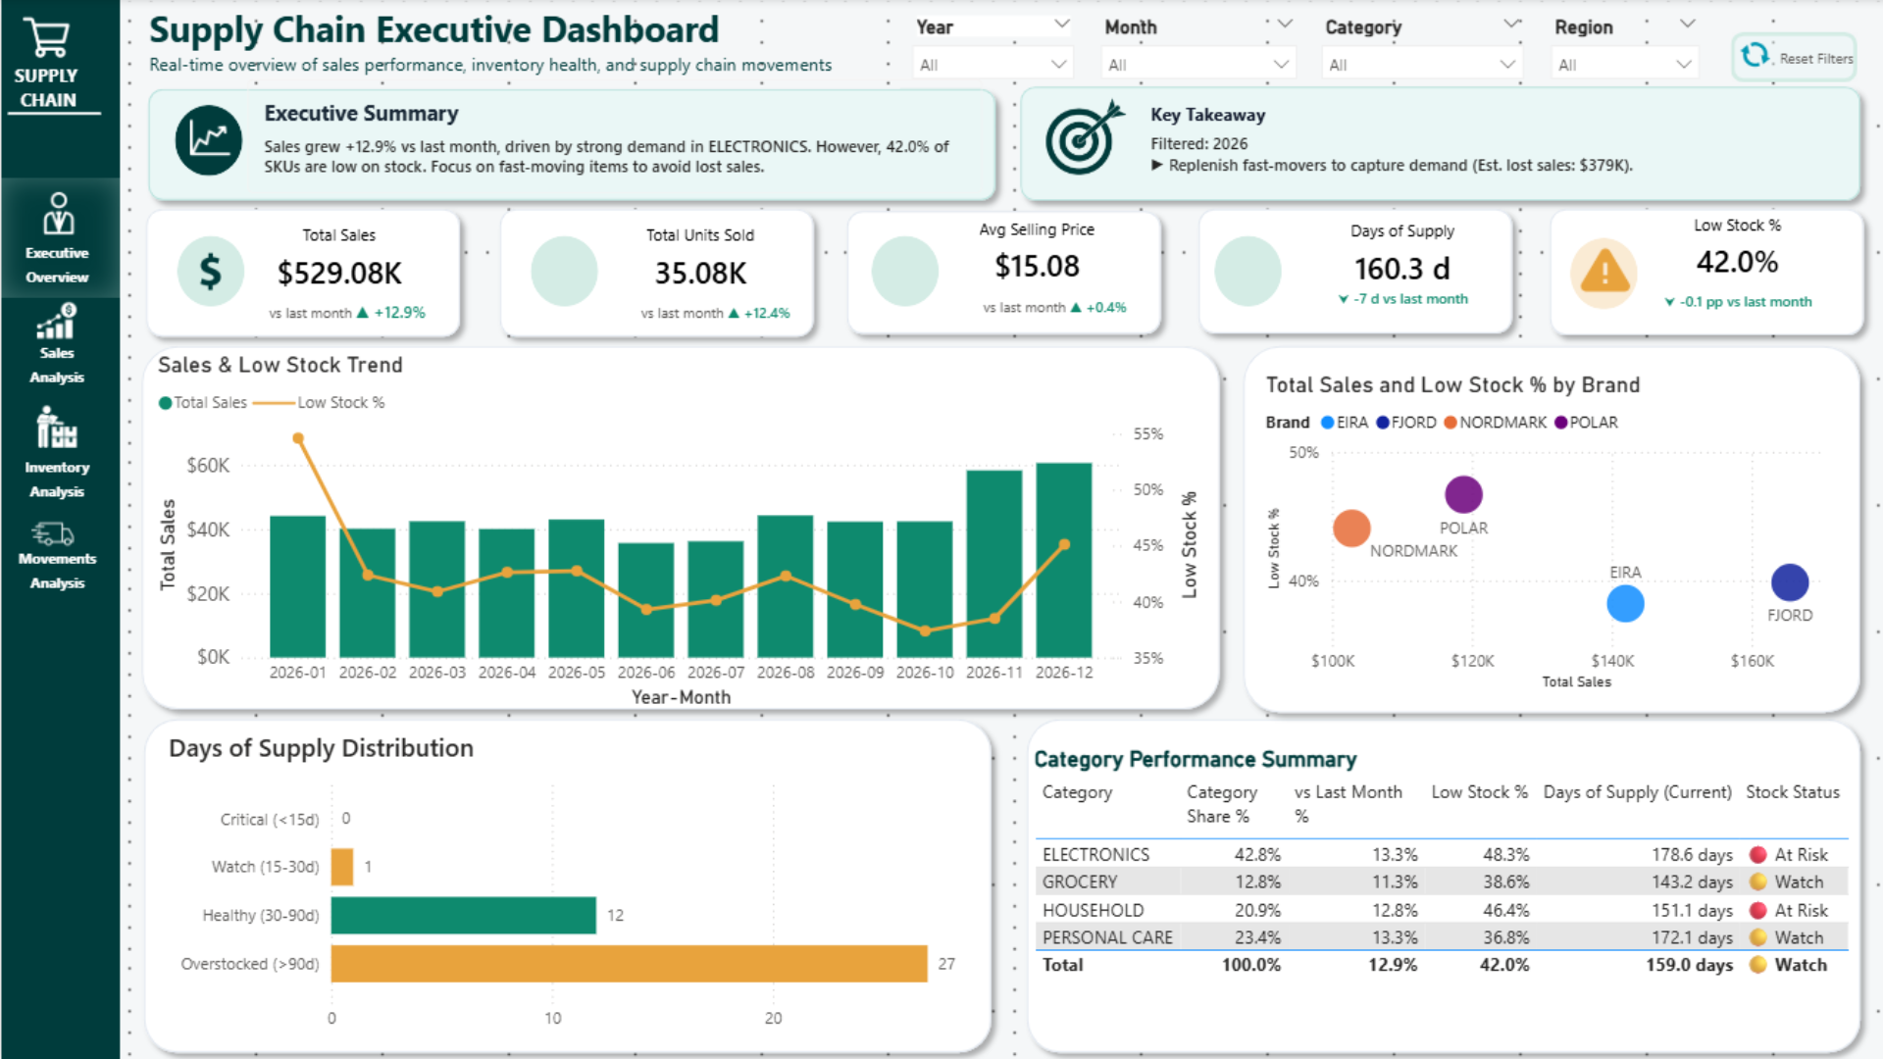
05 · PAGE 1 WALKTHROUGH
Executive Overview — single-screen state of the network
[Screenshot: 01-executive-overview.png]
What it answers
How healthy is the supply chain right now, and where should leadership look next?
Key elements
KPI strip with YoY context
Stock-risk distribution (low + over)
Sales-vs-DoS scatter — outlier finder
Filter-aware narrative + action band
READING THE MIXED SIGNAL
Short-term sales improved month-over-month, but YTD remains below prior year. Translation: demand recovered slightly, the annual gap has not.
Supply Chain Analytics — Case Study · Erwin Glenn L. Capitan II
6

Slide 7
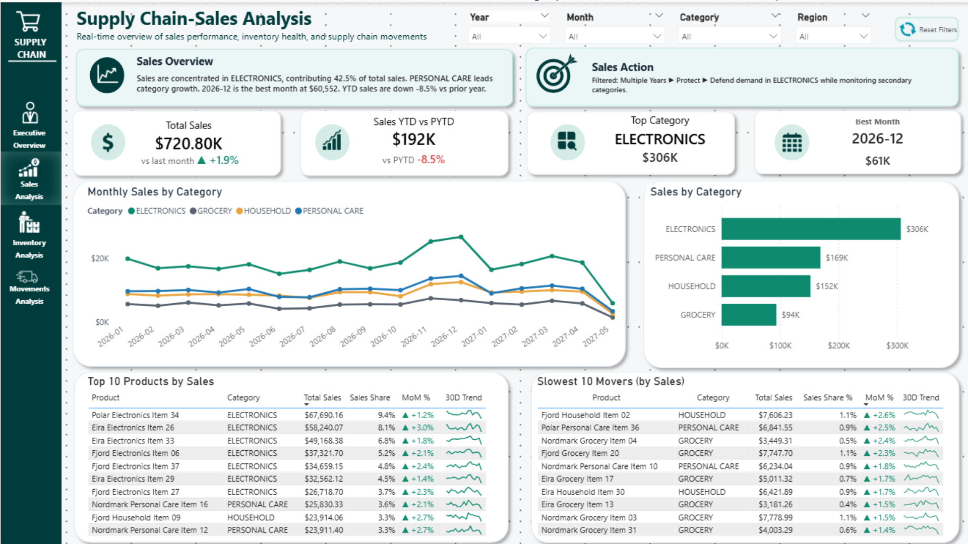
06 · PAGE 2 WALKTHROUGH
Sales Analysis — what is carrying the business
[Screenshot: 02-sales-analysis.png]
What it answers
Which products and categories are driving revenue, and which are dragging?
Key elements
Monthly trend by category
Category share-of-mix bars
Top 10 + Slowest 10 with 30-day sparklines
MoM, QoQ, YoY comparators
WHAT THE PAGE SHOWS
Electronics is 42% of revenue ($304K) — single-category dependency. The Slowest 10 view surfaces clearance candidates earlier than category-level totals would.
Supply Chain Analytics — Case Study · Erwin Glenn L. Capitan II
7

Slide 8
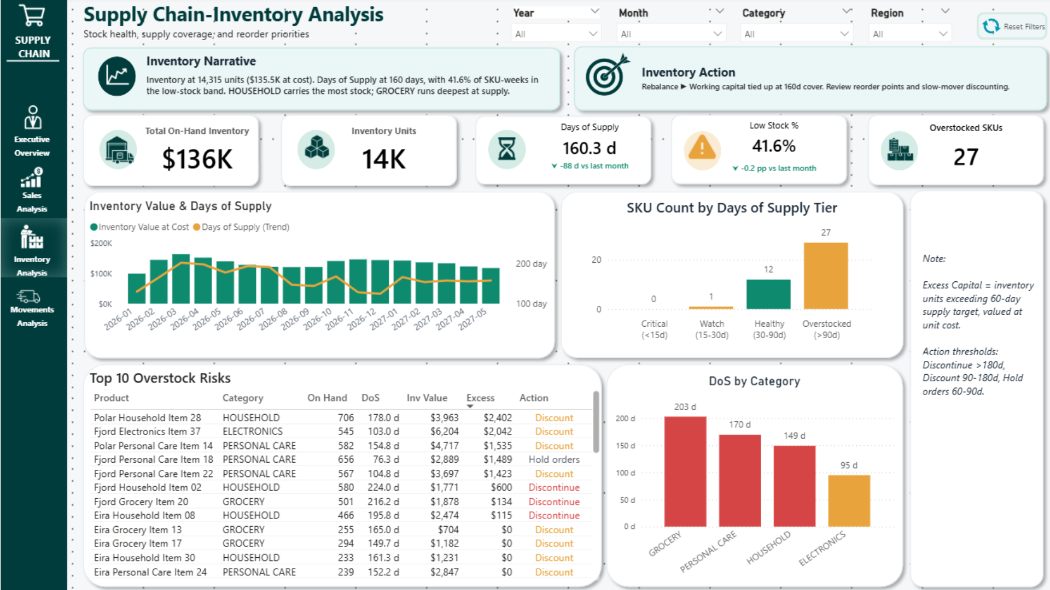
07 · PAGE 3 WALKTHROUGH
Inventory Analysis — where cash is trapped
[Screenshot: 03-inventory-analysis.png]
What it answers
Where is working capital trapped, and which SKUs need action first?
Key elements
On-hand value + units + avg DoS
DoS tier distribution (0–30 / 30–90 / 90+)
SKU-level action register
Overstock vs low-stock split
KEY BUSINESS REFRAME
This is where the reframe lives. 24 of 40 SKUs are overstocked (>90 days cover). 1 SKU is at genuine stockout risk. The page surfaces both directions so the conversation isn't one-sided.
Supply Chain Analytics — Case Study · Erwin Glenn L. Capitan II
8

Slide 9
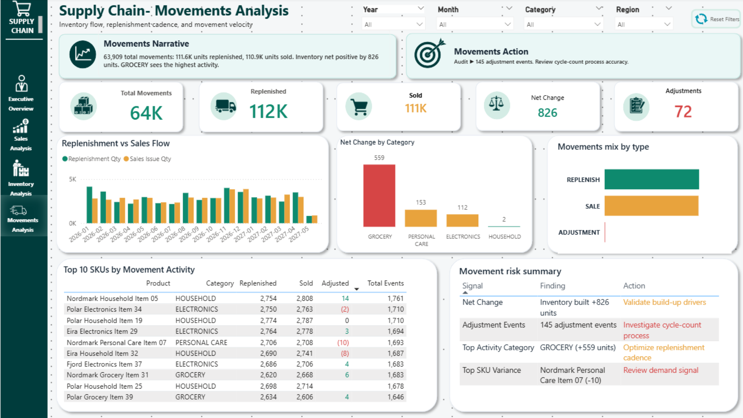
08 · PAGE 4 WALKTHROUGH
Movements Analysis — is replenishment aligned with demand
[Screenshot: 04-movements-analysis.png]
What it answers
Is inventory flowing in proportion to how it's flowing out — and what does adjustment volume say about data quality?
Key elements
Replenish vs Sales vs Adjustments mix
Net change by category (build-up signal)
Adjustment audit list
Signal → Finding → Action table
WHAT THE NUMBERS SHOW
64K events processed cleanly. +826 unit net change — slow accumulation. 145 adjustments flagged for audit — small but non-zero data integrity signal.
Supply Chain Analytics — Case Study · Erwin Glenn L. Capitan II
9

Slide 10
09 · THE REFRAME
From Reorder Priorities to Overstock Risks
BEFORE
AFTER
Top 10 Reorder Priorities
Top 10 Overstock Risks
Implied story: we need to order more aggressively to avoid stockouts.
Sharpened story: the real money is trapped, not missing.
Drove urgency toward replenishment. Made Operations look right.
Drove discussion toward markdowns, pause-replenishment, and cash recovery.
Reality check: only 1 SKU had genuine stockout exposure.
Surfaced 24 SKUs >90 days cover. Recoverable capital ~$50K–$70K.
WHAT CHANGED
The data didn't change. The analytical lens did. Cross-referencing inventory against sales velocity flipped the dashboard's most-used view — and became the project's primary value driver.
Supply Chain Analytics — Case Study · Erwin Glenn L. Capitan II
10

Slide 11
10 · TECHNICAL DEPTH
How the dashboard stays consistent and decision-oriented
101 DAX measures
Filter-aware narrative
Time-aware DoS
Organized into 5 display folders: Sales, Inventory, Stock Health, Movements, Narrative. Sample measures shown in appendix.
Each operational page has a Narrative + Action measure that updates as filters change. Text reflects what's true for the current selection.
Days-of-supply uses a trailing 30-day sales window, defended against incomplete first/last periods. No silent zeroes.
Helper-table-driven risk summary
The Movements page Signal→Finding→Action table is generated from a small disconnected helper table that maps thresholds to action text. Adding a new signal type means one row, not a measure rewrite. This pattern is reused for the executive briefing's SKU-level action register.
Supply Chain Analytics — Case Study · Erwin Glenn L. Capitan II
11

Slide 12
11 · DAX APPENDIX · 1 OF 3
Filter-aware narrative measure
Generates the describe-and-prescribe text band on the Inventory page. Updates dynamically when filters change.
Inventory Narrative =
VAR _OverstockSKUs = [Overstock SKU Count]
VAR _LowStockSKUs = [Low Stock SKU Count]
VAR _AvgDoS = [Days of Supply (30D)]
VAR _Capital = [On-Hand Value]
VAR _SelectedCat = SELECTEDVALUE ( dim_product[category], "the network" )
RETURN
"Across " & _SelectedCat & ", " & _OverstockSKUs &
" SKUs are carrying more than 90 days of cover, against " &
_LowStockSKUs & " SKUs running thin. " &
"Average days of supply is " & FORMAT ( _AvgDoS, "0" ) & " days, " &
"with " & FORMAT ( _Capital, "$#,##0" ) & " in on-hand value at risk of " &
IF ( _OverstockSKUs > _LowStockSKUs, "markdown exposure.", "stockout exposure." )
WHY THIS MATTERS
Static dashboards say the same thing regardless of filter. This one explains the current selection — and shifts its conclusion based on which exposure dominates.
Supply Chain Analytics — Case Study · Erwin Glenn L. Capitan II
12

Slide 13
12 · DAX APPENDIX · 2 OF 3
Time-aware Days of Supply
Uses trailing 30-day sales to compute coverage. Defends against incomplete periods so the measure never silently divides by zero.
Days of Supply (30D) =
VAR _MaxDate = MAX ( dim_date[Date] )
VAR _WindowStart = _MaxDate - 29
VAR _WindowSales = CALCULATE ( [Units Sold],
DATESBETWEEN ( dim_date[Date], _WindowStart, _MaxDate ) )
VAR _DailyRate = DIVIDE ( _WindowSales, 30 )
VAR _OnHand = [On-Hand Units]
RETURN
IF (
_DailyRate > 0 && NOT ISBLANK ( _OnHand ),
DIVIDE ( _OnHand, _DailyRate ),
BLANK () -- explicit blank, not a misleading zero
)
DEFENSIVE CODING
Returning BLANK() when daily rate is zero (rather than a misleading 999 or 0) keeps DoS tier visualizations honest. SKUs with no recent sales are flagged separately, not buried in the long tail.
Supply Chain Analytics — Case Study · Erwin Glenn L. Capitan II
13

Slide 14
13 · DAX APPENDIX · 3 OF 3
Overstock risk → recommended action
Reads from a disconnected helper table mapping DoS tiers to formal supply chain action language. Adding a new tier is a row, not a measure rewrite.
Recommended Action =
VAR _DoS = [Days of Supply (30D)]
VAR _Velocity = [Units Sold (30D)]
RETURN
SWITCH (
TRUE (),
ISBLANK ( _DoS ) , "Cycle Count Audit",
_DoS > 180 , "Liquidate / Discontinue",
_DoS > 90 && _Velocity > 0 , "Markdown / Promo Clearance",
_DoS > 60 , "Pause Replenishment",
_DoS < 14 , "Expedite Replenishment",
"Hold"
)
LANGUAGE CHOICE
Action labels use formal supply chain terminology — Liquidate, Markdown, Pause Replenishment, Cycle Count Audit — so the SKU register reads like an operations document, not a portfolio mock-up.
Supply Chain Analytics — Case Study · Erwin Glenn L. Capitan II
14

Slide 15
14 · VALUE CREATED
Before vs After
BEFORE
AFTER
Data state
Raw sales, inventory, and movement records — three disconnected sources.
Kimball star schema with consistent grain. 101 measures sharing one definitional layer.
Inventory risk view
Generic low-stock count. Tone suggested a stockout problem.
Dual-direction stock risk: 24 SKUs >90 days cover; 1 SKU at genuine stockout risk.
Decision support
No action list. Teams disagreed on the diagnosis.
SKU-level register with formal action language: Markdown, Liquidate, Pause Replenishment, Audit.
Executive output
Spreadsheet dumps interpreted ad-hoc.
30/60/90-day rebalancing roadmap with explicit financial impact methodology.
Supply Chain Analytics — Case Study · Erwin Glenn L. Capitan II
15

Slide 16
15 · RETROSPECTIVE
What I'd do differently
1
Write the takeaway first
The Reorder→Overstock reframe would have surfaced earlier if I'd been forcing myself to write the single-sentence takeaway at each modeling step, not after the dashboard was built.
2
Design the date dimension up front
I added the Year-Month Key integer for sort order halfway through. Small refactor — but easier to design in than retrofit. Date dimensions deserve more thought on day one.
3
Split crowded measure folders
30 measures in one folder (03 Stock Health) is too many. Next build, I'll subdivide into 2–3 sub-folders by intent (exposure / scoring / tiers).
Supply Chain Analytics — Case Study · Erwin Glenn L. Capitan II
16

Slide 17
Let's talk
Happy to walk through any part of the build — including the parts that didn't work the first time.
Erwin Glenn L. Capitan II
BI Analyst / Power BI Developer
Email glcapitan007@gmail.com
LinkedIn linkedin.com/in/erwin-glenn-capitan-ii
GitHub github.com/glcapitan

