Slide 1
Modeling with StarUML
By
Mitali Bakshi

Slide 2
What is StarUML ??
StarUML is an open source project to develop fast, flexible, extensible, featureful, and freely-available UML/MDA platform running on Win32 platform.
GOAL : build a software modeling tool and also platform that is a compelling replacement of commercial UML tools such as Rational Rose, Borland Together and so on.

Slide 3
StarUML is mostly written in Delphi. However, StarUML is multi-lingual project and not tied to specific programming language, so any programming languages can be used to develop StarUML.
StarUML was formerly known as "Plastic" or "Agora Plastic".

Slide 4
Key Features:
UML 2.0 : UML is continuously expanding standard managed by OMG(Object Management Group). Recently, UML 2.0 is released and StarUML support UML 2.0 and will support lastest UML standard.
MDA (Model Driven Architecture) : MDA is a new technology introduced by OMG. To get advantages of MDA, software modeling tool should support many customization variables

Slide 5
Plug-in Architecture : Many users require more and more functionalities to software modeling tools. To meet the requirements, the tool must have well-defined plug-in platform. StarUML provides simple and powerful plug-in architecture so anyone can develop plug-in modules in COM-compatible languages (C++, Delphi, C#, VB, …)
Usability : Usability is most important issue in software development. StarUML is implemented to provide many user-friend features such as ShortCut Generation Syntax,etc

Slide 6
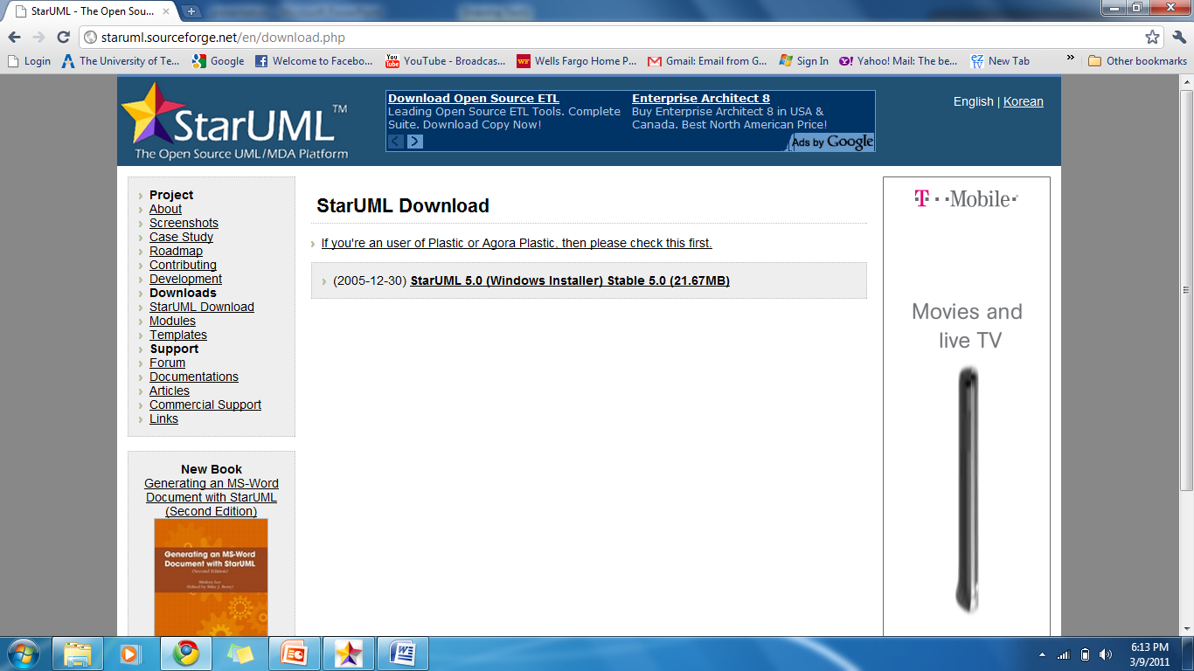
Installation
Go to http://staruml.sourceforge.net/en/download.php

Slide 7
System Requirements
The following are the minimum system requirements for running StarUML™.
Intel® Pentium® 233MHz or higher
Windows® 2000, Windows XP™, or higher
Microsoft® Internet Explorer 5.0 or higher
128 MB RAM (256MB recommended)
110 MB hard disc space (150MB space recommended)

Slide 8
What can you do using StarUML?
StarUML supports the following UML diagrams
Use Case Diagram
Class Diagram
Sequence Diagram
Collaboration Diagram
Statechart Diagram
Activity Diagram
Component Diagram
Deployment Diagram
Composite Structure Diagram (UML 2.0)
Code generation can be done for Java, C++ and C# as well as Reverse Engineering
Documentation can be generated for all of the Microsoft Office suite programs such as Word, Excel and PowerPoint.

Slide 9
Use Case Diagram & Use Case Specification document

Slide 10
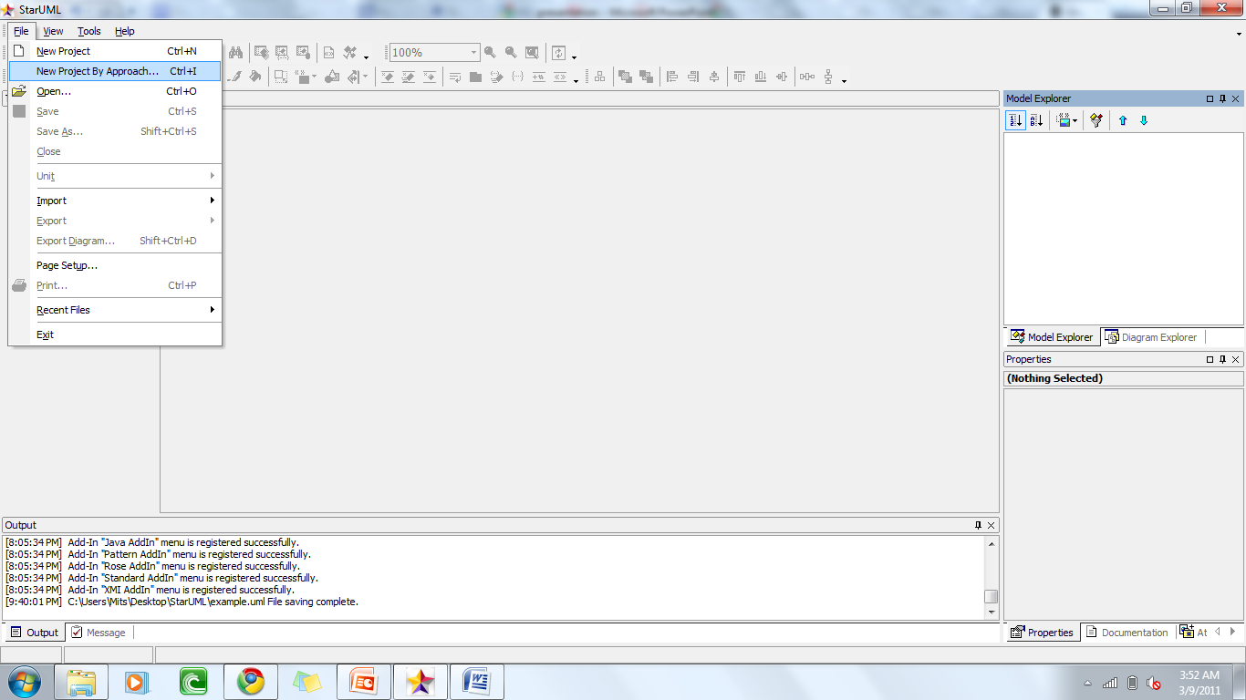
Create a NEW PROJECT
Select the [File] -> [New Project By Approach] menu.

Slide 11
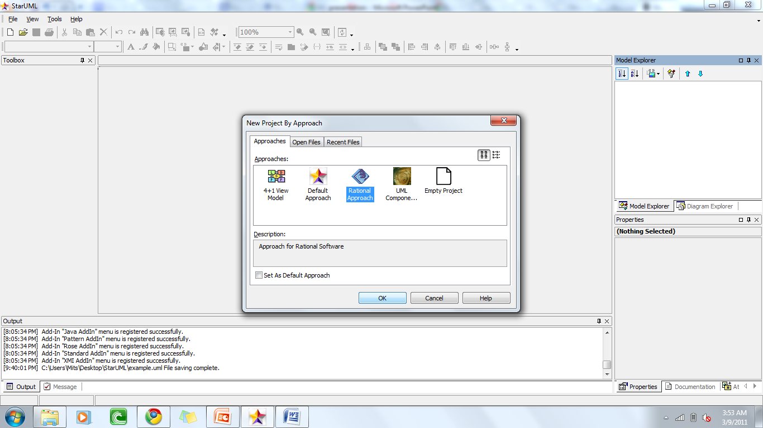
Select [Rational Approach]

Slide 12
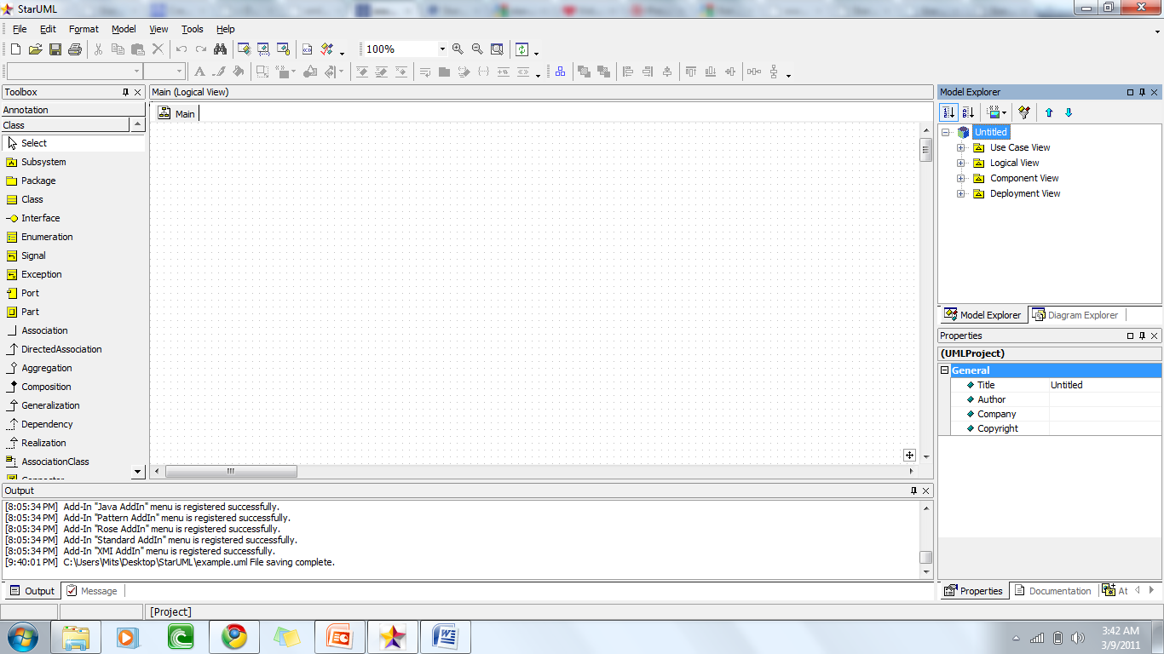
Now there are 4 views in the Model Explorer

Slide 13
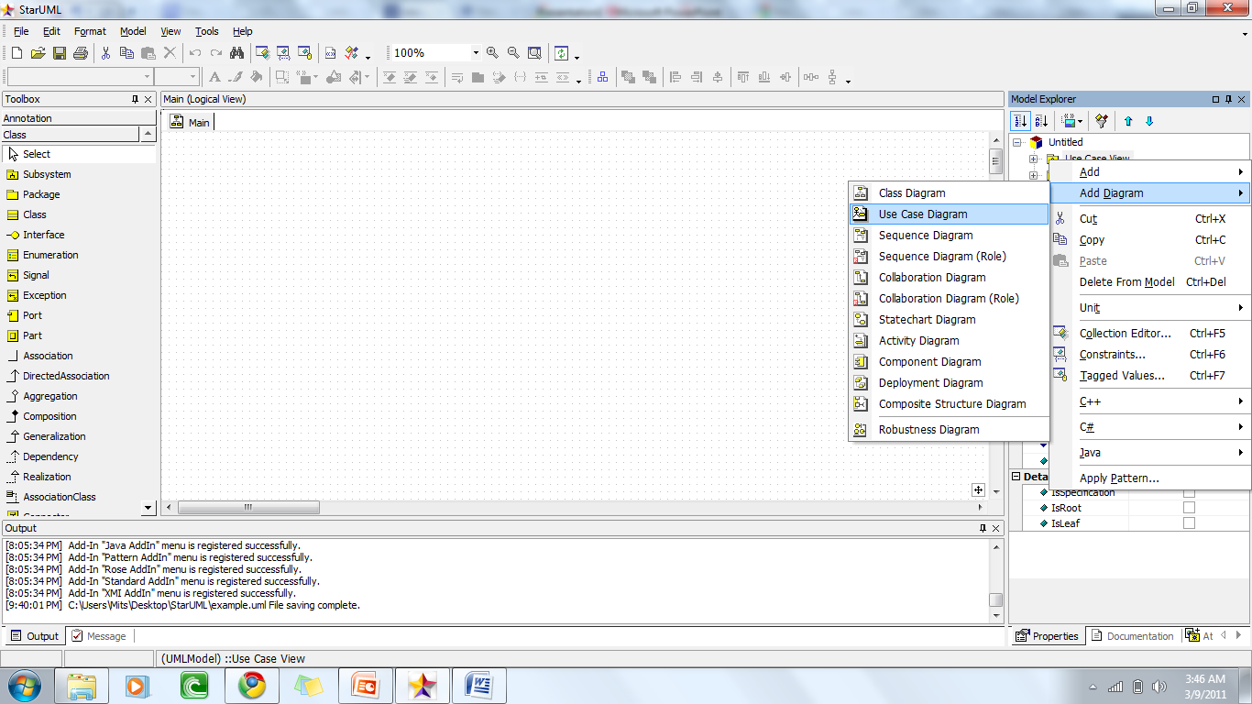
To draw a Use Case Diagram ,double click the Use Case view .
You can start drawing in the default ‘Main’ or [Add Diagram] -> [Use Case Diagram] by right-clicking on the Use Case View.

Slide 14
The following elements are available in a usecase diagram.
Actor
UseCase
Association
Directed Association
Generalization
Dependency
Include
Extend
System Boundary
Package

Slide 15
ShortCut Generation Syntax
()- | UseCase | The target model(Actor) linking with the current element makes a link of communication.
-() | Actor | The target model(UseCase) linking with the current element makes a link of communication.
<i- | UseCase | Makes include relationship from target element to the current element.
-i> | UseCase | The target element linking with the current element makes a link of include.
<e- | UseCase | Makes include relationship from target element to the current extend.
-e> | UseCase | The target element linking with the current element makes a link of extend.

Slide 16
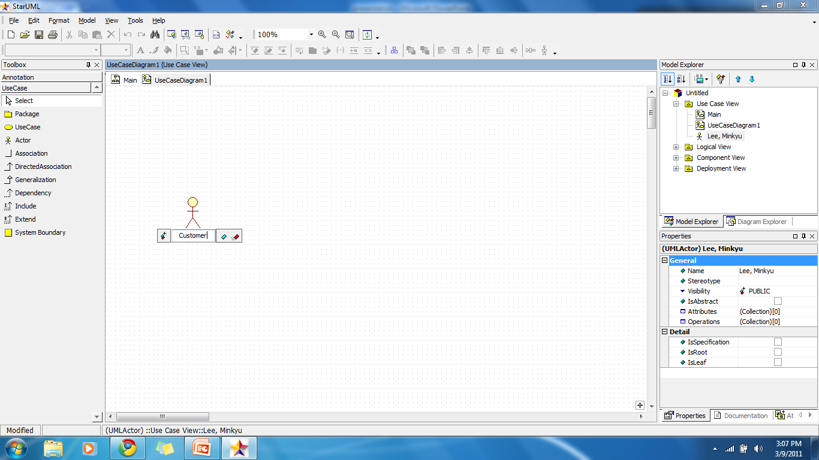
Create Actor

Slide 17
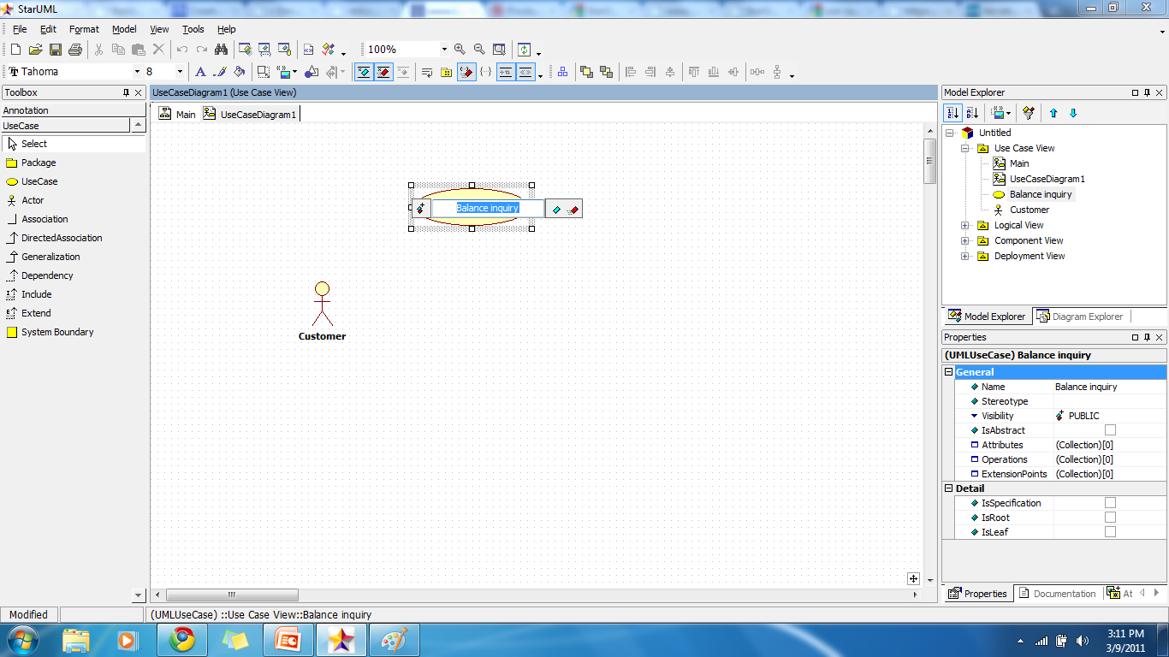
Create Use Case

Slide 18
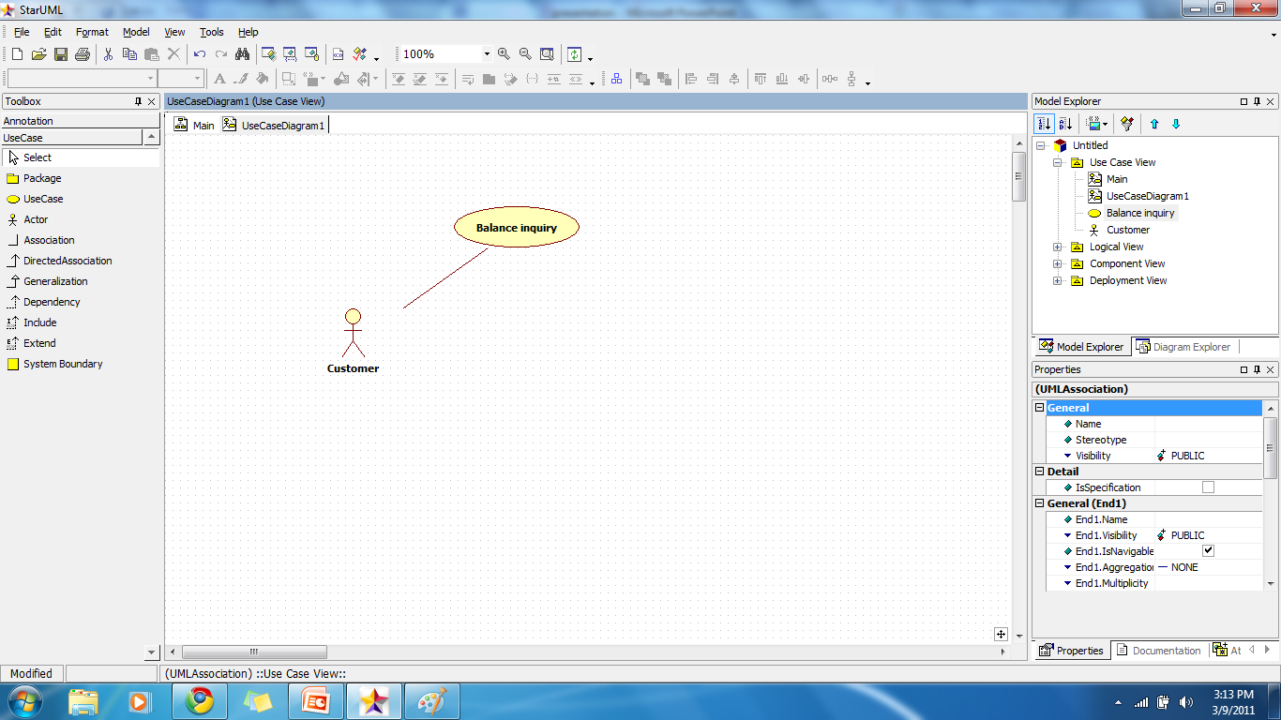
Create Association

Slide 19
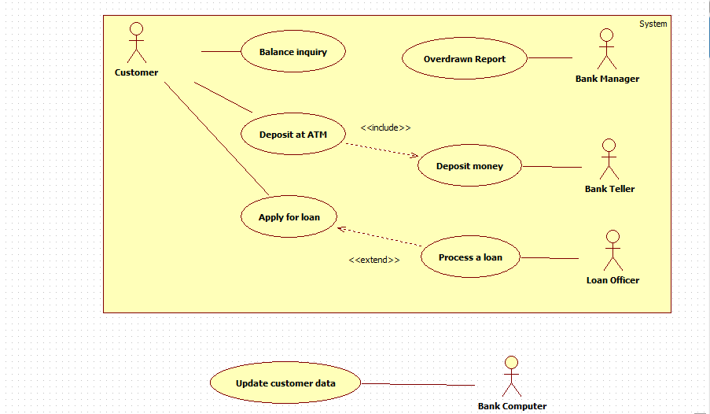
Example

Slide 20
Advantages
Supports plug-ins for both importing and exporting.
Code and documentation plug-ins provided with package.
Useable.
Free.

Slide 21
Disadvantages
Complex for the beginner.
No longer on a release cycle.
Not cross platform. (only Windows)

Slide 22
References
http://staruml.sourceforge.net/en/articles.php
http://staruml.sourceforge.net/docs/user-guide(en)/toc.html

Slide 23
Thank You

Slide 24
Any Questions?

