Slide 1

Members:
Keshia Hines
Gwen Duncan
Sonia Ruiz
Carolyn Cain
Notes:
Good evening and thank you for taking time out of your schedules to introduce us to PowerBI We are workforce be with you. List names.

Slide 2
Workforce Development and what you will learn from our project
What are some insecurities within workforce development?
What jobs will be in demand and what is the salary and educational requirements for the positions?
What industries would have the highest growth rate ?
Where did our data come from?
What analytical technique was used?
Notes:
We choose to look into workforce insecurities as it relates to projected growth from 2019-2029. We found that there are many factors that play into workforce insecurities. Such as unemployment, education, experience, salary and job demand.
We chose this topic because of the current status of the economy, the numerous mentions of jobs being unfilled in the state and the advancement of technology.
During our research it was determined that healthcare was the highest in demand over the ten-year period (Kystat). We thought it would be manufacturing or education rolls. We also found that the top growing job does not require a post-secondary education, but it is also one of the least paying jobs. While researching workforce insecurities we decided to focus on the top 10 growing sectors in the Kentuckiana area.
Kentuckiana is comprised of Bullitt, Henry, Jefferson, Oldham, Shelby, Spencer & Trimble Counties. NO, Indiana is not included in our data.
We obtained our data from kystats.gov and bls.gov. Once we got the data, we scrubbed it and then put it into PowerBi.
We chose to use the descriptive analytical technique. It gave us a better understanding as to what has and is happening in the workforce.

Slide 3
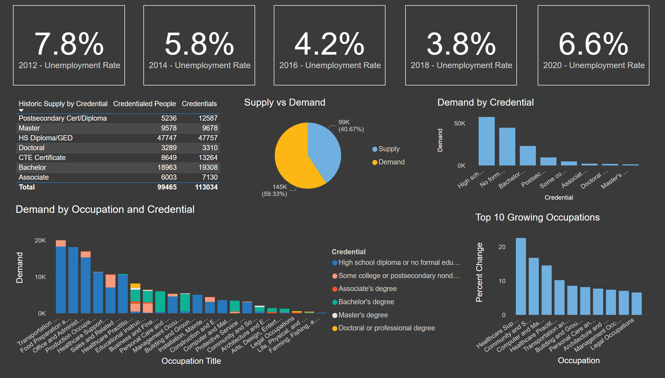
Slide 2 - Report
Notes:
We chose several different types of charts to generate our story. Throughout the presentation we will dive into each chart. Let’s first start with Unemployment and a few historical events from 2011-2020.

Slide 4
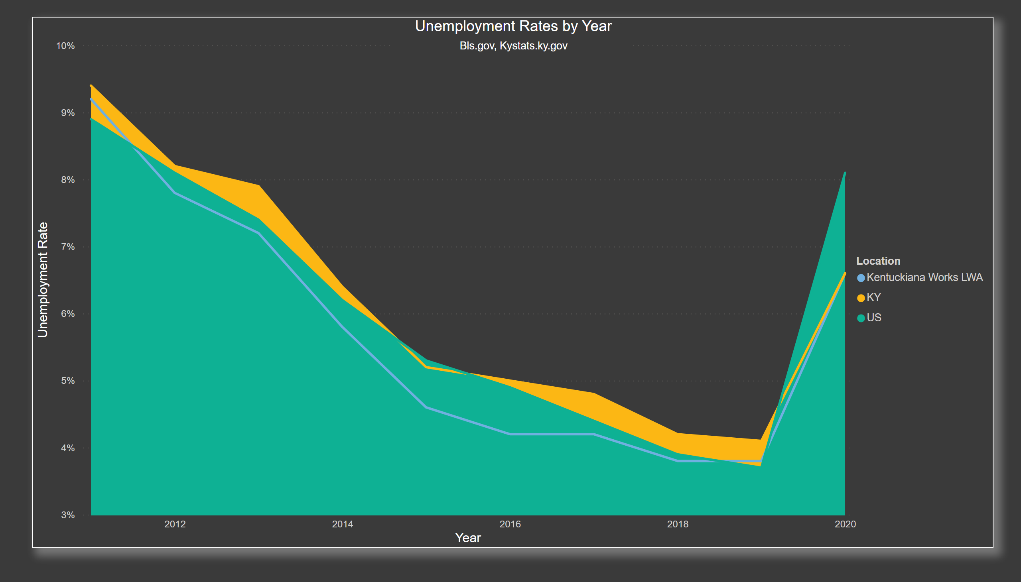
Slide 3 - Unemployment
Notes:
My data was obtained from both Kystats.gov and bls.gov.
The area chart was used because I wanted to emphasize the difference of unemployment from Kentuckiana, Kentucky and the US. The unemployment rate was high in both 2011 and 2020. (coming out of the recession/going into covid)
Kentuciana and Kentucky unemployment was higher than the United States unemployment in 2011. In 2011 Kentucky lost both manufacturing and agriculture jobs. We have always had a 1 heavy presence of Agriculture and Manufacturing jobs in the state and city ( Kentuckiana 9.2, KY 9.4, US 8.9. ) In 2020 it was the opposite. The United States unemployment was higher than both Kentucky and Kentuciana 6.6, KY6.6 and US 8.1
There are many causes of unemployment.
Newly entering the workforce (14-16 year olds and college graduates)
Voluntarily leaving the workforce (to raise kids or take care of elderly parents or retiring)
Reentering the workforce Job Outsourcing
Politics Economy
Advances in Technology Education
Here are some historical events from 2011-2020 that could have played a part in the unemployment.
2011 -2016 President Barack Obama (D)
Coming out of a recession Stock exchange suffer heavy losses (August)
2012 Mosquito-borne West Nile virus kills 243 people and there were 5,387 cases
The Dow Jones Industrial Average goes above 13,000 points for the first time since May 2008
2013 Year of the Flash Crash
2014 The first case of Middle East Respiratory Syndrome coronavirus virus (MERS)
2015 The Republican Party holds majority control of both the Senate and the House of Representatives
2016 The year of the Presidential Elections
2017 President Donald Trump 1st year
19 states raise minimum wage
2018 President Donald Trump
Trade War
49 Year low of unemployment
2019 President Donald Trump
Government shutdown
Federal debt surpasses $23 trillion
2020 President Donald Trump
Covid-19
The US Shut down
Now that we have discussed unemployment lets dive a little deeper and discuss the supply and demand of the workforce

Slide 5
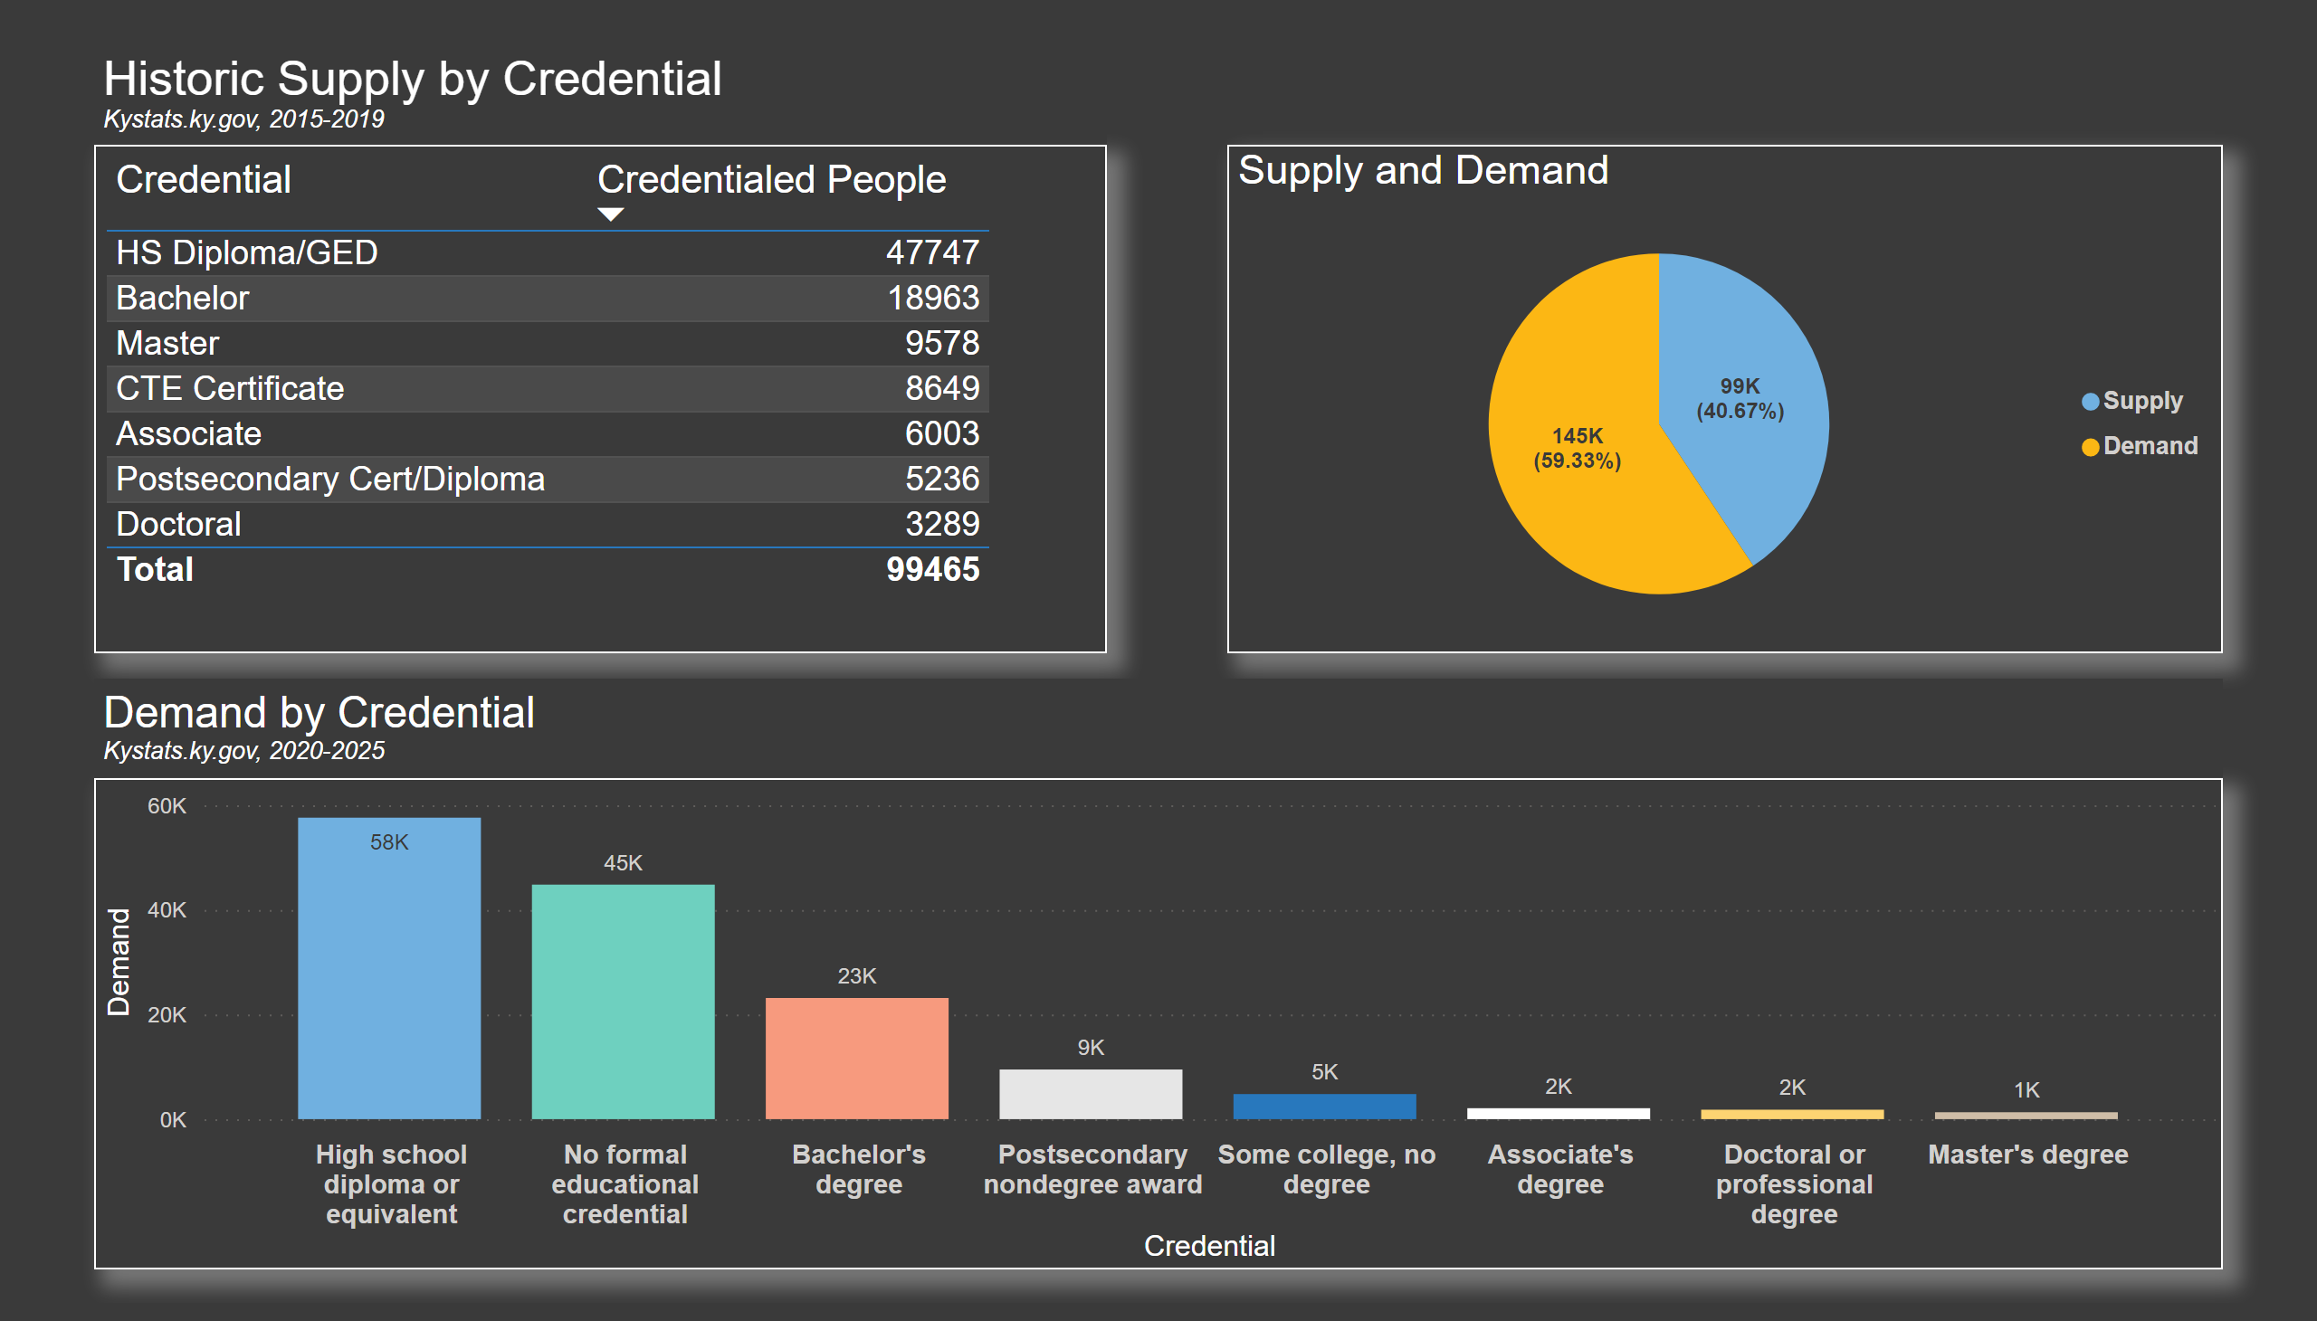
Slide 4 - Supply vs Demand
Notes:
Our first table shows us the Historic supply by Credentials.
We expect major changes in the job markets and a demand for further credentials that will be needed in the future. The credential that has the most supply is for high school/GED and the credential with the least supply is for Doctoral degrees.
What is expected from jobs and the labor force? We are not sure yet, but Robotics, data Analysis and Automation, are very hot right now and what does that mean for us? We will need higher education, more credentials and certifications.
The pie chart show us the demand and supply and we can see that the demand is greater than the supply
In the future we will be seeing more people going back to school for 1st 2nd and 3 degrees and more certifications.
Below, we have the demand by credential and we can see that the highest demanded credential is HS/GED and the lowest demanded credential is a Master’s Degree.
The next slide will show the breakout of employment in key sectors by credential level.

Slide 6
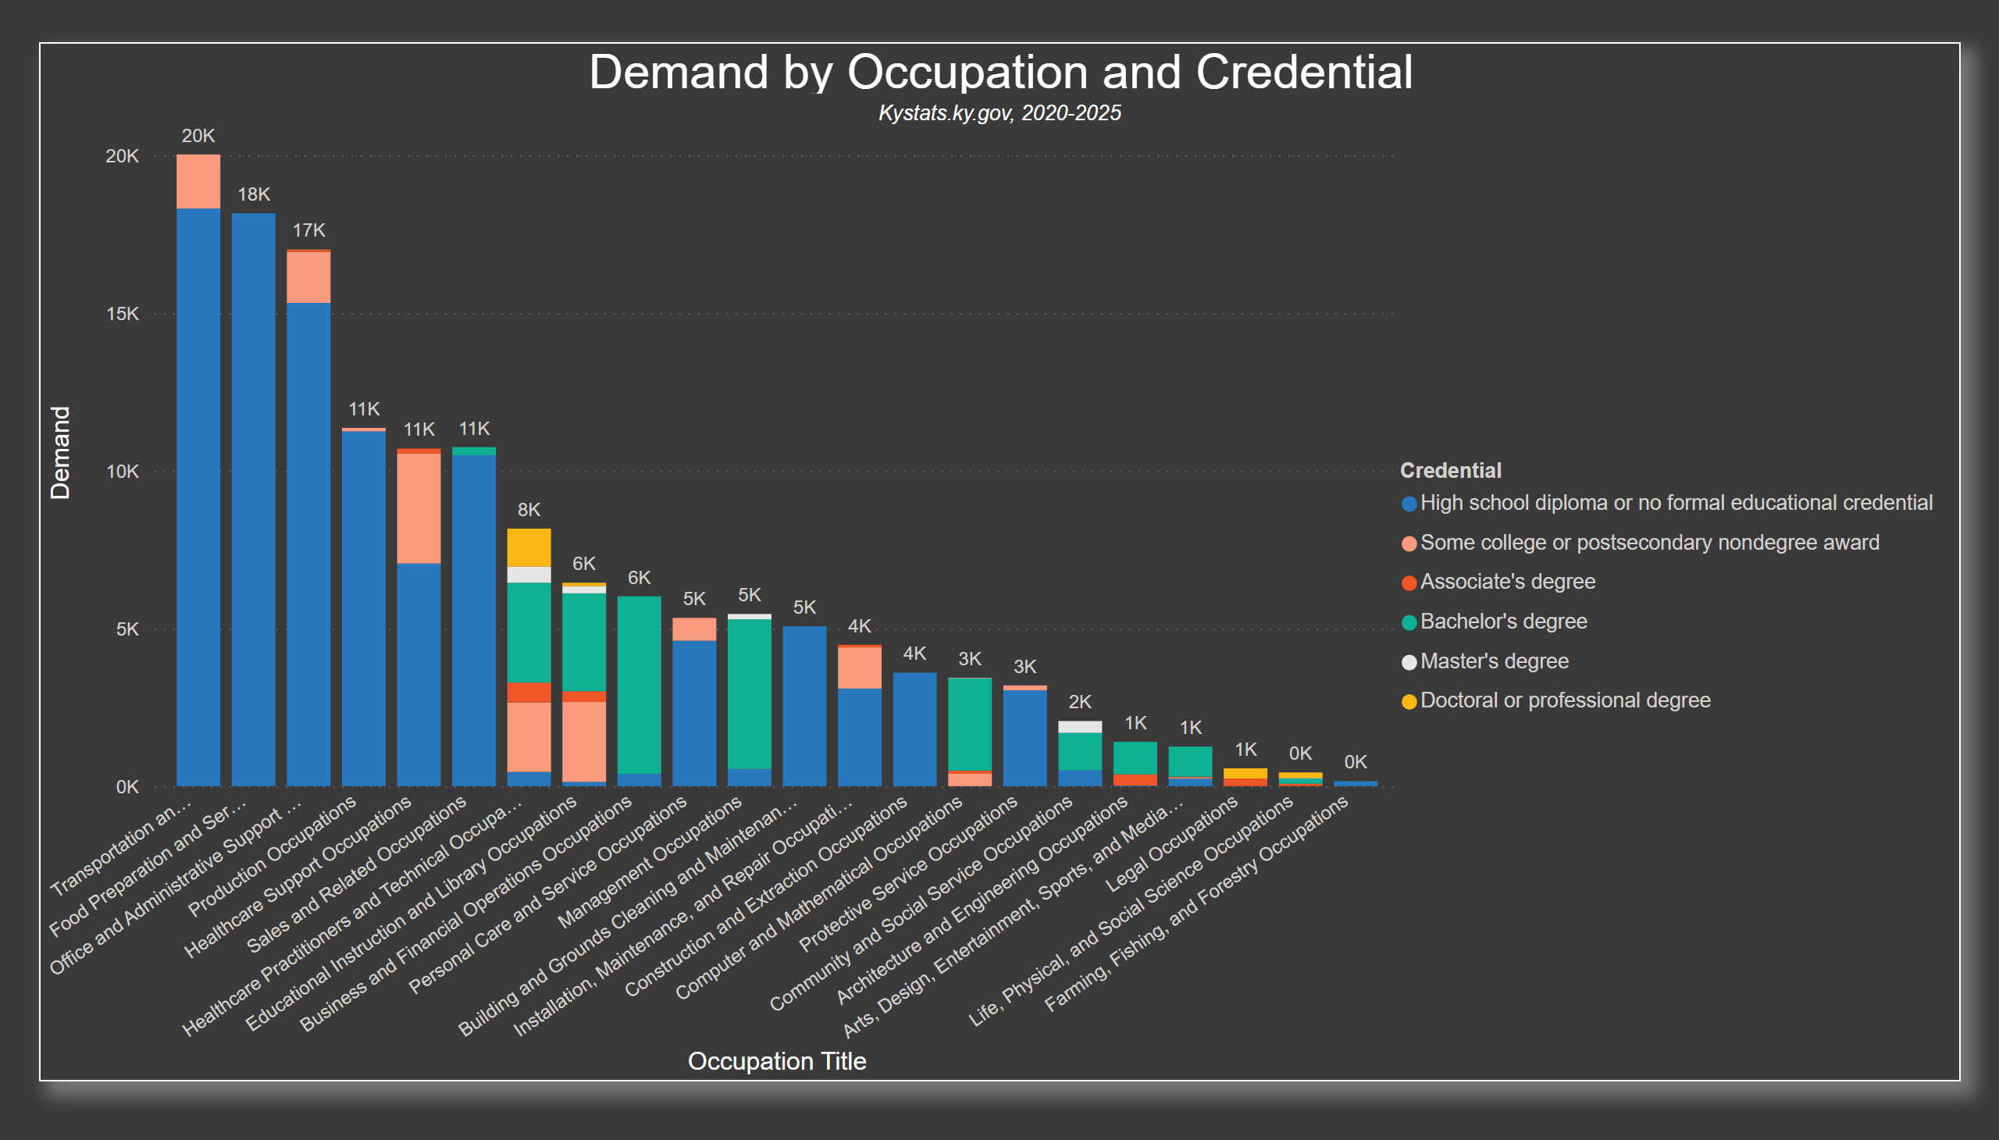
Slide 5 - Demand by Occup by Cred
Notes:
Building off what Sonia said, we had found the supply and the demand, and we really wanted to do a deeper dive into the demand by occupation and by credential
This way we could understand how those credentialed people, so how our supply, were being demanded across the workforce.
This led us to this visual, this is a stacked bar chart that shows the breakdown of the demand of credentials needed within the occupations
It allows us to see what are the most in demand occupations and what level of education is needed to get an entry level job.
From this we can see that the highest in demand occupations are:
1. Transportation & Material Moving Jobs (think truck drivers and freight delivery workers)
2. Food Prep and Serving Related Jobs (think Waiters/Waitresses, Cooks/Chefs and Host/Hostesses) and
3. Office Admin Support Jobs (think clerks and billing specialists)
Those are the most in demand occupations
This makes sense to me right, because every time I see a trucker drive by me on 64, the truck has a Now Hiring sign plastered in big letters on it, and there is not a restaurant I know of that is not in need of additional workers…and yes, that even includes…Chick Fil A.
And with that, I will turn it over to Keshia who will talk more about the highest growing industries and their wages.

Slide 7
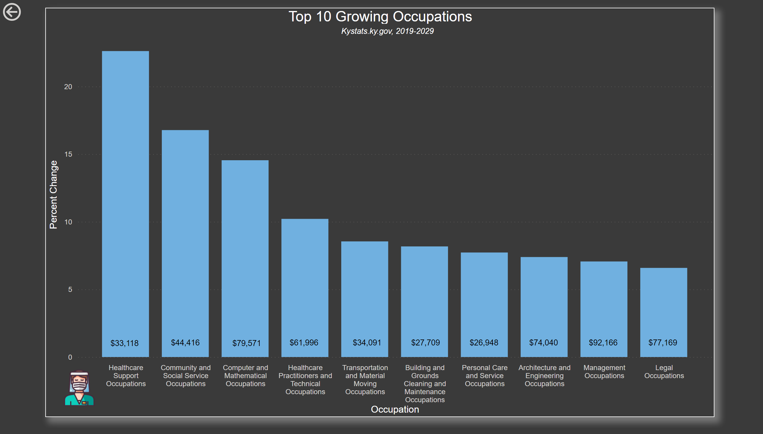
Slide 6 - Top 10 Growing Occupations
Notes:
Thank you, Gwen,
So now that we have talked about the demands of the occupations, we have put together a bar chart that shows the top 10 growing industries here in Kentucky. Our data shows the predicting percentage growth for 2019 to 2029. As you can see the health care support field has towered over them all as we questioned if this is related to the pandemic and other covid related needs. The Healthcare support jobs include:
Jobs- CNA’s, Occupational Therapist assistant, Physical therapist assistant, home health Aids, and other Jobs that are in the healthcare field that are considered entry level jobs.
As a group we asked ourselves why this occupation has the largest growth with such little educational background. We had come up with numerous ideas like:
People Value their time more
Or people are even scared to rack up debt by taking out loans for school
Maybe even job security, People want to know they are secure with an entry leave job with Minimum to no Education needed.
These jobs average median wage is around 33 thousand a year.
The Community and Social Service Occupation take second place. These jobs include:
Jobs- Probation officers, counselors, and social services jobs.
As we all are living witnesses to the aftermath of the pandemic mental health is at an all-time high right now. People are working from home more now than ever. This means more people are in the house consistently and isolated from the outside world. There are more kids out of school getting into trouble and brining outside problems into the home. There are many studies that link mental health to these jobs.
The highest educational requirement to hold these jobs is a bachelor’s degree with an average median wage of 44 thousand a year.
Computer and Math occupations come in 3rd on our chart. These jobs include:
IT, Software Engineer, Software developer, and Data Analysts just to name a few. Programs that offer work force development classes like LCCC helps build these types of occupations so that people like us can learn and grown in our field without having to go back to school.
The average median wage for these occupations is about 79,500 a year.
The fourth occupation bring us back to the health care field with practitioners and technical occupations. The remain 6 occupational have the least growth which include Maintenance, personal care and services, engineering, management, and legal jobs.

Slide 8
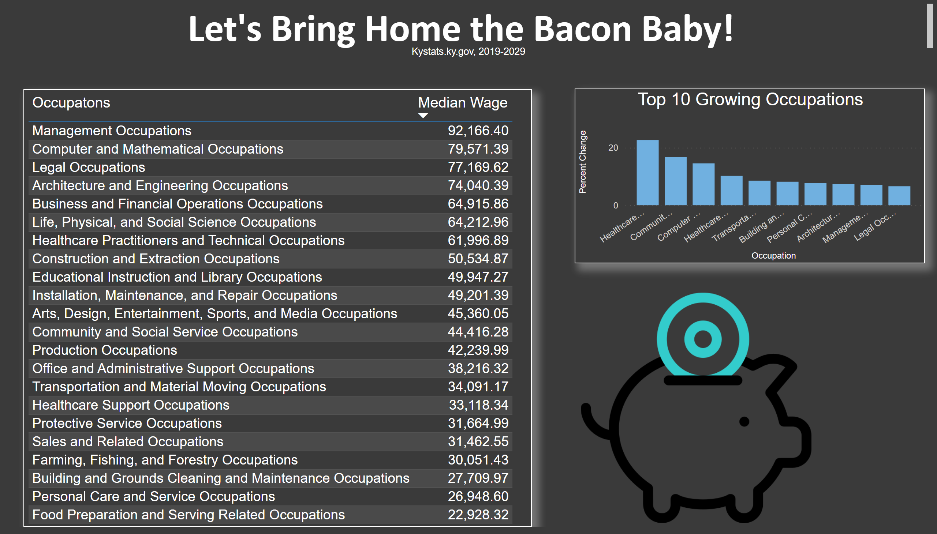
Slide 7 - Wages
Notes:
This Table shows all the different types of occupations and their wages. If you look at the last row/column food preparation and serving related occupation, the average wage is almost 23,000 thousand per year. And Sales and related occupations the average wages are 31,000 per year. If we look back at the bar chart from the previous slide the higher the demand the wages decreases and the lower the demand the wages will increase.

Slide 9
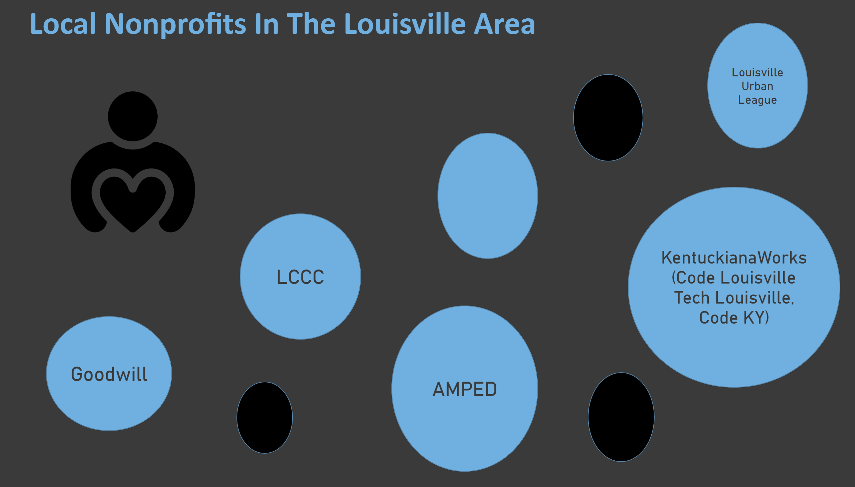
Slide 8 - Non-Profit Showcase
Notes:
Just like the LCCC has given us this amazing opportunity to learn and grow in a field we have all came to love. There are numerous nonprofit organizations that offer workforce programs here in our local area. Some include the Goodwill, Amped, Kentuckian Work, and the Louisville Urban League. Now that I have talked about the top 10 growing indurates and their wages and some difference programs to help you grow in you loving fields, I am going to pass this presentation back over to Gwen with our overall finding Thank you.

Slide 10
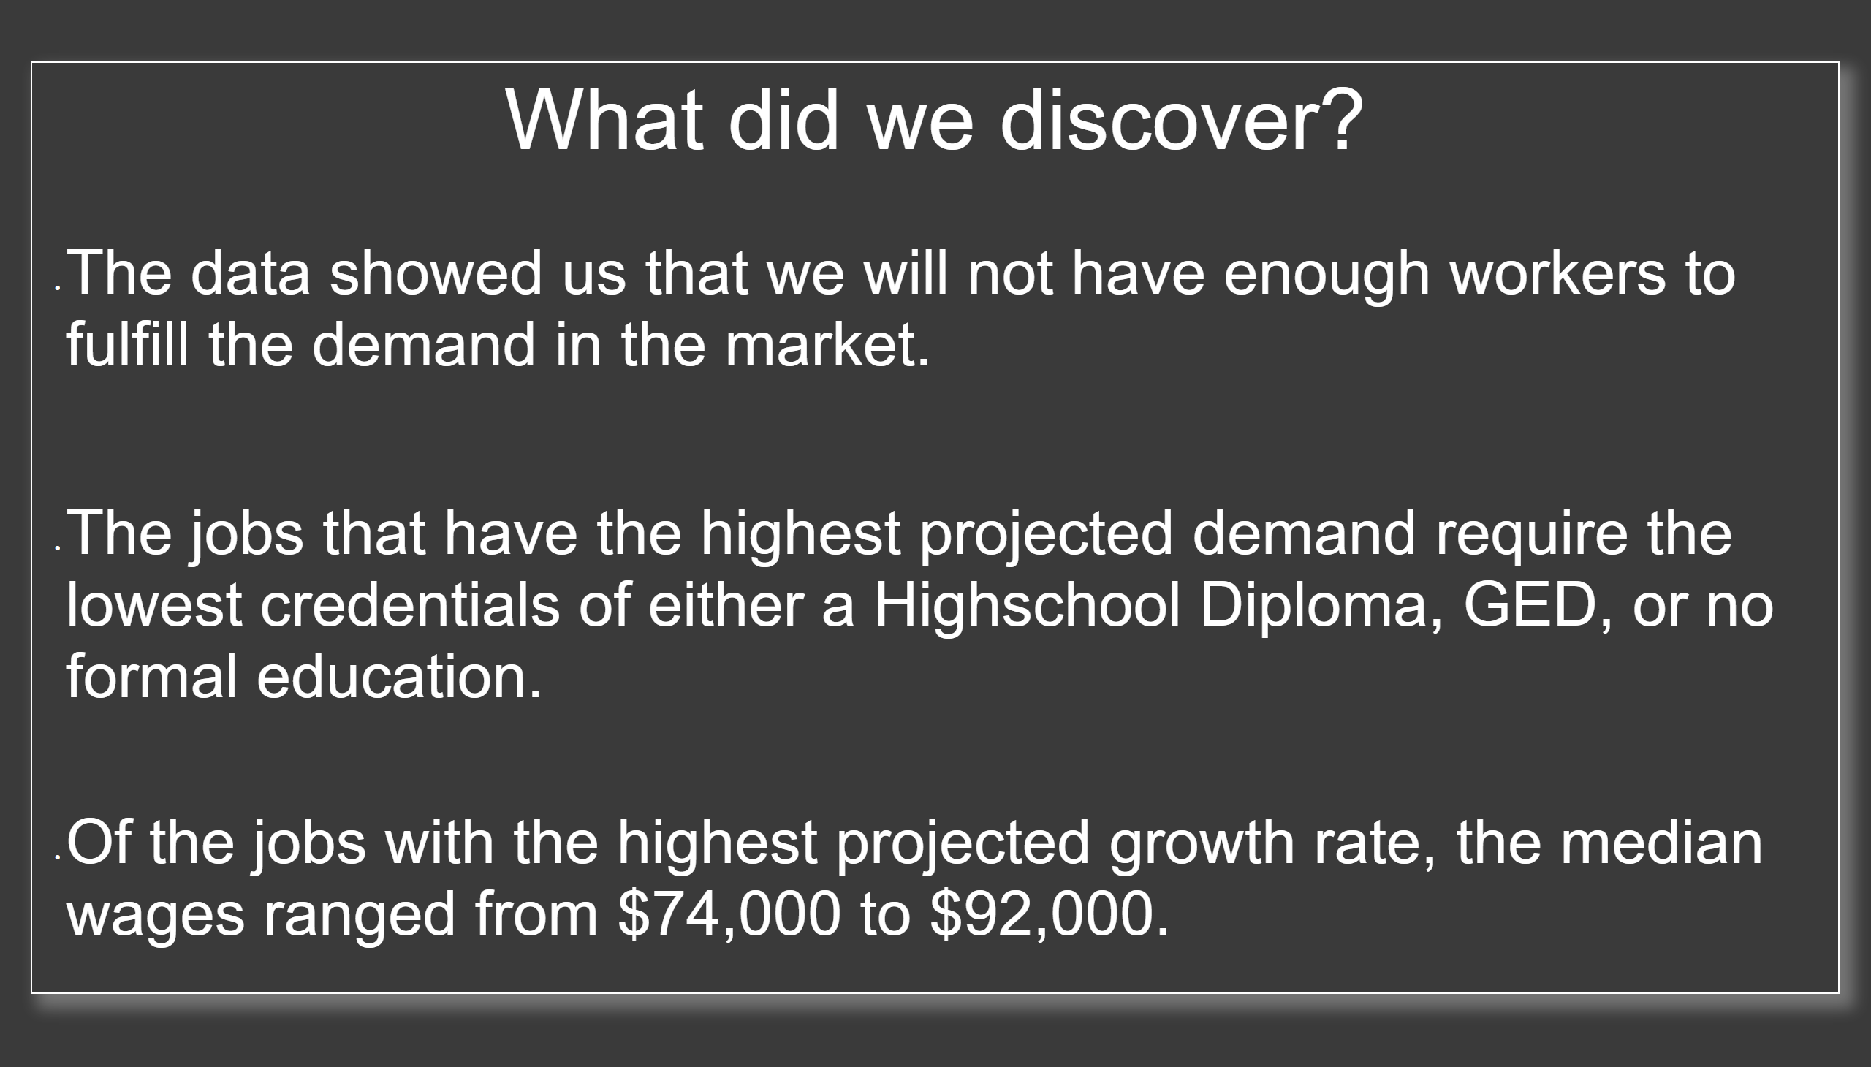
Slide 9 - Conclusion
Notes:
So, wrapping up, we asked ourselves, “What did we discover?
Slide says: The data showed us that we will not have enough workers to fulfill the demand in the market.
Talking Point: This is good for the worker though, right? It means that there are more opportunities than there are workers to fill those opportunities
2. Slide says: And then we also saw that, “The jobs that have the highest projected demand required the lowest credentials, either a High School Diploma or GED or No Formal Education” at all
Talking Point: But in contrast to that high demand, we saw a lower median wage between $23,000 - $38,000 for those jobs
3. Slide says: And then “Of the jobs with the highest projected growth rate, the median wages were between $74,000 - $92,000
Talking Point: And most of them, 75%, required a Bachelor’s Degree with the exception of the Legal Profession which required a Professional Law Degree

Slide 11
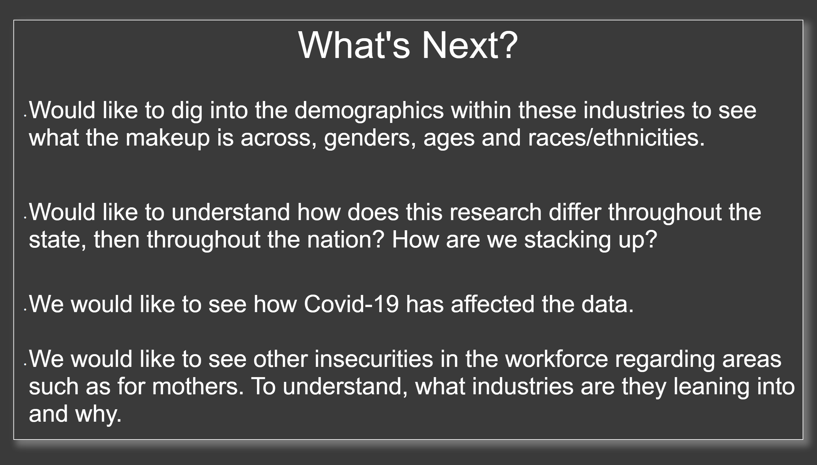
Slide 10 - Conclusion
Notes:
Read directly from the slides until the end

Slide 12

Slide 11 - Conclusion
Notes:
Read Directly From the Slides until the end then add this talking point:
I can personally tell you there were many brainstorming sessions where we got stuck at times, but we learned how to push through, how to lean on one another for ideas and how to play to our individual strengths. We all brought something different and valuable to the table and we were able to focus on those and find ways to use those gifts. Go to the final slide.

Slide 13
Thank you
Notes:
And with that, we would like to say thank you, and may the workforce be with you!
* Leave the presentation up, stop sharing, close the presentation.

