Slide 1
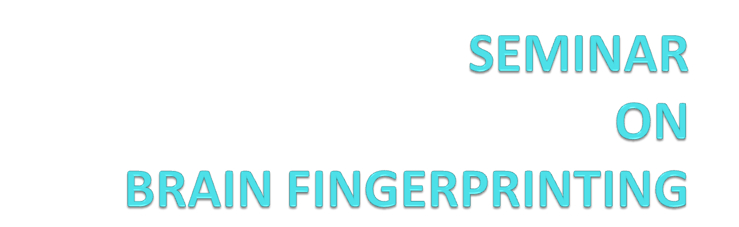
PRESENTED BY:-
Aurobindo Nayak
COMPUTER SCIENCE

Slide 2
CONTENTS
INTRODUCTION
BASED ON
(3) WHAT IS MERMER
(4) INSTRUMENTS
(5) HOW IT WORK
(6) APPLICATION
(7) INVENTED BY
(8) CONCLUSION

Slide 3

Brain Fingerprinting technique used to
determine scientifically what information is, or is
not stored in a particular brain.
Not a measure of guilt or innocence.
Measures the response to visual or audio
stimulus.

Slide 4

Brain Fingerprinting method is based
on an electric signal which is known as
MERMER .

Slide 5

  A MERMER is an electrical signal which is a
  part of the brainwave observed in response
  to familiar information.
  When the brain recognizes something, then
  there is increase in neurons activity, so elicit
  some changes in brain wave signals .

Slide 6

  personal computer
  a data acquisition board
  a graphics card for driving two monitors from one PC
  a four-channel EEG amplifier system
  software developed by the Brain Fingerprinting lab.

Slide 7

  Brain Fingerprinting method uses a signal which
  is known as MERMER i.e. Memory and Encoding
  Related Multifaceted Electroencephalographic.
  A sequence of words, phrases, or pictures is
  presented on a video monitor to the subject,
  wearing a special headband designed for detecting
  the brain wave responses.

Slide 8
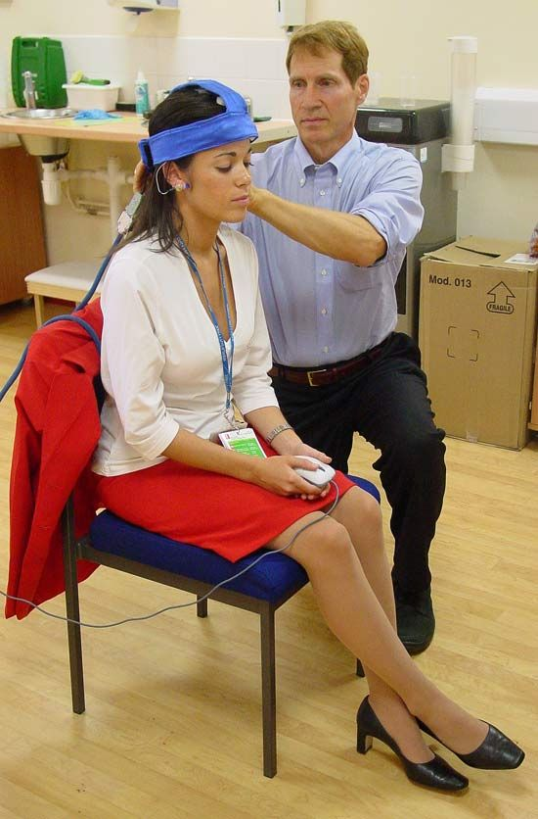
IMAGE
HEADSET

Slide 9

  Actually when brain recognizes something
  then there is some changes in the neurons
  activity ,due to which there is changes in
  brainwave signals .On the basis of these
  changes in brain wave signals scientists
  determine that a particular information is
  present in the subject mind or not

Slide 10

  The entire Brain Fingerprinting system is
  under computer control, including
  presentation of the stimuli, recording of
  electrical brain activity, a mathematical data
  analysis algorithm that compares the
  responses of stimuli and produces a
  determination of "information absent“.

Slide 11
APPLICATION
National security
Medical diagnosis
-Alzheimer’s disease
Advertising

Slide 12
National Security
Identify terrorists and accomplices prior to attacks by
determining whether specific information is
embedded in the memory of the subject.

Slide 13
Medical Field
Alzheimer’s Disease
  Detects MERMER brainwave
  Symptoms reversible through dietary and medicinal changes

Slide 14
Advertising
Brain fingerprinting allows advertisers to determine
what information from an ad is retained in memory
  What elements do people pay attention to
  What type of media is most effective
  How to advertise to people all over the world

Slide 15

Brain Fingerprinting was invented by
Dr B .S. Farwell chief scientist and
president of human brain research and
laboratory , USA .

Slide 16

  It would be inappropriate to generalize the
  results of the present research because of
  the small sample of subjects.
  But the 100% accuracy and high confidence
  level of the results, however, provide further
  support for results from previous research
  using brain MERMER testing.

Slide 17

QUESTIONS

Slide 18
Thank you !
Motivation
What is
BlueEyes ?
Physiological foundations
System
design
System implementation
System
demonstration
Future
improvements
Project work
summary

