Slide 1
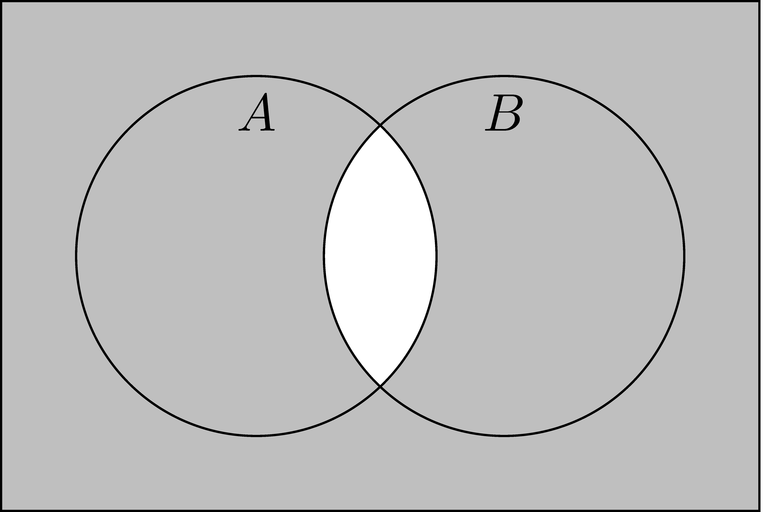
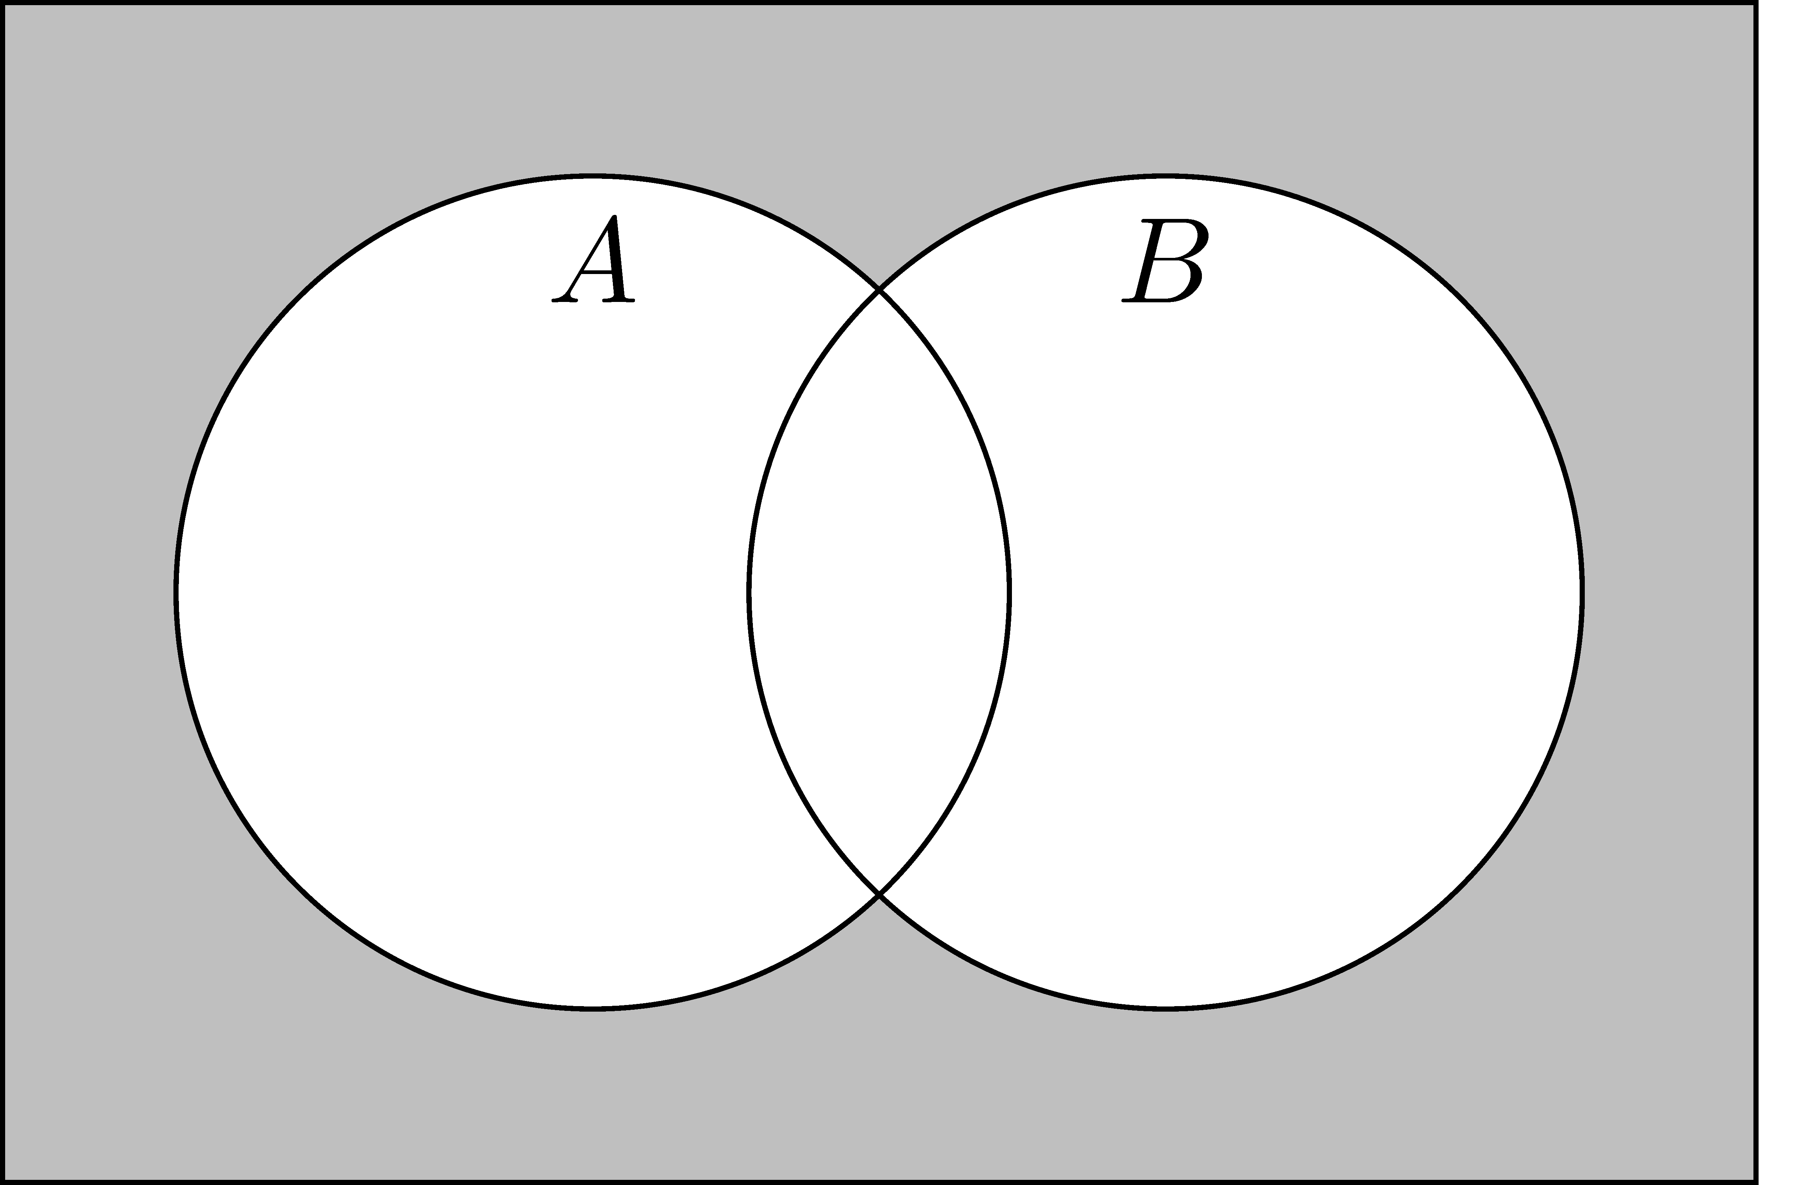


$${\left(A∩B\right)}^{c}=A^{c}∪B^{c}$$
$${\left(A∪B\right)}^{c}=A^{c}∩B^{c}$$

