Slide 1
Business Analytics and Big Data Systems
Moscow
May 2026
Project-based
Automatically Evolving Multi-Turn Customer Service AI Agents via Prompt-Level Distillation
Author: Gleb Dementev
Supervisor: Seungmin Jin, PhD

Slide 2
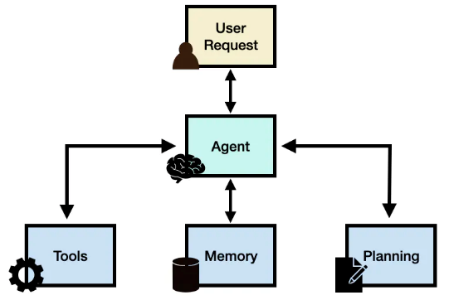
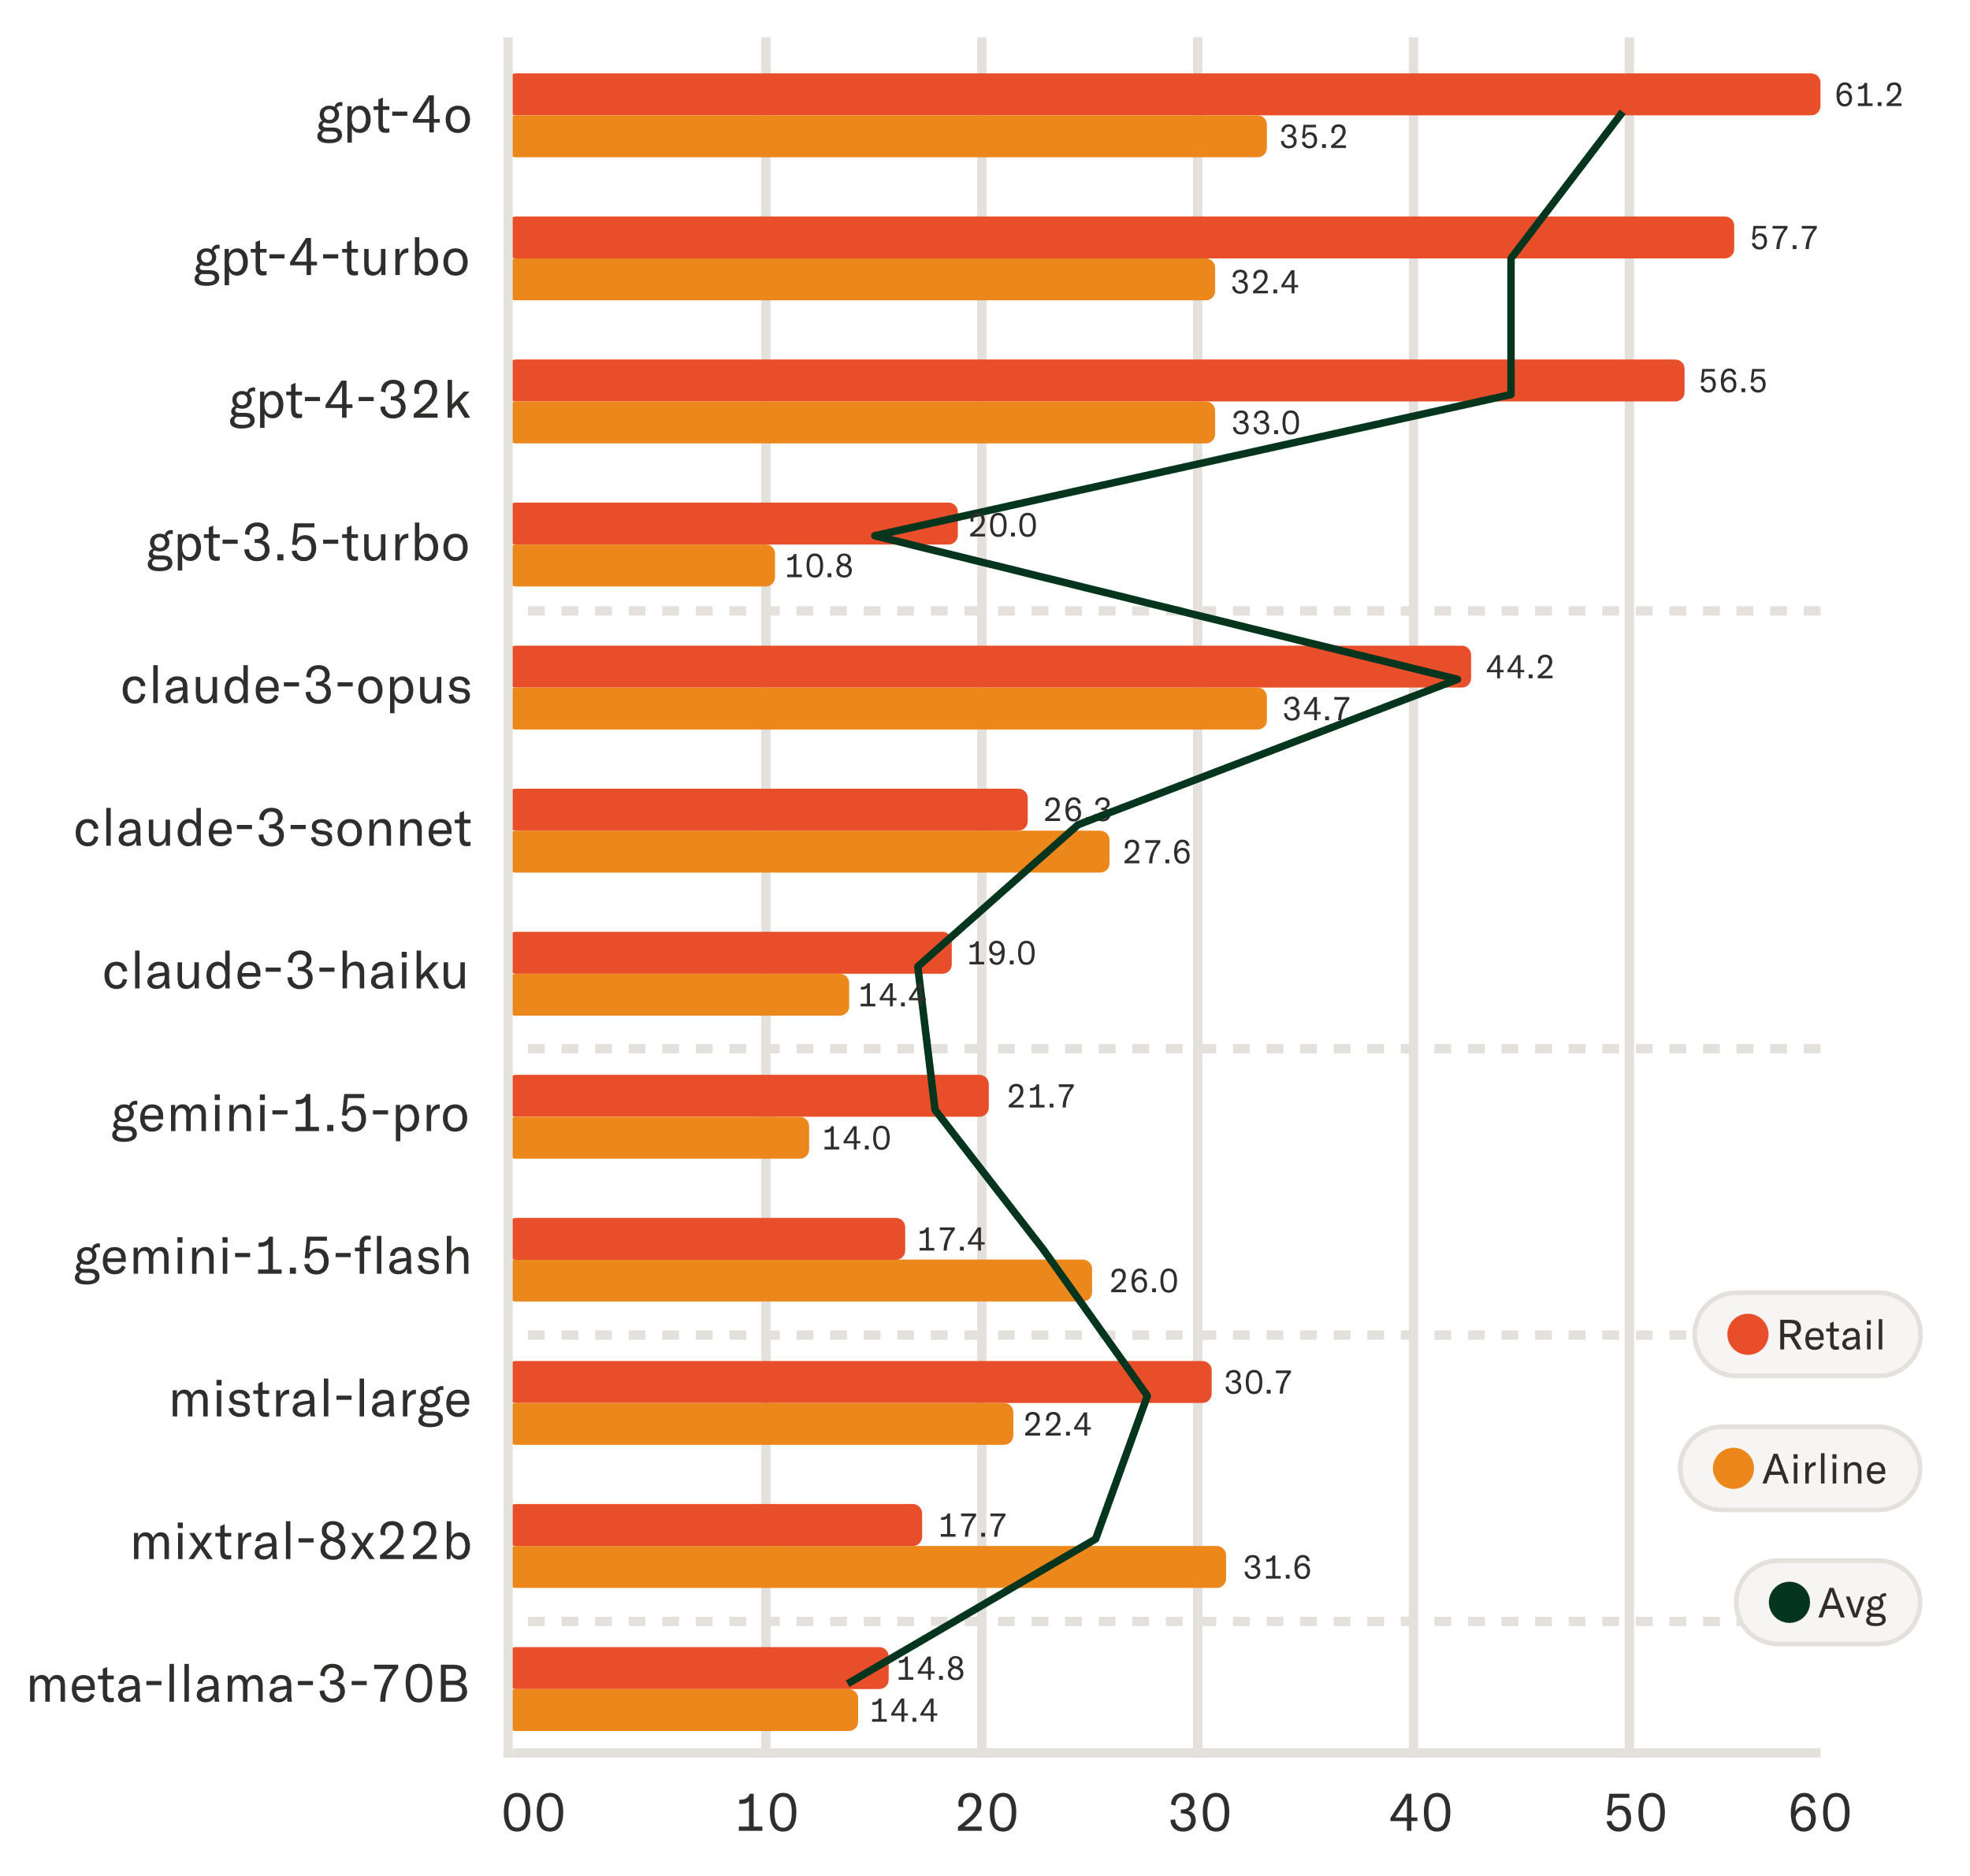
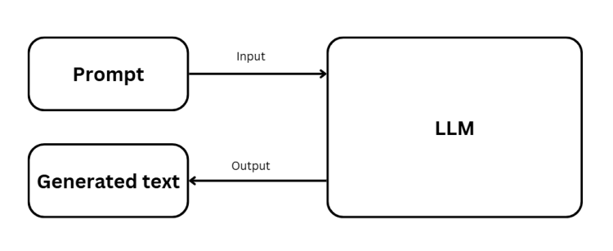
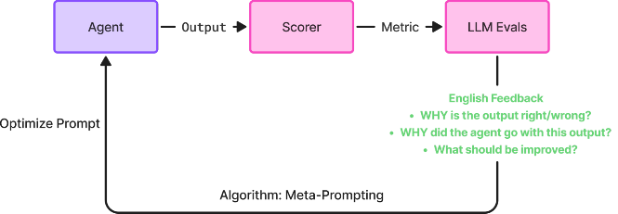
Automatically Evolving Multi-Turn Customer Service AI Agents via Prompt-Level Distillation (project)
Introduction
2
Key Concepts
Large Language Model
Tool-Calling Agent
Agentic Benchmark
Prompt Evolution
Neural network that generates plausible text from learned distributions
LLM harness that allows calls to external tools via structured text output
LLM performance measurement on tasks requiring planning and action
Automated benchmark pass rate improvement
GPT-5.4, Opus 4.6, Gemini 3.1
Claude Code, OpenAI Codex, Manus
Tau-2, Toolbench, GAIA
GEPA, DSPy, EvoPrompt

Slide 3
Automatically Evolving Multi-Turn Customer Service AI Agents via Prompt-Level Distillation (project)
Introduction
3
target ai builds customer service automation for enterprise customers
Problem: deployment is bottlenecked by implementation team
target ai employs a total of 75 FTEs
Its flagship product posted 200M (70%) of 2025 revenue
25
19
22
9
200M RUB
SYSTEMS ANALYSTS
Developers
Sales
Other
Implementation payroll is 37% of revenue
75M RUB
= 37% of revenue
Every new deployment adds load to the same 25-person team. The cost structure is linear in deployments.

Slide 4
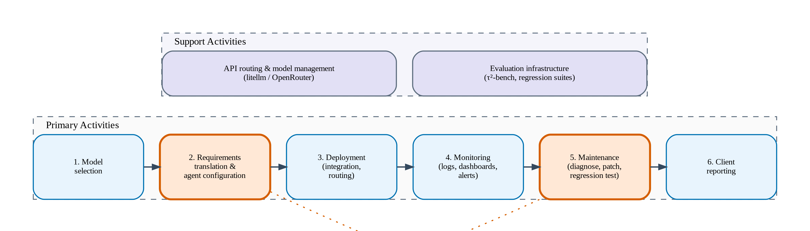
Automatically Evolving Multi-Turn Customer Service AI Agents via Prompt-Level Distillation (project)
Introduction
3
We ran a value chain analysis and shown the bottleneck
Activities 2 and 5 share a single 25-person system analyst pool and limit scaling

Slide 5
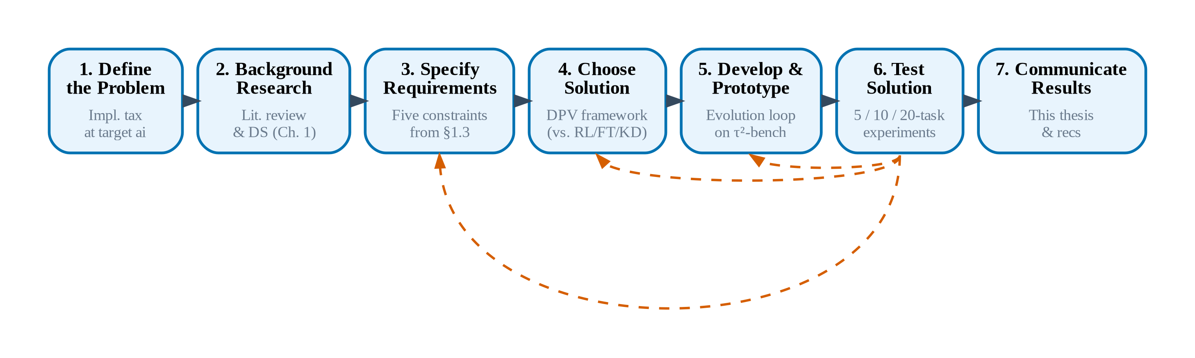
Automatically Evolving Multi-Turn Customer Service AI Agents via Prompt-Level Distillation (project)
Introduction
4
Problem, Goal, Questions, Tasks
Problem: LLM agents require
Goal: Automatically improve agents and fix issues
We have considered TOGAF, SDLC, CRISP-DM, DSR and settled on following EDP because we are building iterative test software (as opposed to production, or enterprise, or ML solutions)

Slide 6
Automatically Evolving Multi-Turn Customer Service AI Agents via Prompt-Level Distillation (project)
Literature Review
5
Literature Review: Why Prompt-Level Evolution?
1. Agents fail
2. Prompting is brittle
3. Fine-tuning is costly
4. Auto-optimization exists
LLM agents are far below enterprise reliability thresholds
Static prompts help but are fragile and hit a hard ceiling
Weight modification works but is expensive and destructive
Prompt optimizers show strong gains — but not on agents
tau-bench (Yao et al., 2024)
GPT-4o fails >50% of tasks
GAIA (Mialon et al., 2023)
humans 92% vs GPT-4 15%
SWE-bench (Jimenez et al., 2024)
best model solves <2%
ToolBench (Qin et al., 2023)
OSS models score 0%
Sensitivity (Sclar et al., 2023)
format → 76 pts variation
CoT (Wei et al., 2022)
only works at ≥100B
ReAct (Yao et al., 2023)
gains, but no self-repair
APE (Zhou et al., 2022)
optimal prompts are fragile
Alignment tax (Young, 2026)
proven irreducible
SFT harm (Shenfeld, 2026)
collapses reasoning
LIMA (Zhou et al., 2023)
alignment = style, not knowledge
InstructGPT (Ouyang et al., 2022)
1.3B>175B, but regresses
DSPy (Khattab et al., 2023)
+5–46% on HotPotQA
TextGrad (Yuksekgonul, 2024)
+20% LeetCode; Nature
EvoPrompt (Guo et al., 2023)
+25% Big-Bench Hard
OPRO (Yang et al., 2023)
+50% Big-Bench Hard
Agents need to get better. Can we just prompt-engineer?
Manual prompts can't adapt. Can we fine-tune instead?
Weights are the wrong level. Can we optimize prompts auto­matically?
Tools exist, benchmarks exist, but the two have not met.

Slide 7
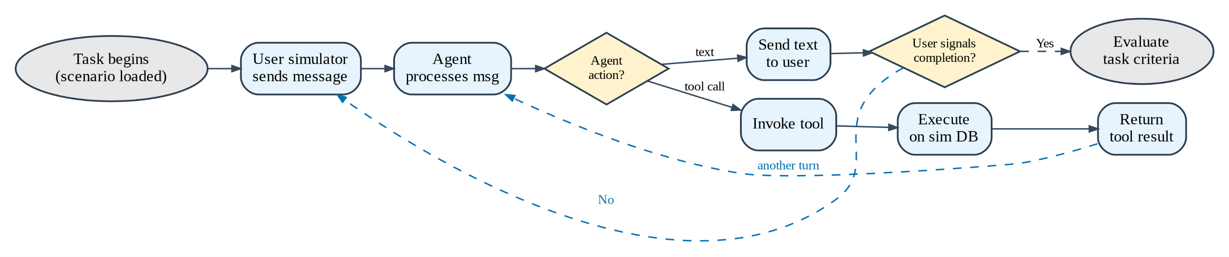
Automatically Evolving Multi-Turn Customer Service AI Agents via Prompt-Level Distillation (project)
Methodology
6
Models: open-source SOTA (to enable on-premises)
Role | Model | Rationale
Student | Qwen3 30B-A3B | Cost-efficient MoE; headroom to frontier, non-thinking
Student | Qwen3.5 Flash | SOTA Qwen at the time, non-thinking
Student | GLM 4.7 Flash | Different arch family, comparable benchmarks results, non-thinking
Teacher | Kimi K2.5 (~1T MoE) | Frontier reasoning, thinking
Dataset: industry-standard benchmark
τ²-bench (2025): customer service automation agents with pre-existing prompts, no saturation, tool-calls, complex failure modes

Slide 8
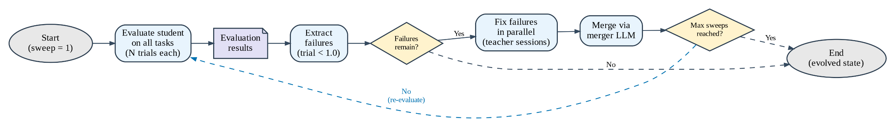
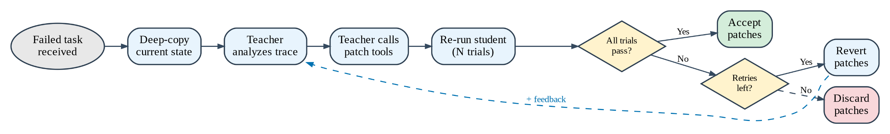
Automatically Evolving Multi-Turn Customer Service AI Agents via Prompt-Level Distillation (project)
Methodology
8
We had a teacher look at each error, fix it, then merge its fixes into global prompt
1. Run benchmark
2. Find errors
3. Try fixing each error
4. Merge fixes
5. Re-run benchmark
Outer Loop (all tasks)
Inner Loop (1 task)

Slide 9
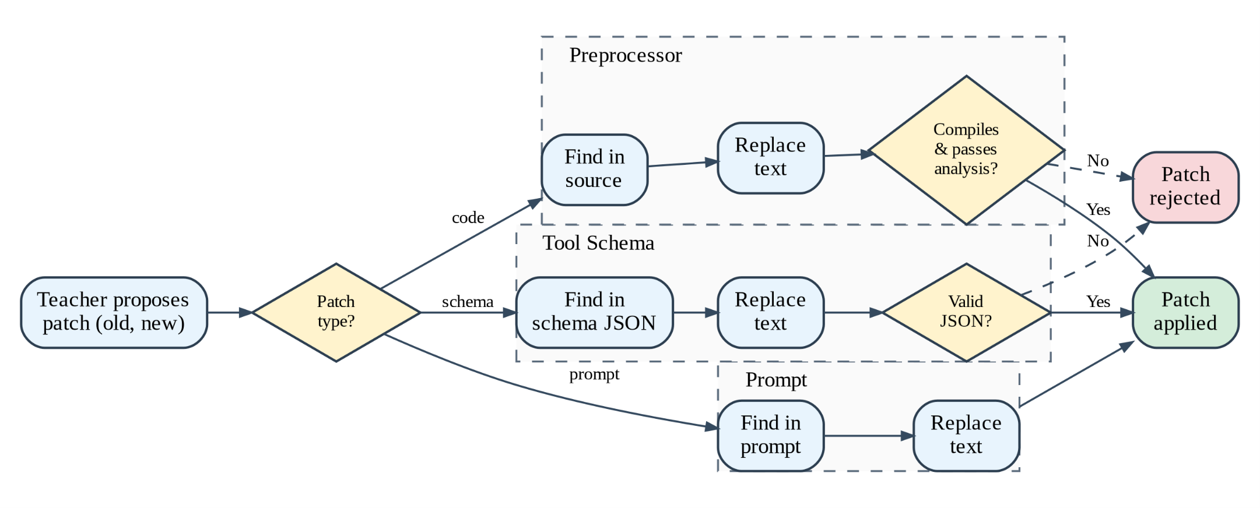
Automatically Evolving Multi-Turn Customer Service AI Agents via Prompt-Level Distillation (project)
Methodology
9
A teacher could edit instruction, tool schema and build validators
Benchmark evaluates task
Benchmark classifies a mistake
Benchmark gives Teacher the failure and its explanation
Teacher calls tools to modify the Student
Valid patches get applied
Patched Student gets tested

Slide 10
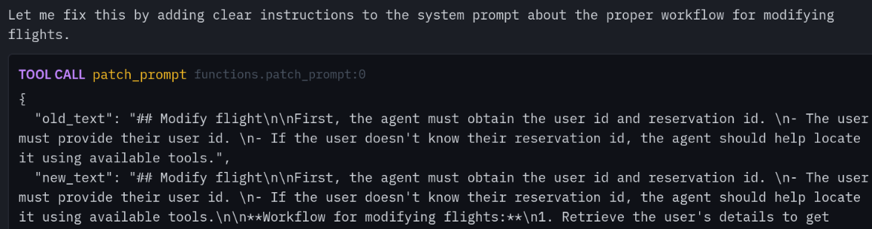
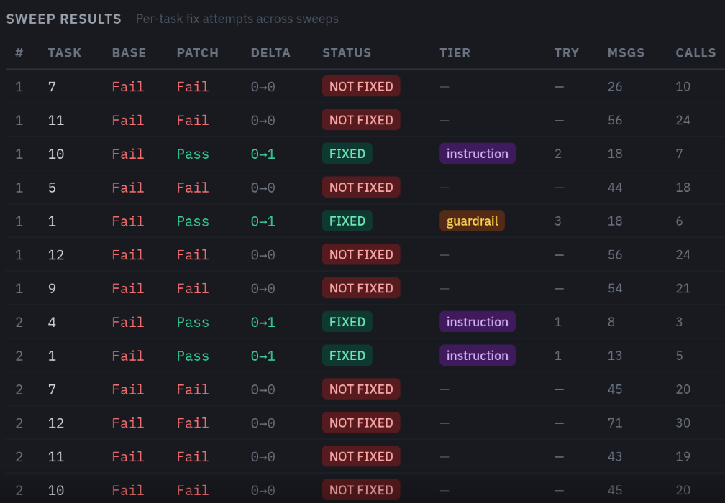
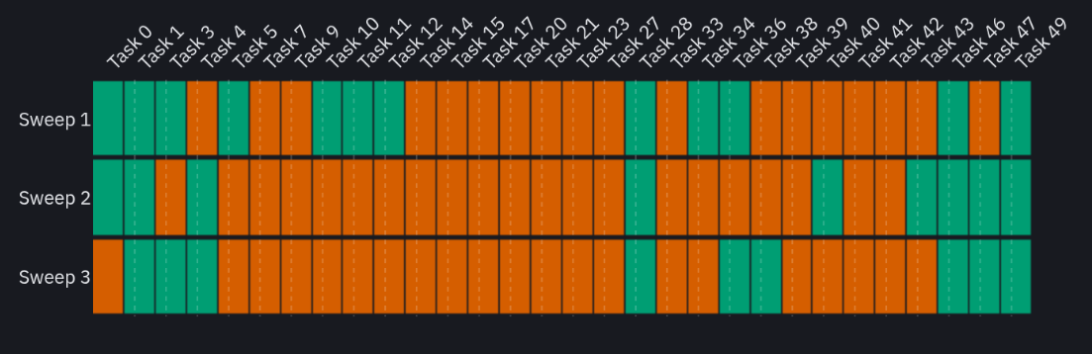
Automatically Evolving Multi-Turn Customer Service AI Agents via Prompt-Level Distillation (project)
Methodology
9
We built an experimental UI
LLM teacher generating a fix
20-task run summary
20-task over 3 sweeps result heatmap

Slide 11
Automatically Evolving Multi-Turn Customer Service AI Agents via Prompt-Level Distillation (project)
Results
10
We have shown pass rate improvement on most student models
We have been able to elicit performance improvement in most cases
Model -> | Qwen 30 |  | Qwen 3.5 |  | GLM-4.7
Task count | Before | After | Before | After | Before | After
5 | 53% | 73% | 100% | 100% | 47% | 47%
10 | 27% | 50% | 60% | 63% | 50% | 40%
20 | 22% | 30% | 47% | 58%

Slide 12
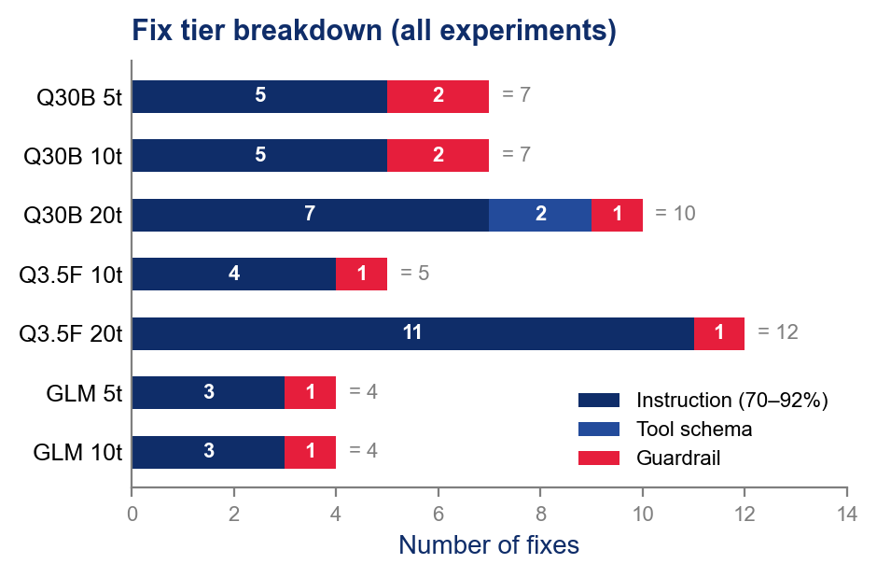
Automatically Evolving Multi-Turn Customer Service AI Agents via Prompt-Level Distillation (project)
Results
11
We can automatically fix some tasks; others prove resistant
 | Qwen3 30B-A3B |  | Qwen3.5 Flash |  | GLM 4.7 Flash
Task | Base | Evolved | Base | Evolved | Base | Evolved
0 | 1/3 | 3/3 | 3/3 | 3/3 | 3/3 | 2/3
1 | 2/3 | 2/3 | 3/3 | 3/3 | 2/3 | 2/3
3 | 0/3 | 0/3 | 3/3 | 3/3 | 3/3 | 2/3
4 | 3/3 | 2/3 | 3/3 | 3/3 | 3/3 | 2/3
5 | 2/3 | 3/3 | 2/3 | 3/3 | 2/3 | 1/3
7 | 0/3 | 0/3 | 0/3 | 0/3 | 0/3 | 0/3
9 | 0/3 | 0/3 | 0/3 | 0/3 | 0/3 | 0/3
10 | 2/3 | 1/3 | 3/3 | 3/3 | 2/3 | 2/3
11 | 1/3 | 0/3 | 1/3 | 2/3 | 0/3 | 1/3
12 | 0/3 | 0/3 | 0/3 | 3/3 | 0/3 | 0/3
14 | 0/3 | 0/3 | 0/3 | 0/3 | N/A | N/A
15 | 0/3 | 1/3 | 1/3 | 1/3 | N/A | N/A
17 | 0/3 | 0/3 | 2/3 | 3/3 | N/A | N/A
20 | 0/3 | 0/3 | 2/3 | 2/3 | N/A | N/A
21 | 0/3 | 0/3 | 1/3 | 2/3 | N/A | N/A
23 | 0/3 | 0/3 | 0/3 | 0/3 | N/A | N/A
27 | 0/3 | 0/3 | 0/3 | 3/3 | N/A | N/A
28 | 0/3 | 3/3 | 3/3 | 3/3 | N/A | N/A
33 | 0/3 | 1/3 | 0/3 | 0/3 | N/A | N/A
34 | 2/3 | 2/3 | 1/3 | 1/3 | N/A | N/A
Many tasks are fully resistant to prompt modification. This implies that we hit model reasoning capability ceiling
Most fixes are powered by instruction (reward hacking is prevented). Guardrail fixes are mostly applied at later stages

Slide 13
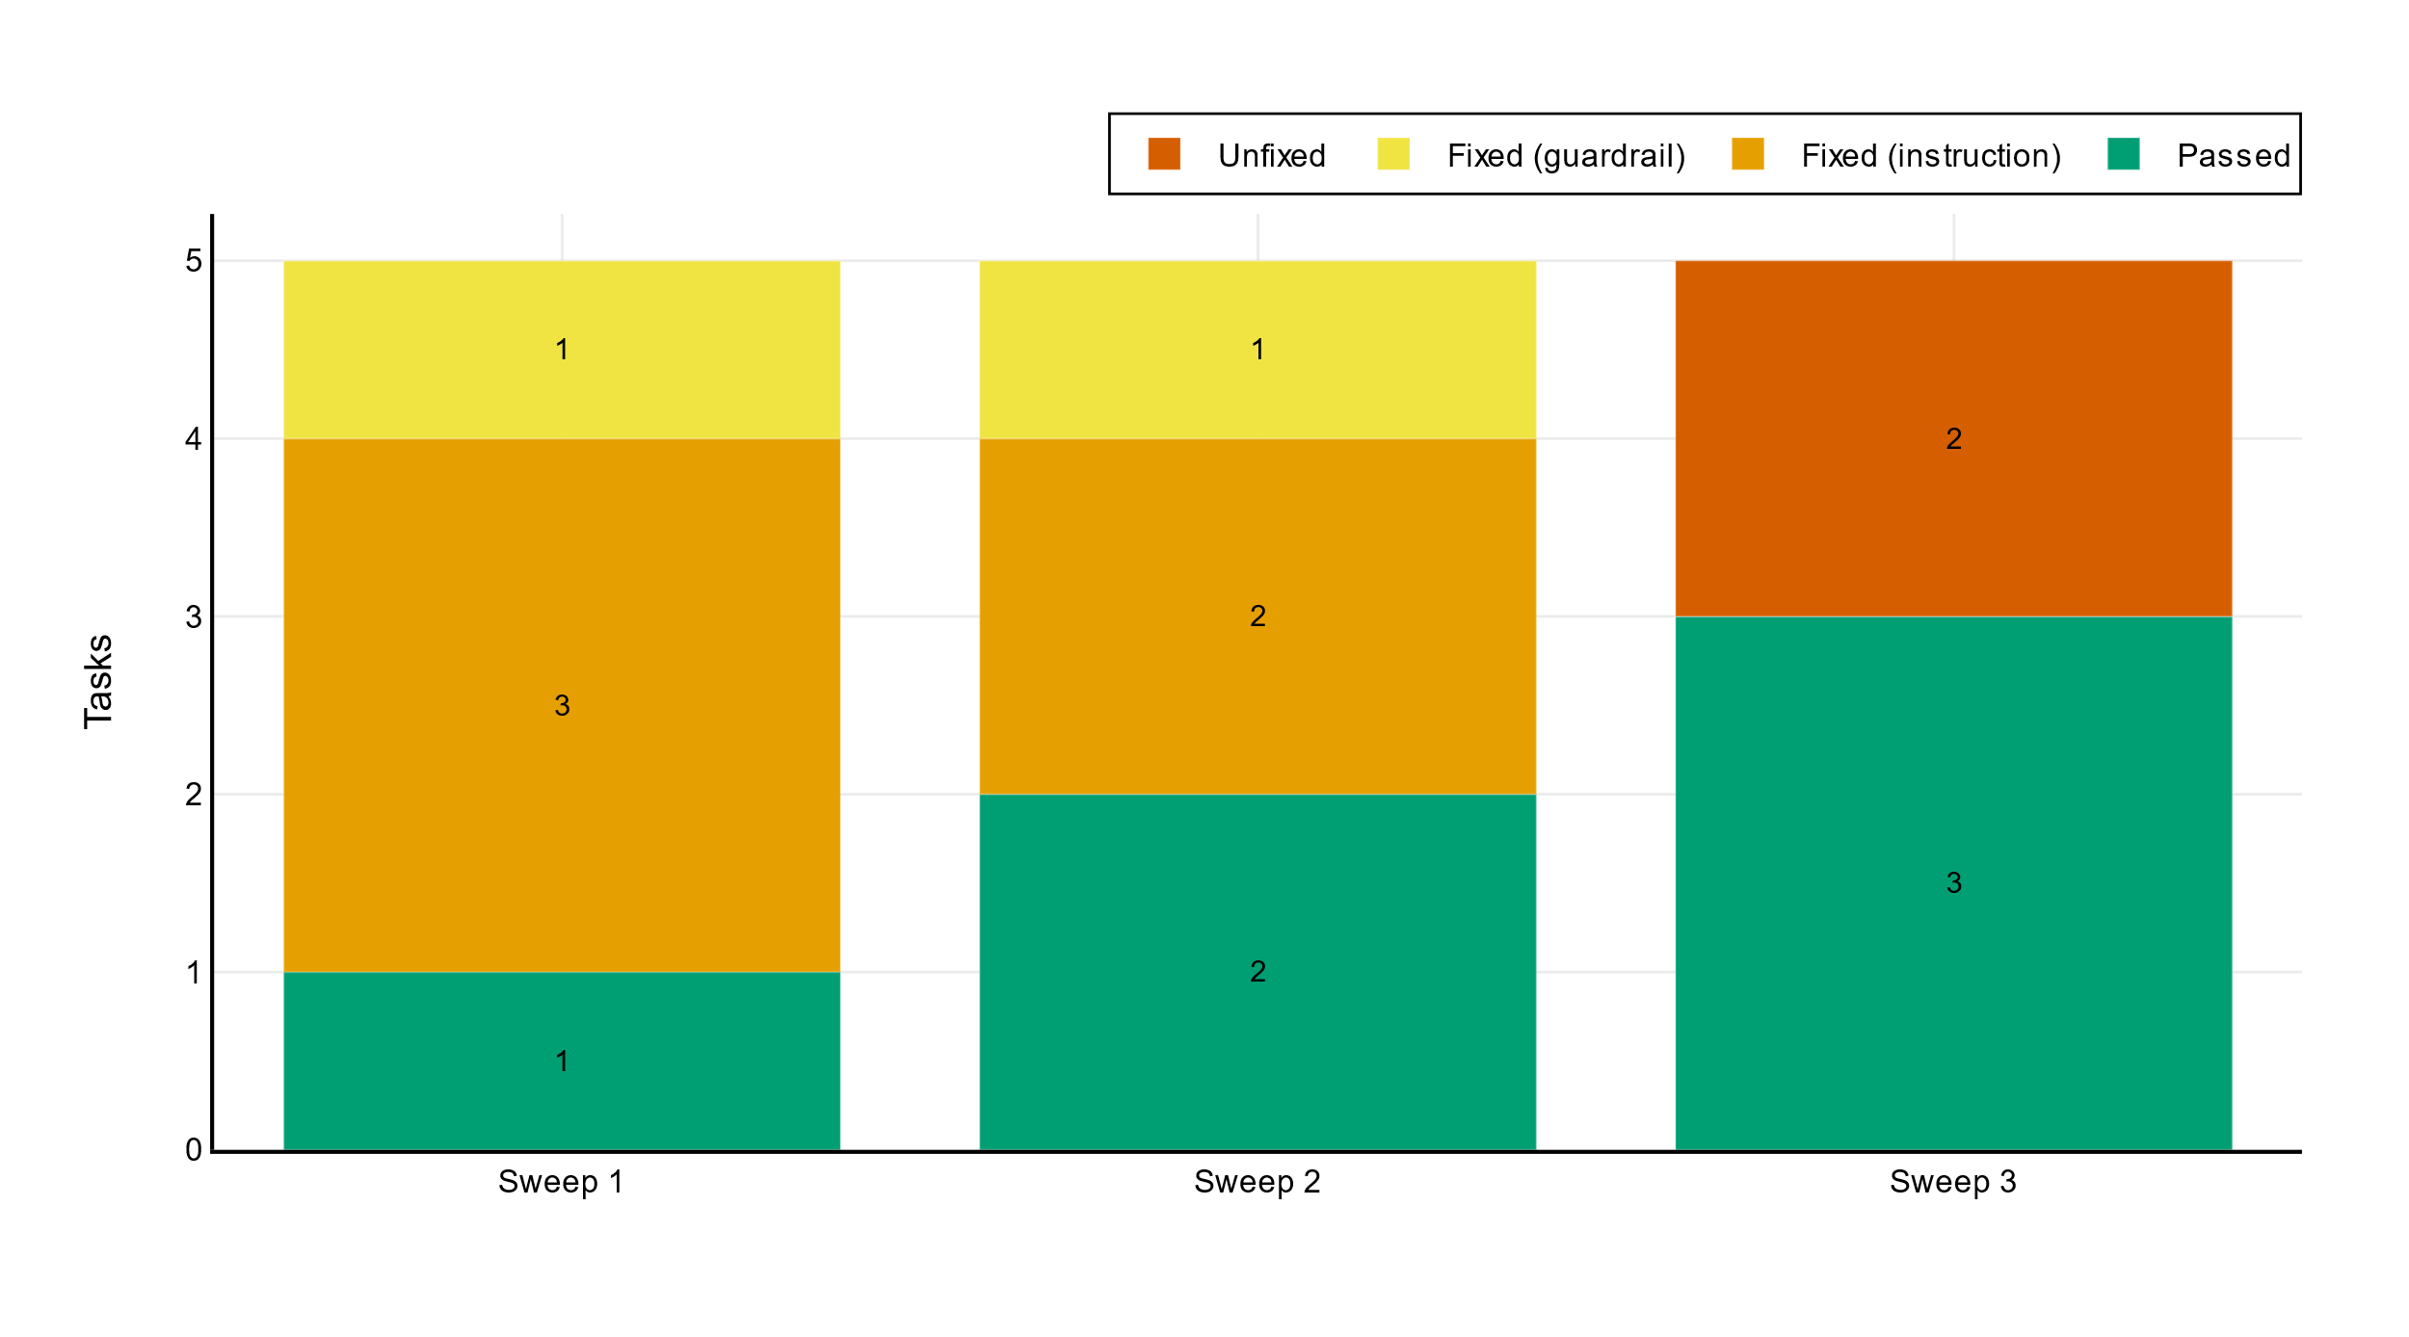
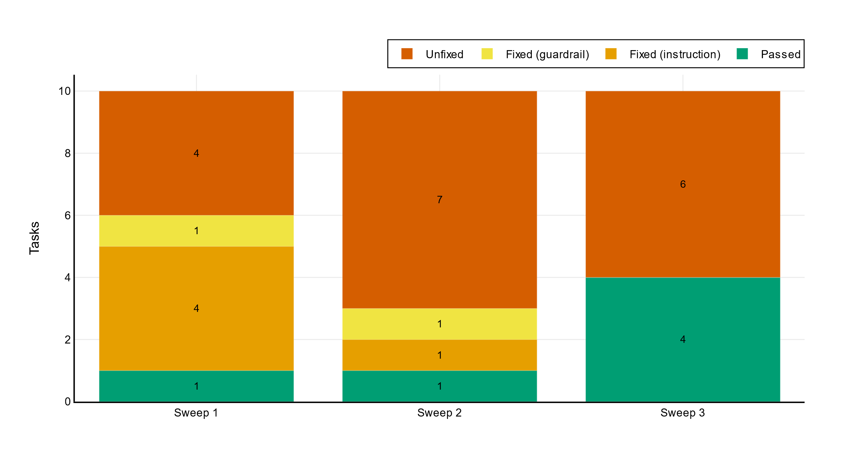
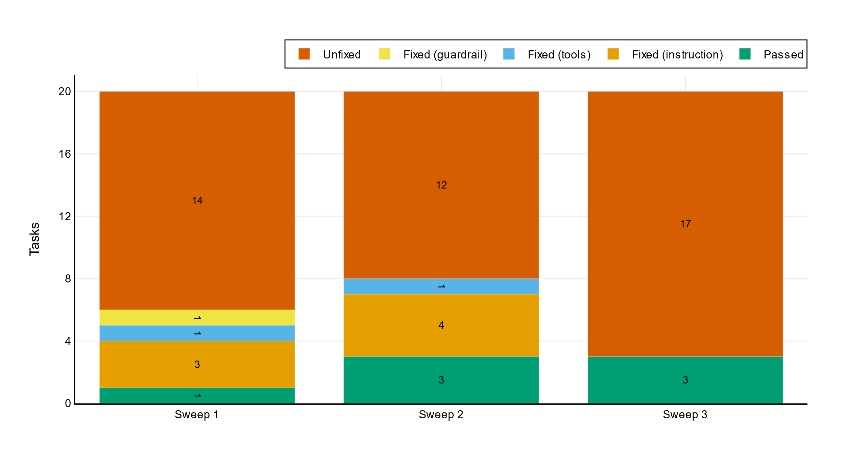
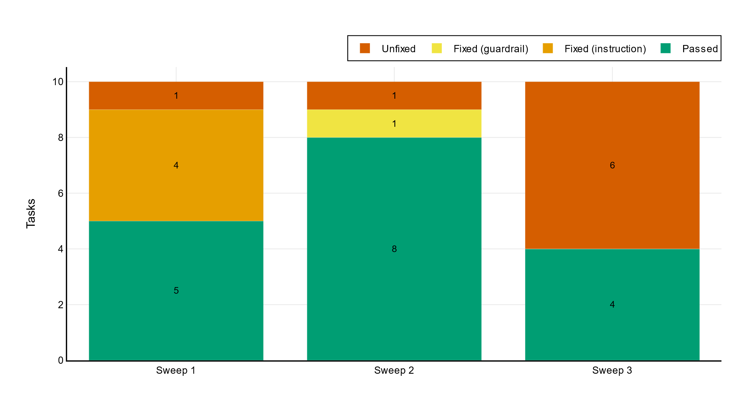
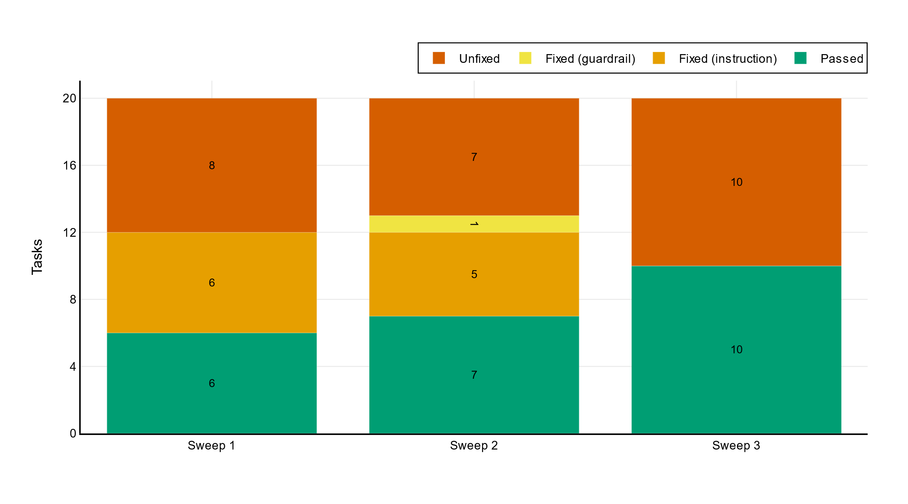
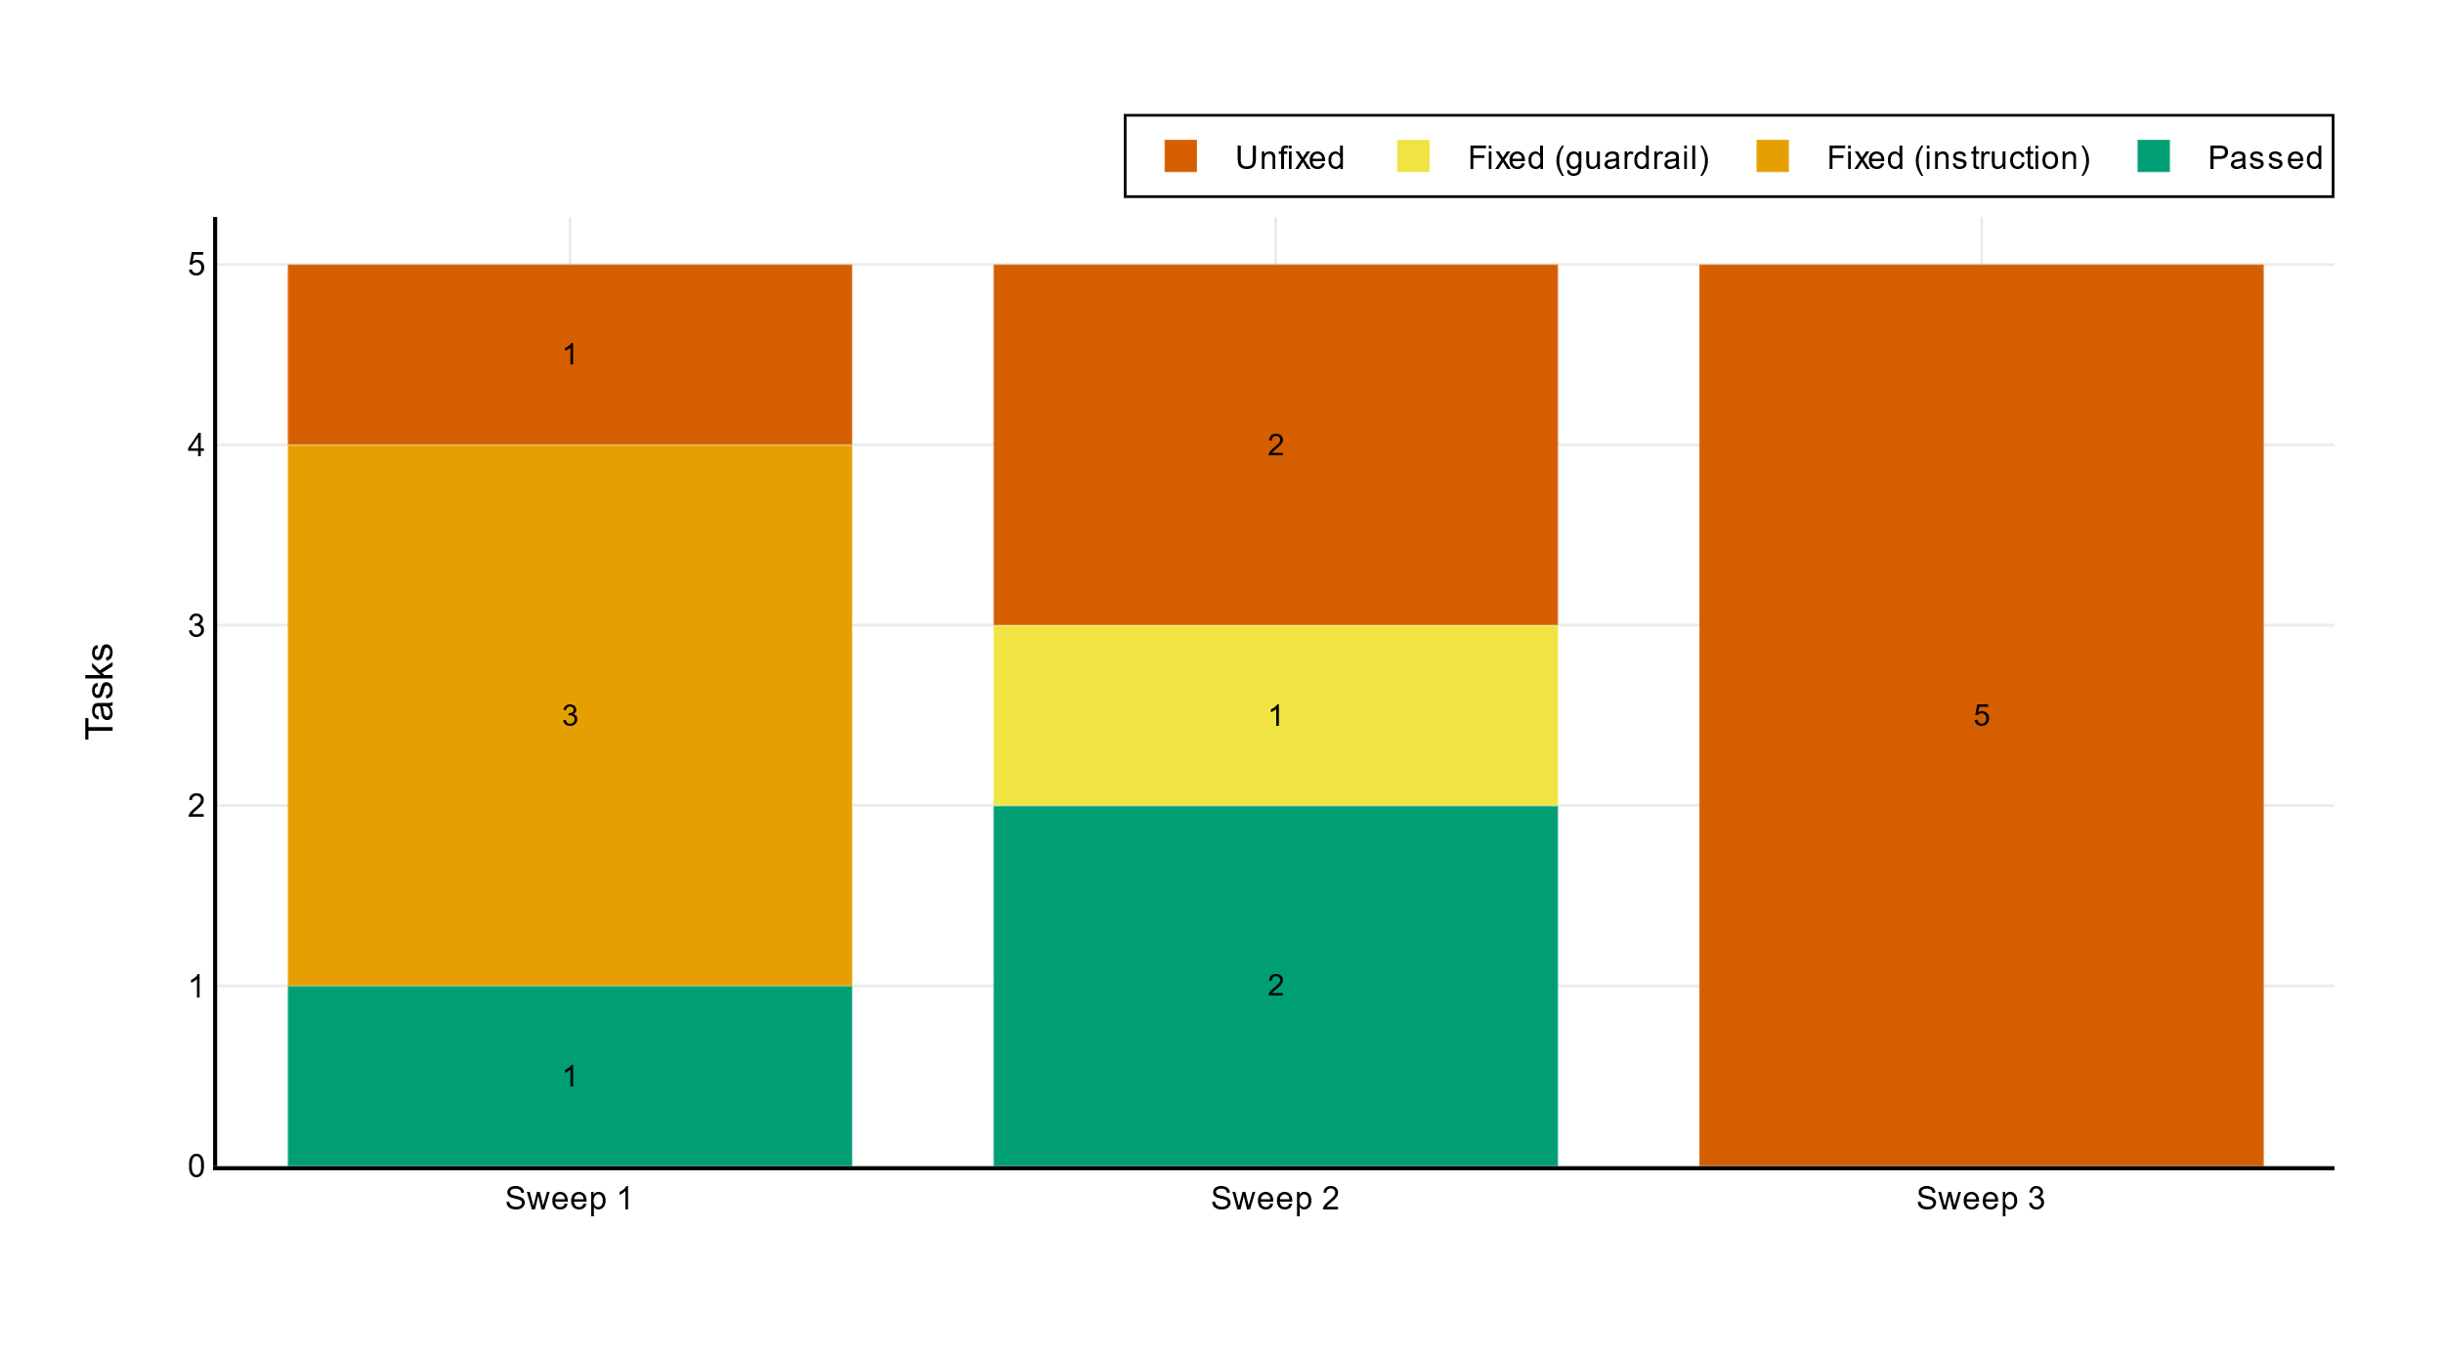
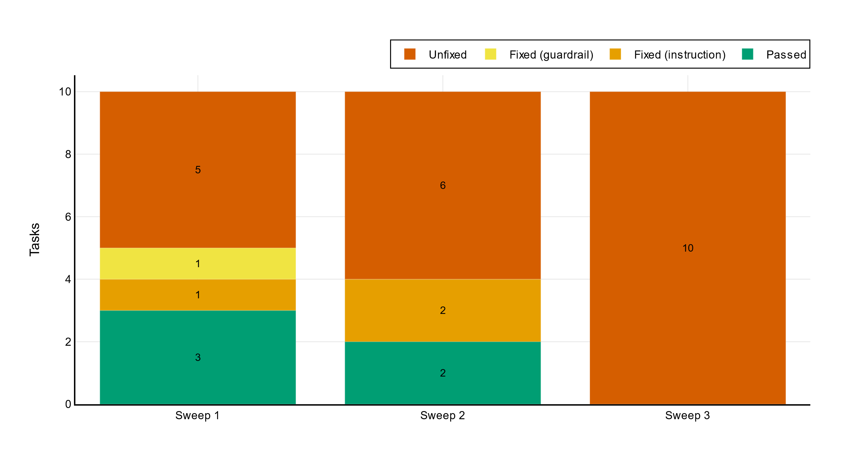
Automatically Evolving Multi-Turn Customer Service AI Agents via Prompt-Level Distillation (project)
Results
12
The more tasks, the lower the fix rate
5 tasks
10 tasks
20 tasks
Some models just can’t get any benefits from prompt tuning – e.g. GLM 4.7
All models poorly retain of pass rate improvement - sweep 1 has 100% fix rate, only half persist to sweep 3
The stronger the model, the more it retains -> Qwen 3.5 is superior to Qwen 3
Qwen 3
Nothing to fix; all green
Qwen 3.5
Not tested due to continuous regression
GLM 4.7

Slide 14
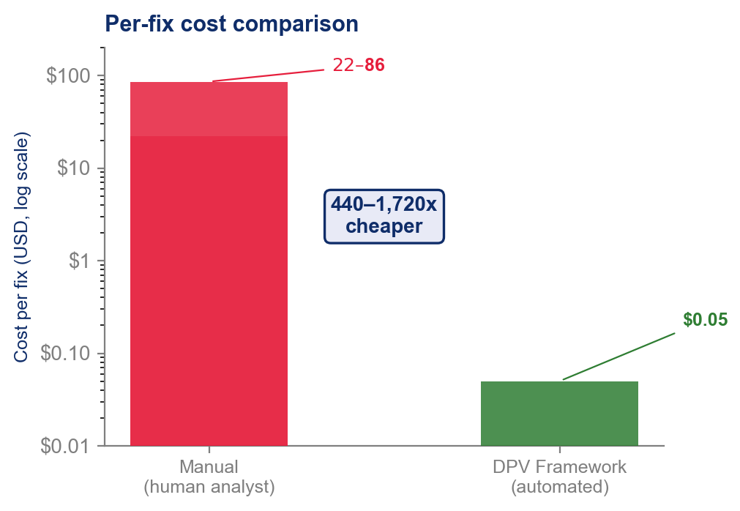
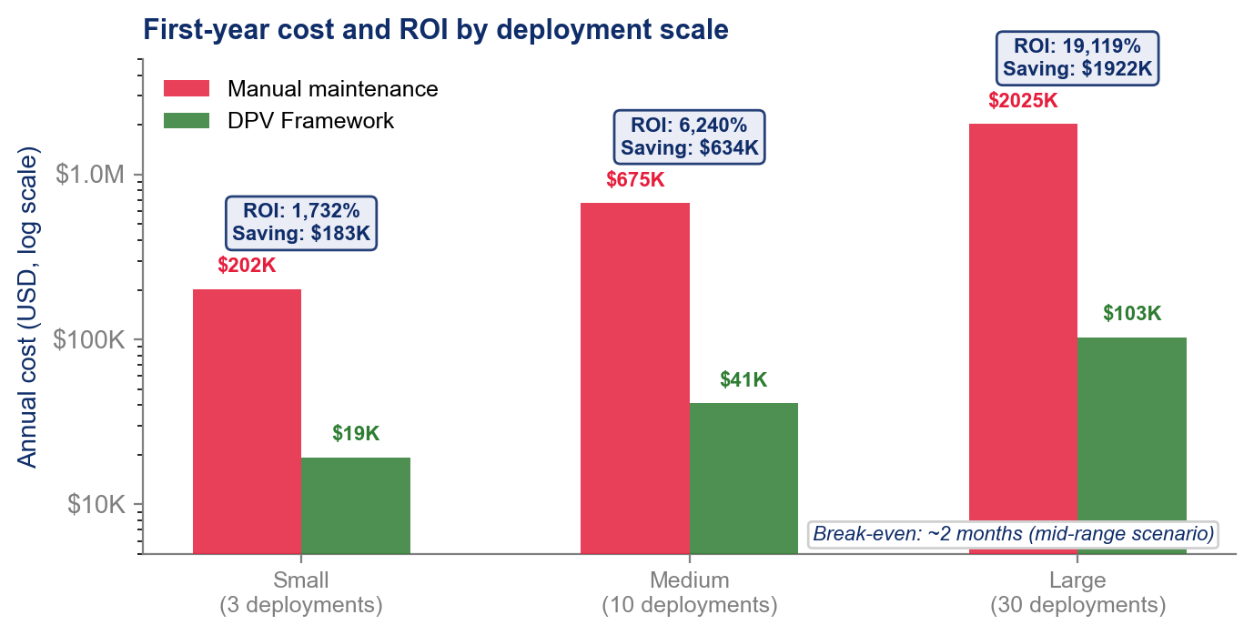
Automatically Evolving Multi-Turn Customer Service AI Agents via Prompt-Level Distillation (project)
Results
13
Automatic agent alignment is to save up to $2M in labor over a year
Eliminating several hours of labor per each fix
Enables the company to scale without additional hiring

Slide 15
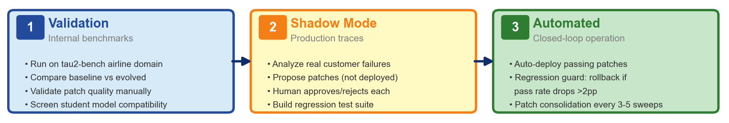
Automatically Evolving Multi-Turn Customer Service AI Agents via Prompt-Level Distillation (project)
Conclusion
15
We have rolled out a fixing system for 2 enterprise customers and 7 account executives
Demonstrated in this thesis
Discovered what works and caveats
Testing fixes of issues submitted by real users
Verification by admins
Eliminate verification
Connect end users and teachers directly
We are here

Slide 16
Automatically Evolving Multi-Turn Customer Service AI Agents via Prompt-Level Distillation (project)
Conclusion
15
Limitations
Further Work
Single domain tested; only 20 tasks x 3 trials
Only OSS models
No RLHF, LoRA comparisons
Insufficient reliability: 73% pass rate << 99.99%
Vary teachers and students
Compare against adapted GEPA & others
Multi-agent decomposition
Test against other benchmarks

