Slide 1
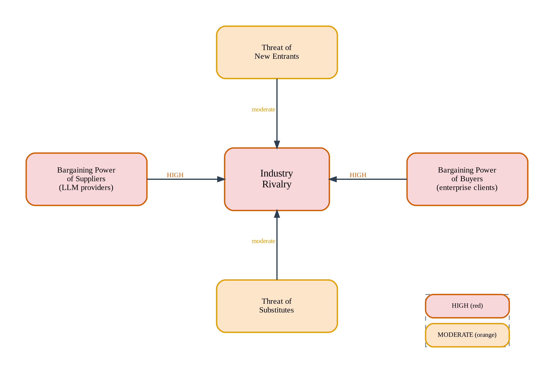
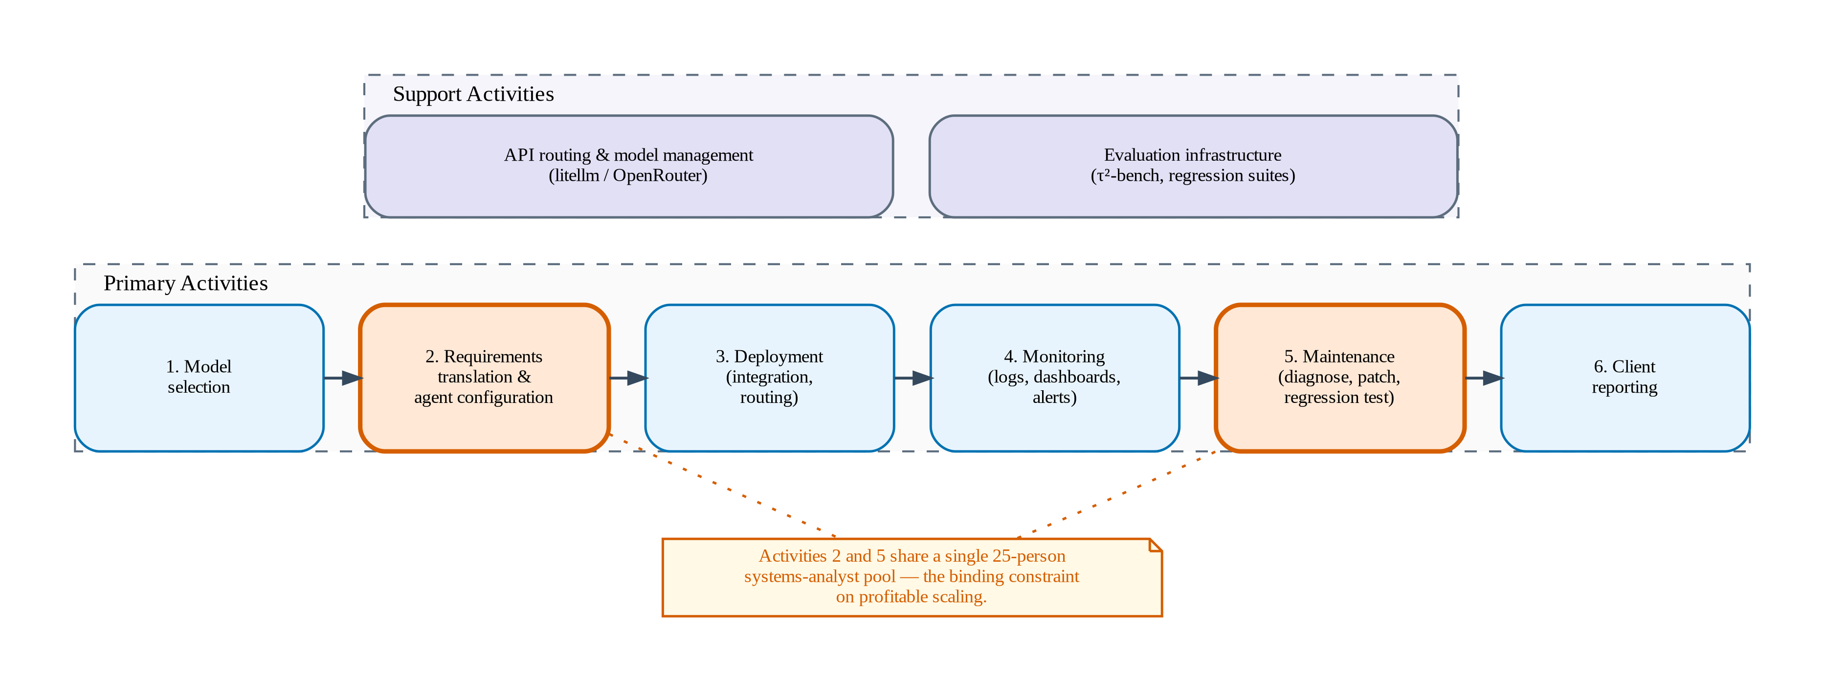
WHY AUTOMATED ALIGNMENT IS NECESSARY
Chapter 1 / Section 1.3 — Diagnostic Study
Porter’s Five Forces: CX Automation Market
Value Chain: The Bottleneck
25 people
75M RUB/yr
$45–$55K
Same analyst pool for activities 2 & 5
= 37% of tos1 annual revenue
Per deployment/yr maintenance cost
DPV shifts cost structure:
Linear (per-FTE, per-deployment) → Near-fixed (teacher model compute)
→ All 5 forces converge: market structurally demands automated agent alignment
The Klarna Warning
Buyers: HIGH
Suppliers: HIGH
Rivalry: HIGH
Entrants: MOD
Substitutes: MOD
2.3M conversations/month, $40M projected savings
→ customer satisfaction declined within a year, human agents rehired
Gartner: 50% of orgs will abandon CX AI workforce reduction by 2027
Switching costs ↓ Outcome-based pricing
Few LLM providers Sanctions limit access
Intercom, Sierra, Zendesk Margins 50–65%
APIs commodity Domain knowledge = moat
AI $0.50–$2 vs human $5–$15
Source: thesis Section 1.3 | All five forces converge: automated agent alignment is a structural market requirement

