Slide 1
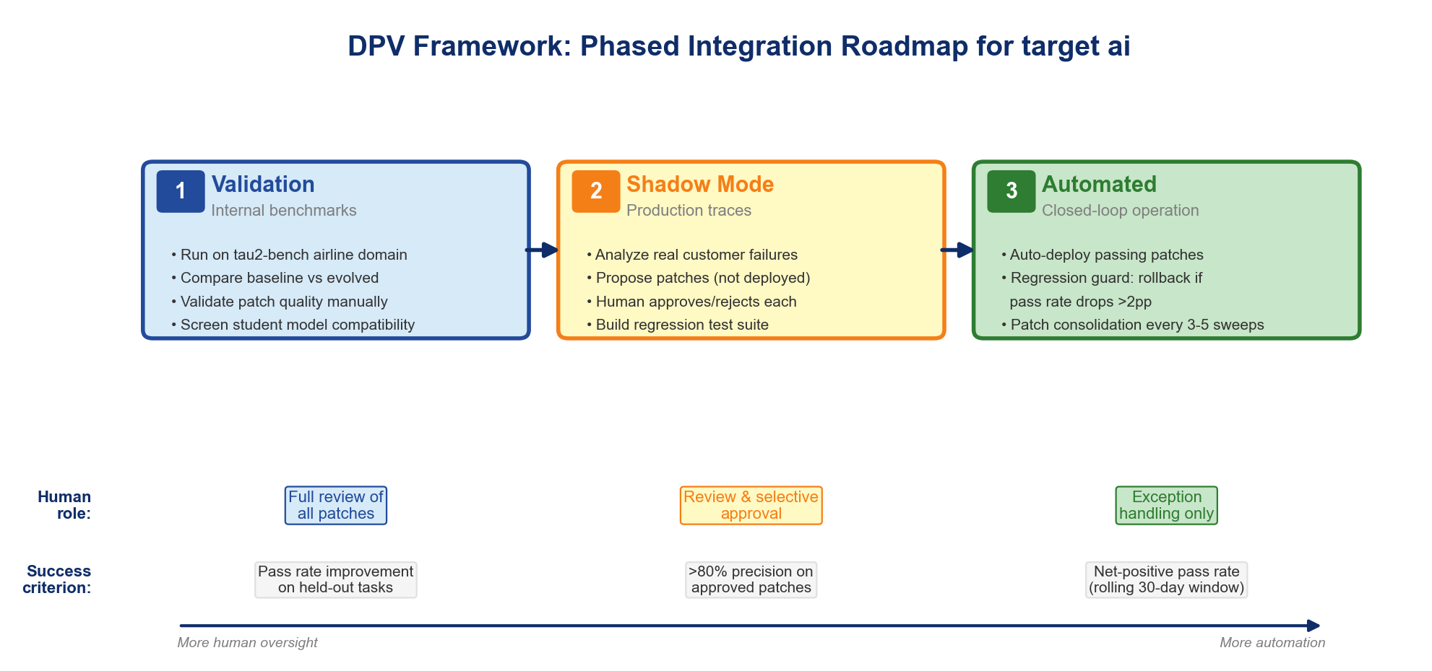
RECOMMENDATIONS FOR TARGET AI
Chapter 3 / Section 3.5 — Recommendations & Roadmap
Phased Integration Roadmap
Key Operational Recommendations
Patch consolidation
Stronger teachers
Model screening
Early termination
Every 3–5 sweeps to mitigate prompt-space interference
Highest-leverage single improvement available
Mandatory before deploying with new student models
Stop after 2 sweeps if no new fixes found
Evidence:
Evidence:
Evidence:
Evidence:
Thesis finding: patches degrade previously passing tasks
Qwen3.5 Flash at ceiling → teacher quality is binding
GLM 4.7 Flash regressed — not all models benefit
Reduces wasted compute by 40–50%
Integration effort: 2–4 engineering weeks to adapt research prototype to production-grade service
Domain-agnostic by design — prioritize domains by: (a) failure rate × (b) analyst cost per deployment = expected ROI per fix
Regression guard: rollback if pass rate drops >2pp; rolling validation set of ≥50 tasks per domain
Objective 5: Produce actionable recommendations for target ai | Phased rollout: validation → shadow mode → automated closed-loop

