Slide 1
Self-Evolving LLM Agents via
Reflective Prompt and Tool-Schema Patching
Gleb Dementev
Thesis Defense • 2026

Slide 2
Key Terms
Tool-Calling Agent
Prompt Evolution
Prompt + tool schemas → multi-turn conversation → tool invocations on DB
Examples: customer-service bots, CRM agents
→
Teacher diagnoses failures → generates patches (prompt, schemas, code) → student re-evaluated
No weight modification.
τ²-bench: evaluation surface — structured tasks, simulated users, binary pass/fail
Domains: airline, retail, telecom | Teacher: Kimi K2.5 | Student: Qwen3 30B-A3B

Slide 3
Why It Matters
Current Agent Deployment
Automated Prompt Optimization
• Agents fail 15–50% on enterprise benchmarks
• Static prompts can't adapt post-deploy
• Fine-tuning: expensive, irreversible, alignment tax
• DSPy, TextGrad, GEPA improve w/o weight access
• Teacher–student distillation works at weight/output level
• Not yet tested at prompt level on agents
GAP: Prompt-level evolution on agentic benchmarks — untested
Fig 2.5: Optimization coverage heatmap — empty 'Tool-Calling Benchmark' column

Slide 4
Problem, Goal & Research Questions
Problem:
No method combines teacher-driven prompt optimization + validation on tool-agent-user benchmarks
Goal:
Determine extent teacher-driven prompt/tool-schema evolution improves agent performance on τ²-bench
RQ1: Which failure modes respond to prompt/schema edits? Which resist?
RQ2: Scaling behaviour — does fix rate hold as task pool grows?
RQ3: Can prompt patches close baseline→frontier gap w/o weight updates?
Objective | Deliverable
1. Baseline eval on τ²-bench airline | Failure mode catalogue
2. Diagnose-patch-validate loop | Evolution framework (software)
3. Eval across 5/10/20 tasks, 3 models | Scaling data + cross-model comparison
4. Measure gap closure | Primary outcome metric
5. Analyse patch distribution | Boundaries of prompt-level intervention

Slide 5
Theoretical Framework
Agentic Benchmarks & Prompting
Automated Optimization & Distillation
• τ-bench, AgentBench, GAIA quantify gap
• Static prompting: capability ↑, adaptability ✗
• Fine-tuning impractical for rapid iteration
• DSPy, TextGrad, GEPA: gains on reasoning tasks
• Distillation: weights → outputs → prompts
• None validated on tool-calling benchmarks
Fig 2.1 — Six-step argument chain

Slide 6
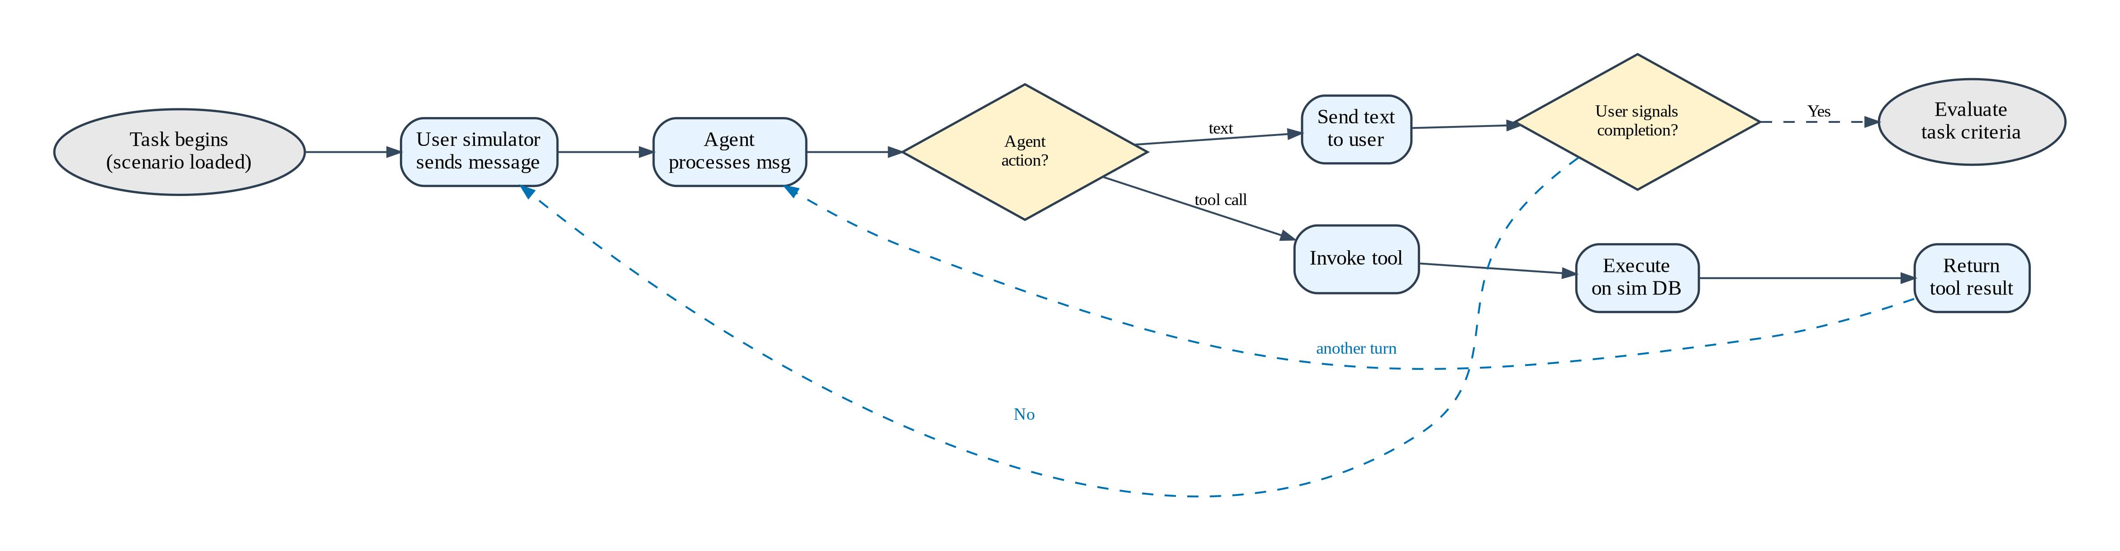
Benchmark & Dataset
τ²-bench (Barres et al., 2025): multi-turn convos, simulated user, tool calls on DB, binary pass¹
Airline domain — 50 tasks (subsets: 5, 10, 20)
B (Baseline)
K (Evolved)
F (Frontier)
Student, default prompt/tools → floor
Student, evolved prompt/patched tools → intervention
Teacher, default prompt/tools → ceiling
Gap Closure = (K − B) / (F − B) × 100%

Slide 7
Model Selection
Role | Model | Rationale
Student (primary) | Qwen3 30B-A3B (3.3B active) | Cost-efficient MoE; headroom to frontier
Student (ablation) | Qwen3.5 Flash | Stronger instruction follower
Student (ablation) | GLM 4.7 Flash (9B) | Different arch family → generalisability test
Teacher | Kimi K2.5 (~1T MoE) | Frontier reasoning; 256K ctx; open-weight
User simulator | Qwen3 30B-A3B | Follows scripts; frontier not needed

Slide 8
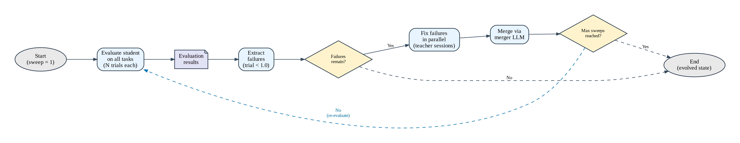
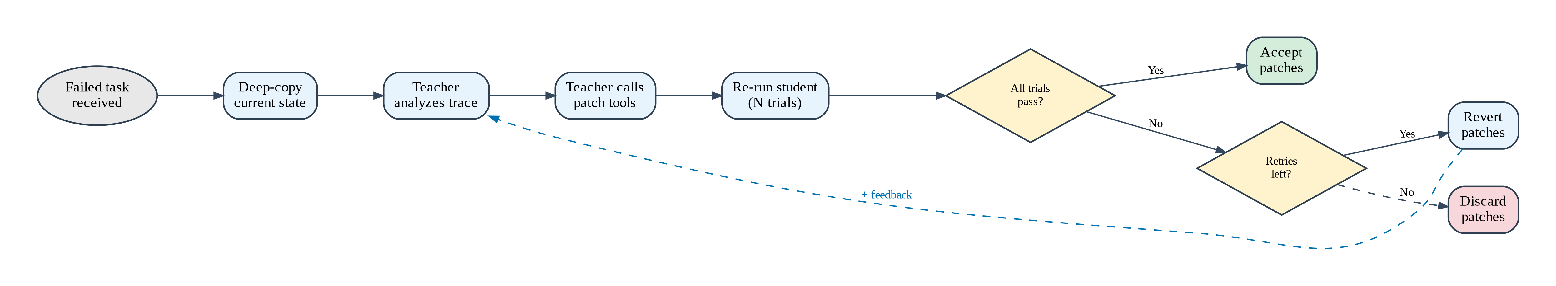
Evolution Framework
Outer Loop
Inner Loop (per-failure fix)
Phase 1: teaching (prompt+schema) → Phase 2: guardrails (+preprocessor code) | Unanimous pass required

Slide 9
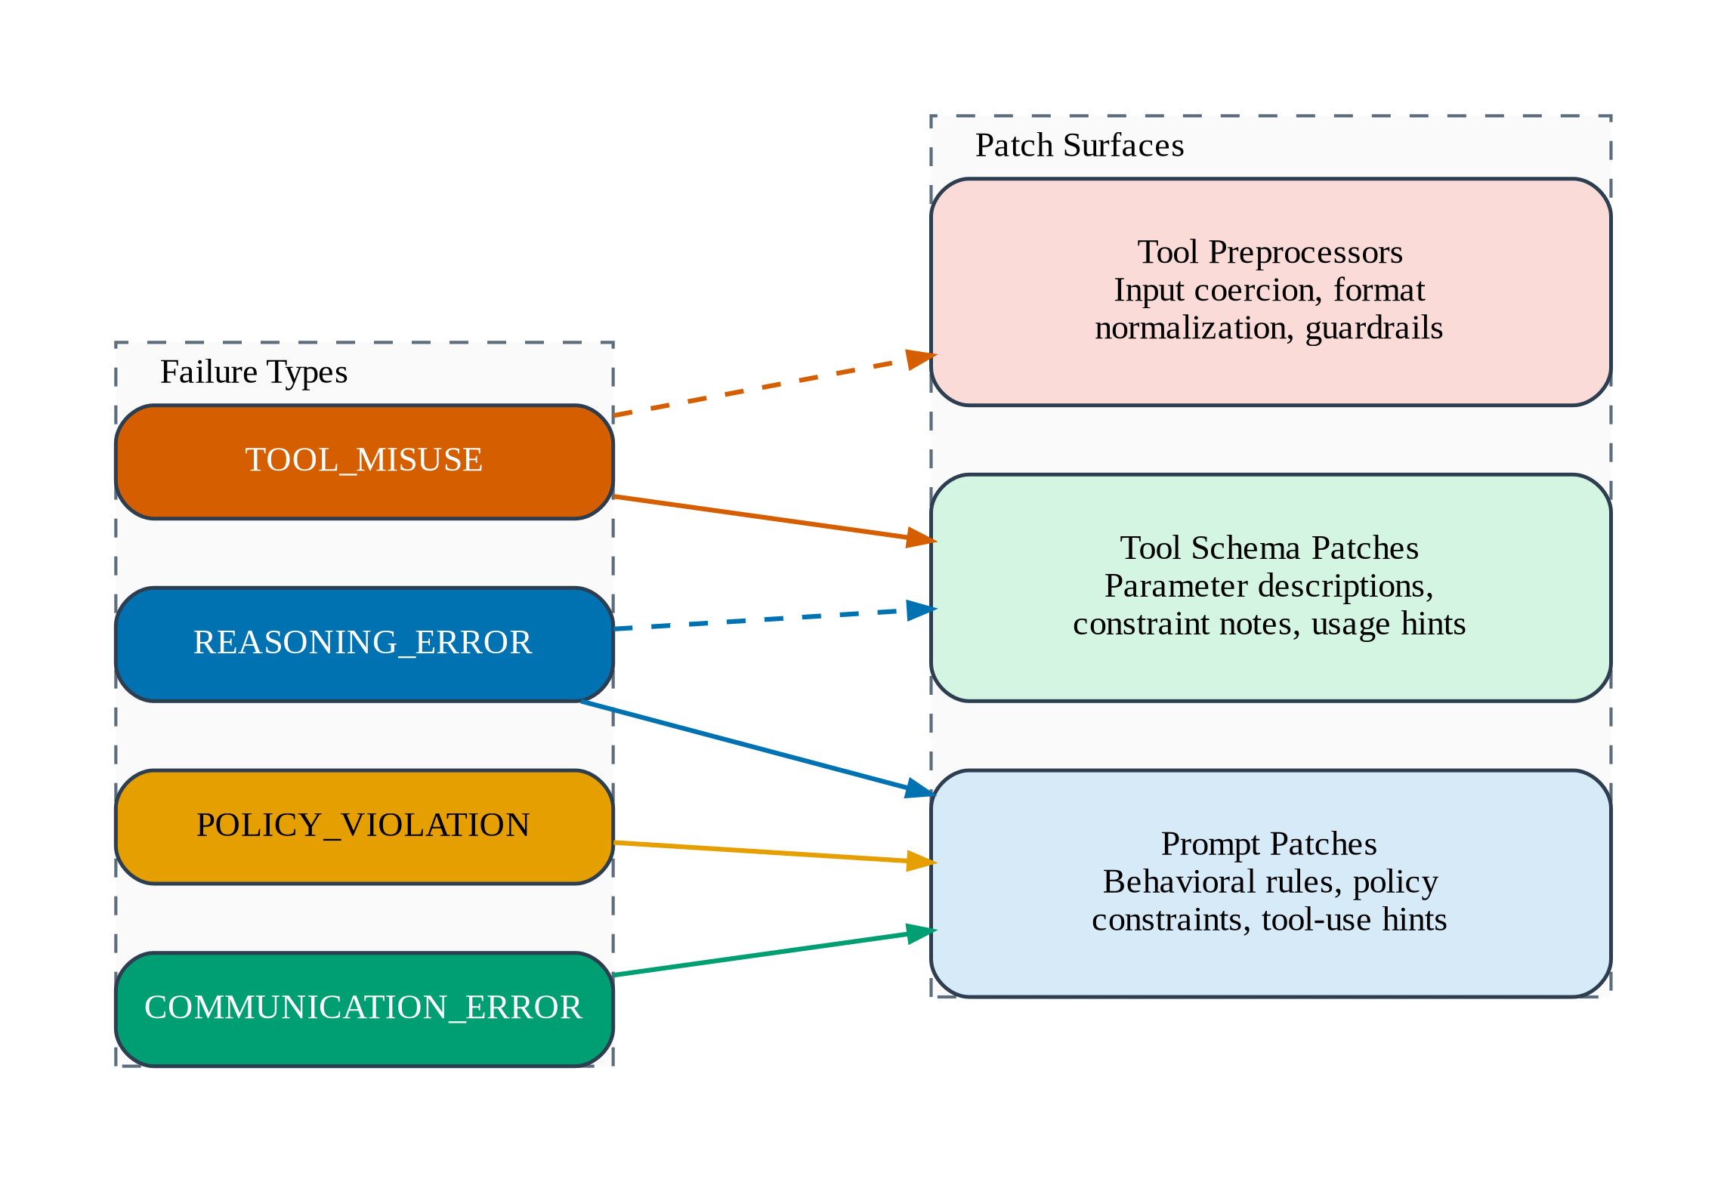
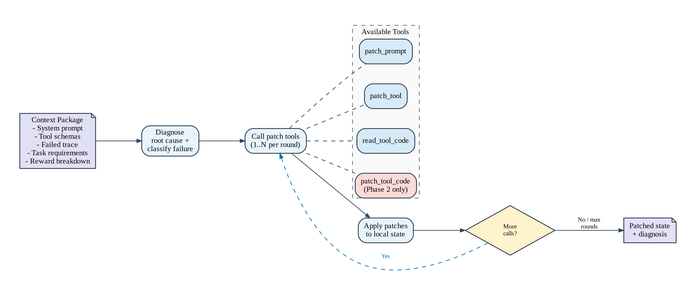
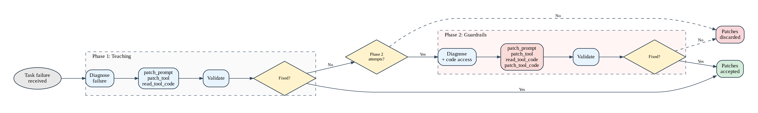
Patch Surfaces & Teacher Session
Three surfaces: prompt patches (rules), tool schema patches (constraints), tool preprocessors (code)

Slide 10
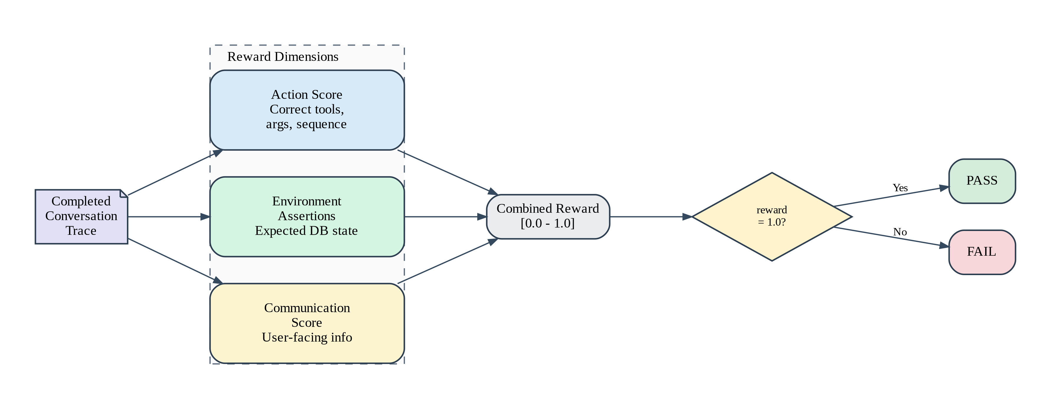
Evaluation Metrics & Failure Taxonomy
pass¹ — fraction of tasks with perfect reward (1.0). Binary, no partial credit.
Gap Closure G = (K−B)/(F−B) × 100%
Fix Rate — fraction of attempted fixes → unanimous pass
Failure Taxonomy
TOOL_MISUSE
POLICY_VIOLATION
REASONING_ERROR
COMMUNICATION_ERROR
Fix Tiers: instruction (prompt/schema) | tools (schema-only) | guardrail (preprocessor code)

Slide 11
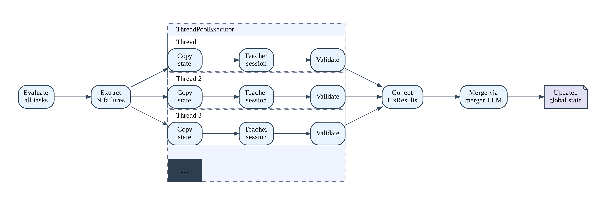
F1: Improvement Across All Scales
Qwen3 30B-A3B: prompt evolution improves pass rate at every scale tested
5 tasks
10 tasks
20 tasks
+20pp
+23pp
+11pp
Fix rate: 100%
Fix rate: 56%
Fix rate: 53%
Stable absolute gain at 5–10 tasks; diminishing returns at 20. Fix rate declines with scale.

Slide 12
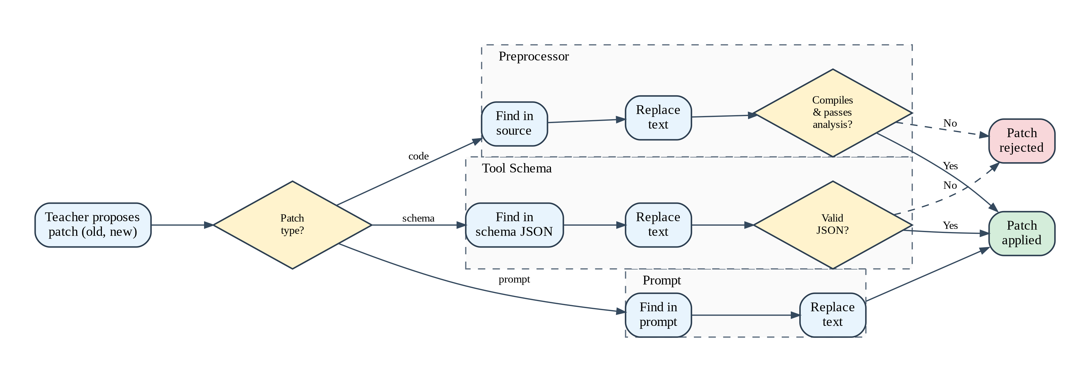
F2: Value Contingent on Student Capability
Identical teacher patches → sharply divergent outcomes across students
Student @ 10 tasks | Δ pass (majority) | Fix rate
Qwen3.5 Flash | +30pp | 80%
Qwen3 30B-A3B | +20pp | 71%
GLM 4.7 Flash | 0pp | 0%
@ 20 tasks: Qwen3.5 Flash → 65% (+20pp) | Qwen3 30B → 30% (+5pp) | GLM dropped (negative results)

Slide 13
F3: 70–92% Fixes Are Instruction-Tier
Prompt text + schema edits dominate; ratio stable across scales and models
5 tasks
71%
10 tasks (Qwen3)
71%
10 tasks (Qwen3.5)
80%
20 tasks
70%
Instruction
Guardrail
Tool-schema
Supports Superficial Alignment Hypothesis (Zhou et al., 2023)

Slide 14
F4: Hard Core of Resistant Tasks
Tasks 7, 9 resist all fixes across all students. Unfixable set shrinks with stronger models but persists.
Fixable cluster
(greens progressively)
→
Resistant cluster
(stays red — Tasks 7, 9)
Qwen3.5 Flash fixes Tasks 11, 12 that Qwen3 30B cannot — capability-limited, not structurally hard

Slide 15
F5: Patch Interference Causes Regression
Accumulated patches create conflicts → regression paralleling catastrophic forgetting
GLM 4.7 Flash @ 5 tasks
Regression severity by model
Sweep 2: 80% → Sweep 3: 40%
Qwen3 30B: mildest
Qwen3.5 Flash: severe at 10 (-17pp trial), stabilises at 20
GLM: monotonic decline everywhere
Monotonic decline at all scales

Slide 16
Hypothesis Summary
Sub-question | Result
RQ1: Which failure modes respond? | Policy failures most responsive (70–92% instruction-tier). Multi-step reasoning resists all intervention. | ✓
RQ2: Does fix rate scale? | Stable at 5–10 tasks (+20pp). Halves at 20 (+11pp). Capacity ceiling: 5–8 fixable tasks. | ✓
RQ3: Can patches close gap? | Yes for capable students (Qwen3.5→65%). No for weak (GLM→0%). Contingent on student. | ~

Slide 17
Conclusions & Contributions
Contributions
1. Teacher-driven prompt evolution framework — 3 patch surfaces, validate-before-merge
2. First empirical eval of auto prompt optimization on multi-turn tool-calling benchmark
3. Scaling evidence: stable gain, declining fix rate, hard core, student capability role
4. Indirect support for Superficial Alignment Hypothesis in agentic settings
Limitations
• Single domain (airline) — retail, telecom untested
• Single teacher — sensitivity unknown
• 3 trials/task — limited statistical power
• No fine-tuning baseline (RLHF/DPO)
• No patch retirement → cumulative interference
• Best result 65% — far from enterprise 99.9%+

Slide 18
Thank You
Self-Evolving LLM Agents via
Reflective Prompt and Tool-Schema Patching
Gleb Dementev
Questions?

