Slide 1

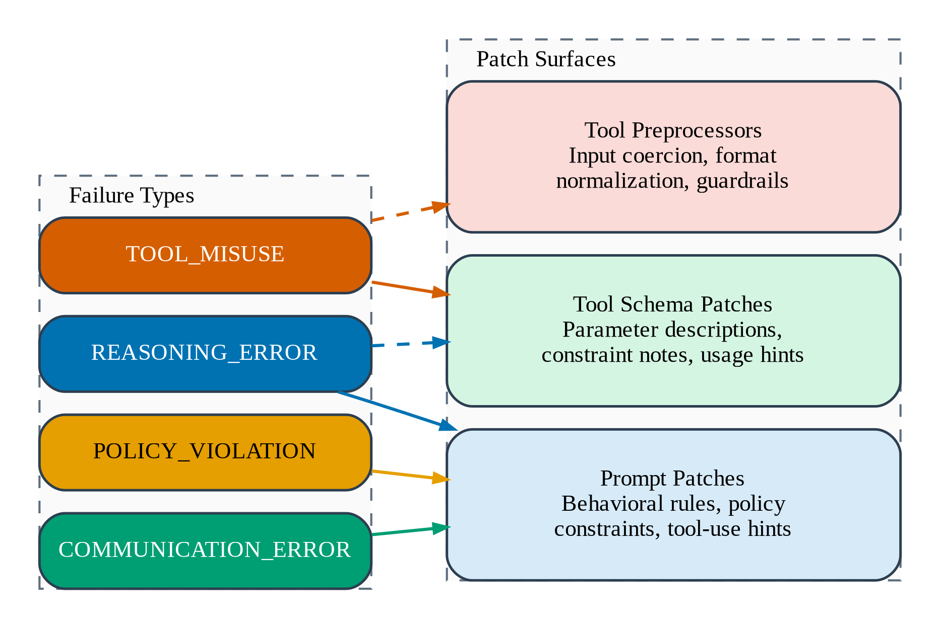
Results: Research Question 1
Chapter 4
Q1: We can fix only some tasks; others prove resistant
20 tasks — sweep 3 vs baseline (pass/3 trials). Q30B & Q3.5F: 20-task exp. GLM: 10-task exp (dropped at 20t).
Fix tier breakdown (all experiments)
Unfixable set shrinks with model strength
 | Qwen3 30B-A3B |  | Qwen3.5 Flash |  | GLM 4.7 Flash
Task | Base | Sw 3 | Base | Sw 3 | Base | Sw 3 | Verdict
0 | 1/3 | 3/3 | 3/3 | 3/3 | 3/3 | 2/3 | Fixed
1 | 2/3 | 2/3 | 3/3 | 3/3 | 2/3 | 2/3 | Stable
3 | 0/3 | 0/3 | 3/3 | 3/3 | 3/3 | 2/3 | Model-dep
4 | 3/3 | 2/3 | 3/3 | 3/3 | 3/3 | 2/3 | Regressed
5 | 2/3 | 3/3 | 2/3 | 3/3 | 2/3 | 1/3 | Mixed
7 | 0/3 | 0/3 | 0/3 | 0/3 | 0/3 | 0/3 | Resistant
9 | 0/3 | 0/3 | 0/3 | 0/3 | 0/3 | 0/3 | Resistant
10 | 2/3 | 1/3 | 3/3 | 3/3 | 2/3 | 2/3 | Regressed
11 | 1/3 | 0/3 | 1/3 | 2/3 | 0/3 | 1/3 | Model-dep
12 | 0/3 | 0/3 | 0/3 | 3/3 | 0/3 | 0/3 | Model-dep
14 | 0/3 | 0/3 | 0/3 | 0/3 | N/A | N/A | Resistant
15 | 0/3 | 1/3 | 1/3 | 1/3 | N/A | N/A | Fragile
17 | 0/3 | 0/3 | 2/3 | 3/3 | N/A | N/A | Model-dep
20 | 0/3 | 0/3 | 2/3 | 2/3 | N/A | N/A | Model-dep
21 | 0/3 | 0/3 | 1/3 | 2/3 | N/A | N/A | Model-dep
23 | 0/3 | 0/3 | 0/3 | 0/3 | N/A | N/A | Resistant
27 | 0/3 | 0/3 | 0/3 | 3/3 | N/A | N/A | Model-dep
28 | 0/3 | 3/3 | 3/3 | 3/3 | N/A | N/A | Fixed
33 | 0/3 | 1/3 | 0/3 | 0/3 | N/A | N/A | Fragile
34 | 2/3 | 2/3 | 1/3 | 1/3 | N/A | N/A | Fragile
Q30B 5t
5
=7
Qwen3 30B (10t)
4
7, 9, 11, 12
Q30B 10t
5
=7
GLM 4.7 (10t)
4
7, 9, 11, 12
Q30B 20t
7
=10
Q3.5 Flash (10t)
1
7 only
Q3.5F 10t
4
=5
Q3.5 Flash (20t)
5
7, 9, 14, 23, 33
Q3.5F 20t
11
=12
Cross-model core
2
Tasks 7 & 9
GLM 5t
3
=4
GLM 10t
3
=4
Instruction (70–92%)
Tool schema
Guardrail
Fig 3.6: Failure types → Patch surfaces
Answer: Policy-comprehension failures respond to instruction patches (70–92% of fixes). Multi-step reasoning failures (Tasks 7, 9) resist all 3 models. "Unfixable" is often model-dependent — a stronger student fixes what a weaker one cannot.
Source: τ²-bench airline domain, 3 trials/task. Sw 3 = final sweep after all patches accumulated. Regression visible where Sw 3 < Base.

