Slide 1

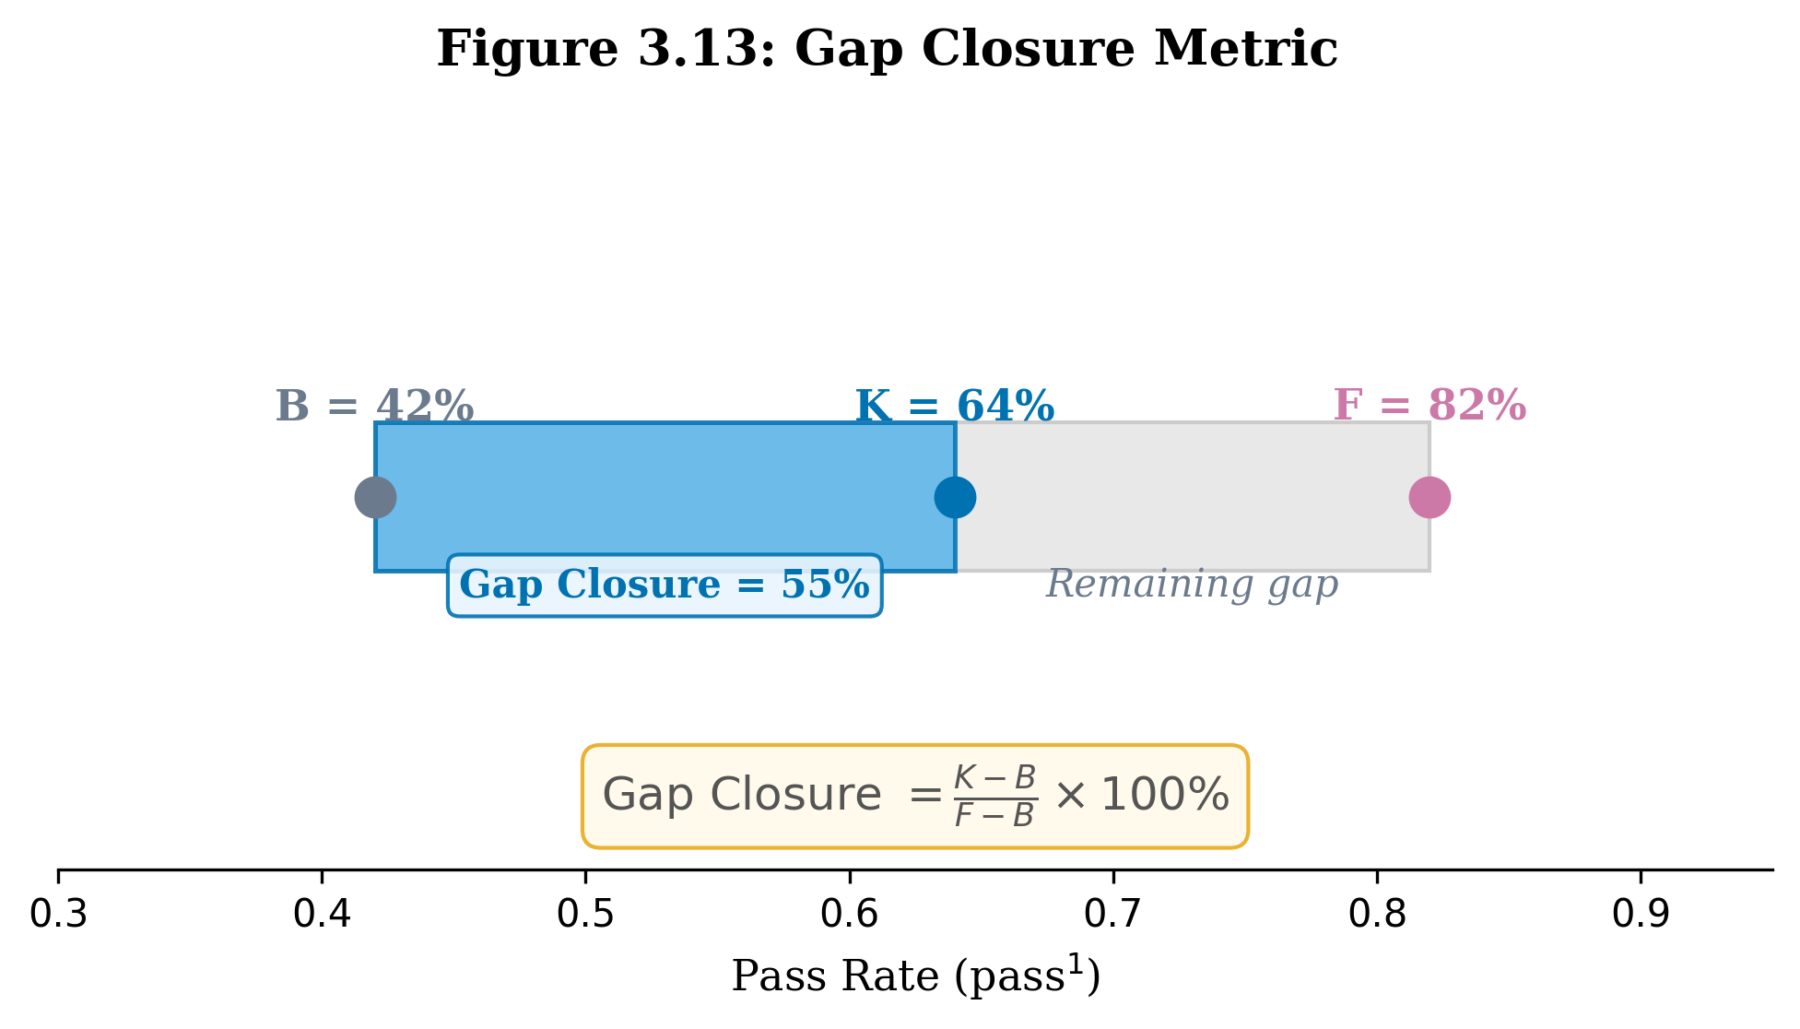
Results: Research Question 3
Chapter 4
Q3: Prompt evolution can narrow the frontier gap — but regression often erases gains
Gap closure by model × scale (trial pass rate, last sweep, F = 82%)
Key findings
Model | Scale | B (%) | K (%) | Δ (pp) | GC (%)
Qwen3 30B-A3B | 5t | 53 | 73 | +20 | 69%
Qwen3 30B-A3B | 10t | 27 | 50 | +23 | 42%
Qwen3 30B-A3B | 20t | 22 | 30 | +8 | 13%
Qwen3.5 Flash | 5t | 100 | 100 | 0 | N/A
Qwen3.5 Flash | 10t | 60 | 63 | +3 | 14%
Qwen3.5 Flash | 20t | 47 | 58 | +11 | 31%
GLM 4.7 Flash | 5t | 47 | 47 | 0 | 0%
GLM 4.7 Flash | 10t | 50 | 40 | -10 | -31%
69% GC for Q30B@5t
Qwen3 30B closes 2/3 of the frontier gap at small scale; holds through sweep 3
42% GC for Q30B@10t
Durable gain (+23pp) survives all 3 sweeps — no regression at this scale
Regression erases gains
Q3.5F@10t peaks at 80% (GC=91%) but sweep 3 regresses to 63% (GC=14%)
−31% for GLM@10t
Prompt evolution makes GLM worse than baseline — patches cause net harm
Durable gains are rare
Fig 3.13: Gap Closure Metric (illustrative example)
Only Q30B retains most improvement through sweep 3; GLM & Q3.5F regress
B
Baseline: Student model pass rate before any evolution (unmodified prompt)
K
Knowledge-patched: Student pass rate after all evolution sweeps (last sweep = sweep 3)
Gap closure visualised (B → K vs F = 82%)
F
Frontier: Frontier model pass rate on same tasks (e.g. Claude 3.5 Sonnet = 82%)
Q30B 5t
GC=69%
Q30B 10t
GC=42%
Gap Closure = (K − B) / (F − B) × 100%
Q30B 20t
GC=13%
Q3.5F 10t
GC=14%
Q3.5F 20t
GC=31%
GLM 5t
GC=0%
Answer: At last sweep, only Qwen3 30B retains durable gains (GC = 13–69%). Q3.5F peaks high but regresses (91% → 14% at 10t). GLM degrades below baseline (−31%). Prompt evolution narrows the frontier gap for compatible models, but patch interference is a binding constraint.
GLM 10t
GC=-31%
B (baseline)
K−B (gain)
Regression
Gap to F
B = baseline trial pass rate (sweep 1). K = last-sweep trial pass rate (sweep 3). F = frontier model (Claude 3.5 Sonnet, pass¹ = 82% on τ²-bench airline). GC = gap closure = (K−B)/(F−B)×100%. Negative GC = regression below baseline.

