Slide 1
Experimental Results & Conclusions
Diagnose-Patch-Validate: Teacher-Driven Prompt Evolution for LLM Agents
Gleb Dementyev | Business Informatics | 2026

Slide 2
Research Context
The Problem
The Approach
LLM agents in customer service fail ~2% of the time on structured benchmarks. At enterprise scale, that means thousands of mishandled interactions daily.
Deployed agents are static — once configured, they don't learn from failures. Fine-tuning is expensive and inaccessible for API consumers.
Research question: How can agent performance be improved through automated, teacher-model-driven prompt and tool evolution?
Diagnose-Patch-Validate Framework
A teacher model (Kimi K2.5) analyzes a student's failed conversation traces, proposes structured patches, and validates before merging.
Three student models tested:
• Qwen3 30B-A3B (weak, MoE)
• Qwen3.5 Flash (strong)
• GLM 4.7 Flash (moderate, different family)
Evaluated on τ²-bench airline domain at 5, 10, and 20 tasks across 8 experimental conditions.

Slide 3
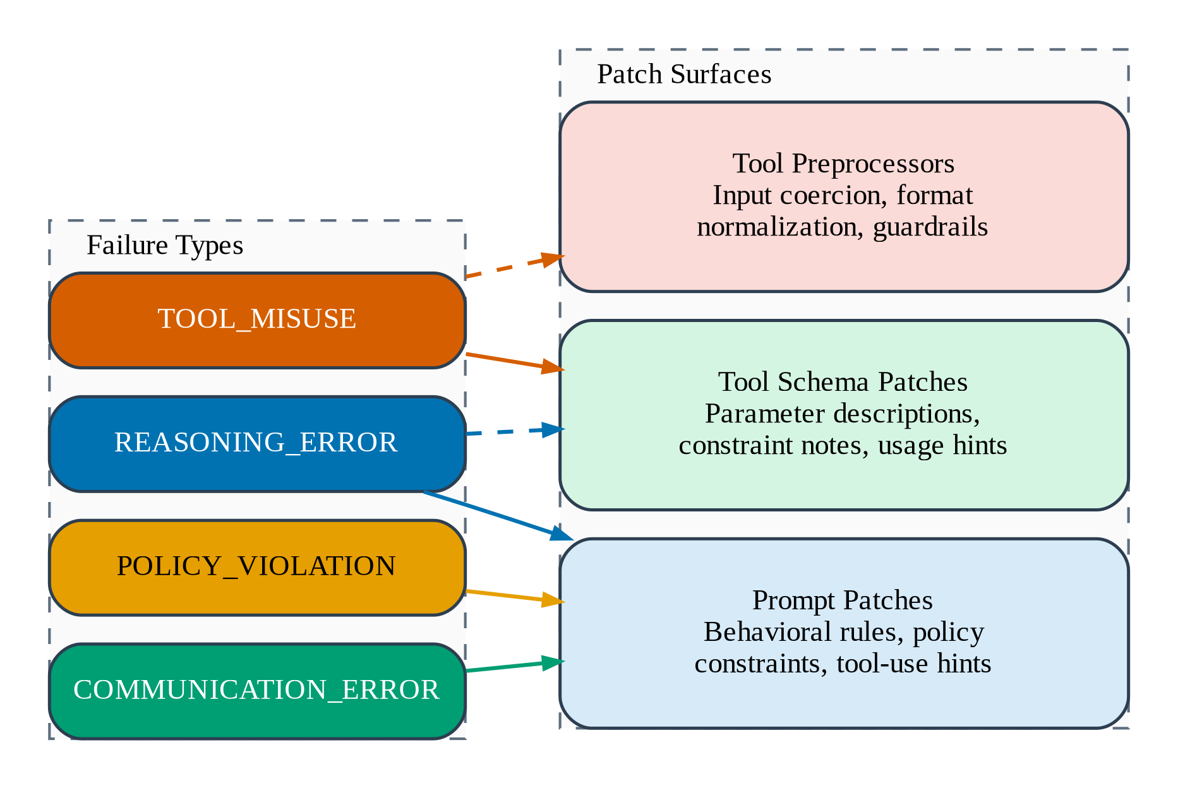
Failure Diagnosis → Patch Surfaces
Three Patch Tiers
1. Instruction Patches
Behavioral rules added to the system prompt. Dominant lever across all experiments (70–92% of fixes).
2. Tool Schema Patches
Parameter descriptions, constraint notes, usage hints in tool definitions. Emerge only at 20-task scale.
3. Guardrail Preprocessors
Input coercion, format normalization. Most expensive fixes (3 attempts, 30+ messages on average).
The escalation order (instruction → tools → guardrail) ensures the cheapest fix is tried first.

Slide 4
Result 1: Five-Task Evaluation
Qwen3 30B-A3B
Qwen3.5 Flash
GLM 4.7 Flash
Weak student
Strong student (ceiling)
Different model family
+20pp
0pp
0pp
net change after all sweeps
net change after all sweeps
net change after all sweeps
Baseline: 53%
After all patches: 73%
Fix rate: 100%
Baseline: 100%
After all patches: 100%
Fix rate: N/A
Baseline: 47%
After all patches: 47%
Fix rate: 67%
5-task evaluation on τ²-bench airline domain | 3 trials per task | Teacher: Kimi K2.5

Slide 5
Result 2: Ten-Task Evaluation
Key Findings at 10 Tasks
GLM 4.7 Flash: net decline to 40%
Patches cause net harm. Trial rate drops from 50% baseline to 40% after all sweeps. Zero genuinely failing tasks were repaired.
Qwen3.5 Flash: +3pp net (60% → 63%)
Peaked at 80% in sweep 2 but regressed to 63% after sweep 3 patches. Fixed tasks that Qwen3 30B-A3B could not (11, 12).
Hard core of resistant tasks
Tasks 7, 9, 11, 12 resist repair for weaker models. The framework has a minimum student capability threshold.

Slide 6
Result 3: Twenty-Task Evaluation
Qwen3 30B-A3B
Qwen3.5 Flash
22% → 30%
trial pass rate (baseline → after all patches)
+8pp net improvement | 53% fix rate
11 of 15 failing tasks unfixable
800+ messages, 300+ tool calls, 7+ hours on failed attempts
Tool-schema fixes emerge (20% of fixes)
47% → 58%
trial pass rate (baseline → after all patches)
+11pp net | +20pp majority (45% → 65%)
92% instruction-tier fixes (no tool patches needed)
Stronger model renders tool-schema patches unnecessary.
Stable between sweeps 2 & 3 — majority holds at 65%

Slide 7
Result 4: Scaling Behavior — Capacity Ceiling
Two Regimes
5 → 10 tasks:
Net gain +20pp at 5 tasks, +23pp at 10. Fix rate drops sharply (100% → 56%) as harder tasks enter.
10 → 20 tasks:
Net gain drops to +8pp. Fix rate stabilises (53%) but regression erodes gains. Framework hits capacity ceiling.
Capacity ceiling: ~5–8 fixable tasks per run regardless of pool size.
Successful fixes: 7 → 7 → 10
Doubling from 10→20 tasks yields only 3 extra fixes. The framework encounters more of the same resistant patterns.

Slide 8
Result 5: Instruction Patches Dominate
70–92%
of all fixes are instruction-tier
Supports the Superficial Alignment Hypothesis: models already have capability; they lack explicit knowledge that they should follow a particular policy.
Stronger student → higher instruction share (80% → 92%) and fewer guardrail escalations.
Tool-schema patches appear only for the weakest model at the largest scale.

Slide 9
Result 6: Patch Interference Across Models
Qwen3 30B-A3B
Qwen3.5 Flash
GLM 4.7 Flash
Mild
Severe at 10 tasks
Catastrophic
Low risk
Scale-dependent
Disqualifying
Task 5 regresses between sweeps 2→3 (3/3 → 1/3). Otherwise stable. Most tolerant of accumulated patches.
Trial rate drops -17pp in sweep 3. Task 11 collapses (3/3 → 0/3). But stable at 20 tasks — larger pool dilutes interference.
Sweep 3 at 5 tasks: -40pp majority collapse to baseline. At 10 tasks: continuous decline, never recovers. Framework causes net harm.

Slide 10
Result 7: Stronger Student → Amplified (Not Equalised) Gains
Framework amplifies capability
The ceiling tracks the student's intrinsic capability, not the teacher's diagnostic power.
Same patches, different outcomes:
Task 11: fails with Qwen3 30B, fixed in 42s with Qwen3.5 Flash. The knowledge in the patch is identical; what differs is the student's capacity.
Only Task 7 is truly model-agnostic resistant — all others are student-dependent.
Note: 'Unfixable tasks' shown as % of 10 for chart scale.

Slide 11
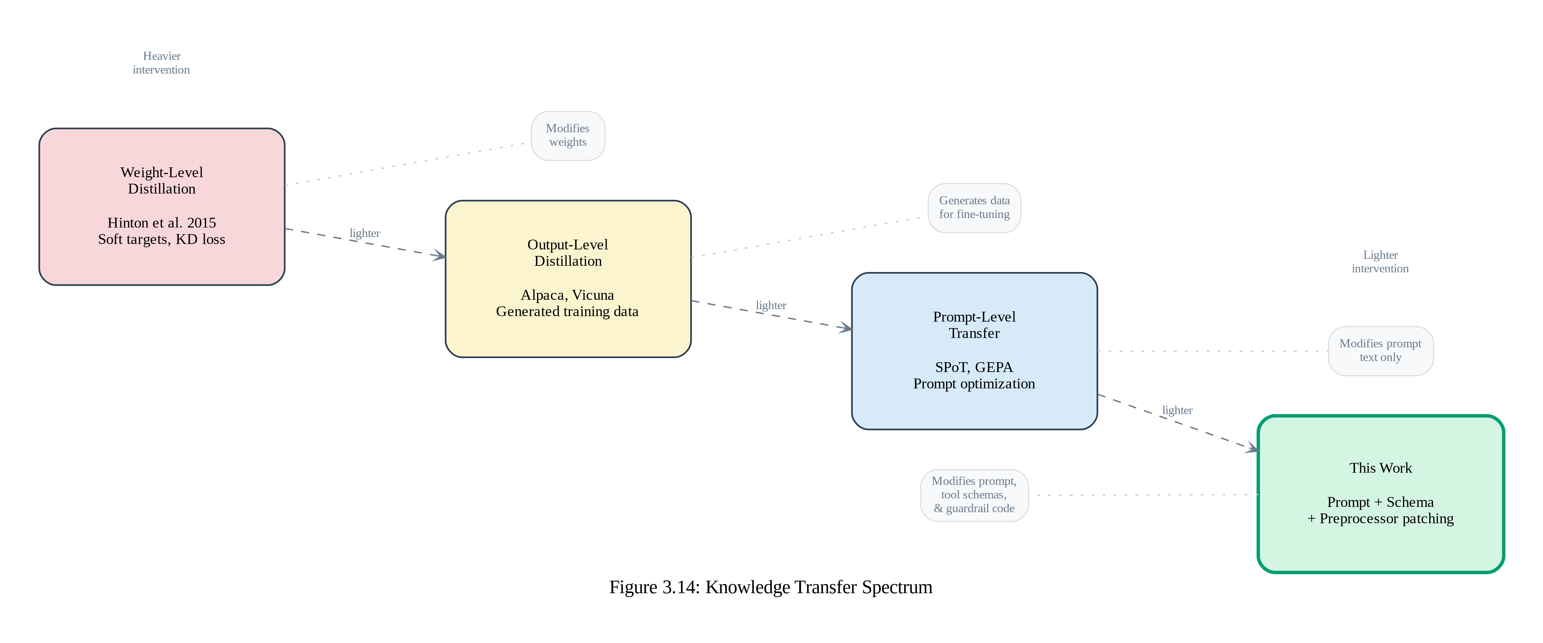
Contribution: Prompt-Level Knowledge Distillation
Novel modality
Classical distillation transfers knowledge into weights.
This work distills into operating instructions — compatible with API-only model access.
Preserves the student's original capabilities while augmenting behavior.

Slide 12
Conclusions
What Works
What Doesn't (Yet)
1. Input-space-only evolution produces +8 to +23pp net improvement without weight updates, GPU infra, or preference data.
2. Plain-text instruction patches dominate (70–92%), supporting the Superficial Alignment Hypothesis in agentic settings.
3. The framework is efficient: value is concentrated in the first 1–2 sweeps. Practical for deployment.
4. Patches are human-readable, versionable, and compatible with existing change-management workflows.
1. Capacity ceiling of ~5–8 fixable tasks per run. Improvement halves from 10 to 20 tasks.
2. Patch interference causes 'prompt-space forgetting.' Unbounded accumulation degrades performance.
3. Not all models benefit. GLM 4.7 Flash experienced net harm from evolution at 10 tasks.
4. Final post-evo: 73% (5t), 50–63% (10t), 30–58% (20t). Regression erodes peaks. Far from 99.99% enterprise target.

Slide 13
Practical Implications for Enterprise Deployment
Invest in the Base Model
Pilot Before Deploying
The framework amplifies capability differences. Qwen3.5 Flash reaches 65% vs 30% at 20 tasks. Choose the strongest feasible model before applying evolution.
Model compatibility testing is essential. GLM 4.7 Flash results show evolution can be actively harmful. A brief 5-task pilot reveals whether patches will destabilise.
Manage Patches Actively
Layer with Other Methods
Version, regression-test, and potentially retire patches. Different models need different sweep limits: 2 sweeps for Qwen3.5 Flash, avoid evolution for incompatible models.
Prompt evolution handles policy-encodable failures efficiently but cannot reach four-nines alone. Combine with stronger models, fine-tuning, architectural improvements, and human escalation.

Slide 14
Limitations & Future Directions
Limitations
Future Directions
Single domain (airline) — retail & telecom untested
Single teacher model (Kimi K2.5) — sensitivity to teacher choice unknown
Only 3 trials per task — limited statistical power
LLM user simulator may share biases with student models
No comparison with RLHF, DPO, or LoRA fine-tuning baselines
No patch retirement or consolidation mechanism
Cross-domain & cross-benchmark validation (CRMArena, τ-bench)
Teacher-student ablations — mapping the design space
Hybrid prompt + weight evolution (prompt for easy wins, LoRA for resistant tasks)
Patch management: consolidation, regression-aware selection, retirement policies
Comparison with GEPA self-reflective evolution
Real-world deployment study with production customer service data

Slide 15
"A lightweight mechanism for continuous improvement in the input space that works within the constraints most enterprises actually face."
No weight access · No training infra · Human-readable patches · API-compatible
Thank you

