Slide 1
HOME CREDIT DEFAULT RISK
From Risk Prediction
to Business Action
Approving the right customers, on the right terms, more often
Rakamin Academy x Home Credit Indonesia — Virtual Internship, Task 5
Steven Glecy Haloho

Slide 2
01 — THE PROBLEM
A scoring model has to do two jobs at once
▪ Don't reject good customers. Applicants capable of repaying should not be turned away — every false rejection is lost revenue and a customer Home Credit could have served well.
▪ Don't approve loans set up to fail. Applicants at genuine risk of default need to be identified early — but the goal is prevention, not just exclusion.
▪ Structure the loan to help the customer succeed. Principal, tenor, and repayment calendar should match the customer's real risk and cash-flow profile — not a one-size-fits-all product.
Objective: build ≥2 ML models (incl. Logistic Regression) that rank-order default risk well enough to support both accept/reject decisions and risk-based loan structuring — evaluated on ROC-AUC / KS at the model level, and on defaults-avoided vs. good-payers-affected at the business level.
Home Credit Default Risk — Rakamin x Home Credit Indonesia Virtual Internship, Task 5
2

Slide 3
02 — THE DATASET
One loan record, five behavioral histories
application_train.csv (main table)
5 supporting behavioral tables
▪ 307,511 loans, 122 raw columns
▪ TARGET: 1 = defaulted (8.07%), 0 = repaid (91.93%)
▪ Heavily imbalanced — accuracy is not a usable metric
▪ bureau.csv + bureau_balance.csv — credit history at other institutions (1.7M / 27.3M rows)
▪ previous_application.csv — client's past applications to Home Credit (1.67M rows)
▪ POS_CASH_balance.csv — past point-of-sale / cash loan behavior (10.0M rows)
▪ credit_card_balance.csv — past Home Credit credit card behavior (3.8M rows)
▪ installments_payments.csv — installment-level repayment history (13.6M rows)
307,511
loan applications
8.07%
portfolio default rate
Engineering challenge: ~2.3GB raw, 8 supporting tables → aggregated to one row per client (bureau/previous-application history → SK_ID_CURR) and merged with engineered ratios (credit/income, annuity/income, EXT_SOURCE combinations) into a 307,511 × 196 master feature set.
Home Credit Default Risk — Rakamin x Home Credit Indonesia Virtual Internship, Task 5
3

Slide 4
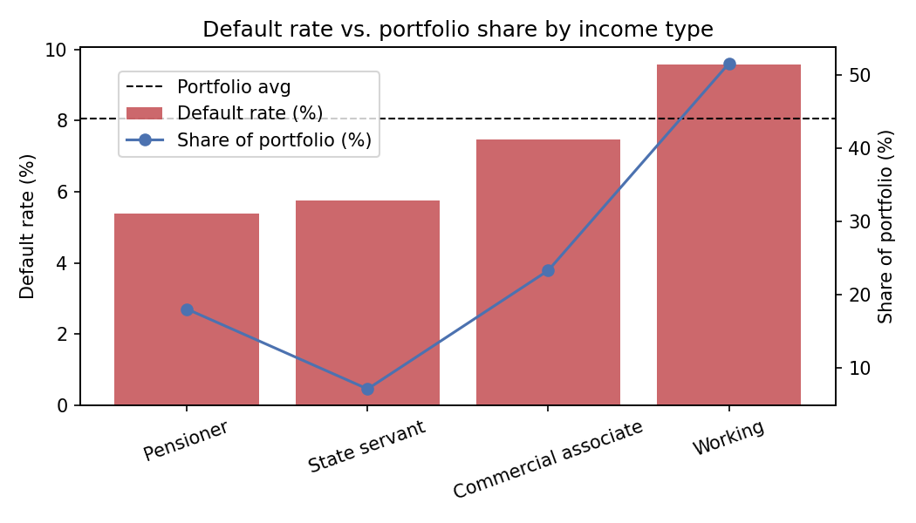
03 — TOP INSIGHT #1
Low-risk segments are under-represented in the portfolio
What the data shows
▪ State servants: 5.76% default (vs 8.07% avg) — only 7.1% of applicants
▪ Pensioners: 5.39% default, the lowest of all segments — only 18.0% of applicants
▪ Working (private sector): 9.59% default — yet 51.6% of the whole portfolio
Action: Run targeted acquisition (partnerships with government/pension-disbursing institutions) toward State servants & Pensioners. This shifts portfolio mix toward lower risk without tightening underwriting on anyone — a volume-and-quality win, not just a rejection rule.
Home Credit Default Risk — Rakamin x Home Credit Indonesia Virtual Internship, Task 5
4

Slide 5
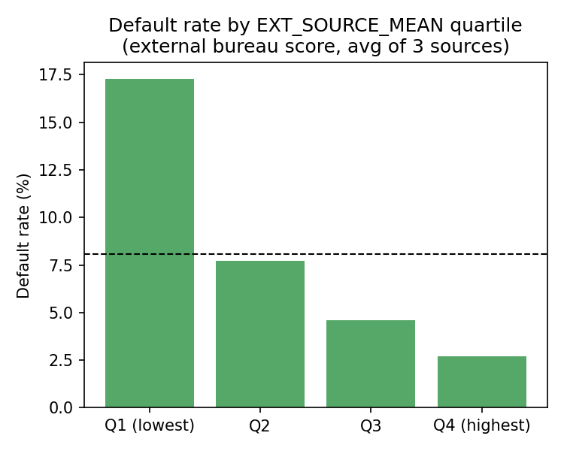
04 — TOP INSIGHT #2
Bureau score should shape loan terms, not just approval
What the data shows
▪ EXT_SOURCE_MEAN bottom quartile: 17.3% default
▪ EXT_SOURCE_MEAN top quartile: 2.7% default — a 6.4x spread
▪ Confirmed as the single strongest driver in both models
Action: Don't use this for a binary cutoff alone. Use the full model score to set risk-tiered principal, tenor, and repayment calendar: top-tier clients get a higher principal ceiling and longer tenor (volume Home Credit is currently leaving on the table); higher-risk clients get a smaller principal, shorter tenor, and more frequent (weekly/bi-weekly) instalments — easier to sustain and a path to a bigger loan next cycle.
Home Credit Default Risk — Rakamin x Home Credit Indonesia Virtual Internship, Task 5
5

Slide 6
05 — MODELING APPROACH
Final models: what features, what preprocessing, what algorithm
Logistic Regression — baseline / scorecard
▪ Features: 178 numeric + 16 categorical (194 total) — full engineered feature set
▪ Preprocessing: median imputation + standardization (numeric); most-frequent imputation + one-hot encoding (categorical)
▪ Imbalance handling: class_weight = 'balanced'
▪ Tuning: GridSearchCV, 3-fold, scoring = ROC-AUC, over C ∈ {0.01 … 3}
▪ Best C = 0.01
▪ Why keep it: fully transparent coefficients — usable as a regulator-facing scorecard
LightGBM — recommended production model
▪ Features: same 194-feature set — categoricals used natively, no manual encoding
▪ Preprocessing: none required — native missing-value handling
▪ Imbalance handling: scale_pos_weight = 11.4 (neg/pos ratio)
▪ Tuning: RandomizedSearchCV, 20 candidates x 3-fold, scoring = ROC-AUC
▪ Tuned: num_leaves, learning_rate, min_child_samples, subsample, colsample_bytree, reg_alpha/lambda
▪ Why: captures non-linear interactions (e.g. ORGANIZATION_TYPE x income ratios) a linear model can't
Home Credit Default Risk — Rakamin x Home Credit Indonesia Virtual Internship, Task 5
6

Slide 7
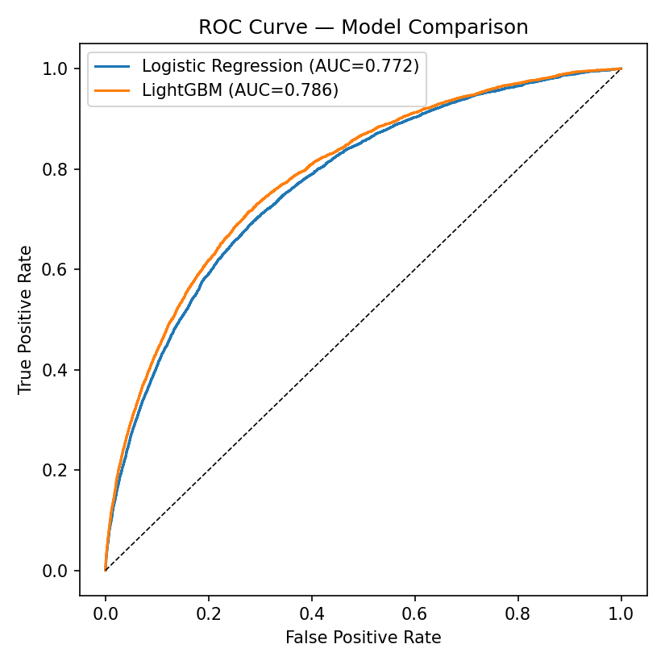
06 — MODEL PERFORMANCE
LightGBM edges out the baseline on both credit-scoring metrics
0.772
Logistic Regression — Test AUC
0.786
LightGBM — Test AUC
0.409
Logistic Regression — KS
0.437
LightGBM — KS
Both models lean on the same strong engineered features (EXT_SOURCE, CREDIT_TERM, bureau/previous-application aggregates); LightGBM's edge comes from non-linear feature interactions a linear model cannot represent. Recommendation: LightGBM for production scoring, Logistic Regression retained as an interpretable challenger / regulatory fallback.
Home Credit Default Risk — Rakamin x Home Credit Indonesia Virtual Internship, Task 5
7

Slide 8
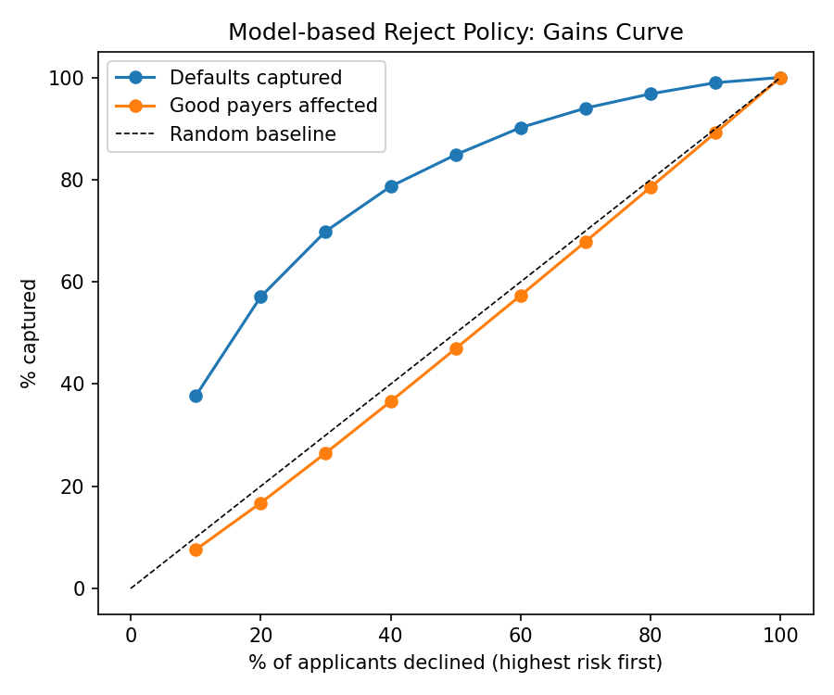
07 — BUSINESS IMPACT
Catch most bad debt by declining only the riskiest few %
Decile gains analysis (LightGBM score)
▪ Decline riskiest 10%: captures 37.7% of all future defaults, affects only 7.6% of good payers
▪ Decline riskiest 20%: captures 57.1% of defaults, affects 16.7% of good payers
▪ Beyond ~decile 3-4: the trade-off worsens fast — remaining pool is genuinely low-risk
Recommendation: decline (or route to a smaller/secured starter product) only the top 1-2 riskiest score deciles, where the ratio of defaults-avoided to good-payers-affected is most favorable (~5:1 and ~3.4:1). This is how the model directly serves the brief's goal: cut bad debt without mass-rejecting creditworthy customers.
Home Credit Default Risk — Rakamin x Home Credit Indonesia Virtual Internship, Task 5
8

Slide 9
08 — BUSINESS RECOMMENDATION
Translate the score into risk-tiered loan terms, not one cutoff
Risk Tier | Score decile | Default rate | Principal ceiling | Max tenor | Down payment | Repayment calendar
1 — Low | 9–10 | ~1–2% | Up to 5x income | 36–48 mo | None | Standard monthly, fast-track
2 — Medium | 5–8 | ~3–7% | Up to 4x income | 24–36 mo | 10–20% | Standard monthly
3 — Elevated | 3–4 | ~7–10% | Up to 3x income | 12–24 mo | 20–30% | Bi-weekly instalments
4 — High | 1–2 | > 15% | Up to 2x income (starter/secured) | 6–12 mo | 30%+ / guarantor | Weekly; graduate after clean history
Fairness note: CODE_GENDER shows a real gap in the data (Male 10.1% vs Female 7.0% default) but is excluded as a scoring/pricing lever — the underlying risk is already captured through income stability, external bureau score, and employment type. A correlate is not automatically a lever.
Next steps: validate on an out-of-time sample (not just a random holdout), add reject-inference for the declined population (models are trained only on historically-approved customers), and A/B test the repayment-calendar policy against the current flat policy before full rollout.
Home Credit Default Risk — Rakamin x Home Credit Indonesia Virtual Internship, Task 5
9

Slide 10
09 — REFERENCES & REPOSITORY
Full analysis, code, and reproducible notebook
GitHub repository: github.com/glecyhaloho/home-credit-default-risk-scoring
Contains the full executed notebook (.ipynb), feature-engineering & training source code, and saved model artifacts.
References
▪ Kaggle — "Home Credit Default Risk" competition dataset & problem description (source of application_{train,test}, bureau, previous_application, POS_CASH_balance, credit_card_balance, installments_payments tables)
▪ Rakamin Academy x Home Credit Indonesia — Virtual Internship Task 5 brief: Dataset Description & PPT guidelines
▪ scikit-learn documentation — Logistic Regression, GridSearchCV, ColumnTransformer
▪ LightGBM documentation — gradient boosting framework, categorical feature handling
▪ Standard credit-scoring practice — KS statistic, decile/gains-table analysis for accept/reject policy design
Home Credit Default Risk — Rakamin x Home Credit Indonesia Virtual Internship, Task 5
10

