Slide 1
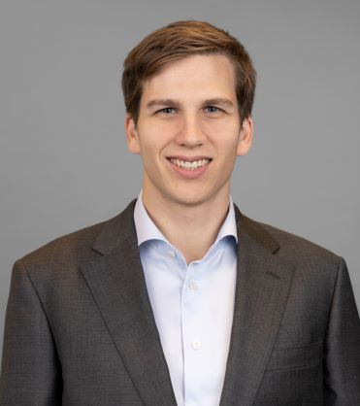
Last Name, First Name Position, Office Location, Germany
Selected consulting engagement experience
Take 3 bullet points from here to insert
Picture to be used for cropping and replacing
Areas of Expertise
Education
Behavioral Science
Telecommunications & Media
Strategic Transformation
Digital Strategy
MSc in Behavioral and Decision Science
University of Pennsylvania
Ba in Combined Honours in Social Sciences (Economics and International Relations)
University of Durham

