Slide 1

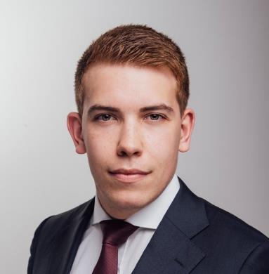
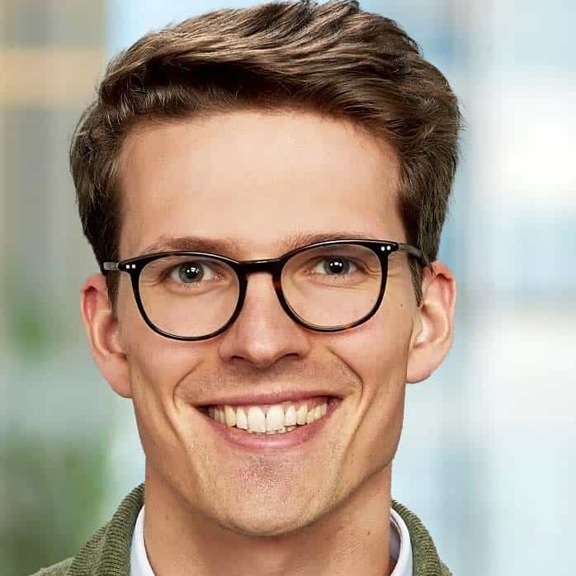
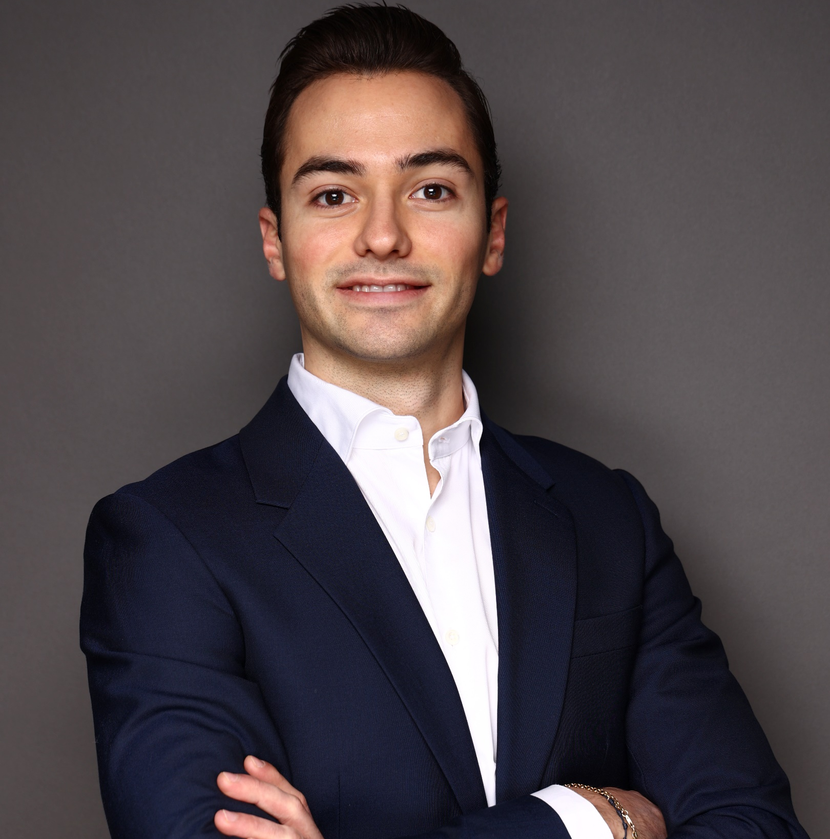
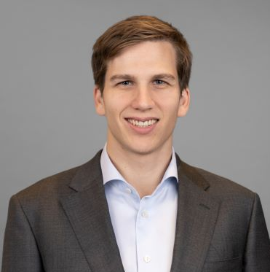
Your Kearney project team
Dr. Caledonia Trapp Sr Consultant, Munich
3+ years of consulting and industry experience
Developed a comprehensive change and communication strategy for a major technology company in Germany, including a case for change, change management concept, stakeholder engagement plan, timeline, and defined responsibilities
Reviewed and further developed a strategic telecommunications partnership and cooperative venture between a municipal utility and a regional provider
Ben Reinitzer Sr Consultant, Munich
3+ years consulting and industry experience
B2B revenue growth transformation for a leading US ICT player, incl. assessment quantification of growth levers
Market entry strategy development for a major European ICT provider, incl. Assessment of Right-to-Play, market positioning and competitive landscape
Transnational workstreams lead on CEP market intelligence project with 60+ market expert interviews
Benchmarking for multiple telcos worldwide
Benedict Wolske Sr Consultant, Munich
2+ years of consulting experience
E2E Analysis and benchmarking of telecommunication companies
Conducted various Global Competitive Benchmarking (GCB) projects for +20 clients globally
Growth strategy for leading German home-sharing service provider
Conception and implementation of Austria market entry strategy
Gregor Ledebur-Wicheln Sr Consultant, Munich
2+ years of consulting and industry experience
Contributed to operating model optimization for the fiber-optic network expansion of a German Telco
Supported in strategic transformation projects for large Media &Telco, facilitating regular workshops with C-suite executives such as CEOs, CFOs, and CTOs to align on key strategic decisions
Facilitated global cost benchmarking initiatives to inform and steer cost reduction strategies
Project Team
Source: Kearney

