Slide 1
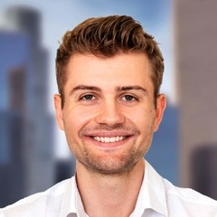
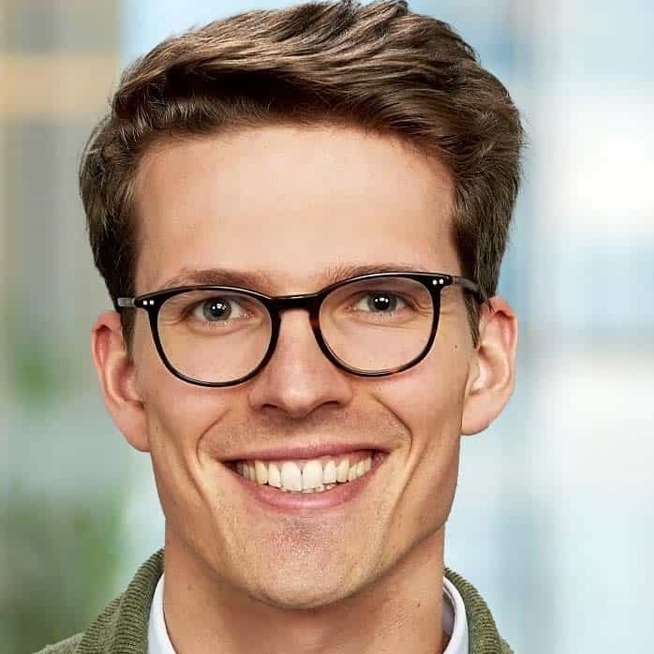
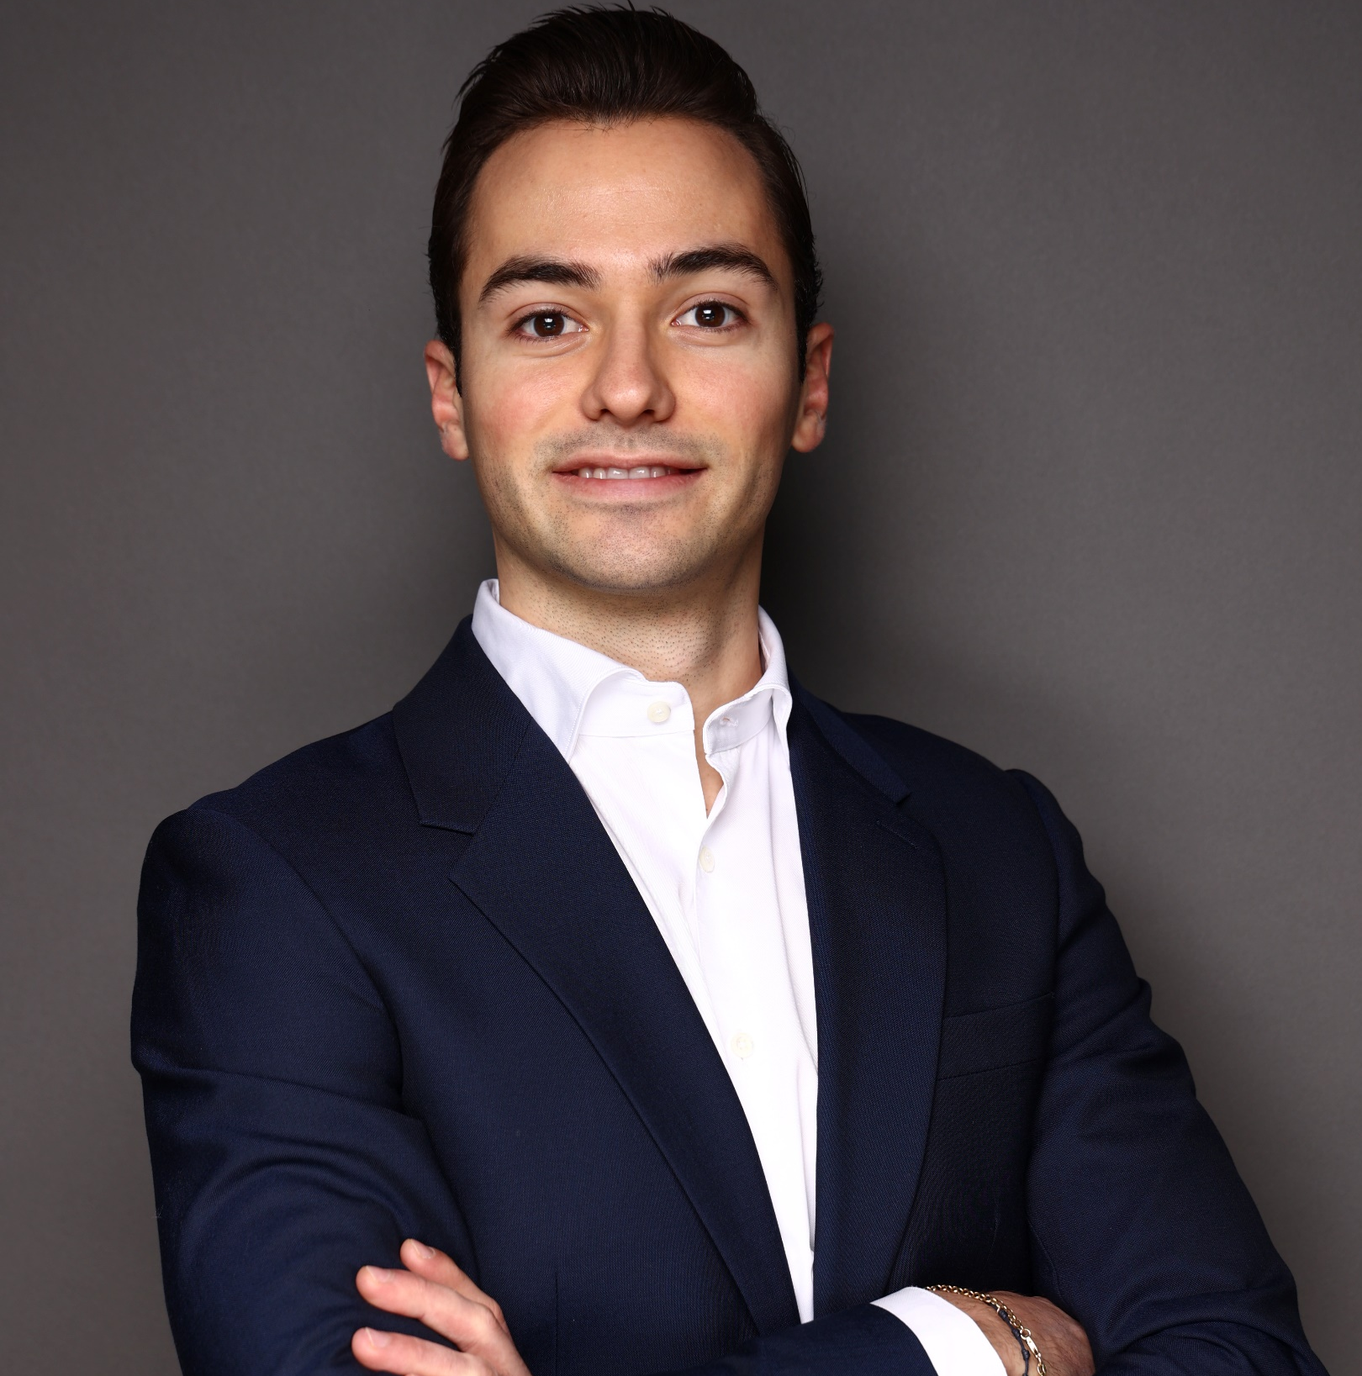
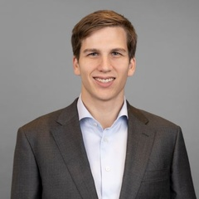
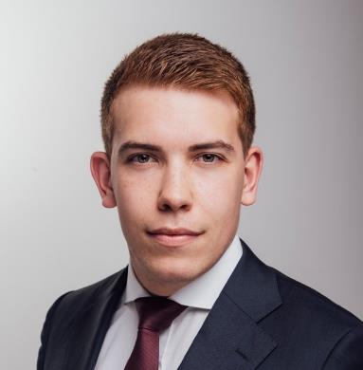
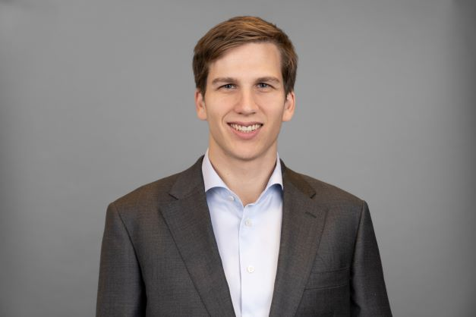
Your Kearney project team
Replace Picture
Replace Picture
HEC Paris Master of Management
Senior Consultant, Developed the sales strategy for a central energy player in Germany with a revenue of > $ 4bn
x+ years of consulting experience
• Proven track record in client engagement and project delivery
• Proven track record in client engagement and project delivery
• Proven track record in client engagement and project delivery
First Name Last Name Position, Office Location
x+ years consulting and industry experience
Insert 3 bullet points from the section “Selected consulting engagement experience”
Gregor Associate Ledebur-Wicheln
Senior Consultant, Global
x+ years of consulting experience
• Supported in strategic transformation projects for large Media &Telco, facilitating regular workshops with C-suite executives such as CEOs, CFOs, and CTOs to align on key strategic decisions
• Contributed to operating model optimization for the fiber-optic network expansion of a German Telco
• Advised in the integration and IT/digital unification of two fiber network companies
Munich Dr. Caledonia Trapp Senior Consultant
Reviewed and further developed a strategic telecommunications partnership and cooperative venture between a municipal utility and a regional provider, The London School of Economics and Political Science (UK)
x+ years of consulting experience
• Proven track record in client engagement and project delivery
• Proven track record in client engagement and project delivery
• Proven track record in client engagement and project delivery
Project Team
Source: Kearney

