Slide 1
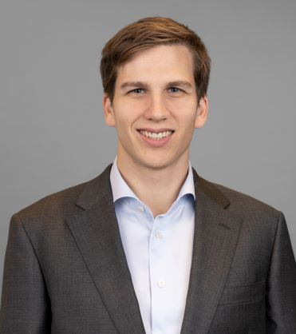
Ledebur-Wicheln, Gregor Associate, Munich, Germany
Selected consulting engagement experience
Supported in strategic transformation projects for large Media &Telco, facilitating regular workshops with C-suite executives such as CEOs, CFOs, and CTOs to align on key strategic decisions
Contributed to operating model optimization for the fiber-optic network expansion of a German Telco
Advised in the integration and IT/digital unification of two fiber network companies
Co-creation of an ESG benchmarking tool with applicability for several industries ​
Facilitated global cost benchmarking initiatives to inform and steer cost reduction strategies
Conducted in-depth process analysis of a large automotive company
Advised an automotive Tier-1 Supplier on technical compliance, conducted specialized technical analysis of core products and communicated complex technical issues to key stakeholders on top management level
Conducted a Digital Strategy project to develop a Digital North Star, Operating Model, and Domain Break-Down for a German semiconductor manufacturer
Led a global Diversity, Equity, and Inclusion (DEI) PMO, delivering continuous reporting and strategic initiatives to drive equity and inclusion across the organization.
Areas of Expertise
Education
Behavioral Science
Telecommunications & Media
Strategic Transformation
Digital Strategy
MSc in Behavioral and Decision Science
University of Pennsylvania
Ba in Combined Honours in Social Sciences (Economics and International Relations)
University of Durham

