Slide 1
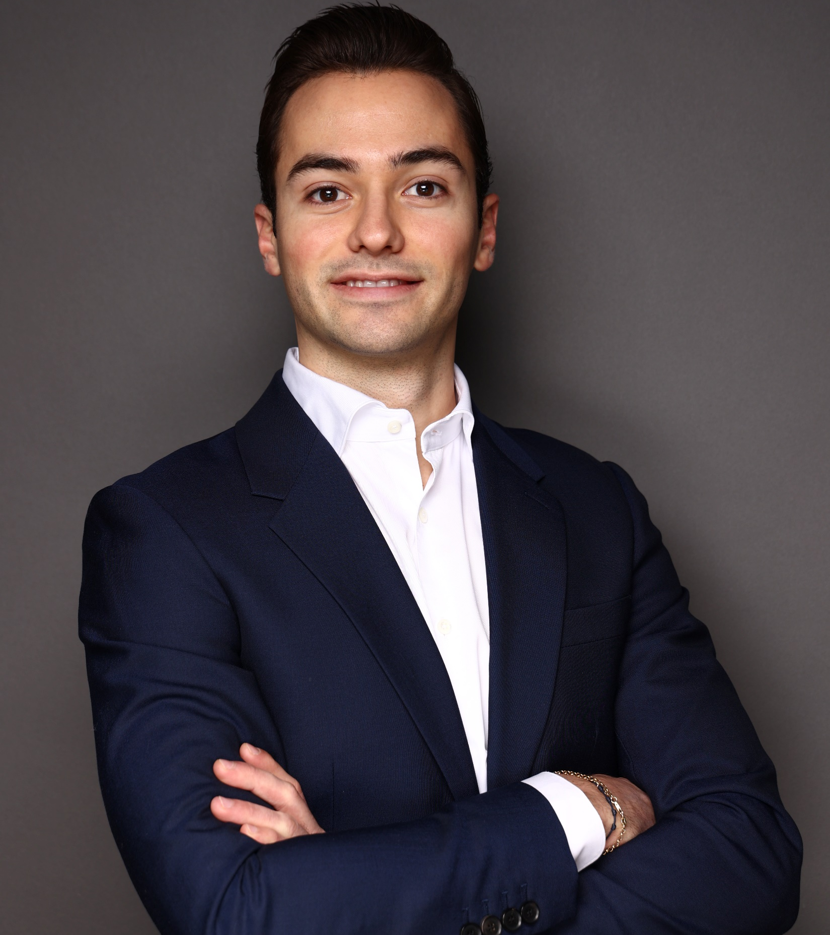
Benedict Wolske Associate, Munich, Germany
Summary of experience
With over 2 years of consulting and industry experience, Benedict has helped clients develop strategies and enable the organization to execute. He is passionate about the healthcare industry, innovative business models and creating value through a consumer/patient-centric approach.
Selected consulting engagement experience
Regulatory development impact assessment for leading global Pharmaceutical player
Developed a systematic and scenario-based approach assess and anticipate regulatory impacts on the company's portfolio, guiding future R&D decisions, access strategies, and market-shaping initiatives
Financial and operational impact assessment of changing legislative landscape for global Pharmaceutical player
Assessed the financial and operational impact of changing legislative landscape on two pharmaceutical assets under development
Developed heatmap indicating legislative impact on entire asset pipeline
Product portfolio and sales assessment for a leading European gardening equipment manufacturer, identifying growth potential
Market Study on innovation in Diabetes care and early diagnosis for European PharmaCo
Operating model transformation for leading energy advisory company
Developed and implemented change management and communication concepts
Concepted and conducted workshops on organizational transformation
Areas of Expertise
Education
Industry
Pharmaceutical
MedTech
Telecommunications
Sharing economy
Functional
Growth strategy
Change Management
Transformation
M.Sc. International Business, Stockholm School of Economics, Sweden
CEMS Master in Management, Ivey Business School, Canada
Languages
German (Native)
English (Full Professional Proficiency)
French (Limited Working Proficiency)
Swedish (Elementary Proficiency)

Slide 2
Benedict Wolske Associate, Munich, Germany
Further selected consulting engagement experience
E2E Analysis and benchmarking of telecommunication companies
Conducted various Global Competitive Benchmarking (GCB) projects for +20 clients globally
Growth strategy for leading German home-sharing service provider
Conception and implementation of Austria market entry strategy
Commercial due diligence, incl. market model creation and competitive landscape analysis, on
Germany Meter Exchange player
German MedTech Electronic Manufacturing Services player
Operational due diligence, incl. analysis and evaluation of departmental synergies and supply chain savings potential, on
Large global chemical player

Slide 3
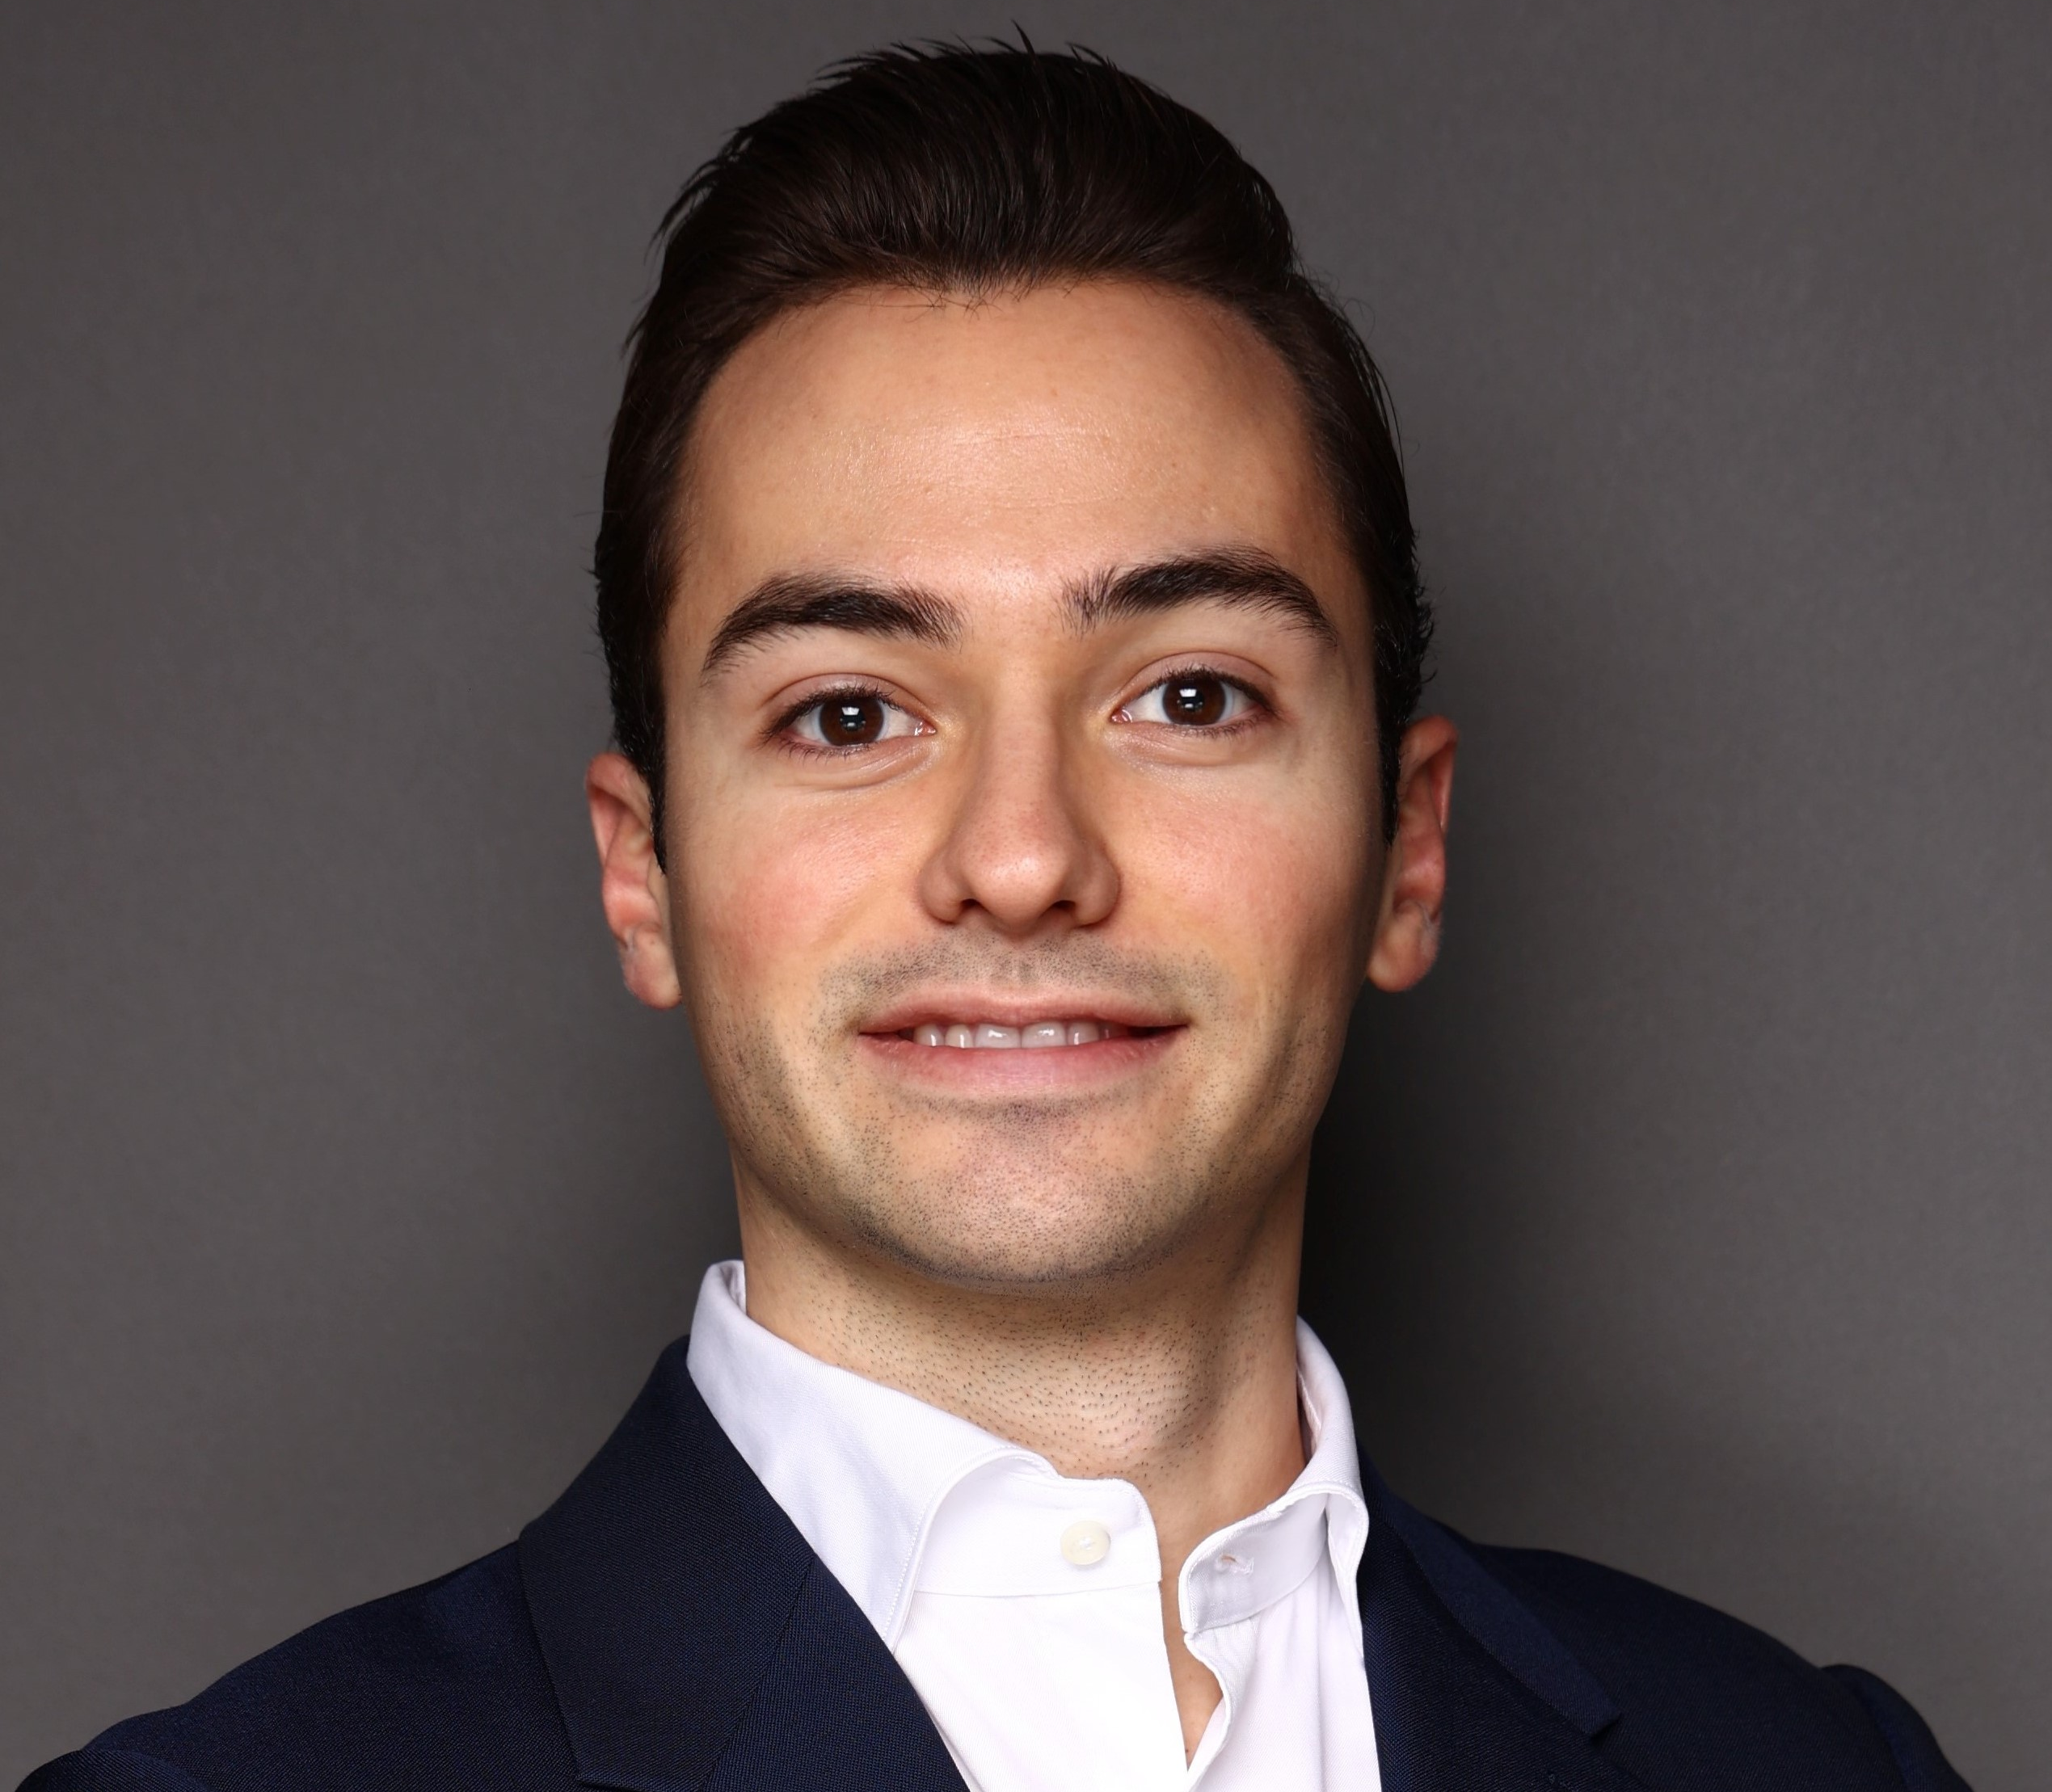
Key message. If the audience reads just this, it will be enough. Make every word count. Say it like you would in the room.
Benedict Wolske
Sr. Business Analyst
Munich
Summary of experience
3+ years of consulting and industry experience with strategy and transformations focus
Engagement experience
Impact assessment and mitigation capability building at global pharma company
Growth strategy for leading European power tool manufacturer
Operating model transformation for leading energy advisory company
Due diligences in the MedTech and energy industries
Name & Surname
Job title and location second level
Summary of experience third level
Fourth level bullet
Fourth level bullet
Fourth level bullet
Areas of experience third level
Fourth level bullet
Fourth level bullet
Fourth level bullet
Name & Surname
Job title and location second level
Summary of experience third level
Fourth level bullet
Fourth level bullet
Fourth level bullet
Areas of experience third level
Fourth level bullet
Fourth level bullet
Fourth level bullet
Optional chapter signpost

