Slide 1
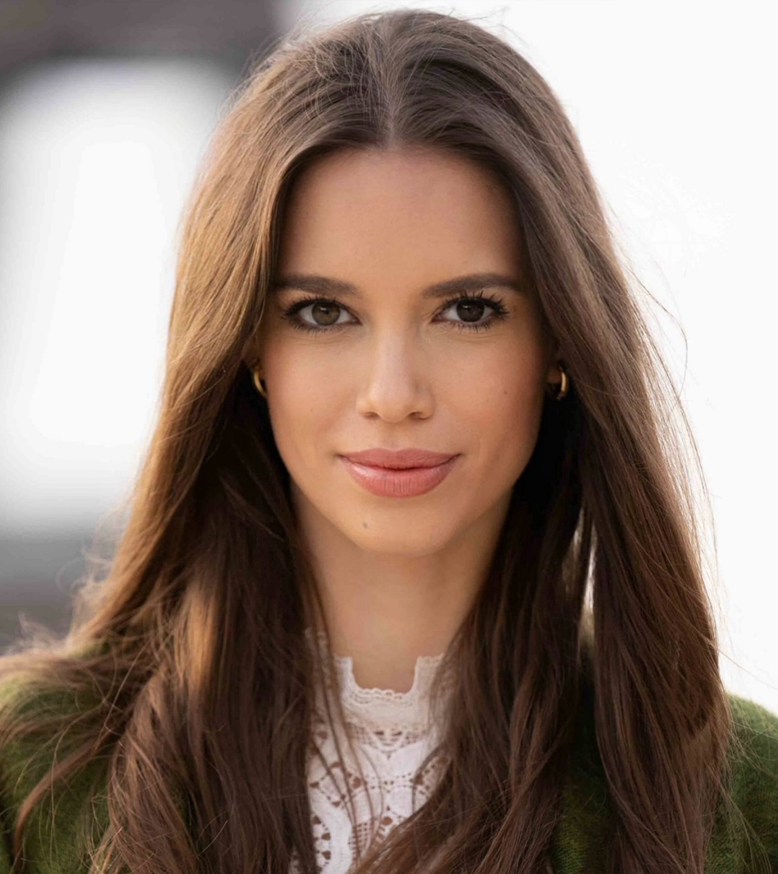
Dr. Caledonia Trapp Senior Consultant, Munich
Summary of Experience
>5 years of consulting and research experience in business models and operating models across diverse industries. Work experience in Germany, Austria, Switzerland, United Kingdom, Spain, Portugal, Italy, Saudi-Arabia and Bahrain.
Selected Experience
Technology
Developed a comprehensive change and communication strategy for a major technology company in Germany, including a case for change, change management concept, stakeholder engagement plan, timeline, and defined responsibilities
Retail & Consumer Goods
Formulated strategic guidelines, designed and implemented an operating model to support the strategic transformation of a leading chocolate manufacturer in Switzerland
Developed a strategic transformation program for a leading supermarket chain in Switzerland
Energy & Process Industries
Reviewed and further developed a strategic telecommunications partnership and cooperative venture between a municipal utility and a regional provider
Developed a strategic transformation program for one of Europe's leading renewable energy providers (PMO)
Advised a major German energy company on strategic positioning and identified key levers to enable a bottom-up transformation across the organization
Conducted due diligence for four chemical companies across AT, CH, and the U.S.
Designed a strategic transformation program for an energy service provider
Collaborated on renewable energy integration, community engagement, and regulatory compliance for sustainable municipal heating plans
Contributed to the IEEE study by conducting CEO interviews
Completed a 12-month voluntary course on carbon dioxide emissions trading
PhD research on the emerging business models in the hydrogen vehicle industry and its value chain and regions‘ transitions towards sustainability
Automotive
Developed an operating model for a major automotive supplier in Germany to advance the company’s transformation regarding renewable drivetrains
DEI
Developed and supported DEI initiatives for a major American consulting firm, contributing to the firm’s strategic efforts from initiative design through execution
Areas of Expertise
Education
Operating Model
Large-scale Transformation
Change & communication
Innovation Strategies
Business models & vertical integration
HHL Leipzig Graduate School of Management (GER)
Dr. rer. oec.
The London School of Economics and Political Science (UK)
MSc Political Economy of Europe
University of Mannheim (GER) & University of Warwick (UK)
BSc Business Administration
Languages
German (Native)
English (Fluent)
French (Advanced)
Source: Kearney

