Slide 1
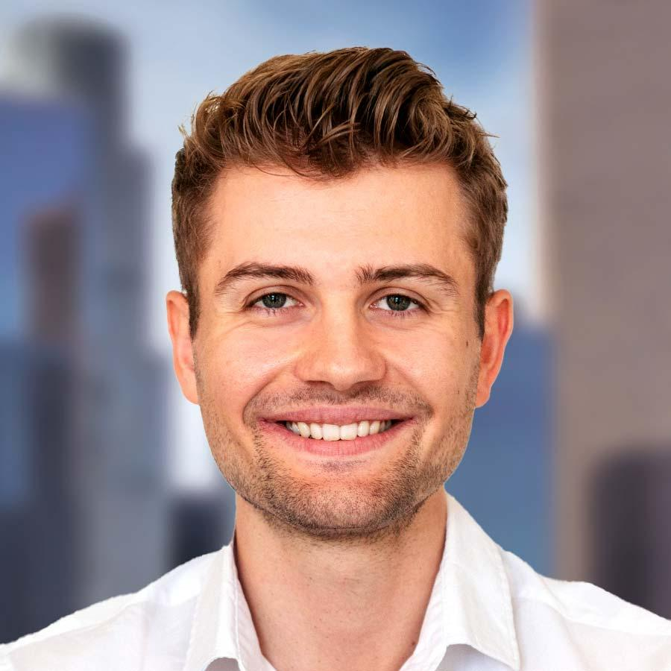
Tim Haltiner Associate Zurich Switzerland
Summary of Experience
With over 3.5 years of consulting & industry experience, Tim has primarily focused on financial & strategic operations consulting and worked as the assistant to the CEO in the German healthcare sector. He is passionate about sustainability, DEI, quantitative analytics in general and the consumer goods industry. Worked on projects for Kearney in the SOP, Procurement, Digital, Sustainable Materials & Energy practices with a focus on data analysis & post-merger integration. Worked on a large internal DEI project with the goal to embed inclusion in areas such as recruiting.
Selected Consulting Engagement Experience
Co-created a large financial model to quantify the financial impact of +100 ESG initiatives which can be used across sectors & companies for sustainability projects
Worked on a large procurement project for a multinational conglomerate focusing on indirect non-COGS procurement optimizations & renegotiations
Developed the software & localization strategy for a major European truck OEM. Responsible for the investment roadmap until 2040
Worked on a SOP project for a German industrial manufacturer with $ 500mn revenue. Responsible for the product portfolio & complexity analysis and evaluation.
Responsible for the PMO/ PMI workstream in the context of a merger for a German specialty chemicals manufacturer
Developed the sales strategy for a central energy player in Germany with a revenue of > $ 4bn
Worked on a major internal DEI initiative embedding inclusion in multiple processes such as recruiting as well as local offices
Worked on multiple proposals in the chemicals, consumer goods, energy, CMT & procurement sectors
Areas of Expertise
Education
Project Management Office (PMO)
Integration Management
DEI & Sustainability (ESG Financial Modelling)
Asset-Liability Management
Predictive Econometrics
Big Data Analytics & Natural Language Processing
Luxury Market Entry Strategies
Master of Management, HEC Paris
Master in Quantitative Economics & Finance, HSG University of St. Gallen
Bachelor of Economics, HSG University of St. Gallen
Languages
Swiss German (Native)
German (Native)
English (Fluent)
French (Fluent)

Slide 2
Tim Haltiner Associate Zurich Switzerland
Tim Haltiner
Associate, Zurich
Summary of experience (non-exhaustive)
Procurement project for a multinational conglomerate
PMO workstream for a German specialty chemicals company
Areas of experience third level (non-exhaustive)
Project Management Office (PMO)
Integration Management
DEI & Sustainability (ESG Financial Modelling)
Asset-Liability Management
Data Analytics
Name & Surname
Job title and location second level
Summary of experience third level
Fourth level bullet
Fourth level bullet
Fourth level bullet
Areas of experience third level
Fourth level bullet
Fourth level bullet
Fourth level bullet
Name & Surname
Job title and location second level
Summary of experience third level
Fourth level bullet
Fourth level bullet
Fourth level bullet
Areas of experience third level
Fourth level bullet
Fourth level bullet
Fourth level bullet
Optional chapter signpost

