Slide 1
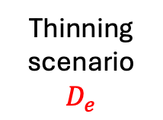


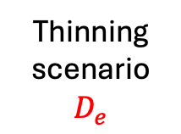


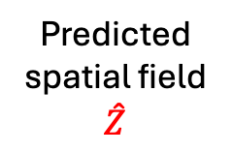
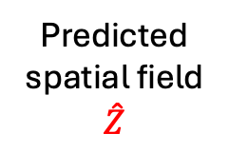
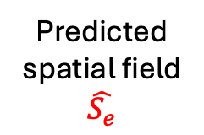
Simulated data
Generated
spatial field
First thinning process
42x28
N=4000
N=4000
Discrete sampling
$$X$$
Predicted spatial field
$$\hat{Z}$$
N=2000
N=2000
ε₁
N=1000
N=1000
N=600
N=600
N=358
N=358
N=200
N=200
Thinning scenario
$$D_{e}$$
Predicted spatial field
$$\hat{S_{e}}$$
Real world data
Unknown
spatial field
Second thinning process
N=358
N=358
N=358
Predicted spatial field
$$\hat{Z}$$
Predicted spatial field (GP)
Discrete sampling
N=330
N=330
ε₂
ε₂
N=330
N=330
N=300
N=300
N=300
N=300
N=260
N=260
N=260
N=260
N=220
N=220
N=220
N=220
N=150
N=200
N=200
N=150
N=100
N=100
N=100
N=100
Thinning scenario
$$D_{e}$$
Predicted spatial field
$$\hat{S_{e}}$$
Predicted spatial field
$$\hat{S_{e}}$$
Thinning scenario
$$D_{e}$$

Slide 2



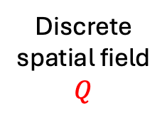
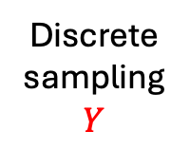


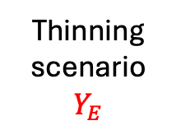



N=18916
A
B
Discrete spatial field
$$Q$$
Simulated
spatial field
(μ, α, ρ, σ)
Simulated (in-silico) data
Real world (in-situ) data
N=4000
N=4000
Discrete sampling
$$Y$$
Predicted spatial field
$$Z$$
Unknown
spatial field
(μ, α, ρ, σ)
N=2000
N=2000
N=1000
ε₂
N=1000
N=358
N=600
Predicted spatial field
$$Z$$
N=358
N=600
Discrete sampling
$$Y$$
N=358
N=358
Thinning scenario
$$Y_{e}$$
Predicted spatial field
$$S_{e}$$
N=330
N=330
N=330
ε₁
N=330
N=330
N=300
N=300
N=300
N=300
N=260
ε₃
N=260
N=260
N=260
N=220
N=220
N=220
N=220
N=150
N=150
N=150
N=150
Thinning scenario
$$Y_{E}$$
Predicted spatial field
$$S_{E}$$
Predicted spatial field
$$S_{E}$$
Thinning scenario
$$Y_{E}$$

