Slide 1










Smart environmental DNA sampling strategies
Gledis Guri
Postdoc @University of Washington
gguri@uw.edu
Notes:
This is Gledis Guri, short Gled, postdoc at eDNA collaborative at University of Washington. This talk is all about how to make eDNA metabarcoding quantitative.

Slide 2
Marine Resources
Ecosystem Services
Living Marine Resources (LMR)
Clean water
Food & protein security
Medicine
Protection
Recreation
Economic dev.
(Stock et al., 2011)
Unicellular organisms
Phytoplankton
Zooplankton
Coral reefs
Benthic organisms
Fish
Seabird
Mammals
Multicellular complex organisms
(Stock et al., 2011)
(Selig et al., 2019)

Slide 3







Marine Resources
Living Marine Resources (LMR)
Governmental or National Agencies
National
International
Advisory / Framework
USA
Norway
UNCLOS
IPBES
MSFD
CBD
Notes:
Therefore, Governmental or National Agencies
Such as NOAA in the US and IMR in Norway, and many other IMR’s in other countries are invested to protect and manage those resources. Typically, these agencies conduct resource assessments.
In international scale (***) UNCLOS sets the regulation for sustainable use of Marine Resources.
Additionally other (***) advisory working groups or frameworks between countries helps to set the regulations for Marine Resource management

Slide 4
Marine Resources
Governmental or National Agencies
National
International
Advisory / Framework
USA
Norway
UNCLOS
IPBES
MSFD
CBD
What is the number of (eDNA) samples I need to deploy/require?
It depends…
Notes:
Therefore, Governmental or National Agencies
Such as NOAA in the US and IMR in Norway, and many other IMR’s in other countries are invested to protect and manage those resources. Typically, these agencies conduct resource assessments.
In international scale (***) UNCLOS sets the regulation for sustainable use of Marine Resources.
Additionally other (***) advisory working groups or frameworks between countries helps to set the regulations for Marine Resource management

Slide 5
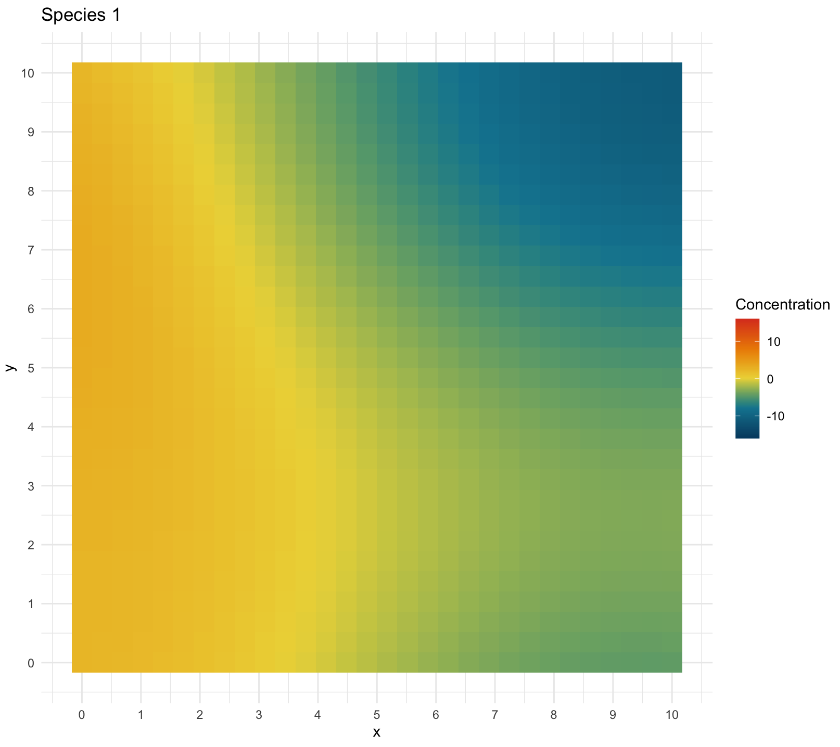
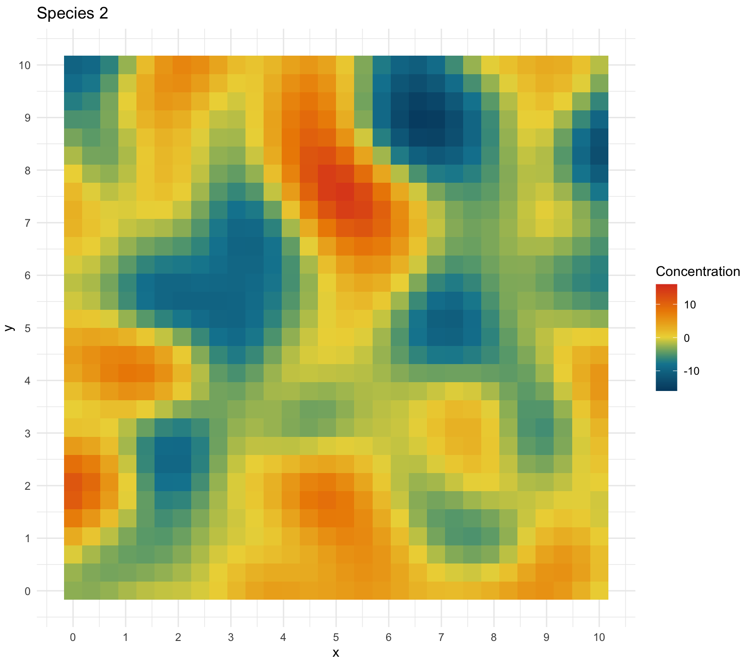
Concentration
Distance (m)
Concentration
Distance (m)

Slide 6
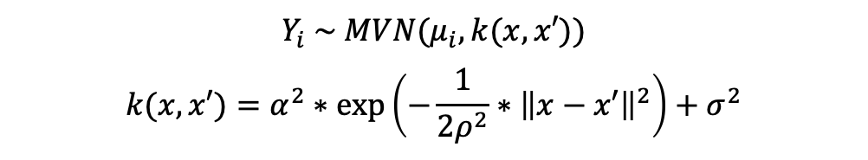
Concentration
Distance (m)
Gaussian Process (GP)
$$Y_{i} \sim MVN(μ_{i},k(x,x′))$$
$$k(x,x′)=α^{2}∗exp⁡\left(−\frac{1}{2ρ^{2}}∗{\left\|x−x′\right\|}^{2}\right)+σ^{2}$$
Concentration
Distance (m)

Slide 7
α
ρ
μ
Autocorrelation
σ
Distance (m)
Gaussian Process (GP)
$$Y_{i} \sim MVN(μ_{i},k(x,x′))$$
$$k(x,x′)=α^{2}∗exp⁡\left(−\frac{1}{2ρ^{2}}∗{\left\|x−x′\right\|}^{2}\right)+σ^{2}$$
Autocorrelation
μ
Distance (m)

Slide 8
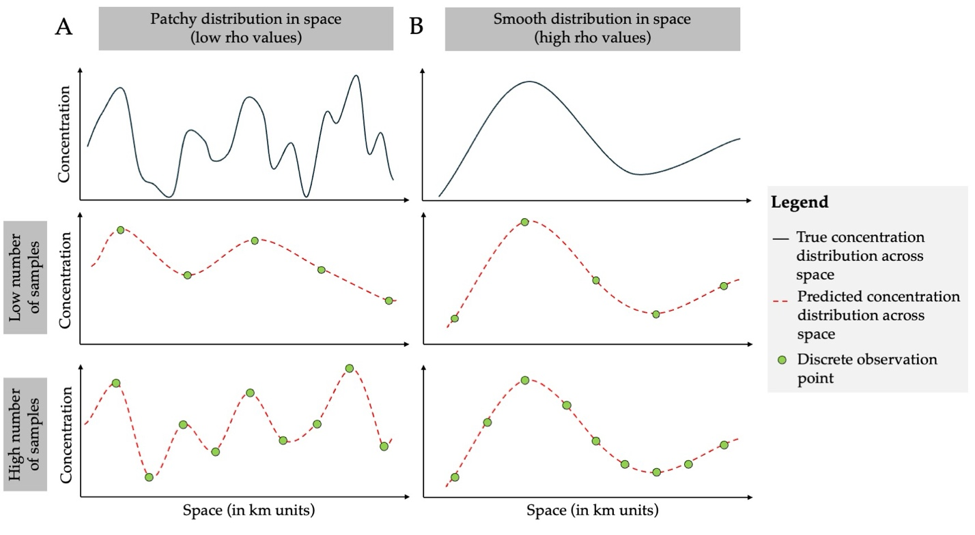
Notes:
I don’t have much time so I will jump straight in the topic!
We all know the complicated cacophony of the factors (all the numbers here in circle here) affect how much eDNA we capture. All these processes skew our interpretation of the ecology and biotic inference.
So we capture these samples and what do we typically do?

Slide 9
Notes:
I don’t have much time so I will jump straight in the topic!
We all know the complicated cacophony of the factors (all the numbers here in circle here) affect how much eDNA we capture. All these processes skew our interpretation of the ecology and biotic inference.
So we capture these samples and what do we typically do?

Slide 10
Notes:
I don’t have much time so I will jump straight in the topic!
We all know the complicated cacophony of the factors (all the numbers here in circle here) affect how much eDNA we capture. All these processes skew our interpretation of the ecology and biotic inference.
So we capture these samples and what do we typically do?

Slide 11
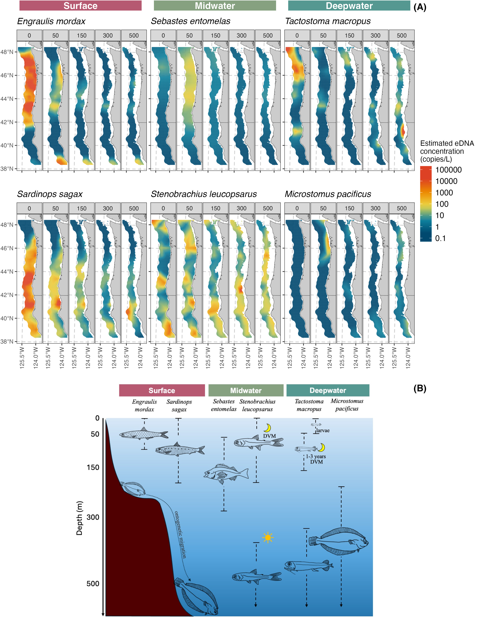
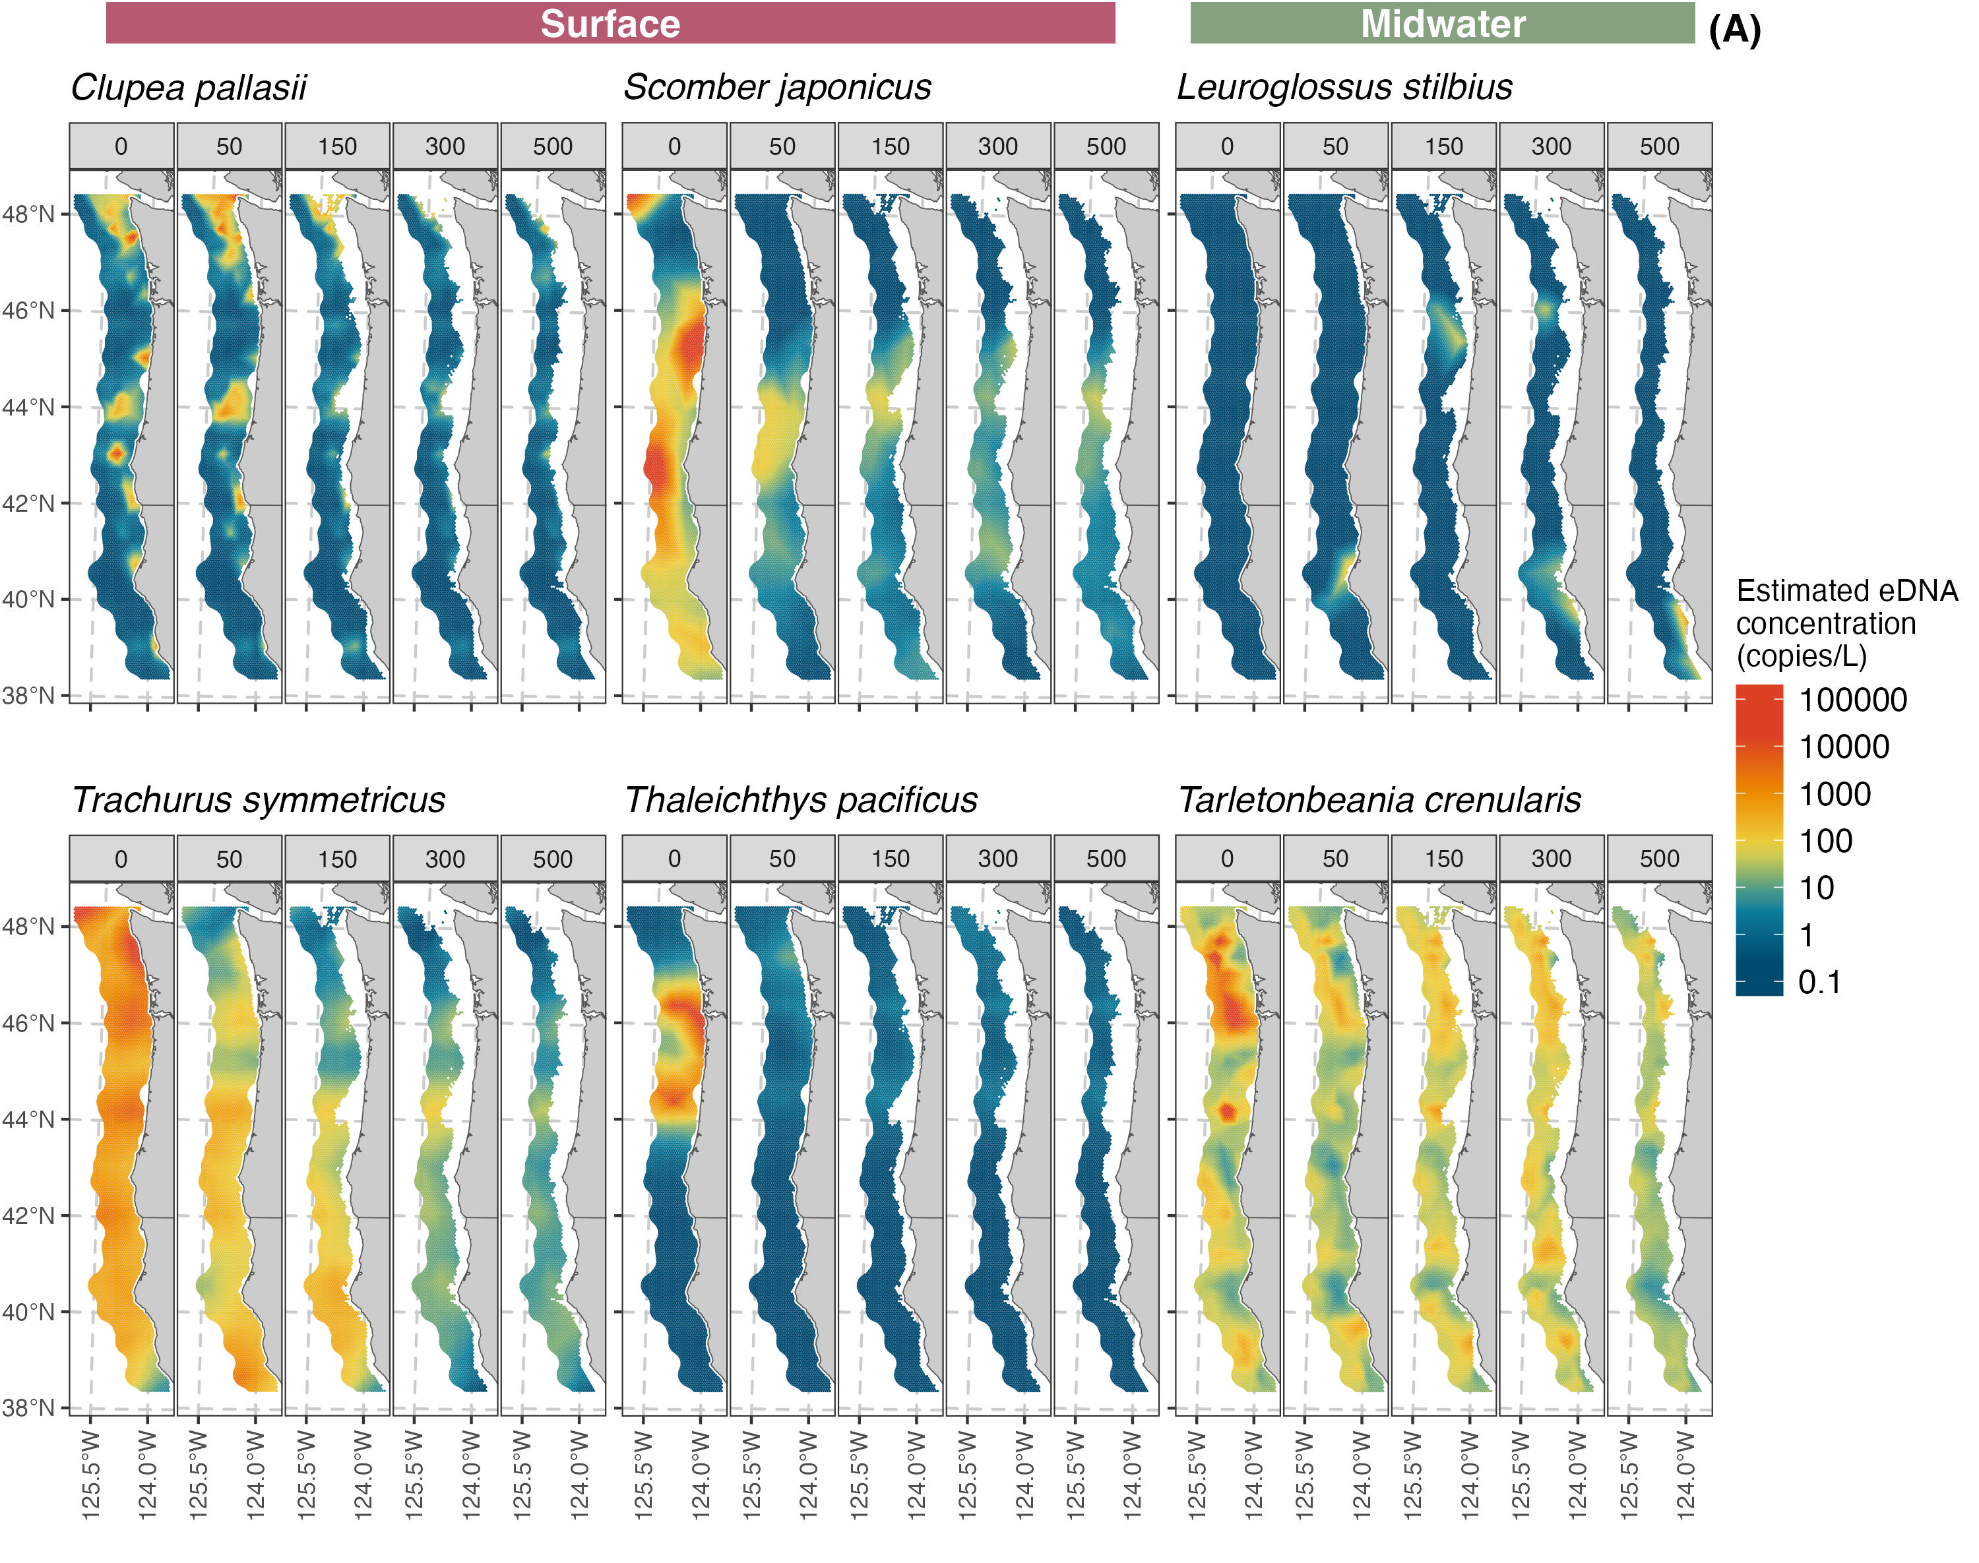
Empirical data

Slide 12
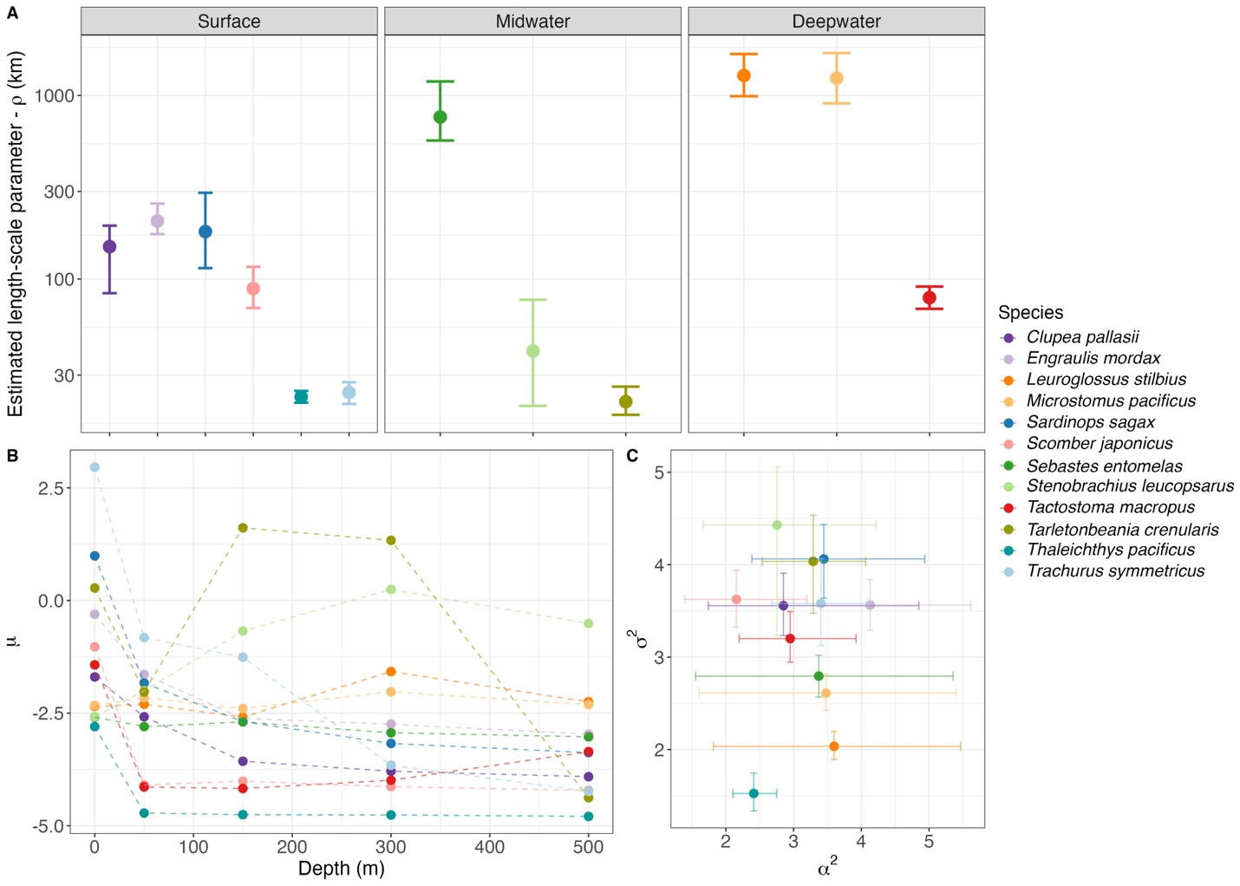
Notes:
I don’t have much time so I will jump straight in the topic!
We all know the complicated cacophony of the factors (all the numbers here in circle here) affect how much eDNA we capture. All these processes skew our interpretation of the ecology and biotic inference.
So we capture these samples and what do we typically do?

Slide 13
Cool we learned something new!
But what about the number of samples needed?
Notes:
I don’t have much time so I will jump straight in the topic!
We all know the complicated cacophony of the factors (all the numbers here in circle here) affect how much eDNA we capture. All these processes skew our interpretation of the ecology and biotic inference.
So we capture these samples and what do we typically do?

Slide 14

Simulation mode ON

Slide 15
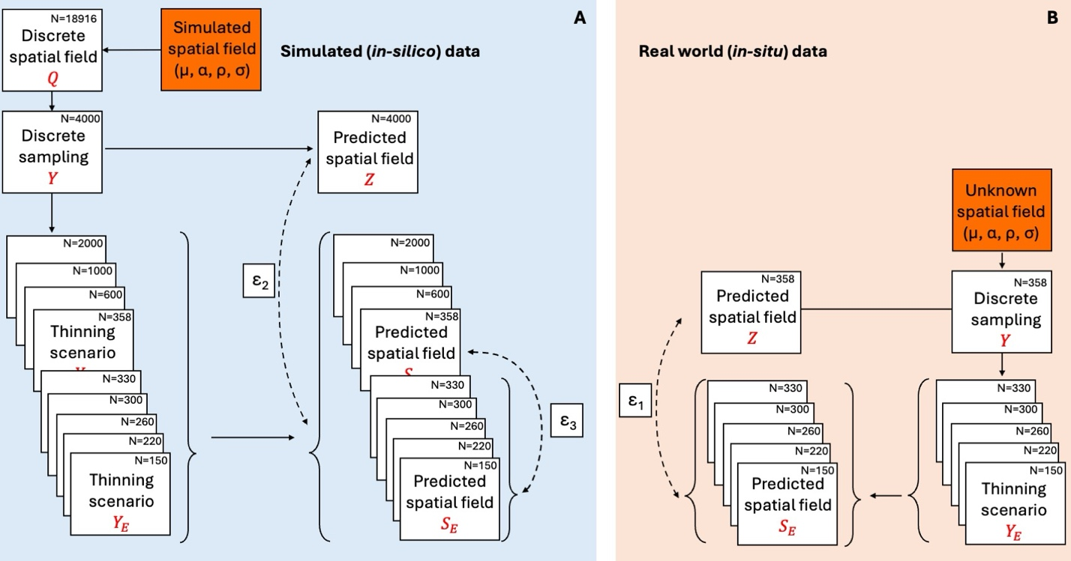
Notes:
I don’t have much time so I will jump straight in the topic!
We all know the complicated cacophony of the factors (all the numbers here in circle here) affect how much eDNA we capture. All these processes skew our interpretation of the ecology and biotic inference.
So we capture these samples and what do we typically do?

Slide 16
Notes:
I don’t have much time so I will jump straight in the topic!
We all know the complicated cacophony of the factors (all the numbers here in circle here) affect how much eDNA we capture. All these processes skew our interpretation of the ecology and biotic inference.
So we capture these samples and what do we typically do?

Slide 17
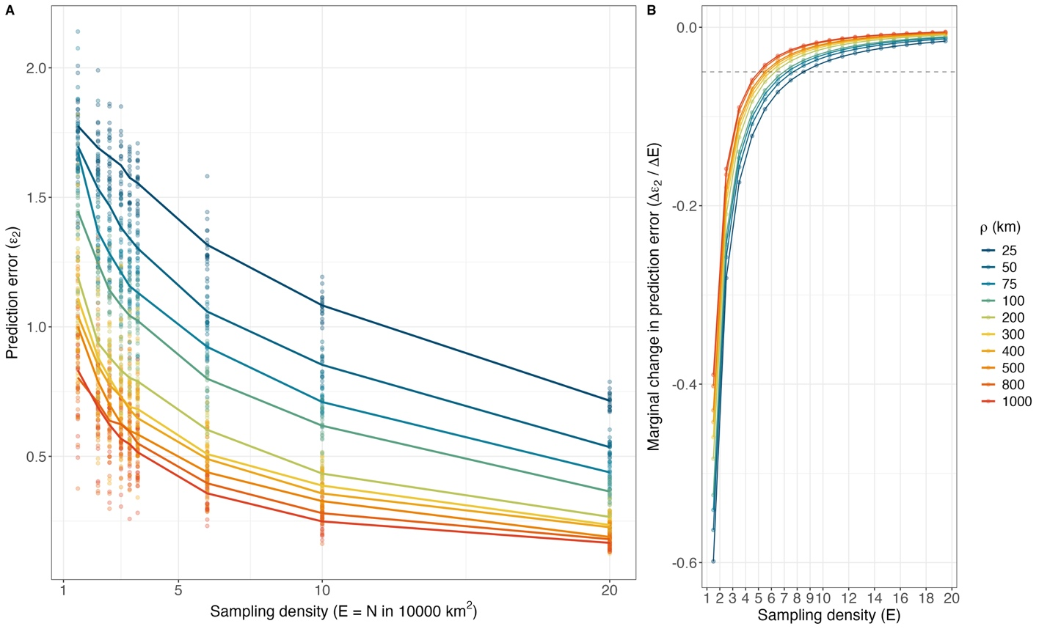
Notes:
I don’t have much time so I will jump straight in the topic!
We all know the complicated cacophony of the factors (all the numbers here in circle here) affect how much eDNA we capture. All these processes skew our interpretation of the ecology and biotic inference.
So we capture these samples and what do we typically do?

Slide 18
Notes:
I don’t have much time so I will jump straight in the topic!
We all know the complicated cacophony of the factors (all the numbers here in circle here) affect how much eDNA we capture. All these processes skew our interpretation of the ecology and biotic inference.
So we capture these samples and what do we typically do?

Slide 19
Notes:
I don’t have much time so I will jump straight in the topic!
We all know the complicated cacophony of the factors (all the numbers here in circle here) affect how much eDNA we capture. All these processes skew our interpretation of the ecology and biotic inference.
So we capture these samples and what do we typically do?

Slide 20
Simulations cool!
But what about the empirical data?
Notes:
I don’t have much time so I will jump straight in the topic!
We all know the complicated cacophony of the factors (all the numbers here in circle here) affect how much eDNA we capture. All these processes skew our interpretation of the ecology and biotic inference.
So we capture these samples and what do we typically do?

Slide 21
Notes:
I don’t have much time so I will jump straight in the topic!
We all know the complicated cacophony of the factors (all the numbers here in circle here) affect how much eDNA we capture. All these processes skew our interpretation of the ecology and biotic inference.
So we capture these samples and what do we typically do?

Slide 22
Notes:
I don’t have much time so I will jump straight in the topic!
We all know the complicated cacophony of the factors (all the numbers here in circle here) affect how much eDNA we capture. All these processes skew our interpretation of the ecology and biotic inference.
So we capture these samples and what do we typically do?

Slide 23
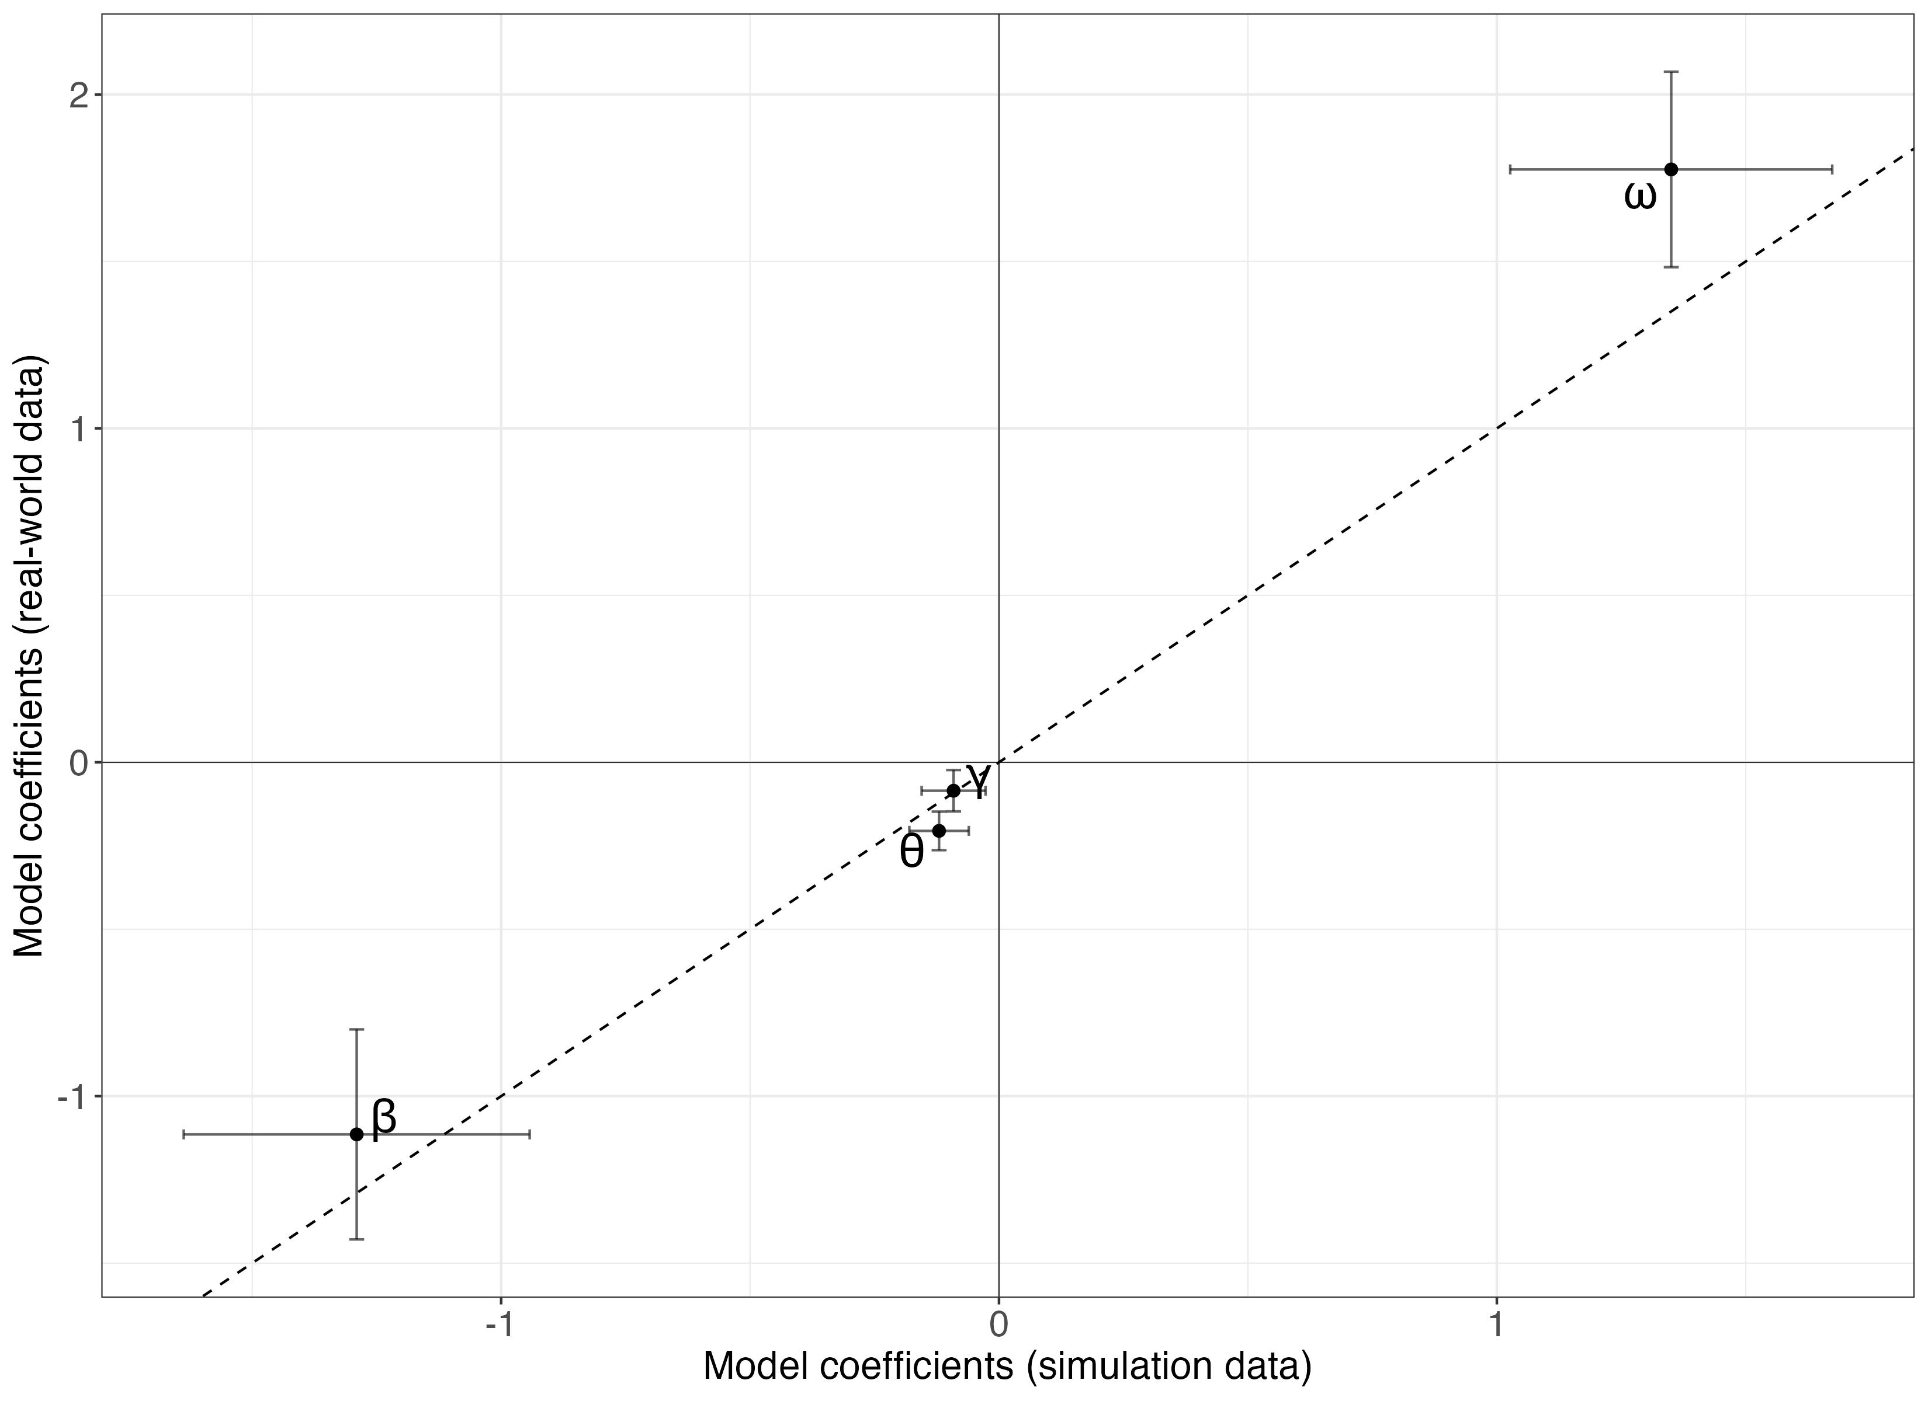
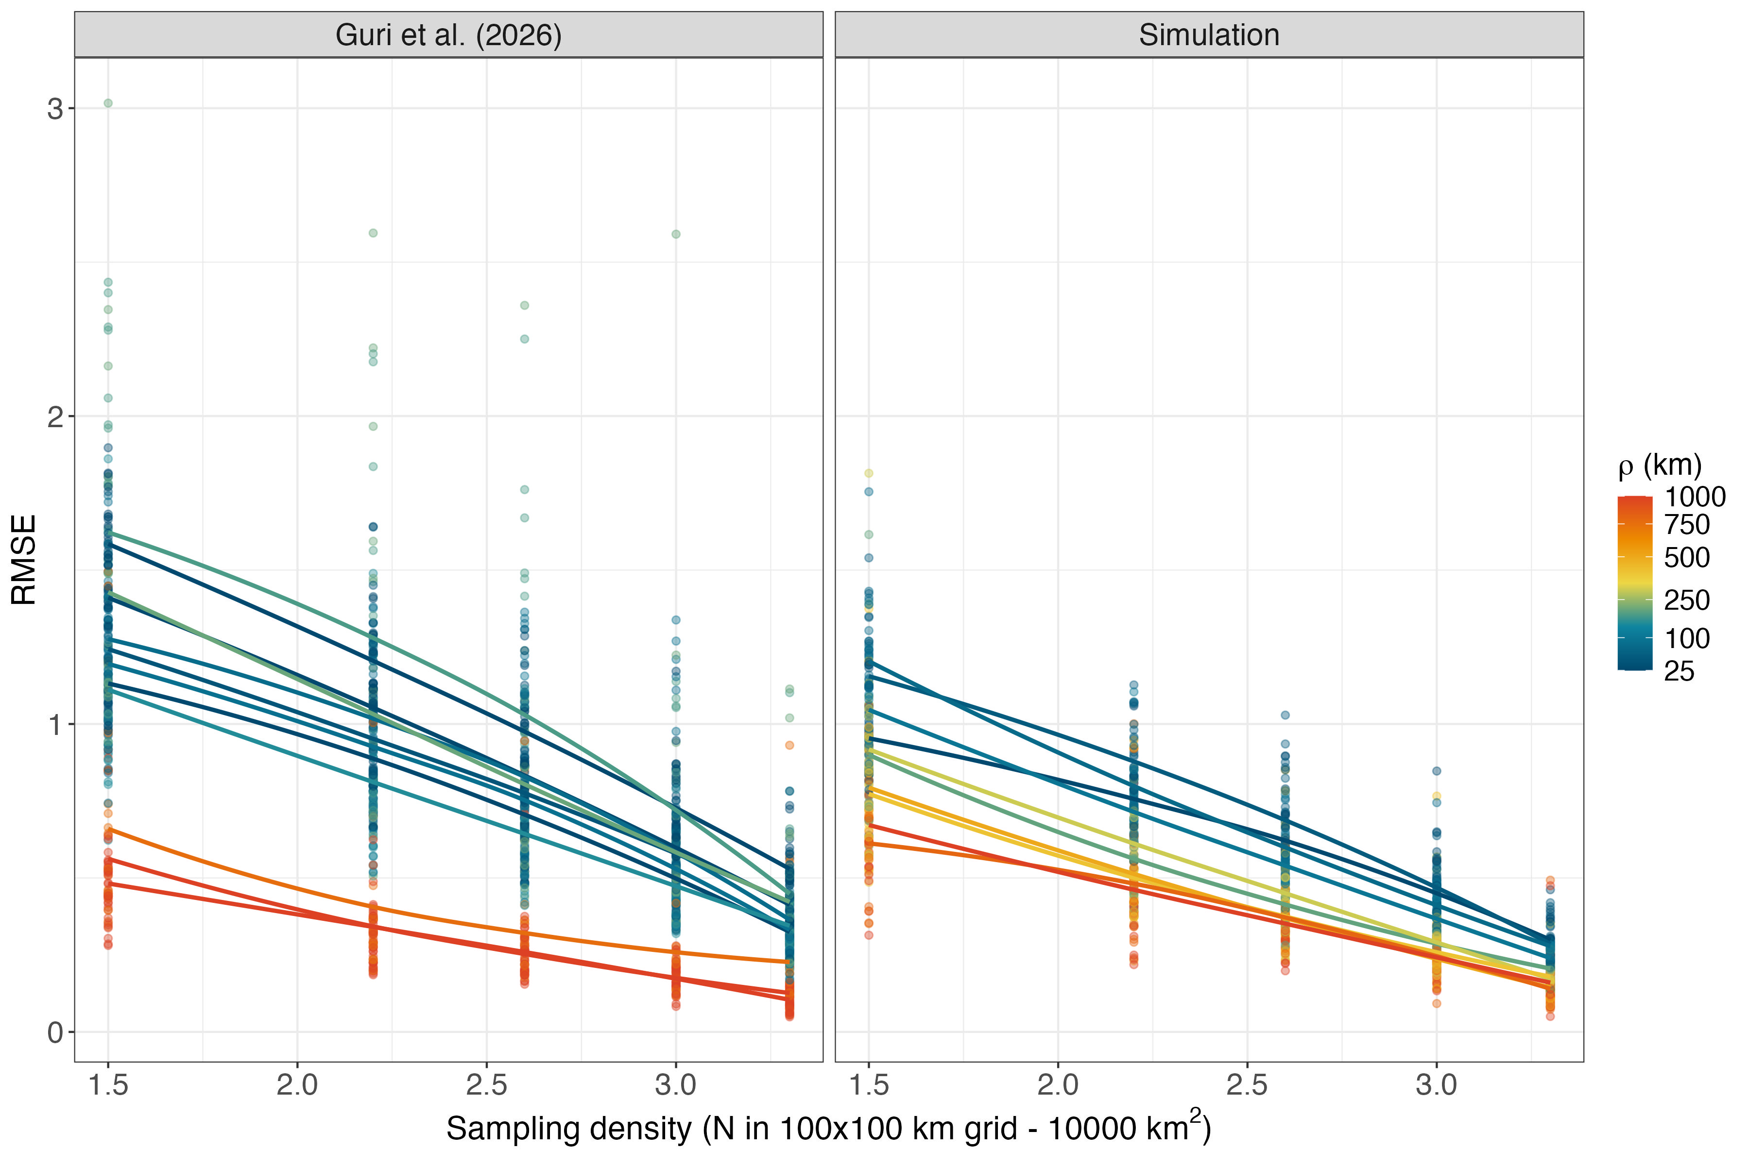
$$\begin{aligned}log\left(ε\right)=ω+β log\left(E\right)+θ log\left(ρ\right)+γ log\left(E\right)log\left(ρ\right)\#\end{aligned}$$
Prediction error (ε)
Notes:
I don’t have much time so I will jump straight in the topic!
We all know the complicated cacophony of the factors (all the numbers here in circle here) affect how much eDNA we capture. All these processes skew our interpretation of the ecology and biotic inference.
So we capture these samples and what do we typically do?

Slide 24
$$\begin{aligned}log\left(ε\right)=ω+β log\left(E\right)+θ log\left(ρ\right)+γ log\left(E\right)log\left(ρ\right)\#\end{aligned}$$
Great! That’s good news!
But what about the parameters?
Prediction error (ε)
Notes:
I don’t have much time so I will jump straight in the topic!
We all know the complicated cacophony of the factors (all the numbers here in circle here) affect how much eDNA we capture. All these processes skew our interpretation of the ecology and biotic inference.
So we capture these samples and what do we typically do?

Slide 25
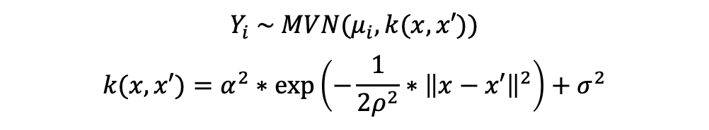
α
ρ
μ
Autocorrelation
σ
Distance (m)
Gaussian Process (GP)
$$Y_{i} \sim MVN(μ_{i},k(x,x′))$$
$$k(x,x′)=α^{2}∗exp⁡\left(−\frac{1}{2ρ^{2}}∗{\left\|x−x′\right\|}^{2}\right)+σ^{2}$$
Autocorrelation
μ
Distance (m)

Slide 26
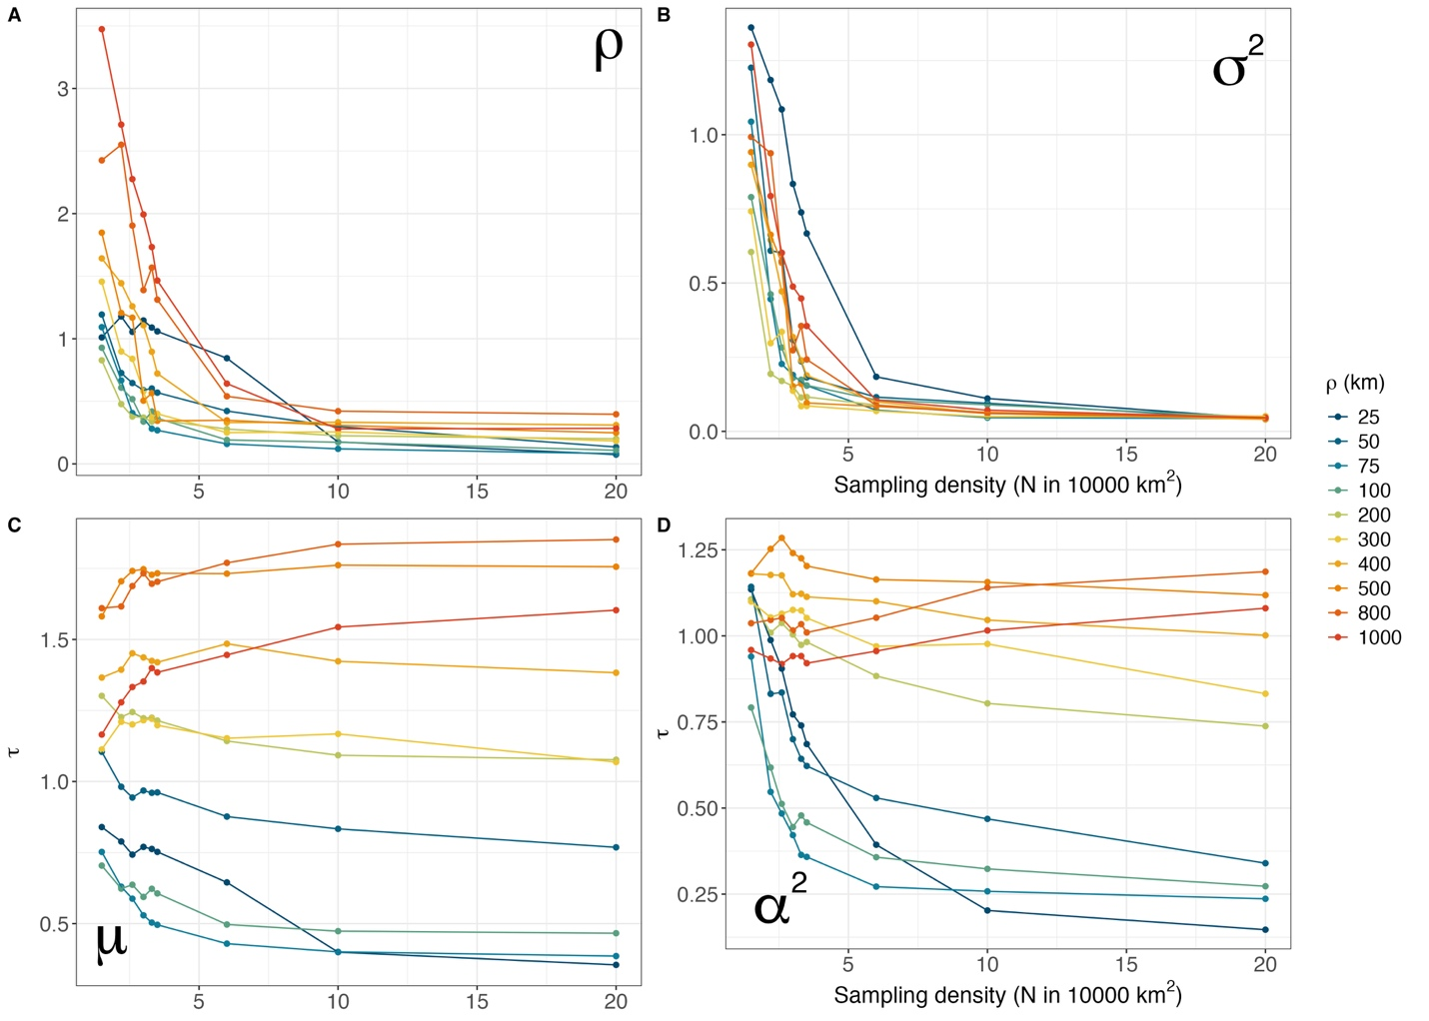
α
ρ
Autocorrelation
σ
Distance (m)
Autocorrelation
Distance (m)

Slide 28
Prediction error (ε)
5 samples / 10000 km²
GP parameters (τ)
6 samples / 10000 km²
Prediction error (ε)
9 samples / 10000 km²
GP parameters (τ)
6 samples / 10000 km²

Slide 29
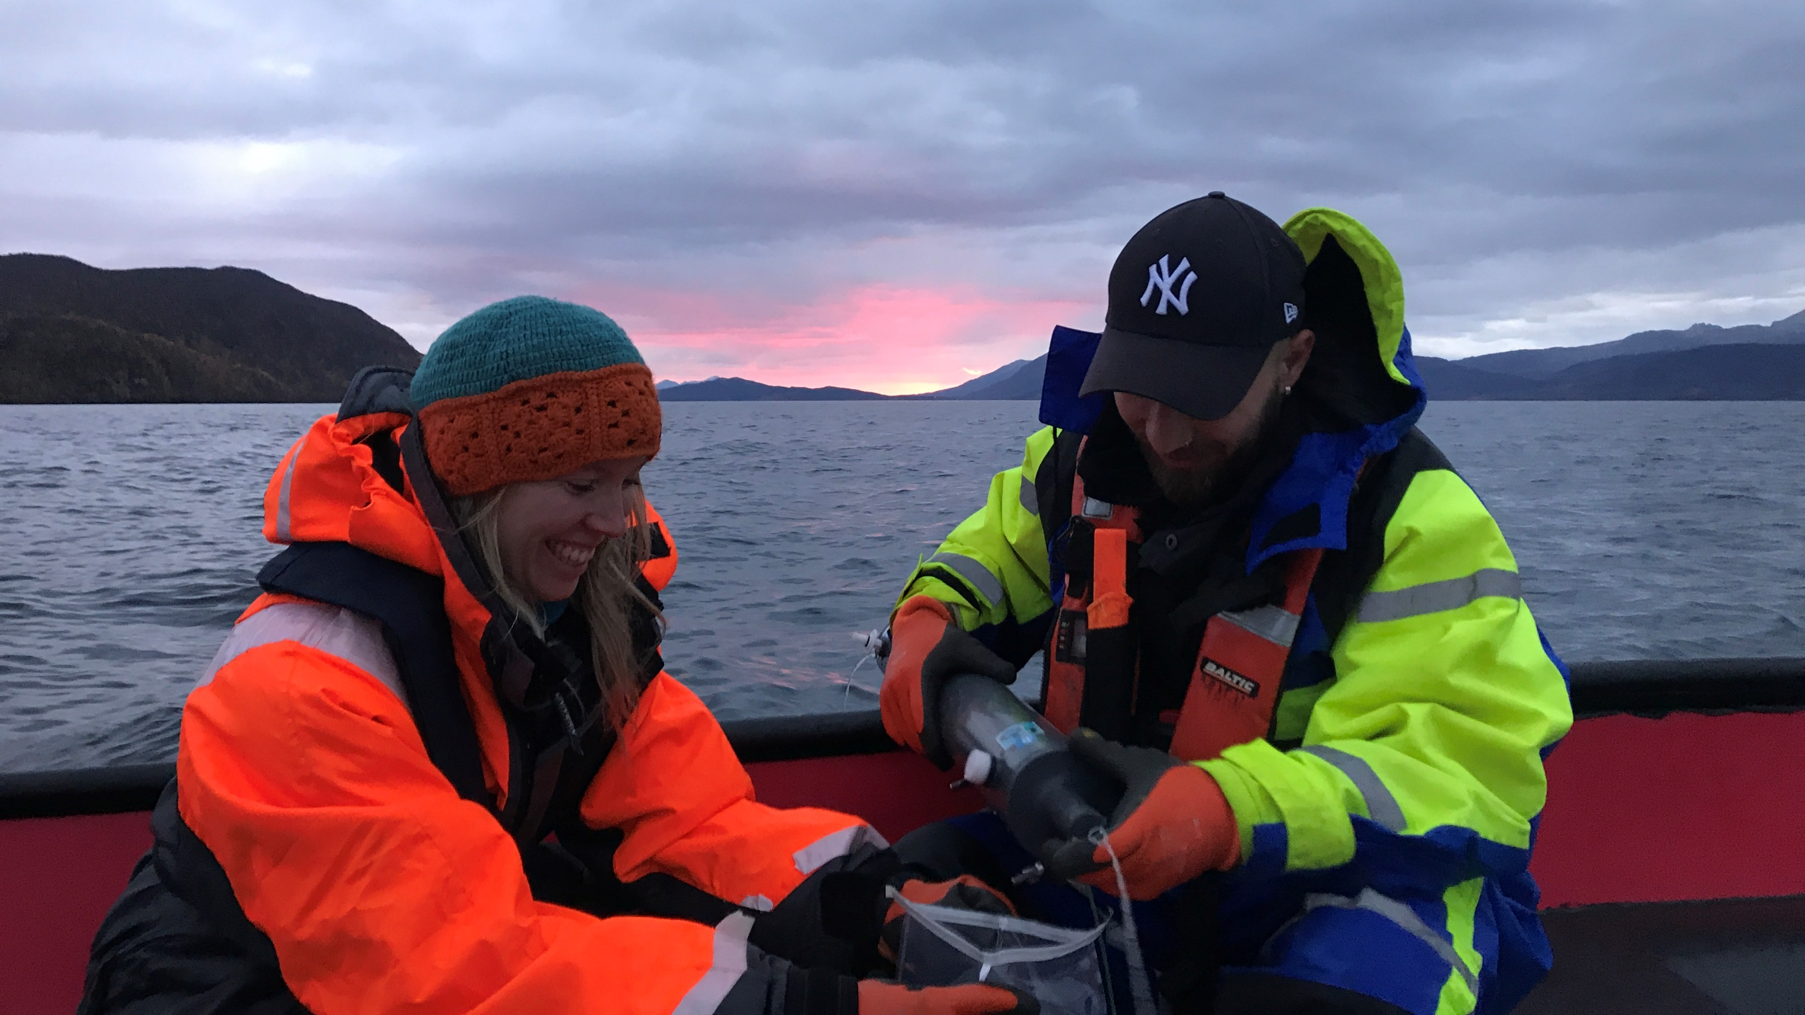

Please approach me for questions and details!!
Thank you for your attention!

