Slide 1
Smart environmental DNA
sampling strategies
Spatial autocorrelation can guide efficient survey design
A 15-minute research talk
01
Notes:
Timing: 0:00–0:40 (40 seconds).
How many environmental DNA samples should a marine survey collect? This study addresses that question by linking sampling effort to the spatial structure of the eDNA field. The central result is that the answer depends on the species and on what we want the survey to estimate. A design that supports an abundance index may still leave important gaps in a distribution map. I will explain the spatial idea, describe the empirical and simulation analyses, and finish with the implications for planning a survey.
Source: 1_Manuscript.docx, Abstract, Methods, Results and Discussion.

Slide 2
The survey design problem
Ship time limits how much of the ocean we can sample
Abundance indices and distribution maps require different information
The useful question is where extra stations improve the intended inference
02
Notes:
Timing: 0:40–1:40 (60 seconds).
Marine biodiversity monitoring supports fisheries and conservation decisions, but survey budgets are limited. Environmental DNA can provide observations for many species from the same water samples. That efficiency does not remove the spatial design problem. If stations are too far apart, we can miss local variation between them. If they are already close enough for the target species, additional stations may contribute little information. The study therefore considers both prediction of spatial distributions and recovery of the parameters describing those distributions. These are distinct objectives. A regional or depth-specific average can be useful even when the detailed map remains uncertain. Keeping those objectives separate helps us interpret the sampling thresholds later in the talk.
Source: 1_Manuscript.docx, Abstract, Methods, Results and Discussion.

Slide 3
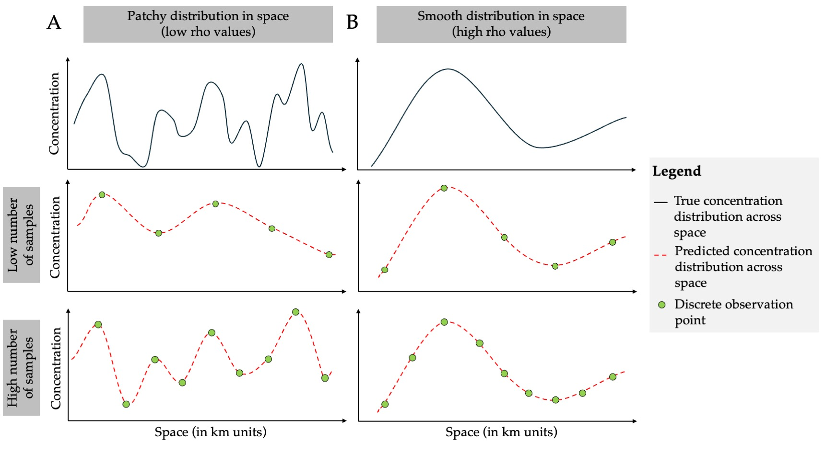
Spatial autocorrelation and patchiness
Short length-scale ρ: nearby concentrations change rapidly
Long length-scale ρ: concentrations vary more gradually
Figure 1 from the manuscript
03
Notes:
Timing: 1:40–2:55 (75 seconds).
The key concept is the autocorrelation length-scale, denoted rho and measured in kilometres. It describes the distance over which observations tend to remain similar. In the conceptual figure, the patchy field changes over shorter distances, so sparse observations miss some of its structure. A smoother field can be reconstructed with fewer observations because each observation informs a larger surrounding area. This gives the central hypothesis: the density needed for spatial prediction should increase as the length-scale becomes shorter. Rho here describes the observed eDNA field. It combines organism distributions with the effects of DNA transport and decay, so we should not interpret it as a direct measurement of fish movement or habitat size. The practical issue is sample spacing relative to the spatial variation we need to resolve.
Source: 1_Manuscript.docx, Figure 1 and associated methods/results.

Slide 4
A West Coast dataset across five depths
12 fish species across the California Current
358 observations distributed among five depth layers
0, 50, 150, 300 and 500 m
Summer 2019 survey, central California to northern Washington
04
Notes:
Timing: 2:55–4:00 (65 seconds).
The empirical analysis uses samples from the 2019 Joint U.S.-Canada Integrated Ecosystem and Pacific Hake Acoustic-Trawl Survey aboard the Bell M. Shimada. The dataset spans central California to northern Washington and includes 358 observations distributed among five depth layers. Those depths are zero, fifty, one hundred fifty, three hundred and five hundred metres. The study estimates concentrations for twelve fish species spanning surface, midwater and deeper habitats. The molecular workflow combines metabarcoding with calibration for amplification bias and Pacific hake qPCR measurements. The spatial analysis uses log eDNA concentrations. This broad geographic and taxonomic coverage provides a real-world basis for estimating how spatial structure varies among species, while the limited number of empirical observations motivates the simulation component.
Source: 1_Manuscript.docx, Abstract, Methods, Results and Discussion.

Slide 5
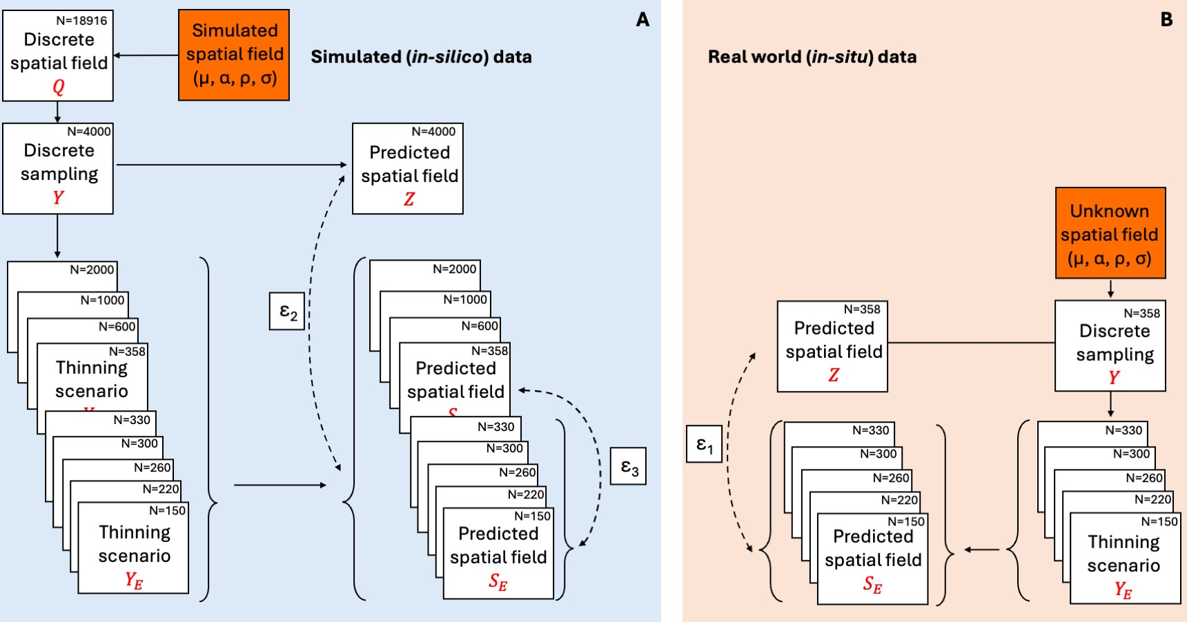
The analysis combines field data and simulations
Gaussian processes estimate spatial structure and depth means
Random thinning tests the effect of reduced sampling
200 simulated fields extend effort beyond the empirical survey
Figure 2 from the manuscript
05
Notes:
Timing: 4:00–5:25 (85 seconds).
Both components use a common Bayesian Gaussian process framework. The model estimates a depth-specific mean, a spatial length-scale, spatial amplitude and non-spatial variance. It then predicts concentrations across a grid of 18,916 locations. The empirical analysis repeatedly thins the dataset to smaller sample sizes and compares the resulting maps with predictions from the complete empirical dataset. The simulations extend the range of sampling effort. Ten length-scales, from twenty-five to one thousand kilometres, each have twenty replicate fields, giving two hundred simulations. A four-thousand-point subset provides each simulation's complete reference dataset. Smaller subsets are fitted again to quantify prediction and parameter error. Simulation amplitude and noise are fixed, and a single length-scale applies across depth layers. This controlled setup isolates the effects of effort and spatial autocorrelation.
Source: 1_Manuscript.docx, Figure 2 and associated methods/results.

Slide 6
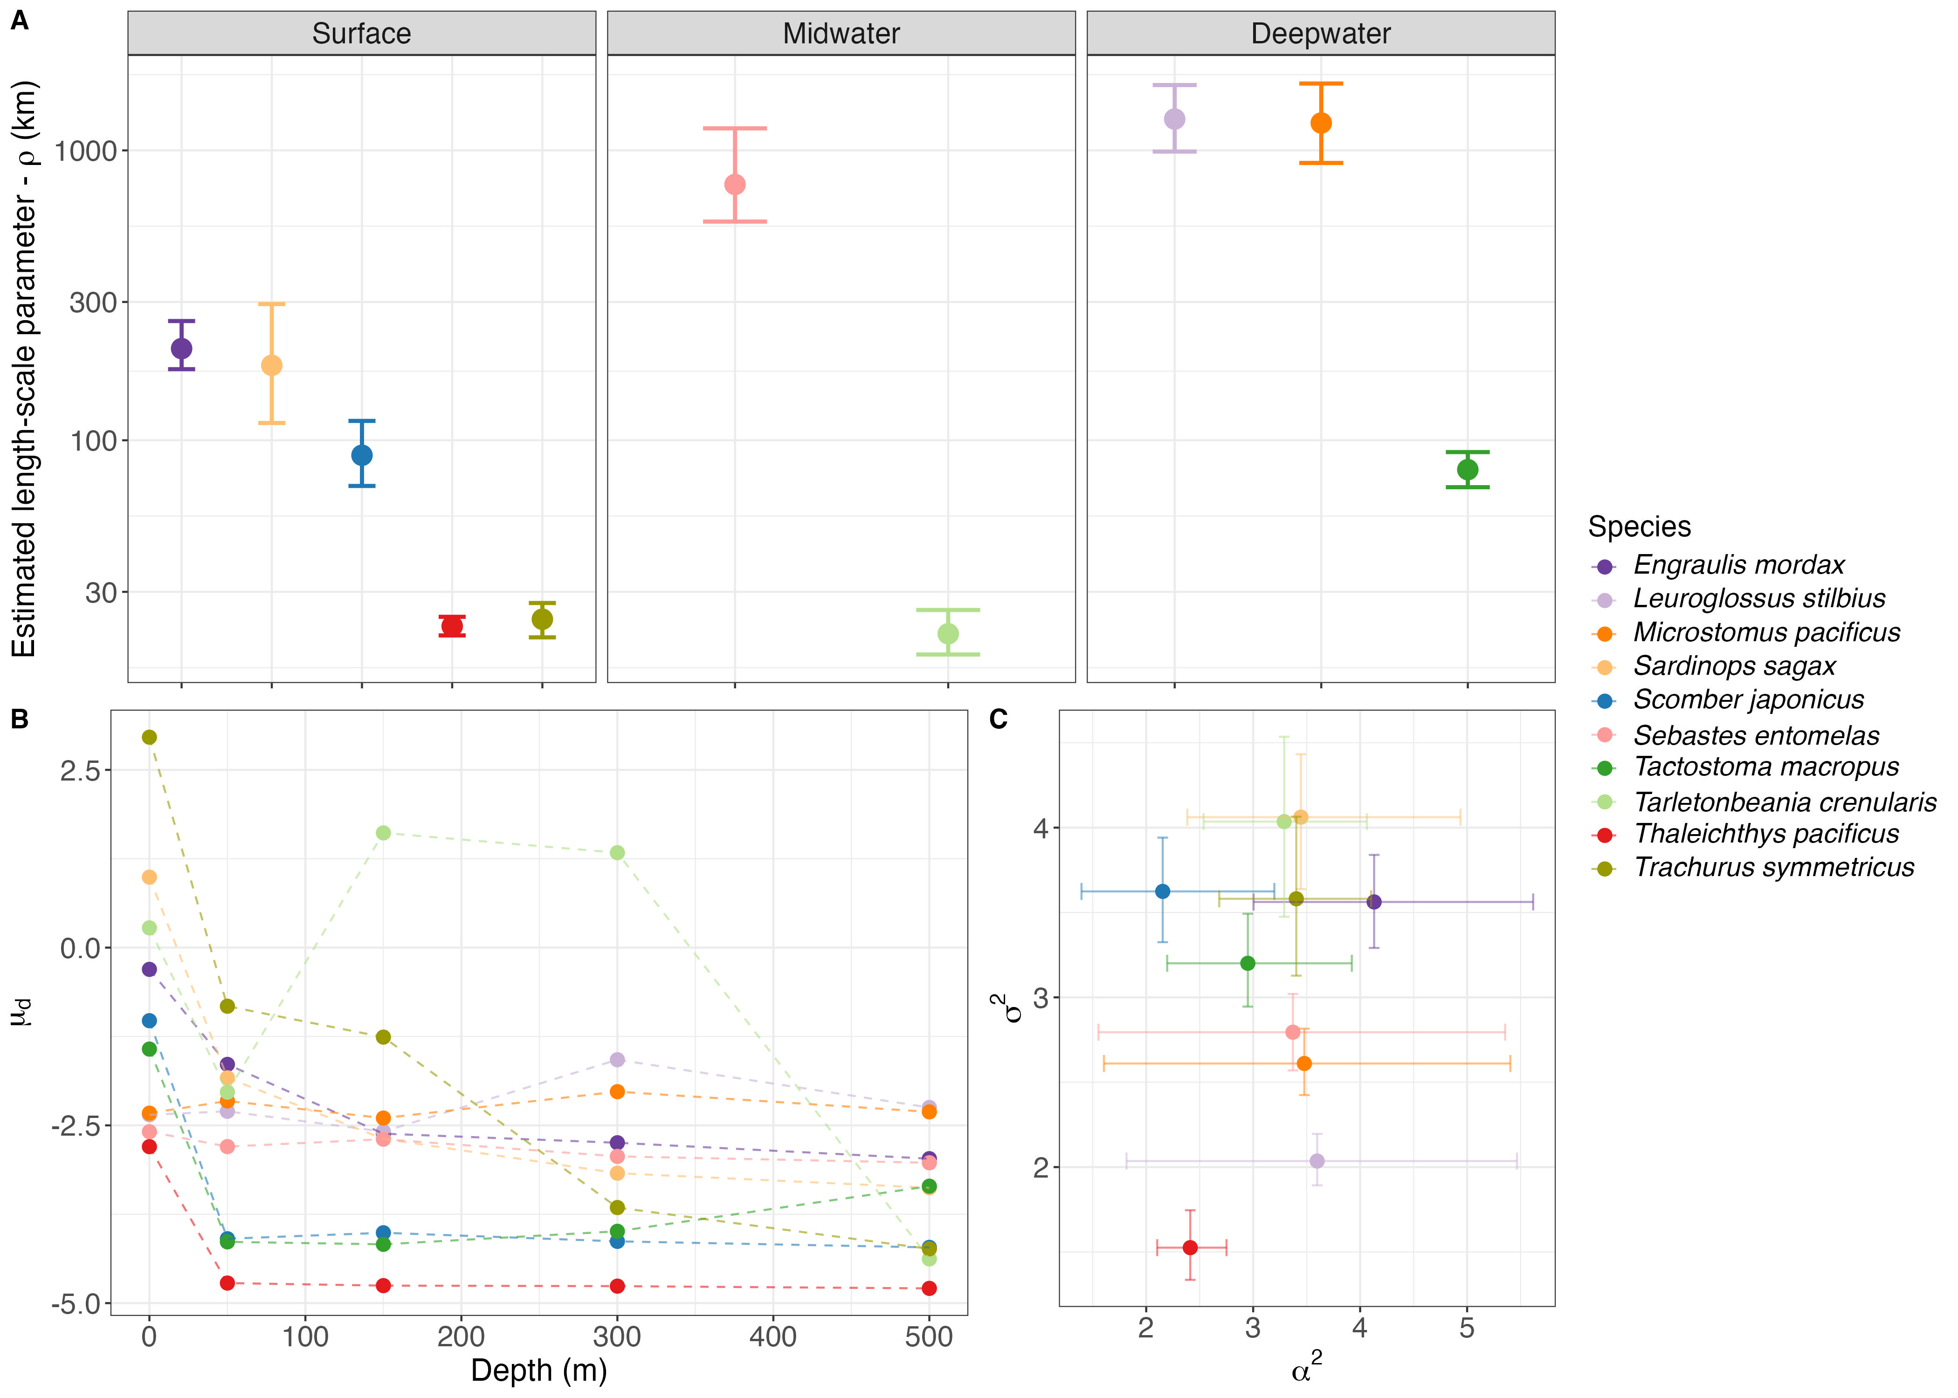
Species differ substantially in spatial structure
Surface-associated taxa generally have shorter length-scales
Deeper taxa tend to have smoother eDNA fields
Exceptions make species-specific estimates important
Figure 3 from the manuscript
06
Notes:
Timing: 5:25–6:40 (75 seconds).
The empirical results support the premise that species differ in spatial structure. Surface-associated taxa generally have shorter estimated length-scales and larger differences in mean concentration between shallow and deep samples. Deeper taxa broadly show longer length-scales and more similar mean concentrations across depths. These patterns are tendencies rather than rules. Tactostoma macropus, for example, has a relatively short length-scale despite its deep-water affinity. The credible intervals also remind us that spatial structure has uncertainty. For survey planning, depth association may offer a starting expectation, but a species-specific estimate from a pilot survey or an existing model is more informative. The results justify exploring a broad range of length-scales rather than selecting one representative value for the whole fish assemblage.
Source: 1_Manuscript.docx, Figure 3 and associated methods/results.

Slide 7
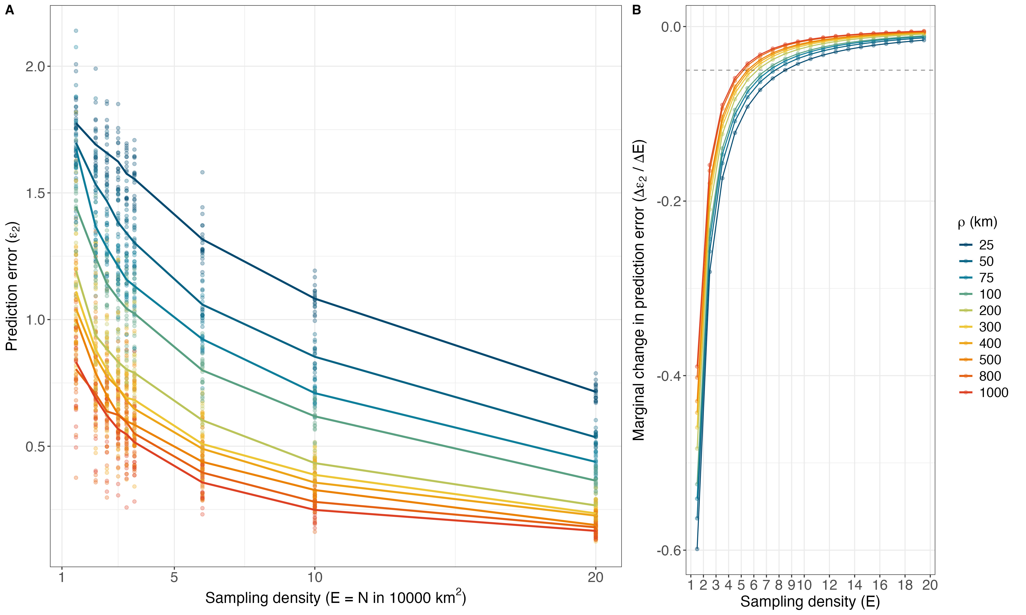
More sampling improves maps, with diminishing returns
Patchy fields retain higher prediction error at the same effort
The largest gains occur when sampling is sparse
Figure 4 from the manuscript
07
Notes:
Timing: 6:40–8:15 (95 seconds).
This figure shows the main simulation result. On the left, prediction error declines as sampling density increases. The different colours represent different spatial length-scales. The short-length-scale fields remain harder to reconstruct at every comparable level of effort. The curves also flatten, showing that the benefit of adding samples becomes smaller as density increases. On the right, the marginal change in error approaches zero. The dashed line marks the study's chosen criterion for negligible improvement: a marginal error reduction of zero point zero five per additional unit of sampling density. That criterion is an operational choice, not a biological threshold. The empirical thinning analysis showed similar directional relationships. However, its reference is the complete empirical model, whereas the simulation reference uses four thousand observations. Agreement supports the general pattern, but the two error benchmarks are not interchangeable.
Source: 1_Manuscript.docx, Figure 4 and associated methods/results.

Slide 8
Sampling targets depend on patchiness
Smooth fields, ρ > 500 km: about 4–5 samples
Patchy fields, ρ < 50 km: about 8–11 samples
Density unit: samples per 10,000 km² per depth layer
Targets depend on the chosen marginal-gain criterion
08
Notes:
Timing: 8:15–9:30 (75 seconds).
The manuscript gives useful planning ranges. For smoothly distributed fields with length-scales greater than five hundred kilometres, marginal gains become small at about four to five samples per ten thousand square kilometres per depth layer. For very patchy fields with length-scales below fifty kilometres, the reported range is about eight to eleven samples in the same area and depth unit. These figures indicate roughly twice the effort for patchy fields to reach the selected diminishing-return criterion. They should not be read as a promise of equal absolute map accuracy. The manuscript also summarizes the broader transition as four to nine, so these are approximate, scenario-dependent ranges. Most importantly, they are normalized by area and depth. They are not a total station count that can be transferred directly to any cruise.
Source: 1_Manuscript.docx, Abstract, Methods, Results and Discussion.

Slide 9
The same effort can produce very different precision
At E = 6 and ρ = 50 km: log-scale RMSE ≈ 1
At E = 6 and ρ > 500 km: log-scale RMSE < 0.4
Approximate multiplicative scales: 2.7× versus 1.5×
09
Notes:
Timing: 9:30–10:30 (60 seconds).
A concrete comparison shows why spatial structure matters. At a density of six samples per ten thousand square kilometres per depth layer, the manuscript reports prediction error around one log unit for a fifty-kilometre length-scale. At the same effort, fields with length-scales above five hundred kilometres have errors below zero point four. Exponentiating those values gives multiplicative scales of about two point seven and one point five. This helps communicate the size of log-scale error, but these factors are not confidence limits or guaranteed prediction intervals. The comparison says that the same sampling budget yields substantially different precision for different spatial fields. It also shows why diminishing returns and acceptable absolute accuracy must be considered separately.
Source: 1_Manuscript.docx, Abstract, Methods, Results and Discussion.

Slide 10
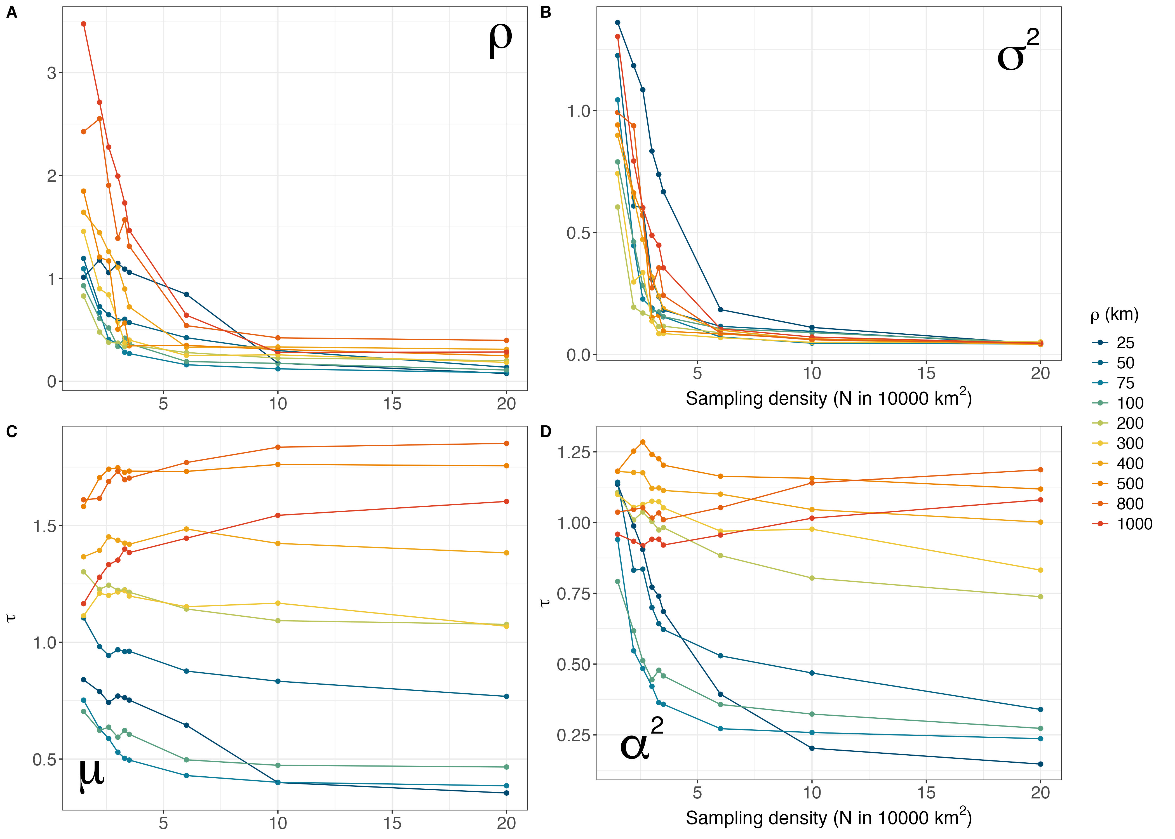
Parameter recovery differs from map accuracy
Length-scale estimates stabilize above roughly E = 6
Depth means can be recovered with relatively sparse sampling
Long spatial ranges complicate mean estimation
Figure 5 from the manuscript
10
Notes:
Timing: 10:30–11:45 (75 seconds).
Parameter recovery tells a more nuanced story than simply saying that more samples always help. Estimates of the length-scale have substantial error at low effort and improve quickly, with recovery stabilizing above roughly six samples per ten thousand square kilometres per depth layer. The non-spatial variance also becomes well recovered. Depth-specific means often need less sampling than detailed spatial predictions. However, the results identify an important exception: mean-estimation error increases with effort in simulations with length-scales above four hundred kilometres. When spatial structure spans much of the domain, the global mean and the spatial process can be difficult to separate. We therefore should not claim that abundance indices are automatically reliable under every sparse design. Broad domain coverage, the scale of the field and the intended precision still matter.
Source: 1_Manuscript.docx, Figure 5 and associated methods/results.

Slide 11
Survey planning follows the inferential objective
Abundance indices: prioritize broad and balanced coverage
Spatial maps: add stations where the target field varies rapidly
Length-scale estimation: include close and distant station pairs
Multispecies design: consider the patchiest priority taxon
11
Notes:
Timing: 11:45–13:00 (75 seconds).
These findings translate into a sequence of planning decisions. First define the product the survey must deliver and the precision needed for that product. For a depth-specific abundance index, broad coverage and avoiding excessive concentration of effort in one region are important. For a spatial map or hotspot analysis, observations need to be close enough to resolve local variation. Next obtain a plausible length-scale, ideally with uncertainty, from existing fits or a pilot survey. The fitted error relationship can then help identify a suitable density. Finally examine the actual station configuration. Estimating spatial correlation needs both close pairs that resolve rapid decorrelation and distant pairs that constrain broader structure. In a multispecies survey, the patchiest taxon that the programme must resolve may determine the spatial effort required.
Source: 1_Manuscript.docx, Abstract, Methods, Results and Discussion.

Slide 12
Transfer to other systems requires care
Length-scale includes eDNA transport and decay
Simulations assume smooth, stationary, isotropic spatial structure
Prediction error compares fitted fields, not independent ground truth
Density thresholds depend on domain size and required precision
12
Notes:
Timing: 13:00–14:10 (70 seconds).
Several limits matter when applying the results. The Gaussian process assumes a smooth, stationary and isotropic spatial field. Ocean fronts, directional transport and local habitat boundaries can violate those assumptions. Simulations also fix amplitude and noise, and use one length-scale across depth layers, while real systems can vary more strongly. Prediction errors measure differences from a fitted reference field, rather than error against an independently observed truth. Finally, length-scale must be interpreted relative to the survey domain. A field that is patchy over a continental survey may look nearly uniform in a small study area. Together these points mean that the reported densities are starting points for planning in comparable settings. Pilot data and checks against independent abundance information would strengthen their transfer to other systems.
Source: 1_Manuscript.docx, Abstract, Methods, Results and Discussion.

Slide 13
Effort should match the species and the decision
Current regional grids may support abundance-index objectives
Mapping patchy taxa may require roughly 2–3 times current density
Additional spatial coverage addresses gaps between stations
13
Notes:
Timing: 14:10–15:00 (50 seconds).
The practical conclusion is that survey effort should match both the spatial structure of the target taxa and the decision the data must support. The manuscript compares current regional densities of about three point four to three point six samples per ten thousand square kilometres with its diminishing-return ranges. Those grids may be close to sufficient for smoother fields and abundance-index objectives. Mapping patchy taxa may require roughly two to three times the spatial density. More sequencing or filtering at existing stations cannot directly fill gaps between stations. The useful planning shift is to specify the required product and target spatial scale before the cruise, then choose a station design that can resolve them. Thank you.
Source: 1_Manuscript.docx, Abstract, Methods, Results and Discussion.

