Slide 1
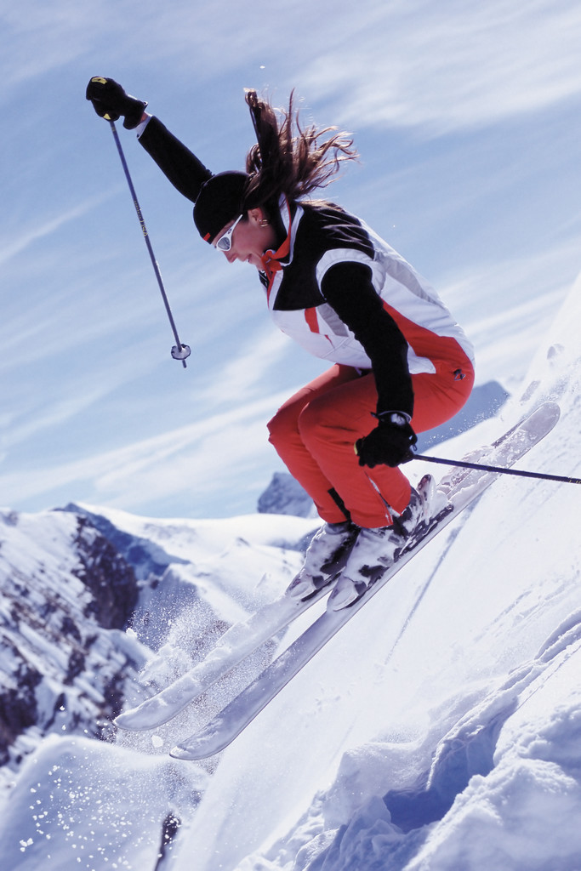
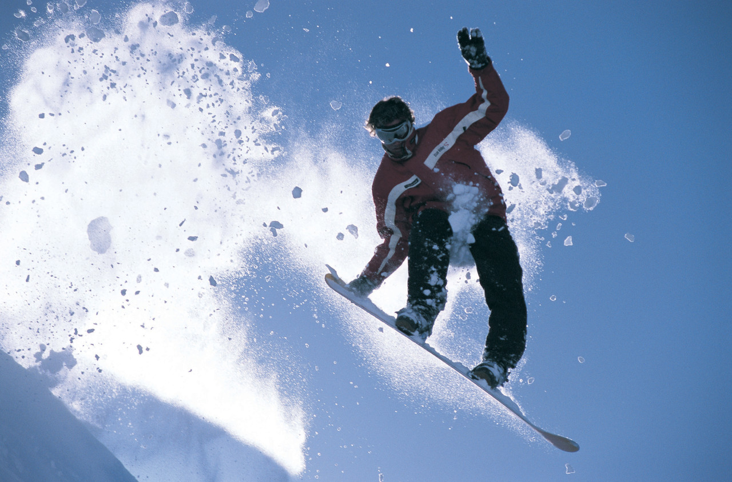
Welcome Brighton Ski Patrols
Welcome to American
Sign Language (ASL)

Slide 2
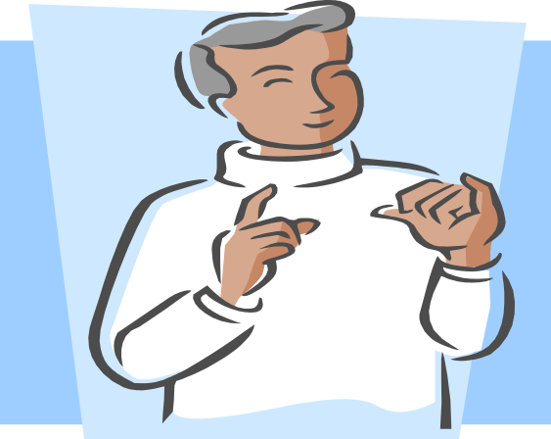
Who am I?
Wade Hester
Deaf
Hearing Wife and Family
Utah School for the Deaf and Blind

Slide 3
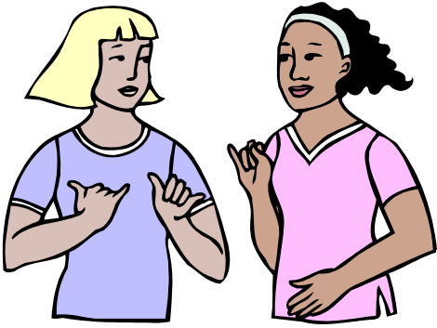
What is American Sign Language?
(ASL)
Visual and gestural language
Created with hands
Facial expressions
Body posture and movement

Slide 4
How many Deaf people are there in U.S.?
Severe to profound hearing loss
  Estimated 28 million Americans
Culturally Deaf and use ASL
  Estimated 500,000 to million
Utah Deaf population?
  245,00 Deaf and Hard of Hearing
  4000-5000 are culturally Deaf
  (Census, 2000)

Slide 5
Should Deaf rely on lip-reading?
Catch 25% of spoken messages
Misunderstandings! Frustrating!
Some Deaf are skilled lip-readers also using residual hearing
Better Options
  Certified ASL interpreters
  Exchanging written notes
Example

Slide 6
Suppose Deaf woman says:
"This place is a mess! C'mon,
You and I need to clean this place up,
Your stuff is lying all over on the floor
and you'll have no clothes to wear tomorrow
unless we do the laundry right now!"
Her lipreading to Deaf husband will get:
blah, blah, blah, blah, C'MON
YOU AND I blah, blah, blah, blah,
blah, blah, blah, blah, ON THE FLOOR
blah, blah, NO CLOTHES blah, blah,
blah, blah, blah, blah, RIGHT NOW!

Slide 7
A 92 year-old Deaf man went to the Doctor to get a physical.
A few days later the Dr. saw the man walking down the street with a gorgeous young lady on his arm.
A couple of days later the Dr. talked to the man and said, "You're really doing great, aren't you?"
The man replied, "Just doing what you said Doctor, 'Get a hot mamma and be cheerful."
The Doctor said, "I didn't say that. I said you got a heart
murmur. Be careful."

Slide 8
Deaf Life
Deaf attention (How?)
Restaurants and Business
  Communication
  Interpreters
Deaf Jokes
Deaf clubs

Slide 9
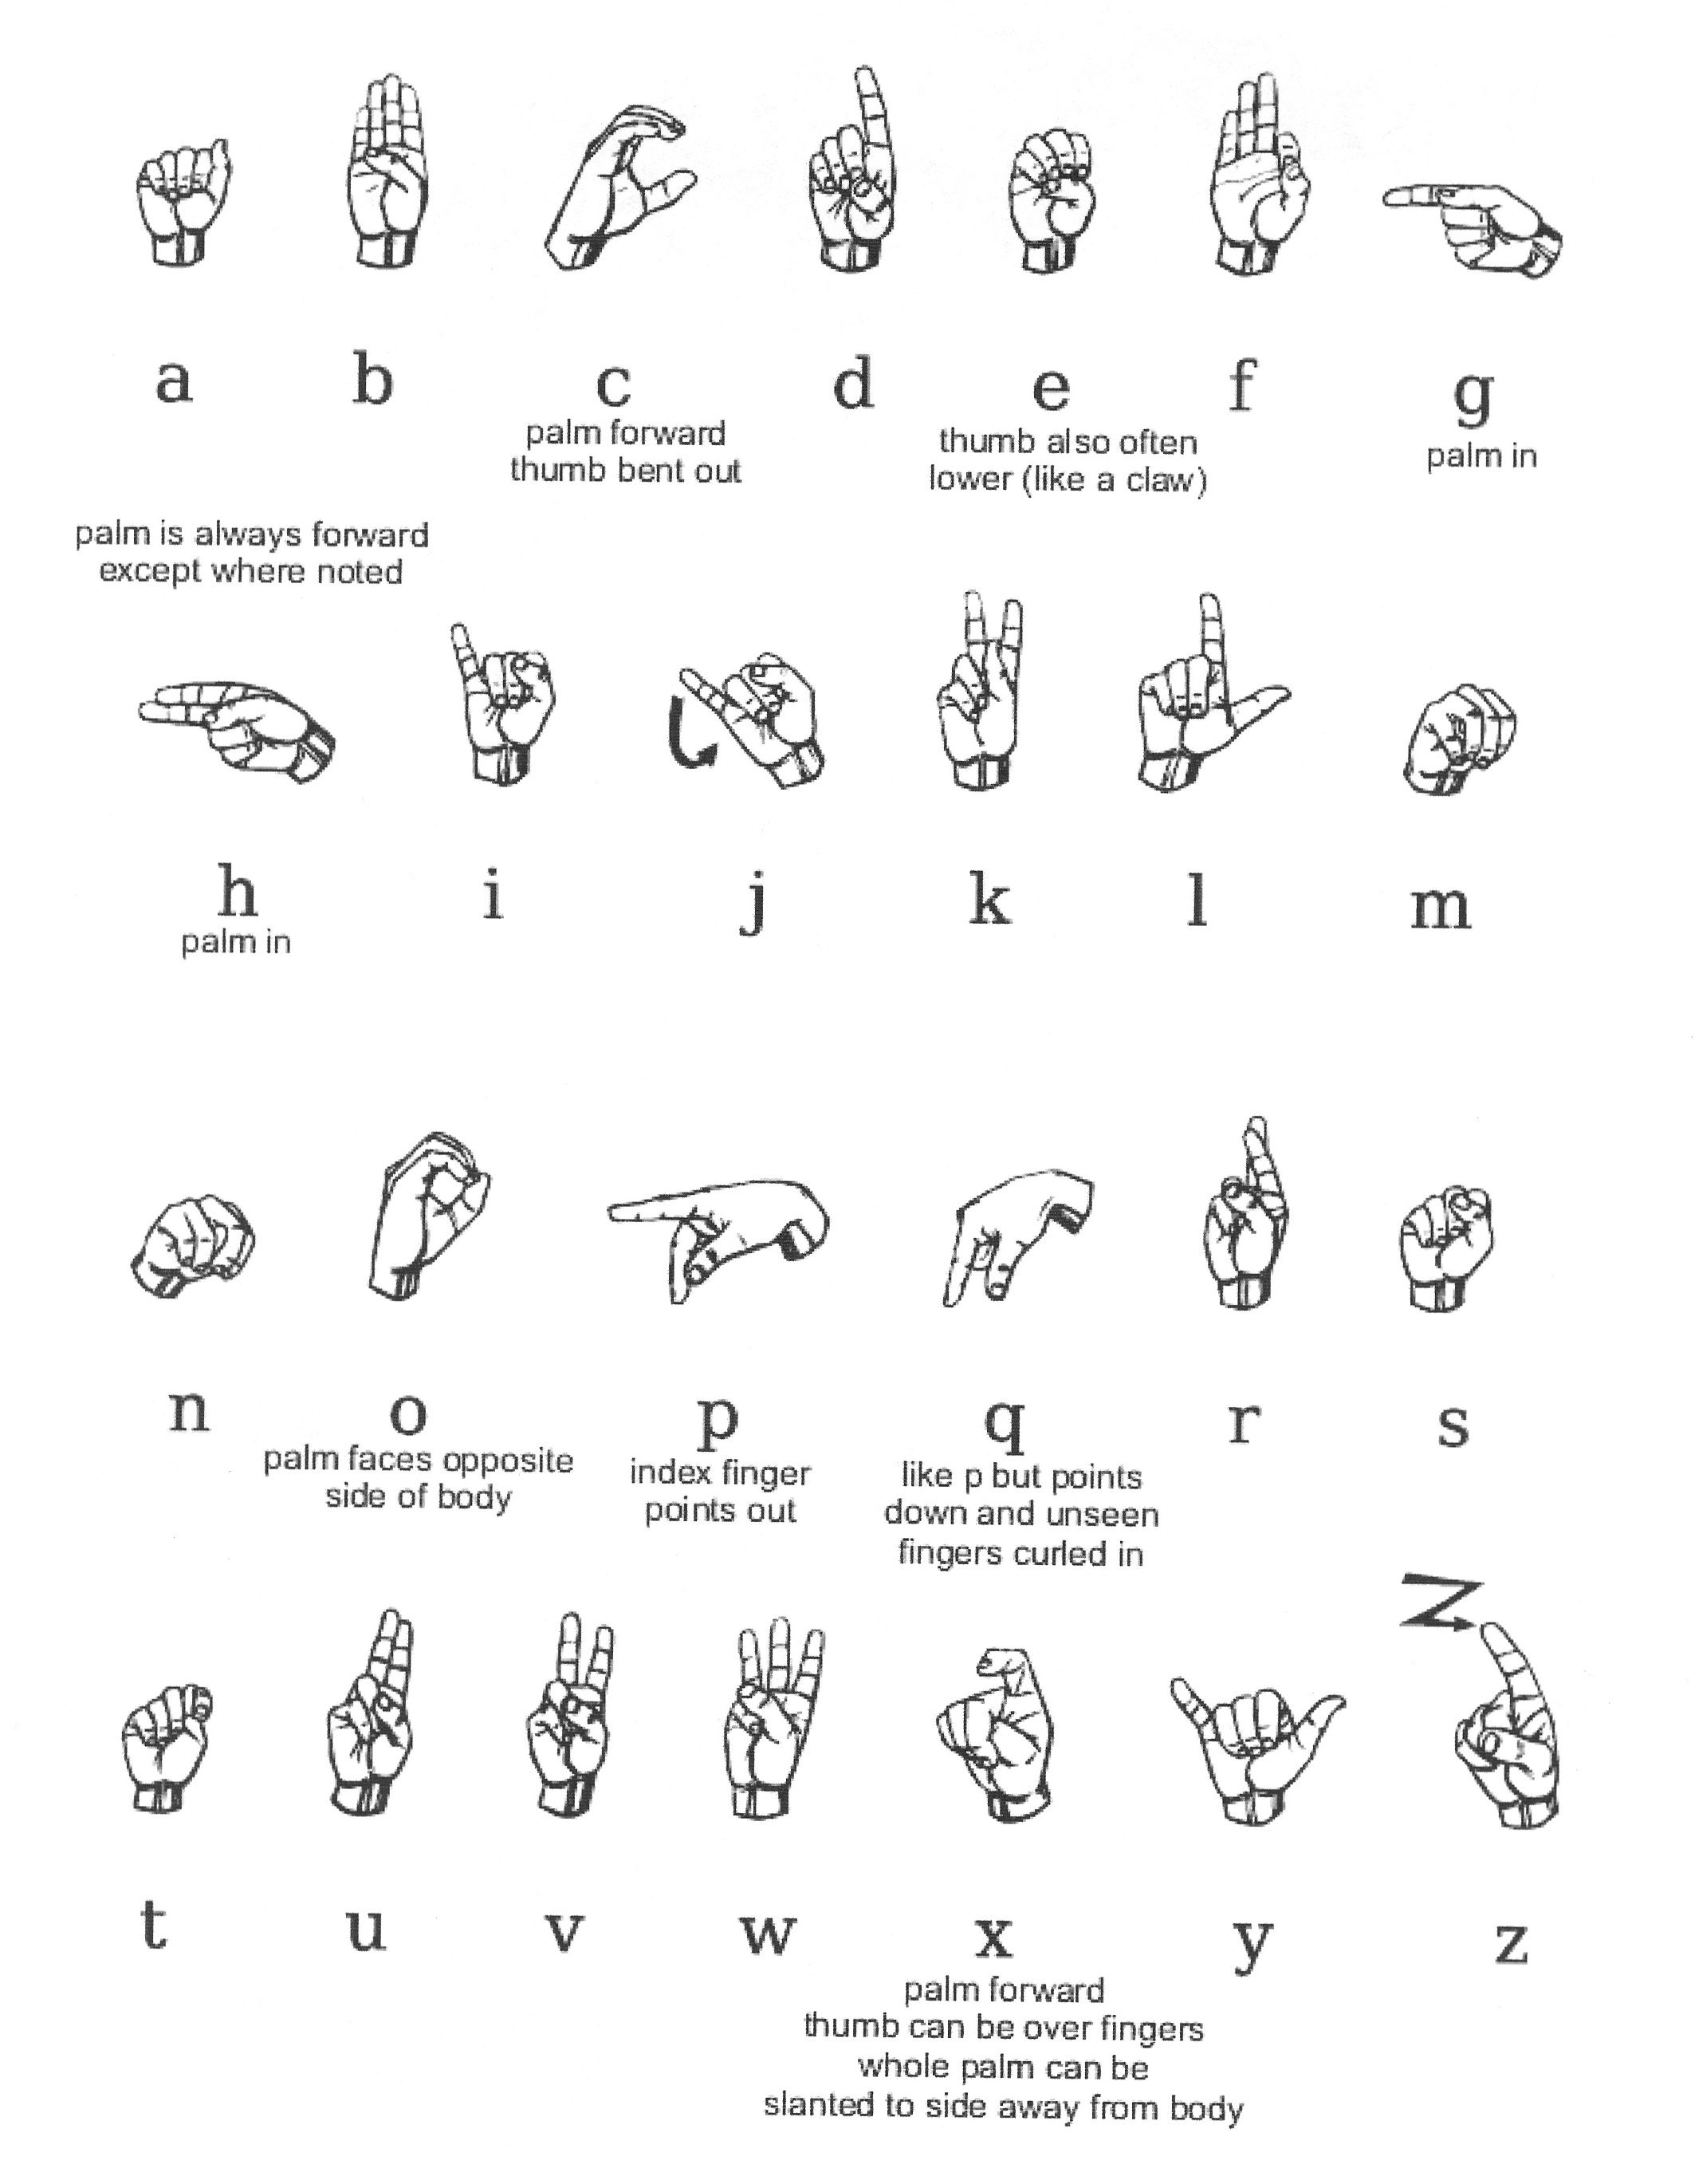

Slide 10
Questions
How
What
When
Where
Who
Why

Slide 11
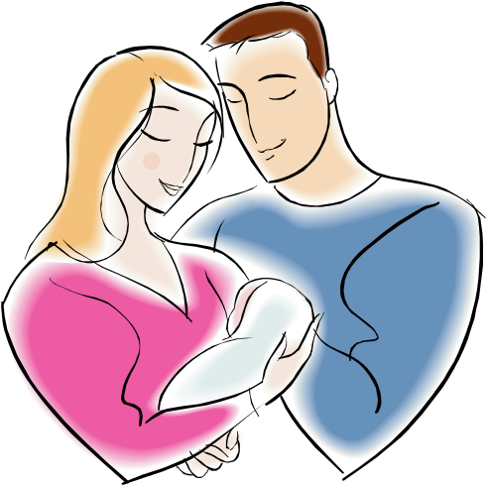
Family
Father
Mother
Son
Daughter
Brother
Sister
Grandpa
Grandma
Baby

Slide 12

Medical Emergency
Hospital
Identification
Hurt/Pain
Blood
Headache
Accident
Suffer
Shocked
Weak
Blood Pressure

Slide 13

Medical Emergency
Dizzy
Broken
Sprain
Doctor/Nurse
Breathe
Heart
CPR
Allergy

Slide 14

Emotion
Frustrated
Hate
Like
Sorry
Alright
Good
Bad

Slide 15

Emotion
Happy
Sad
Afraid/Scare
Feel
Fine
Tired
Sick

Slide 16
Common Signs
Address/Live
Call
Careful
Deaf
Do Not
Finish
Happen
Help
Home
License
Lost

Slide 17
Paper/Write/Pen
Please
Problem
Show
Sit
Snow Ski
Snow
Snow boarding
Speeding/Fast
Stand
Stay
Stop
Thank You
Time

Slide 18
Understand
Walk
Water
What’s Wrong
Yes
Avalanche
Now/Today
Fire
Follow
Food/Eat
Go
Move
Need
No

Slide 19
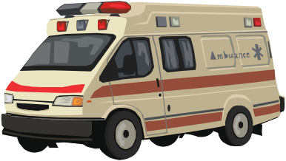
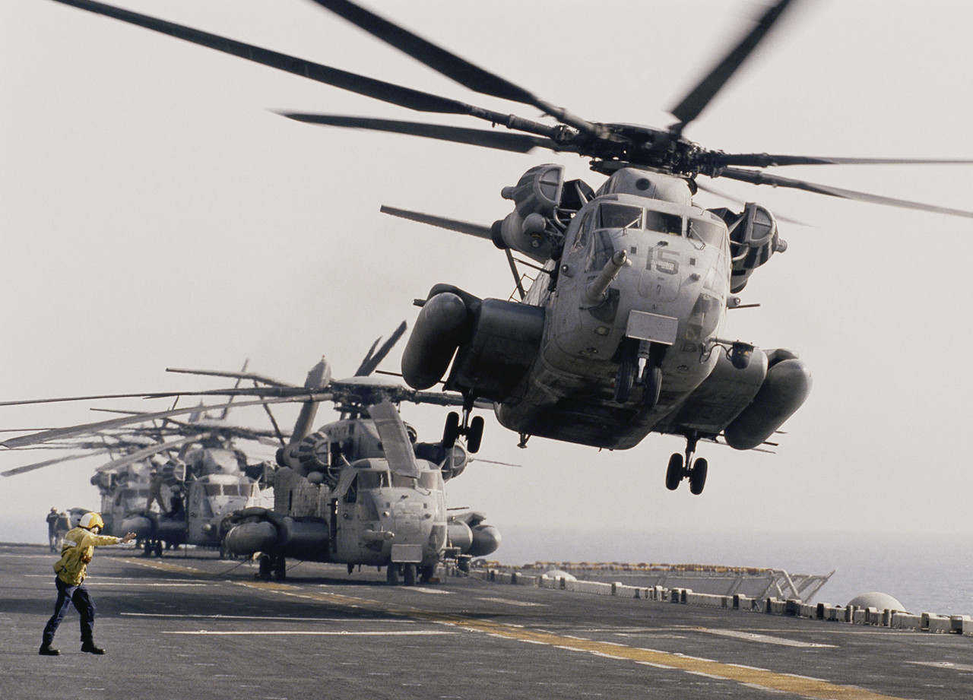


Transportation
Airplane
Helicopter
Car
Truck
Ambulance
Snowmobile
Chair Lift
Bus

Slide 20
Information from Internet
ASLPRO.com
ASL.MS.com
Singingonline.com
Lifeprint.com

