Slide 1

Animation by Adaptation
Michael Gleicher
Graphics Group
Department of Computer Sciences
University of Wisconsin – Madison
http://www.cs.wisc.edu/graphics

Slide 2
The Dream:
Animation for Everyone!
Animation is great
  Expressive, appealing, …
  Flexibility and control
But it is still the realm of experts
  Non-experts need different tools
  Not the same as making it easier for experts

Slide 3
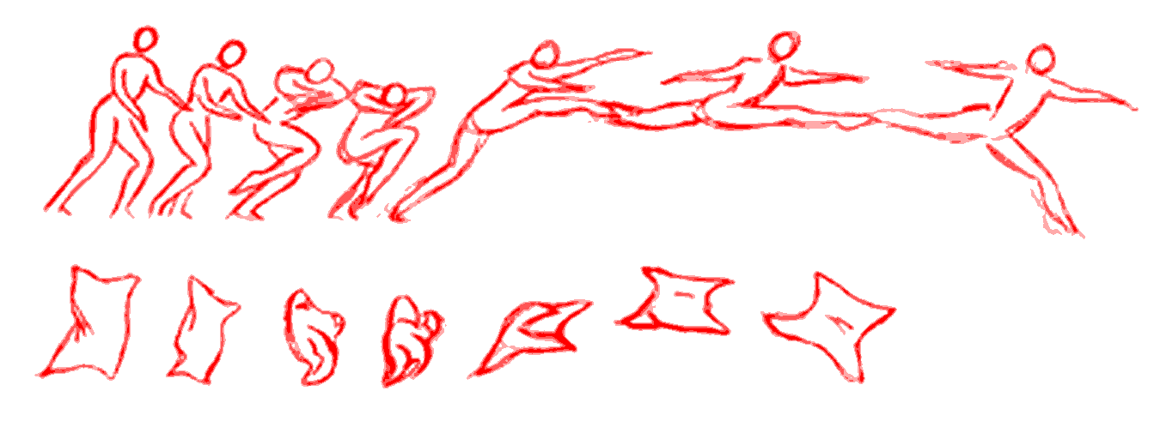
The Plan…
Create animation by re-use
Easier to beg, borrow, steal, buy, …

Slide 4
The Challenge…
Specific Action
Specific Character
different sized
character
doesn’t fit
hand is
not here
Edit motion to meet new needs
Retarget motion to new character

Slide 5
The Talk
The problem of motion
Creating motion
Motion editing
Our work on motion editing
What’s next

Slide 6
Why focus on motion?
It is the heart of animation
It’s the most unique aspect of animation
It’s the thing most people have the least experience with
It’s the thing that most interests me

Slide 7
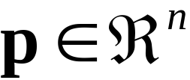
What is a motion?
Animated Character
Pose or Configuration
  parameters in a vector
Examples are articulated figures (humans)
  trees of rigid links
  center + joint angles
  nothing specific about methods
θ
θ
θ
θ
(x,y)
θ
θ
θ
p = {x,y,θ1,θ2,θ3,...}

Slide 8
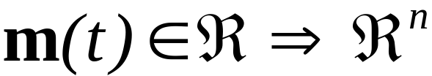
What is a motion (2)
A motion maps times to configurations
Vector-valued, time-varying signal
Representation comes from creation
  typically interpolation
  may not be convenient for editing
signal (p)
Time (t)

Slide 9
Three main ways to make motion
Create it by hand
Compute it
Capture it from a performer
  And increasingly…
Re-use an existing motion
  (don’t make it at all)

Slide 10
Creating Motion by Hand:
Keyframing
Skilled animators place “key” poses
  Computer “in-betweens”
Requires incredible amounts of talent
  But can be done extremely well
Verdict: Produces the highest quality results, at a very high cost

Slide 11
Computing Motion:
Procedural and Simulation
Define algorithms to create motions
Ad-hoc rules, or simulate physics
Physics provides realism
But how do you control it?
Verdict: Good for secondary effects, not for characters (yet)

Slide 12
Motion Capture and Performance Animation
Use sensors to record a real person
Get high-degree of realism
  Which may not be what you want...
Possibility for real-time performance
Verdict: Good for realistic human motions. Scary to animators.

Slide 13
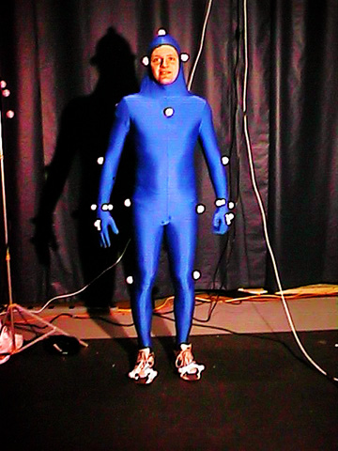
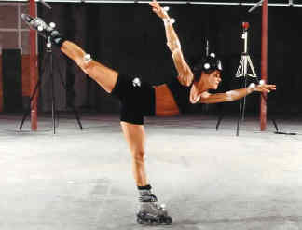
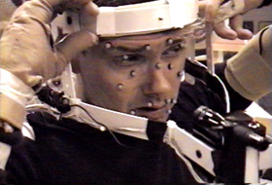
Motion Capture Technology:
Optical Tracking
User markers and special cameras
Tracking + Math

Slide 14
Motion Capture Technology:
Video
An interesting and open problem…
Limited information
  But seemingly enough
Problem can be arbitrarily hard
  Or easy – if you make assumptions
Video is surprisingly bad

Slide 15
Motion Editing
Once you have the motion, now what?
Change something about a motion
  Character
  Environment
  Mood
  Action
  …

Slide 16
Transformation Basics
Change what isn’t important, retain what is
Hard to define what is important
  high-level properties
  motion specific
Stick to what’s easy to define
  geometric constraints
  signal characteristics
  framework for better metrics later

Slide 17
Transformation as Constrained Optimization
Find a motion that…
  1. Meets any specific requests
  2. Keeps any specific characteristics of the original
  3. Is as similar as possible to the original
Naturally posed as constrained optimization
  subject to meeting the constraints (1 and 2) minimize some objective (3)

Slide 18
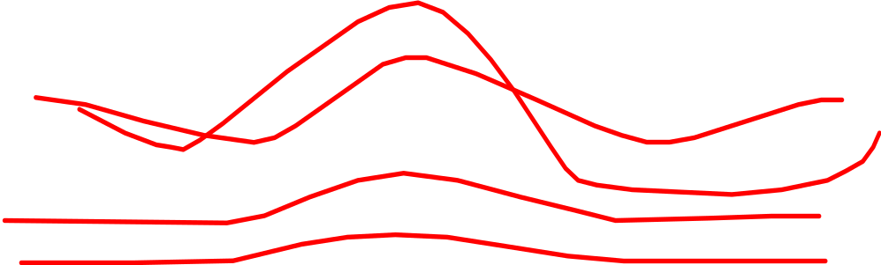
Spacetime Constraints
Consider all constraints simultaneously
  NOT frame at a time
Solve for motions
  “best” motion that meets constraints

Slide 19
Basic Idea 1: Constraints
Exact parameter values may not be important
Geometric constraints often are important

Slide 20
Basic Idea 2: Frequency Content
High frequencies (abrupt changes) are significant and noticeable
Altering high-frequencies changes motions
Adaptations should avoid disturbing high frequencies

Slide 21
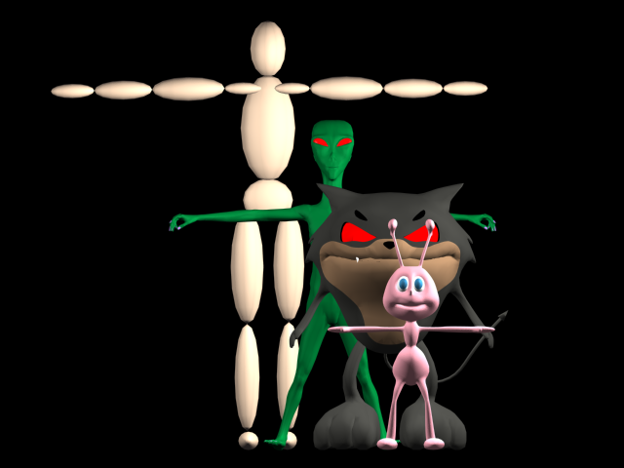
Retargetting Motion to New Characters
Goal: one motion, a cast of characters
Focus on similar structure

Slide 22
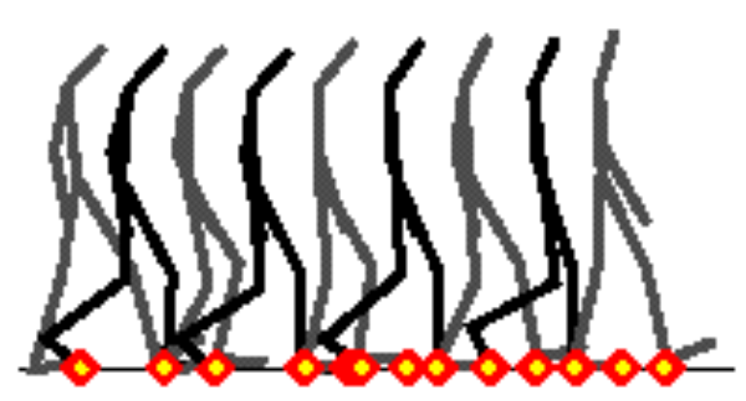
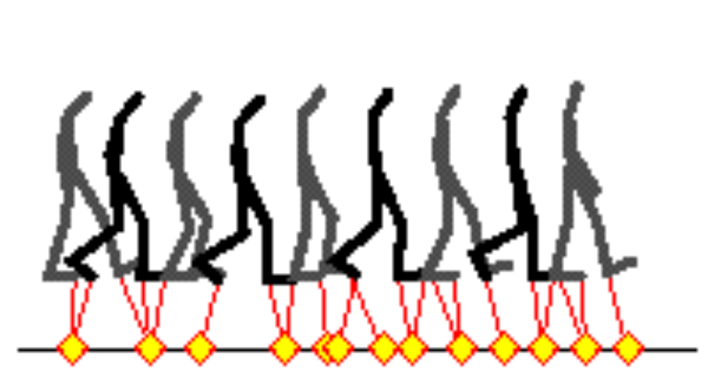
Retargetting Recipe
1. Define Constraints
2. Apply to new character

Slide 23
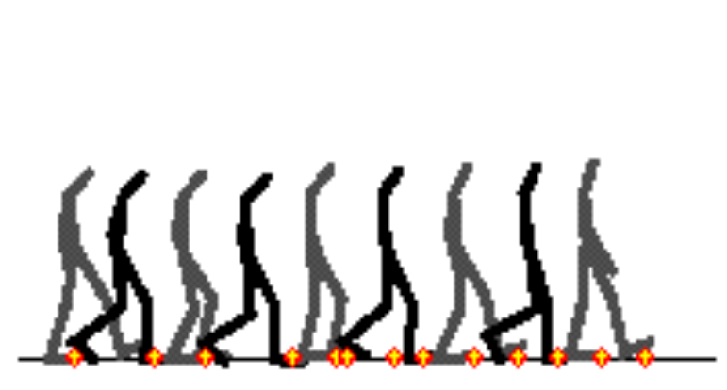
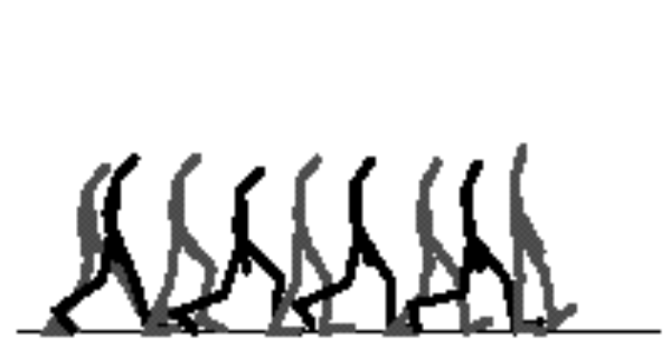
Retargetting Recipe
3. Approximate Answer
4. Solve constraints (band-limited adaptation)

Slide 24
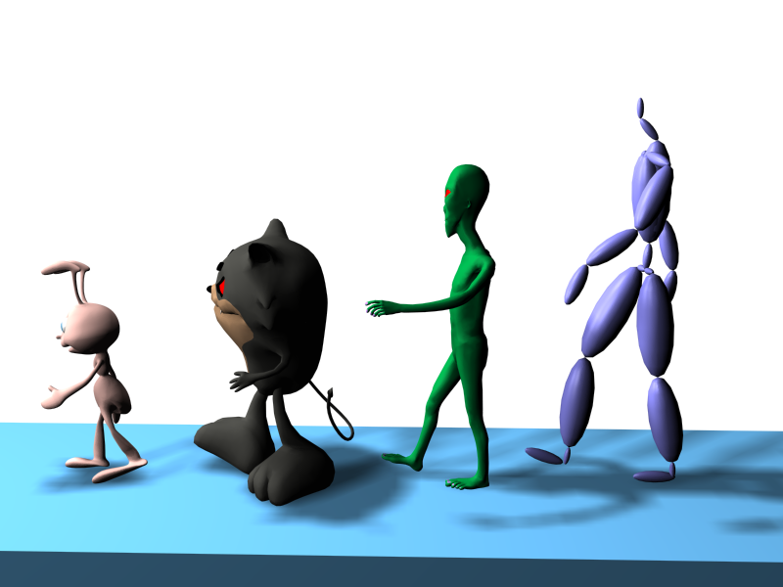
Retargetting Results

Slide 25
Other Editing Tricks
Contraint-based Editing
Motion Path Editing
  Abstract the “path” of a motion
  Alter the path, preserve details of the motion

Slide 26
Wins and Losses of Spacetime
Fast, practical
  Linear complexity?
Solves real problems
Flexibility in:
  Spatial Constraints
  Objective Functions ?
  Temporal Constraints ?
Widely applicable
Nice results
Hard to implement
Poor integration
Off-line
No guarantees
Spatial constraints not enforced
Flexibility not exploited
Rely on constraints

Slide 27
Is there an alternative?
Need to deal with spatial and temporal constraints
Don’t want the messiness of “whole motion” computation
Handle spatial and temporal constraints separately!

Slide 28
Per-Frame IK + Filter (PFIK+F)
IK per frame to solve spatial constraints
  But this messes up temporal constraints
Filter changes to enforce temporal constraints
  But this messes up spatial constraints
Iterate until converges, or …

Slide 29
PFIK+F vs. Spacetime
Fast, practical
Solves real problems
Flexibility in:
  Spatial Constraints
  Objective Functions (?)
  Temporal Constraints (?)
Widely applicable
Nice results
Yes! (requires fast IK)
Yes!
  (depends on IK)
  (depends on IK)
  (limited, unexplored)
Yes!
Um, it’s a matter of taste, and IK quality

Slide 30
PFIK+F vs. Spacetime
Use standard pieces!
Use standard pieces!
Choice in which last
Solve spatial constraints last
Need good IK
Hard to implement
Poor integration
Off-line
No guarantees
Spatial constraints not enforced
Flexibility not exploited
Rely on constraints

Slide 31
My PFIK+F solver
Use pieces I have lying around
Non-linear optimizing solver for IK
FIR linear filters for temporal constraints
Propagation of results for temporal coherence

Slide 32
Downsides of PFIK+F?
No global decisions
  Doesn’t handle “don’t cares” as well
  Order dependence
  No interframe constraints
Reliance on quality of IK solver
Not necessarily faster (or slower)

Slide 33
Animation by Adaptation!
Motion editing enables libraries of motion
As editing evolve, motion re-use becomes more possible
Increasingly practical to create motions by adapting old ones

Slide 34
What’s next?
Graphics group projects
Video Motion Capture
Stylized rendering
Virtual Videography
User Interface for 3D Applications
Visualization

Slide 35
What’s next?
Graphics group projects
Practical issues in Motion Editing
Mix-n-match motion
  Transitions
  Motion Databases
Dynamic Applications
Automatic Contraint Detection
Improved Motion Retargetting

Slide 36
Thanks!
UW Graphics Gang
Mainframe Entertainment, House of Moves Studios, Digital Domain
This research is supported by:
Microsoft, Intel, Pixar, IBM
NSF Career Award

