Slide 1
Guide
When you complete to write this doc, please delete this page.
All green and Italic font(e.g., like this) are for guidance. When you write your own contents, please delete the guide comments.
All required item should be filled. If not, the app testing will be rejected.
If your app has “Quiz” part, please provide ‘answer sheet’. Your app will be tested much easier and faster.

Slide 2
(App_name) Description
(CP_name)

Slide 3
Revision History
Version | Date | Description | Author
1.0 | 2012.01.01 | Description for Document Reason for changes | Author_name

Slide 4
Contents
UI Structure
Usage Scenario
Menu & function description
Key policy
How to change languages

Slide 5
UI Structure
Whole UI Structure
Please draw or display your whole UI structure here.
Next 2 slides are samples. You can choose anyone.
Tree structure, flow graph, or depth navigation

Slide 6
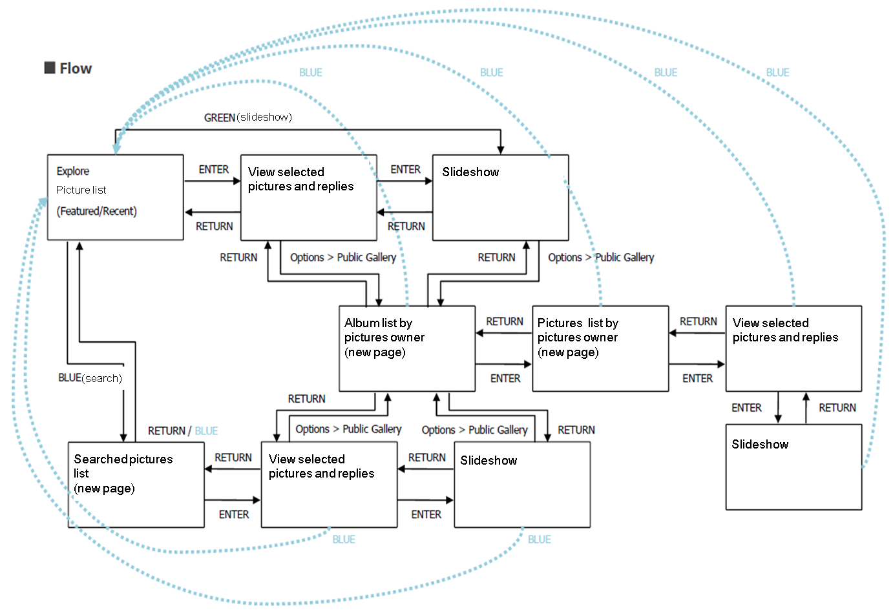
UI structure – sample1(flow graph)

Slide 7
UI Structure – sample2(depth navi.)
1st depth
2nd depth
3rd depth
4th depth
5th depth
Picture list
View selected pictures and replies
Slideshow
Album list by pictures owner
Picture list by pictures owner
View selected pictures and replies
Slideshow
Searched pictures list
View selected pictures and replies
Slideshow

Slide 8
Usage Scenario
All steps for using app should be described.
Especially, if you have log-in/Activation or payment system on your app, it should be handled on usage scenario. Testers will refer the scenario and it will be very helpful to test.

Slide 9
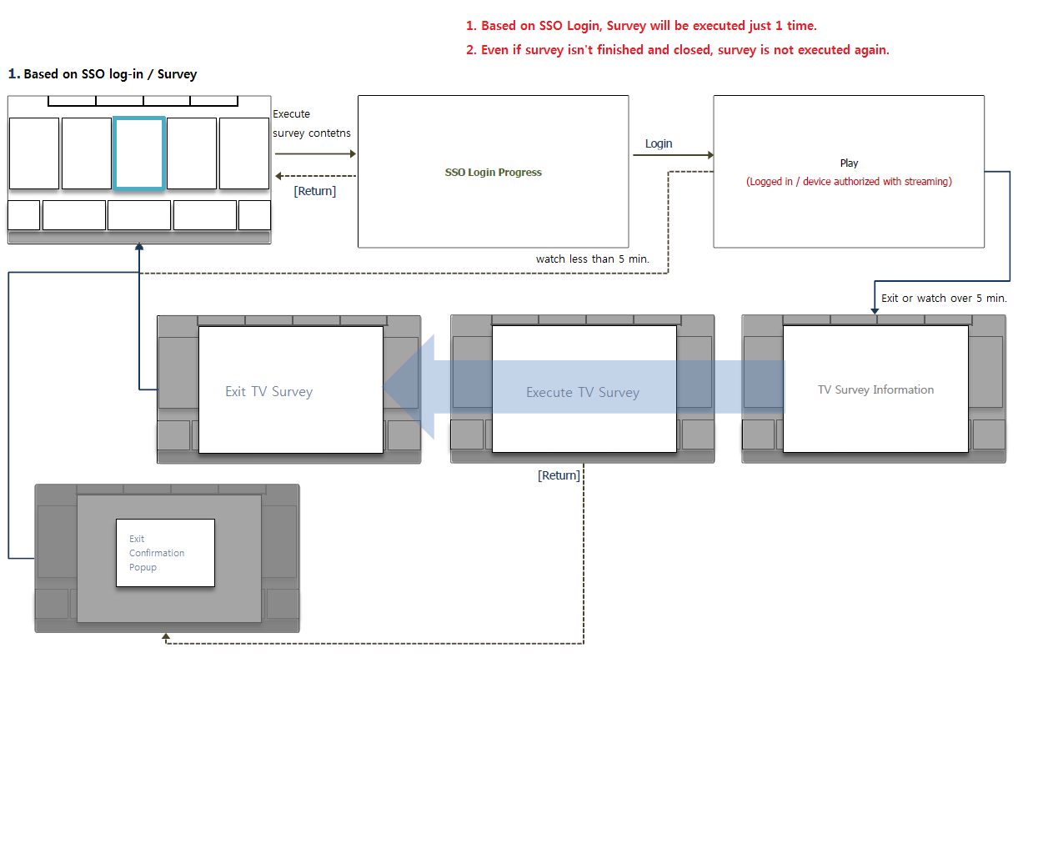
Usage Scenario – sample
It’s a sample of log-in function. Make your usage scenario refer to below sample.(It’s only example)

Slide 10
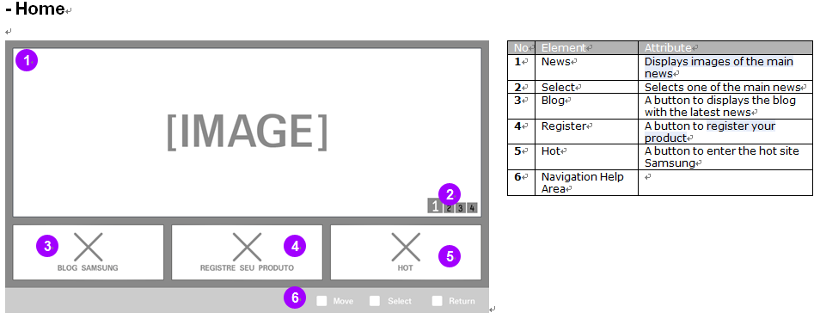
Menu & function description
Menu& function description with screen shot(sample)

Slide 11
Key Policy - sample
If you have your own key policy on your app, please describe it.
Button | Action | Remarks
ENTER | Change window screen to full screen or full screen to window screen.
Ch. Up/Down | N/R
UP/DOWN | N/R
LEFT/RIGHT | Move highlight to left or right
YELLOW | View information
RETURN | Move to previous page | Samsung Mandatory
EXIT | Close the app and show broadcasting channel | Samsung Mandatory
RETURN/EXIT | In case of Game App, if game is terminated, the exit popup should be displayed. | Samsung Mandatory

Slide 12
How to change languages
Items | Contents
How to change languages | If multi languages are supported, describe how to check multi languages on the App. If not, ignore this box. (e.g.) change country setting to Spain on SMART HUB (e.g.) change OSD Language setting to German etc..

