Slide 1
IoT-Based Smart Medicine Dispenser to Control and Supervise Medication Intake
WISHWell 2020 : 10th International Workshop on Intelligent Environments Supporting Healthcare and Well-being
Gleiston Guerrero Ulloa
Miguel J. Hornos
Carlos Rodríguez Domínguez
Ma. Mercedes Fernández Coello

Slide 2



INTRODUCTION
IoT-Based Smart Medicine Dispenser to Control and Supervise Medication Intake
An estimated 25% of the elderly population does not intake their medication according to the professional prescription.
We present a system consisting of a smart medicine dispenser and a mobile application for its conﬁguration and management.
Population ageing is a worldwide concern, and One of the side its effects is the widespread impact of many chronic diseases and conditions.
Notes:
Population ageing is a worldwide concern, due to the system-changing effects that it implies: well-being and social policies, economical sustainability, availability of public services, etc.
One of the side effects of the population ageing is the widespread impact of many chronic diseases and conditions: diabetes, high blood pressure, heart conditions, cognitive impairment, etc. In that sense, researchers are proposing Internet of Things (IoT) based systems and smart environments to help elderly people to deal with their consequences. One of the aids that these systems can offer is to remind and ease medication intakes.
An estimated 25% of the elderly population does not intake their medication according to the professional prescription. A wrong medication intake can lead to many negative situations, such as health worsening, increased amount of hospitalizations, or even a premature death.
We present a system consisting of a smart medicine dispenser and a mobile application for its conﬁguration and management. The dispenser emits a sound and lights up an LED to alert the patient that it is time to take his/her medication. When he/she is close to the smart medicine dispenser, it will identify him/her through facial recognition and deliver the prescribed medication. If the medication is not removed during the expected timings, a notiﬁcation is sent to the caregiver through the mobile application so that she/he can act consequently. The mobile application can also deliver reminders to those patients able to use a smartphone.

Slide 3
RELATED WORKS
IoT-Based Smart Medicine Dispenser to Control and Supervise Medication Intake
Comparison of the medicine dispensers analysed in the literature review that we have carried out
Table 1. Comparison of existing dispensers
Reference | Dispensation | Programing | Detection | Identification | Reminders | Alerts | Notificacions | Multiple Patients
[6] | A | ✘ | ✘ | ⌨️ | - | 📱 | ✘ | ✘
[8] | A | ✘ | ✘ | - | ✘ | ✘ | ✘ | ✘
[14] | A | ✔ | ✘ | - | 📱,♫,☼ | 📱 | ✔ | ✘
[15] | - | ✔ | X | - | ✉,♫ | ✉ | ✔ | ✘
[16] | M | ✔️ | ✔(IR) | ✘ | ✉,♫ | ✉ | ✘ | ✘
[17] | A | ✔ | ✔(FP) | ✔ | ♫ | - | ✔ | -
[18] | A | ✔ | ✔(US) | ✘ | ♫, ✉,@ | ✘ | ✘ | ✘
[19] | M | ✔ | ✘ | - | ☼ | ✉ | ✘ | ✘
[20] | A | ✔ | ✘ | - | ☼, ♫ | ✘ | ✔ | ✘
[21] | - | ✘ | ✔(US) | ✘ | 📱 | 📱 | ✔ | ✘
None of the systems analysed meet all the aspects that have been considered.
Notes:
This table summarizes the features we have evaluated in existing dispensers. As none of them includes all the features that, in our opinion, they should have, we decided to work on the proposal that we present in this paper.

Slide 4
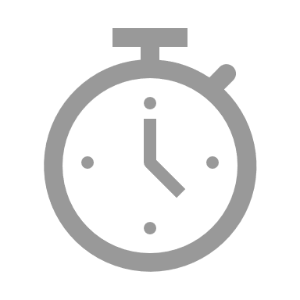


Features of the Proposed System
IoT-Based Smart Medicine Dispenser to Control and Supervise Medication Intake
HARDWARE
SOFTWARE
Network of sensors and actuators.
Raspberry Pi B single-board computer.
Mobile application.
03
01
EVALUATION
We are currently evaluating with a real patient who is undergoing medical treatment for diabetes.
02
METHODOLOGY
Test-Driven Development Methodology for IoT-based Systems (TDDM4IoTS).
Notes:
HARDWARE: The system we propose is made up of sensors and actuators with a gateway implemented in a Raspberry Pi B single-board computer.
These hardware components are integrated with a mobile application that allows the system data management and that provides an intuitive interface to be used by the end users, i.e. the patients and/or their caregivers
METHODOLOGY: We have followed the Test-Driven Development Methodology for IoT-based Systems (TDDM4IoTS), which is an appropriate agile methodology for the development of IoT-based systems. TDDM4IoTS considers the inherent aspects of this type of systems, such as its characteristic hardware (sensors, actuators,...) and its conﬁguration, as well as the eventual (semi)automatic generation of part of the software code used for data processing and interaction with the user.
EVALUATION: We have developed a ﬁrst prototype of the system, which we are currently evaluating with a real patient who is undergoing medical treatment for diabetes. This person must take the medications, which also details the doses and timetable in which she has to take them. Given that it would be necessary for more patients and their caregivers to evaluate the developed prototype, it is still too early to guarantee the success of our proposal.

Slide 5
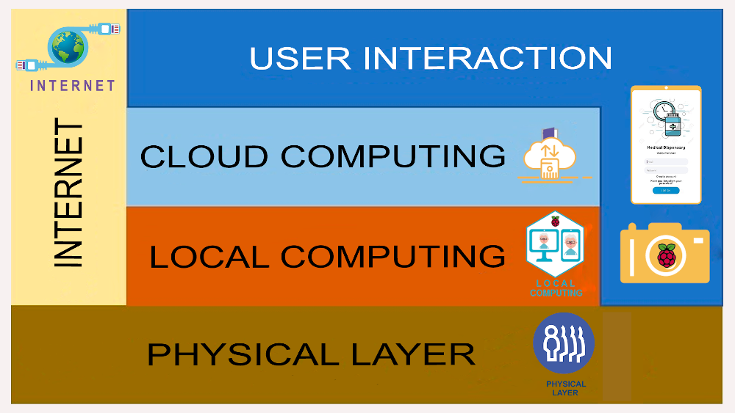
System Architecture
IoT-Based Smart Medicine Dispenser to Control and Supervise Medication Intake
This architecture enables to interconnect sensors and actuators, and also to emit remote notiﬁcations from Cloud computing servers. Furthermore, it will allow a future interaction with other IoT devices.
Notes:
This architecture enables to interconnect sensors and actuators, and also to emit remote notiﬁcations from Cloud computing servers. Furthermore, it will allow a future interaction with other IoT devices.
INTERNET: Is used for cloud storage of all information and for remote processing when local devices do not have enough resources. All notiﬁcations intended for users are issued from a remote system, being also essential to use the Internet for this.
PHYSICAL LAYER: It is made up of the sensors and actuators that are embedded into the dispenser. [HC-SR501 (PIR) sensor, Raspberry Pi Camera Board v1.3., servomotors, Arduino Uno R3 microcontroller board. LCD screen, in that compartment lights up and the buzzer emits a sound to alert the use].
LOCAL COMPUTING: This layer registers patients by detecting their faces and taking the necessary photographs to automatically identify them later on. A mobile app detects people’s faces using the Vision library in AndroidStudio and sends them to a Raspberry Pi 3 model B+.
CLOUD COMPUTING: We use RESTful cloud services for processing, storage and database management (speciﬁcally in PostgreSQL, version 10.8). In addition to storing information in the PostgreSQL database, a folder is created for each patient in which we store the photographs that are used for his/her later identiﬁcation.
USER INTERACTION: The dispenser works non-intrusively. Thus, when the PIR sensor detects any movement near the dispenser, the camera is activated to try to identify if the approaching person is a registered patient. The mobile app also serves for the caregiver to receive notiﬁcations about whether or not the patient has obtained the medications from the dispenser.

Slide 6
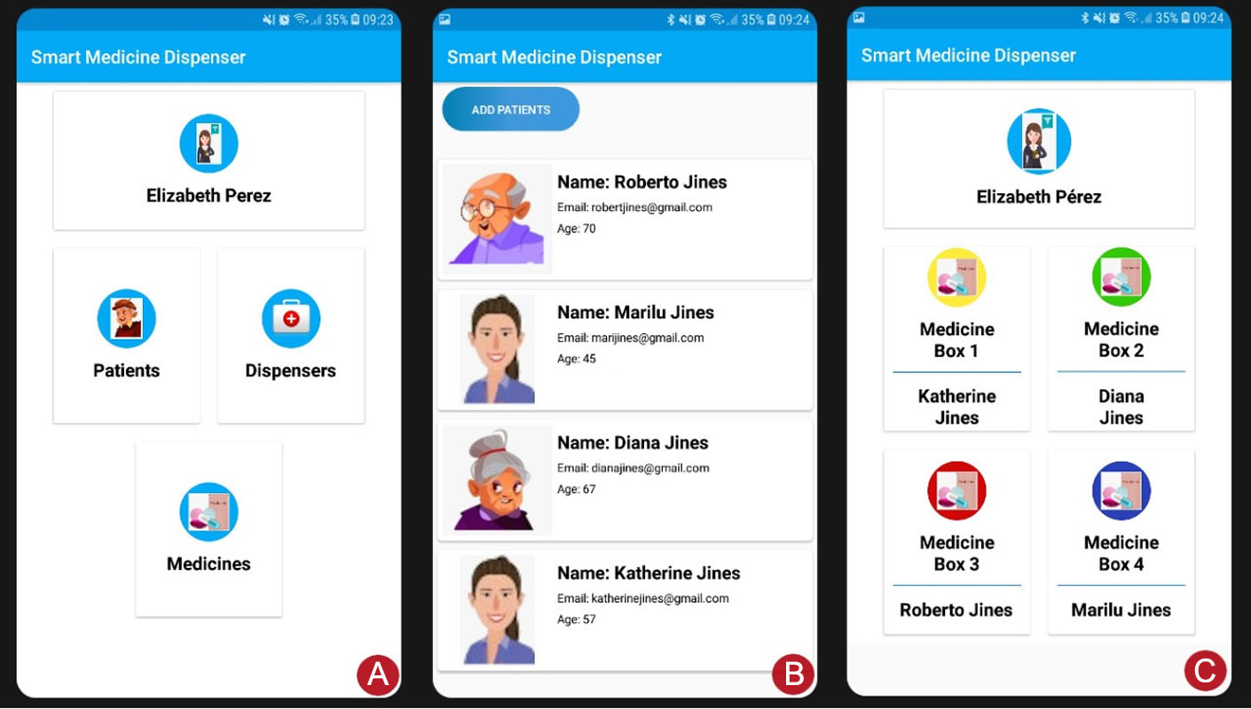
User Interaction
IoT-Based Smart Medicine Dispenser to Control and Supervise Medication Intake
A
Menu for the
Caregiver Proﬁle
B
Dispensers Option
C
Medicine Boxes
Option
Notes:
The mobile application that we have developed as part of the system that we are presenting can be used for several caregivers with their respective patients. In the captures we show the case of Elizabeth as a caregiver.
The one on the left shows the menu for the caregiver proﬁle. In it, the Patients option gives access to the list of patients who are in charge of the caregiver.
The central capture shows the registered patients and also allows to add new patients; the Dispensers option would show the list of nearby dispensers, being necessary to have the Bluetooth of the smartphone activated so that it can recognize them;
And the Medicine Boxes option displays the screenshot C, which shows bottom-lined buttons to manually dispense the medicine boxes from any of the (four) compartments.

Slide 7
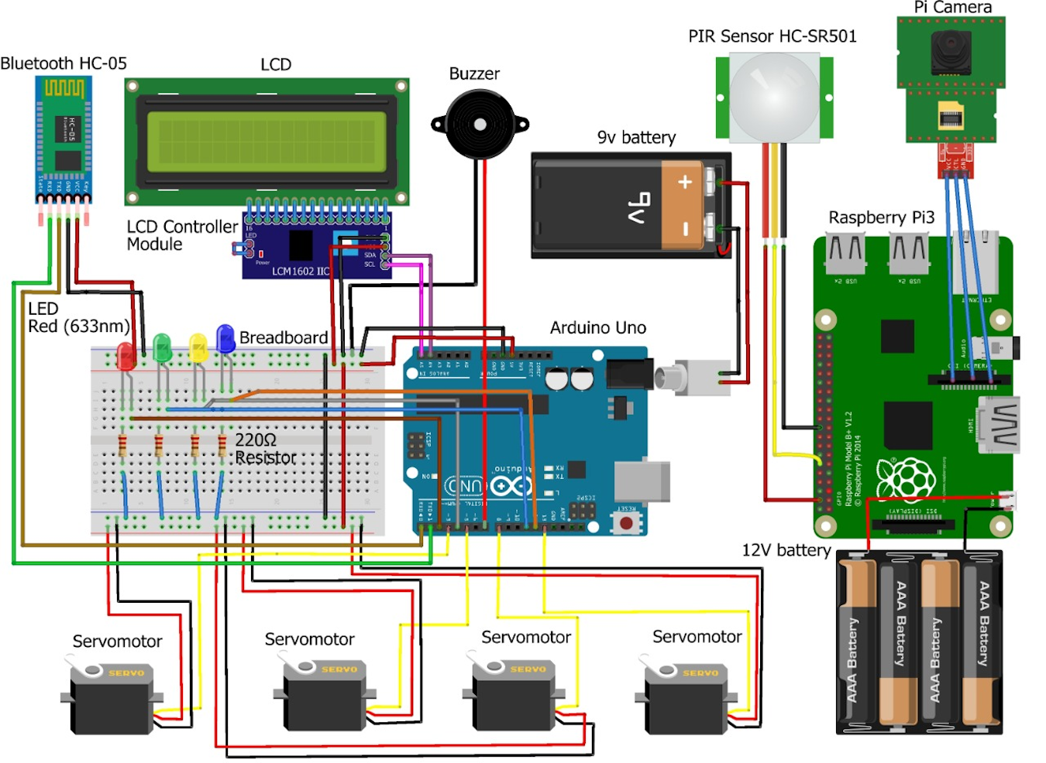
Design and Implementation Details
IoT-Based Smart Medicine Dispenser to Control and Supervise Medication Intake
Notes:
Here we show the elements used in the design and construction of the smart medicine dispenser and its interconnection. The smart dispenser can be placed in a fixed location, and thus, the batteries can be replaced by voltage sources directly connected to the public electricity supply.

Slide 8
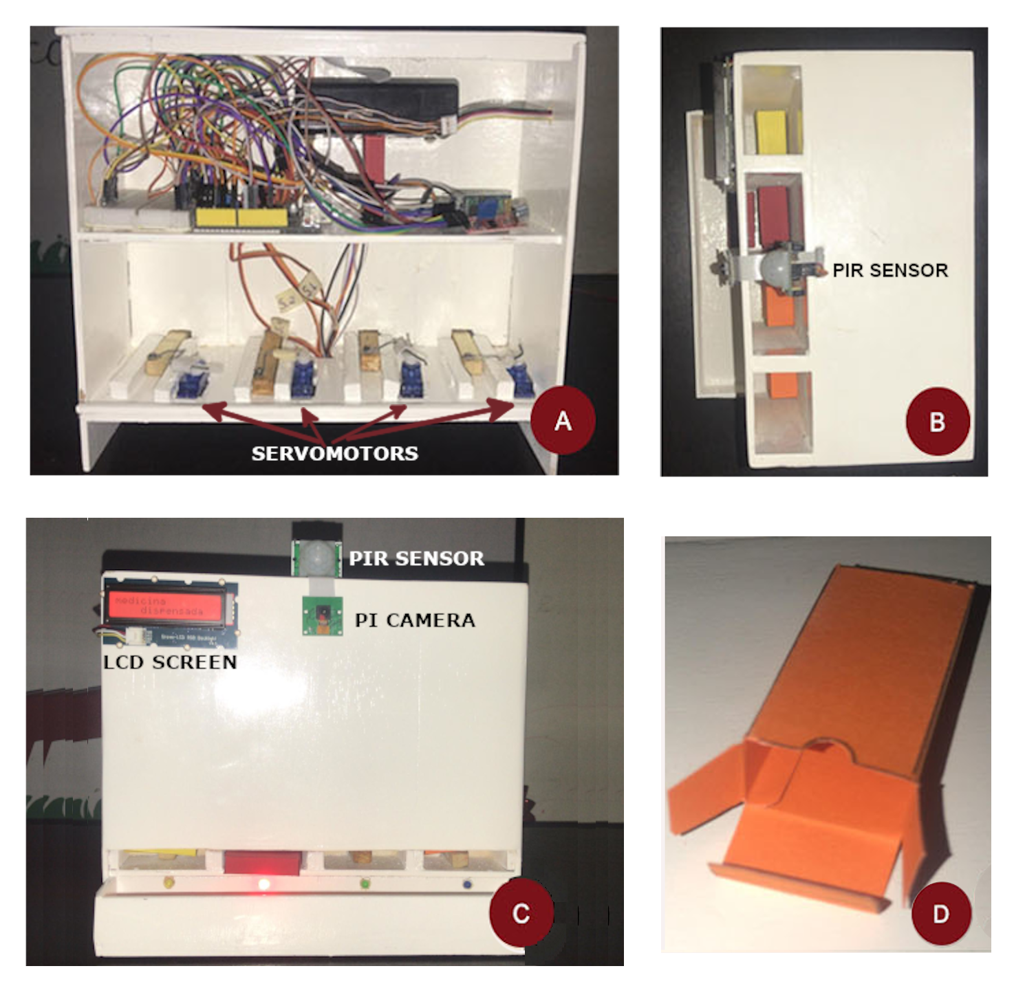
Design and Implementation Details
IoT-Based Smart Medicine Dispenser to Control and Supervise Medication Intake
BOXES
SHELVES
All the medicines that a patient must take at a certain time should be introduced in one of these boxes.
Shows the internals of the dispenser (with the back cover removed), where we can see two shelves.
SENSORS
COMPARTEMENTS
The Raspberry Pi B+ controls the PIR sensor and PI Camera. And Arduino board controls servomotors, the Bluetooth module and the LCD screen.
The dispenser, it has four vertical compartments.
Notes:
SHELVES: Shows the internals of the dispenser (with the back cover removed), where we can see two shelves. At the bottom one, there are four servomotors, which are in charge of activating a mechanism with a small rectangular piece that will push the medicine box at the bottom of the corresponding compartment towards the dispenser tray.
SENSORS: The Arduino board controls the servomotors, the Bluetooth module and the LCD screen so that each of these elements fulﬁls their function, while the Raspberry one manages the facial identiﬁcation using the camera, as well as the notiﬁcations through the LED lights and the sounds emitted by the buzzer.
COMPARTEMENTS: the dispenser, it has four vertical compartments. In each of them, we can place up to 12 small boxes (48 in total) like the one shown in the fourth photo.
BOXES: All the medicines that a patient must take at a certain time should be introduced in one of these boxes. Each box (whose dimensions are 2.5 cm X 2 cm X 1 cm) may have a different colour. .

Slide 9
Conclusions and Future Work
IoT-Based Smart Medicine Dispenser to Control and Supervise Medication Intake
We have presented a smart medicine dispenser that helps older people or people with a cognitive problem to take their medicine doses on schedule.
As for future work, we want to improve the proposed system.
Besides, the overall system performance will be evaluated after encrypting the whole patient database and face detection images.
Notes:
We have presented a smart medicine dispenser that helps older people or people with a cognitive problem to take their medicine doses on schedule. In addition, it allows caregivers to supervise that their dependents take their medications on time. Using a facial identiﬁcation mechanism, it recognizes the patients registered in the system and supplies Them with the medicines they should take just when needed.
As for future work, we want to improve the proposed system, closing the dispenser compartments so that they only open when the camera detects the face of the caregiver who must place the medicine boxes in them. This would make it safer.
Besides, the overall system performance will be evaluated after encrypting the whole patient database and face detection images inside the Raspberry Pi, so as to improve patient privacy. Finally, it is important to highlight that our system is currently in use by one real patient, whose feedback will be valuable to develop a reﬁned prototype.

Slide 10
Thank You!
Any Questions?

