Slide 2
INTRODUCTION
IoT-Based Smart Medicine Dispenser to Control and Supervise Medication Intake
Population ageing is a worldwide concern, due to the system-changing effects that it implies: well-being and social policies, economical sustainability, availability of public services, etc.
One of the side effects of the population ageing is the widespread impact of many chronic diseases and conditions: diabetes, high blood pressure, heart conditions, cognitive impairment, etc. In that sense, researchers are proposing Internet of Things (IoT) based systems and smart environments to help elderly people to deal with their consequences. One of the aids that these systems can offer is to remind and ease medication intakes.
We present a system consisting of a smart medicine dispenser and a mobile application for its conﬁguration and management. The dispenser emits a sound and lights up an LED to alert the patient that it is time to take his/her medication. When he/she is close to the smart medicine dispenser, it will identify him/her through facial recognition and deliver the prescribed medication. If the medication is not removed during the expected timings, a notiﬁcation is sent to the caregiver through the mobile application so that she/he can act consequently. The mobile application can also deliver reminders to those patients able to use a smartphone
INTRODUCTION

Slide 3
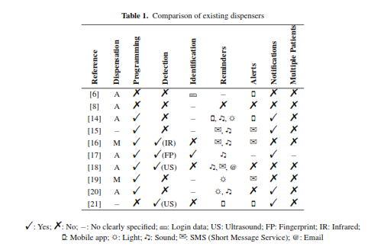
RELATED WORKS
IoT-Based Smart Medicine Dispenser to Control and Supervise Medication Intake
IoT is a lifestyle transforming computing paradigm
Hat can even lead to the fourth industrial revolution. However, in a comparison of some existing medicine dispensers, the conclusion was that most of the existing proposals do not rely on an Internet connection (i.e., they do not allow remote operation) and do not have any user interaction. Other works do not guarantee if it is the correct patient who really removes the medication from the dispenser.
shows a comparison of the medicine dispensers analysed in the literature review that we have carried out
None of the systems analysed meet all the aspects that have been considered. For example, all systems are intended for a single patient (per dispenser), except one, where it is not clearly speciﬁed for how many patients it is designed.

Slide 4
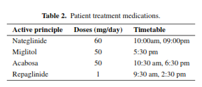
Features of the Proposed System
IoT-Based Smart Medicine Dispenser to Control and Supervise Medication Intake
HARDWARE
Methodology
EVALUATION
The system we propose is made up of a network of sensors and actuators with a gateway implemented in a Raspberry Pi B single-board computer.
These hardware components are integrated with a mobile application that allows the system data management and that provides an intuitive interface to be used by the end users, i.e. the patients and/or their caregivers
We have followed the Test-Driven Development Methodology for IoT-based Systems (TDDM4IoTS), which is an appropriate agile methodology for the development of IoT-based systems. TDDM4IoTS considers the inherent aspects of this type of systems, such as its characteristic hardware (sensors, actuators,...) and its conﬁguration, as well as the eventual (semi)automatic generation of part of the software code used for data processing and interaction with the user.
We have developed a ﬁrst prototype of the system, which we are currently evaluating with a real patient who is undergoing medical treatment for diabetes. This person must take the medications, which also details the doses and timetable in which she has to take them. Given that it would be necessary for more patients and their caregivers to evaluate the developed prototype, it is still too early to guarantee the success of our proposal.

Slide 5
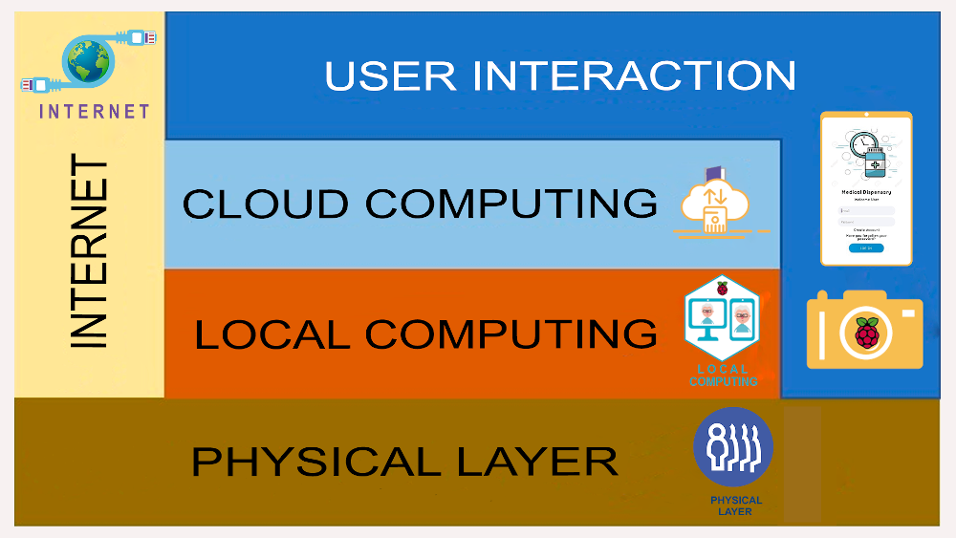
System Architecture
IoT-Based Smart Medicine Dispenser to Control and Supervise Medication Intake
This architecture enables to interconnect sensors and actuators, and also to emit remote notiﬁcations from Cloud computing servers. Furthermore, it will allow a future interaction with other IoT devices. Each of its layers are described below.

Slide 6


System Architecture
IoT-Based Smart Medicine Dispenser to Control and Supervise Medication Intake
Internet.
Is used for cloud storage of all information and for remote processing when local devices do not have enough resources. All notiﬁcations intended for users are issued from a remote system, being also essential to use the Internet for this.
Cloud Computing.
We use RESTful cloud services for processing, storage and database management (speciﬁcally in PostgreSQL, version 10.8). In addition to storing information in the PostgreSQL database, a folder is created for each patient in which we store the photographs that are used for his/her later identiﬁcation.
Physical Layer.
It is made up of the sensors and actuators that are embedded into the dispenser (more details and photos about it will be provided in the following subsection). [HC-SR501 (PIR) sensor, Raspberry Pi Camera Board v1.3., servomotors, Arduino Uno R3 microcontroller board. LCD screen, in that compartment lights up and the buzzer emits a sound to alert the use]
User Interaction.
The dispenser works non-intrusively. Thus, when the PIR sensor detects any movement near the dispenser, the camera is activated to try to identify if the approaching person is a registered patient. The mobile app also serves for the caregiver to receive notiﬁcations about whether or not the patient has obtained the medications from the dispenser.
Local Computing.
This layer registers patients by detecting their faces and taking the necessary photographs to automatically identify them later on. A mobile app detects people’s faces using the Vision library in AndroidStudio and sends them to a Raspberry Pi 3 model B+.

Slide 7
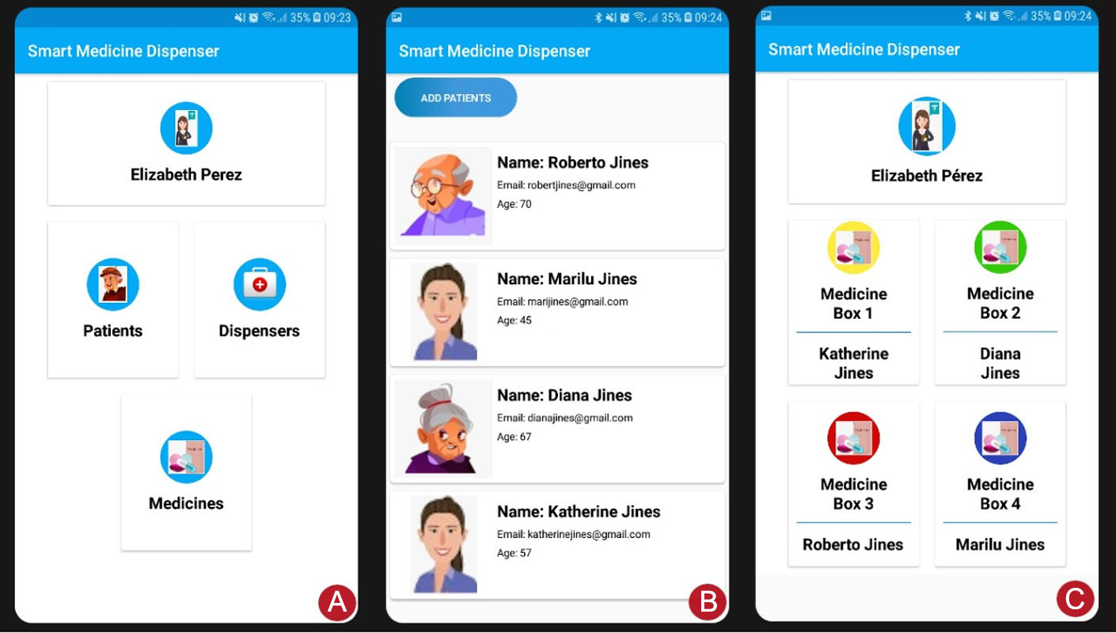
System Architecture
IoT-Based Smart Medicine Dispenser to Control and Supervise Medication Intake
User Interaction.
Shows some screenshots of the mobile app:
the one on the left (A) shows the menu for the caregiver proﬁle. In it, the Patients option gives access to the list of patients who are in charge of the caregiver.
As shown in the central capture (B), which also allows adding more patients; the Dispensers option would show the list of nearby dispensers, being necessary to have the Bluetooth of the smartphone activated so that it can recognize them;
And the Medicine Boxes option displays the screenshot (C), which shows bottom-lined buttons to manually dispense the medicine boxes from any of the (four) compartments.

Slide 8
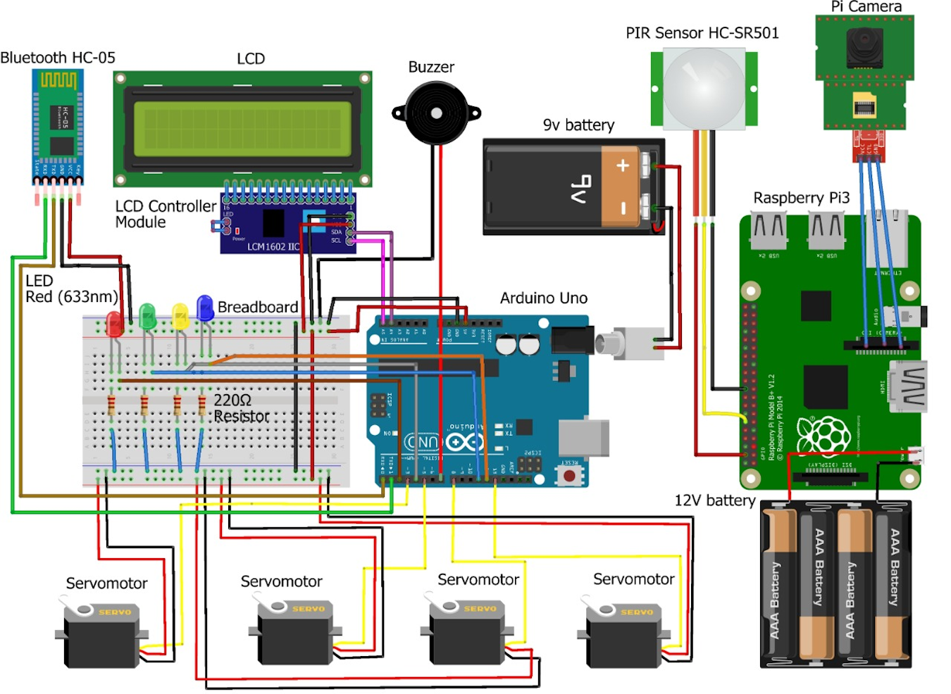
Design and Implementation Details
IoT-Based Smart Medicine Dispenser to Control and Supervise Medication Intake

Slide 9
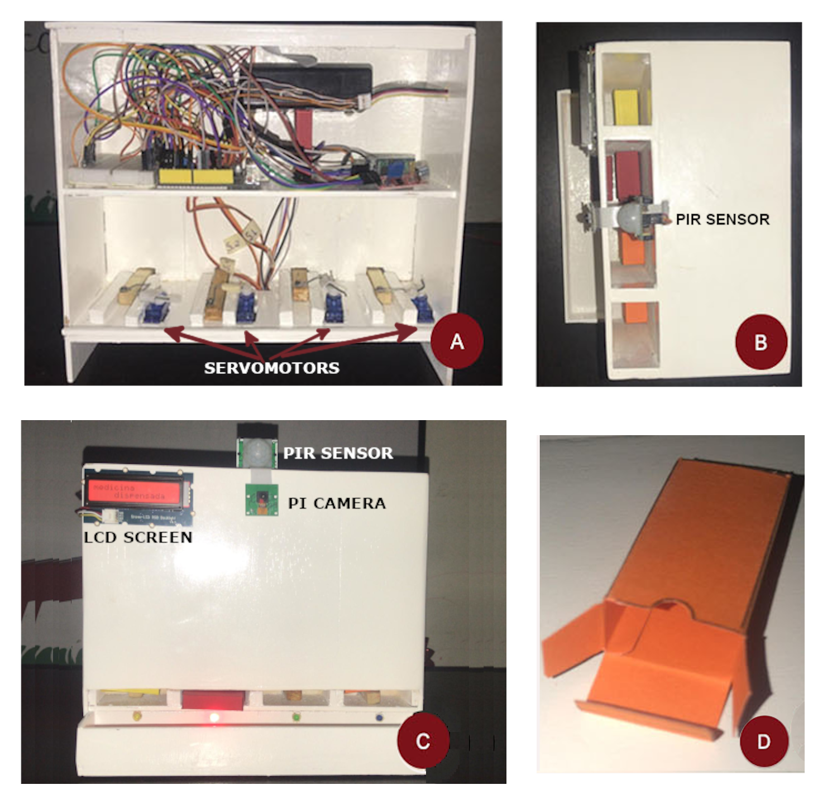
Design and Implementation Details
IoT-Based Smart Medicine Dispenser to Control and Supervise Medication Intake
BOXES
SERVOMOTORS
All the medicines that a patient must take at a certain time should be introduced in one of these boxes. Each box (whose dimensions are 2.5 cm X 2 cm X 1 cm) may have a different colour. .
Shows the internals of the dispenser (with the back cover removed), where we can see two shelves. At the bottom one, there are four servomotors, which are in charge of activating a mechanism with a small rectangular piece that will push the medicine box at the bottom of the corresponding compartment towards the dispenser tray.
PIR SENSOR
COMPARTEMENTS
The Arduino board controls the servomotors, the Bluetooth module and the
LCD screen so that each of these elements fulﬁls their function, while the Raspberry one manages the facial identiﬁcation using the camera, as well as the notiﬁcations through the LED lights and the sounds emitted by the buzzer
the dispenser, it has four vertical compartments. In each of them, we can place up to 12 small boxes (48 in total) like the one shown in the fourth photo.

Slide 10
Design and Implementation Details
IoT-Based Smart Medicine Dispenser to Control and Supervise Medication Intake
We have presented a smart medicine dispenser that helps older people or people with a cognitive problem to take their medicine doses on schedule. In addition, it allows caregivers to supervise that their dependents take their medications on time. Using a facial identiﬁcation mechanism, it recognizes the patients registered in the system and supplies Them with the medicines they should take just when needed.
As for future work, we want to improve the proposed system, closing the dispenser compartments so that they only open when the camera detects the face of the caregiver who must place the medicine boxes in them. This would make it safer.
Besides, the overall system performance will be evaluated after encrypting the whole patient database and face detection images inside the Raspberry Pi, so as to improve patient privacy. Finally, it is important to highlight that our system is currently in use by one real patient, whose feedback will be valuable to develop a reﬁned prototype.

Slide 11
Thank You!
Any Questions?

