Slide 1

Bayesian Additive Regression Trees
An overview of applications of Bayesian methods in regression

Slide 2
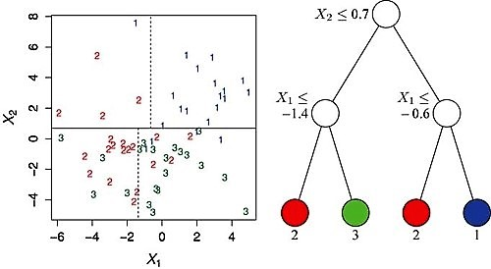
Background: CART
The algorithm starts at the root node of the tree and grows itself :
Step 1: Explore every possible split on each predictor variable. Binary questions are typically used to produce binary splits.
Step 2: Select and apply the best split (ie. selects the best feature which helps us better predicting the target class)
Step 3: Recursively proceed in this way until a stopping criterion is reached.

Slide 3

Background: MCMC
Markov Chain
Fare clic per inserire testo
Fare clic per inserire testo

Slide 4
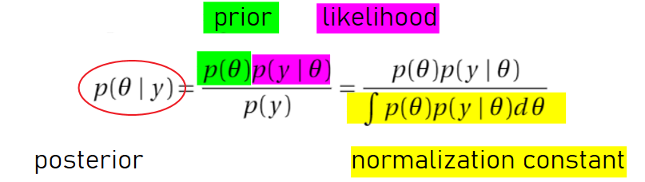
Background: MCMC
Monte Carlo
Monte Carlo simulations are just a way of estimating a fixed parameter by repeatedly generating random numbers
Monte Carlo simulations provide an approximation of a parameter where calculating it directly is impossible or prohibitively expensive
Bayes Rule

Slide 5
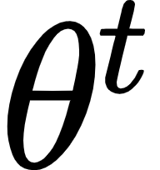
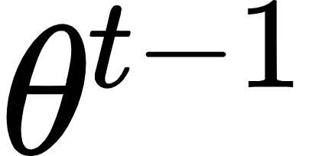
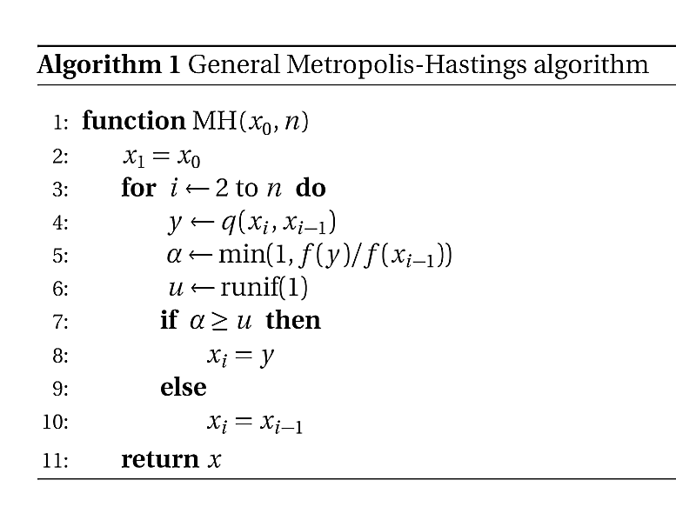
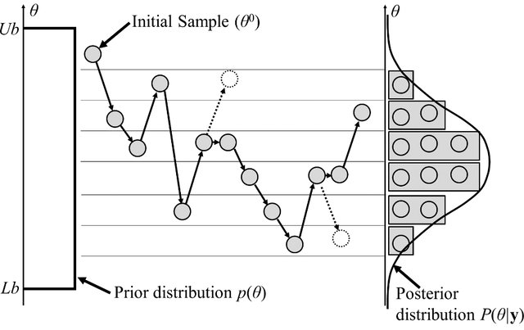
Background: MCMC
MCMC with Metropolis Hastings Algorithm
employs proposal distribution from which each state at iteration step t is proposed, eventually leading to the desired Markov chain
The proposed state depends on the state from the previous iteration
Rejected sample
Source: https://www.researchgate.net/publication/279248766_Metamodel_for_Efficient_Estimation_of_Capacity-Fade_Uncertainty_in_Li-Ion_Batteries_for_Electric_Vehicles

Slide 6
Background: MCMC
Gibbs Sampler
Special case of Metropolis-Hastings Algorithm
Acceptance rate = 1
Only requires the conditional distributions to approximate the traget distribution
Source: https://towardsdatascience.com/gibbs-sampling-explained-b271f332ed8d

Slide 7

BART: Overview
Water = data
Basins = Regression Tree
sum-of-trees model
each tree is contrained by a regularization prior to be a weak learner
prediction is achieved via an iterative Bayesian backfitting MCMC algorithm
BART is defined by a statistical model: a prior and a likelihood
Source: https://www.youtube.com/watch?v=4NIYZrL2y5g&ab_channel=SaltLakeCityRUsersGroup

Slide 8
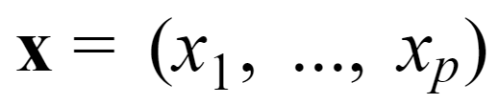

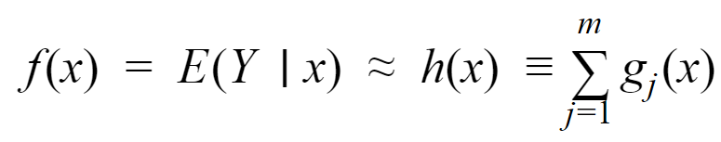
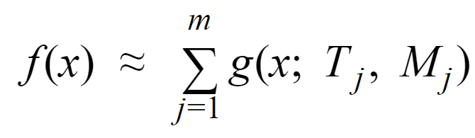
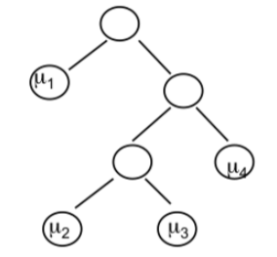

BART: Sum-of-Trees Model
Problem: dependent variable Y needs to be predicted using the input vectors :
Aim to approximate the mean of Y given x by the sum of m trees.
Each tree represented by the g_{j} function:
The sum-of-trees model can be written as:

Slide 9
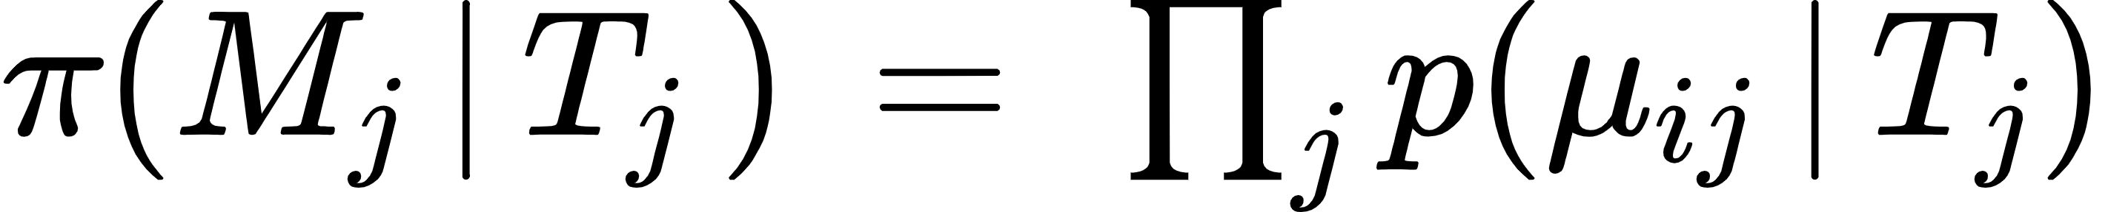
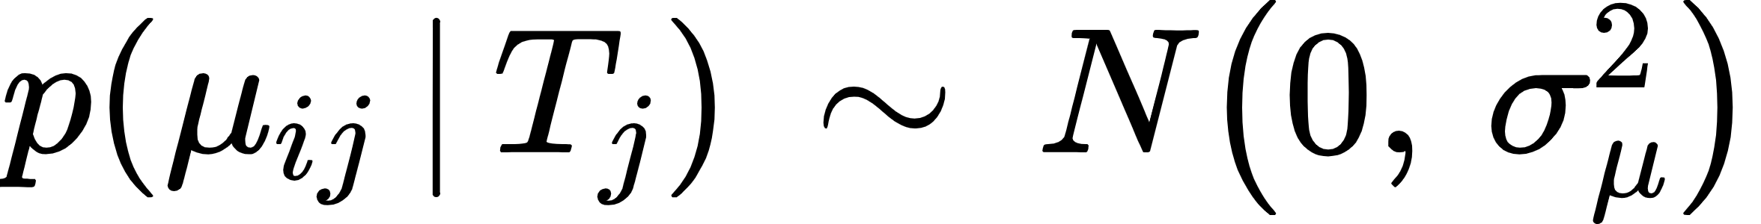
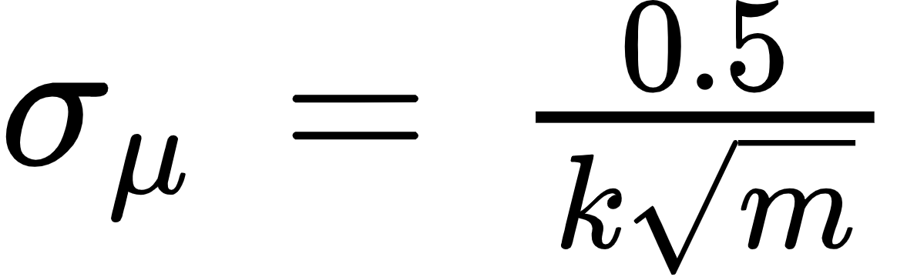
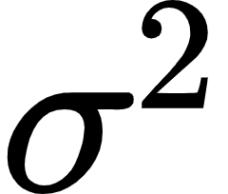
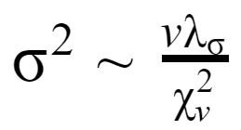
BART: Regularization Priors
Regularization prior for vector of parameters
Three components of the prior used for regularization:
1. π (T_{j}) the prior of the tree structure itself
The probability that node at depth d is not terminal:
The probability that the i-th feature of data is the decisive splitting variable for a node
The probability that for the selected i-th feature a certain value of the cut off point is used.
2. π (M_{j} | T_{j}) the prior of leaf structures given the tree (conjugate normal distribution prior)
3. p( ) the residual variance
Prior is modeled with the conjugate inverse chi-squre distribution prior

Slide 10
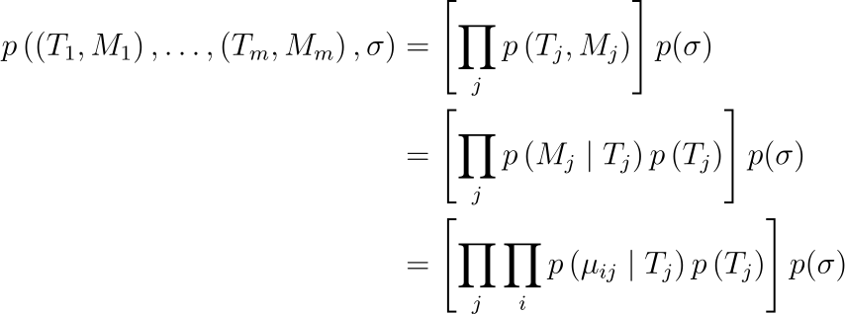

BART: Regularization Prior
Constraints the overall fit
Keeps the contribution of each tree model g(x; T_{j}, M_{j}) component small
=> reduce overfitting
Likelihood is modelled with normal distribution

Slide 11
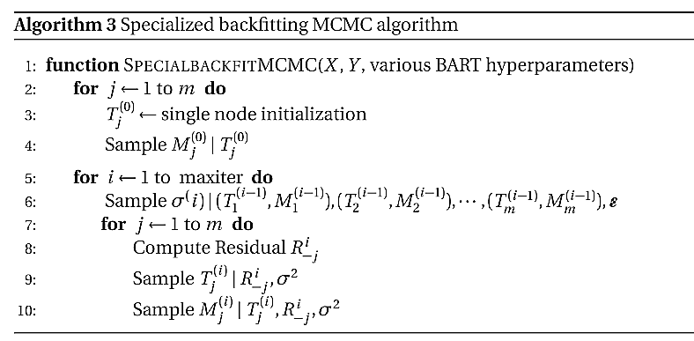
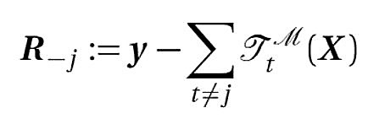

BART: Posterior Distributions
Whereby is the residual term of the remaining tree structures :
The whole residual term for the entire tree structures:
Modified version of Gibbs sampling --> sampling from posterior distribution without evaluating non-trivial integrals

Slide 12
Results and Discussions
Datasets
1. Diabetes dataset available at Hastie, Tibshirani, Wainright website
442 observations from 442 patients. For our case 3:1 test,train split
Y = quantitative measure of disease progression one year after baseline
X = 10 features ( BMI, sex, age,blood serum measurements ) + 54 codependencies of the features = 64 total covariates
2. Synthetic Friedman dataset
X = runif(0,1) for n number of covariates
For our experiments, 100 total covariates --> only the first 5 contributes to response Y
1000 observations , 500 train set and 500 test set
'bartMachine' BART implementation in R compared against classic CART and random forest
Comparison metrics : test set RMSE and R-squared

Slide 13
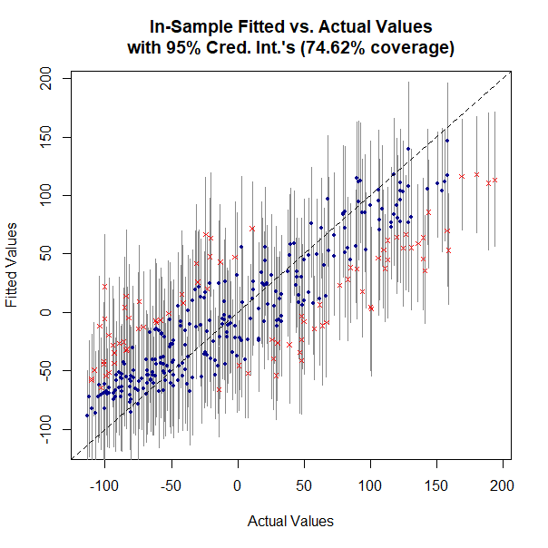
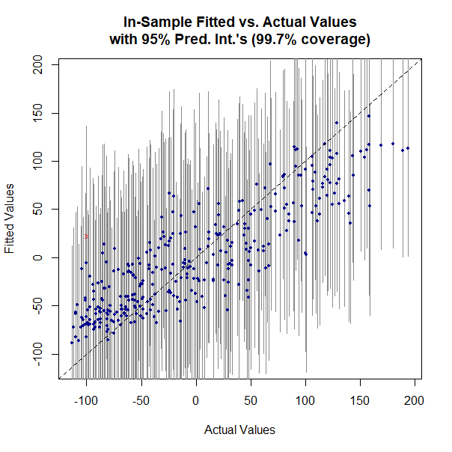
Results and Discussions
bartMachine fitting results
Credible interval doesn't take into account of regularization uncertainty!
Prediction interval with regularization uncertainty included --> reasonable fit!

Slide 14
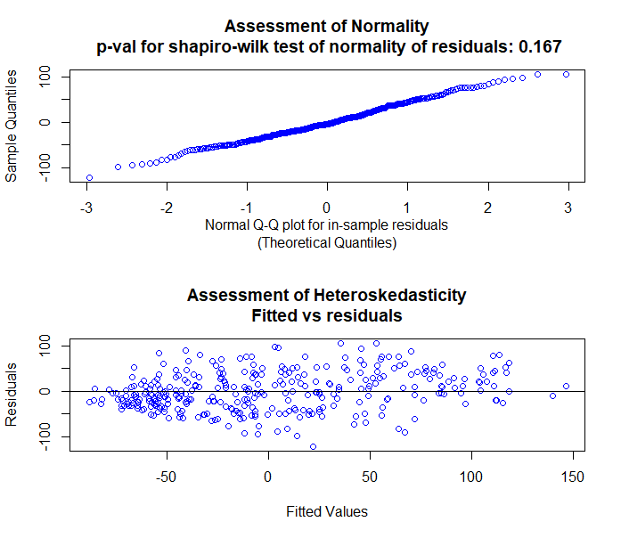
Results and Discussions
bartMachine assumption check
The p-value for shapiro-wilk test = 0.167 > 0.05 --> Null hypothesis of normality of residuals not rejected!
Visual inspection of normal Q-Q plot and heteroskedasticity plot further confirms normality of residuals!

Slide 15
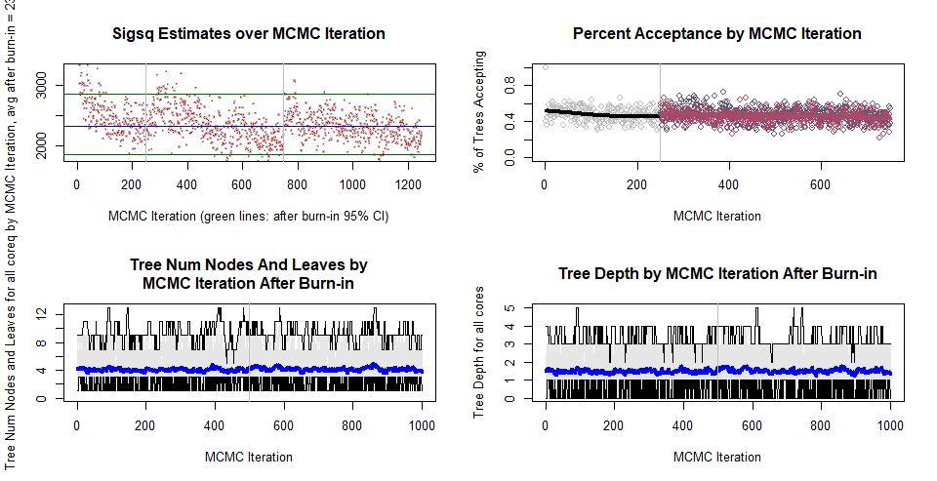
Results and Discussions
bartMachine MCMC convergence check
Overall convergence of trace plots of variance and tree parameters post burn-in

Slide 16
Results and Discussions
Overall bartMachine results for diabetes dataset
 | In-sample | 10-fold CV | Test-set
RMSE | 41.6 | 56.9 | 56.1
R-squared | 0.71 | 0.45 | 0.50
Slight overfitting in general
BART test set results against tuned regression tree and random forest models for diabetes dataset
​ | BART | Random Forest | Regression tree
RMSE​ | 56.1 | 56.8​ | 63.9
R-squared​ | 0.50​ | 0.47 | 0.33
Better performance compared to tuned random forest and regression tree models !

Slide 17
Results and Discussions
BART test set results against tuned regression tree and random forest models for synthetic Friedman dataset
​ | BART | Random Forest | Regression tree
RMSE​ | 1.61 | 2.51 | 2.93
R-squared​ | 0.88 | 0.78 | 0.62
Significantly better performance compared to tuned random forest and regression tree models !
BART accurately models non-linearity and multimodality in a high dimensional data with very large number of insignificant covariates!
Similarly observed in study by Scarpone et al. (2020) for COVID data regression in Germany and study by Kapelner and Bleich (2016).

Slide 18
Limitations and Outlook
Limitations
Overfitting is still a problem ( also observed by Kapelner and Bleich (2010)
Classic MH and Gibbs --> may result to slow mixing for high dimensional data and high memory usage
Outlook
Compare computation time and memory usage of BART against different regression models
Compare other novel posterior sampling methods used in BART such as particle Gibbs (Lakshminarayanan et. al 2015) and stochastic hill climbing algorithm used in XBart( He et. al 2020 )
Investigate different applications of BART in machine learning such as BART in causal inference ( Hahn e.t. al 2020, Hill e.t. al 2020 )

Slide 19
Thank you for your attention!

Slide 20
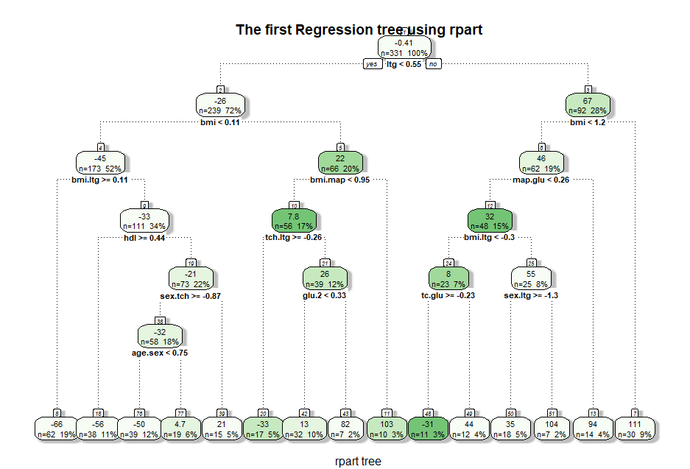
Appendix

Slide 21
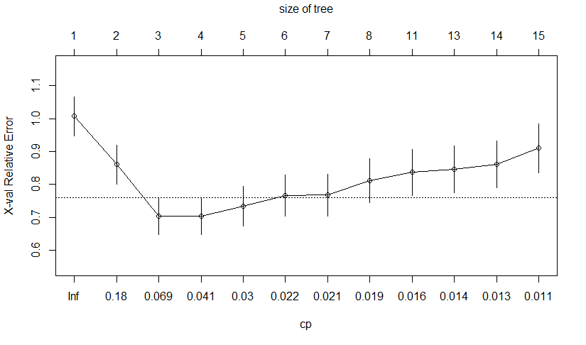
Appendix

Slide 22
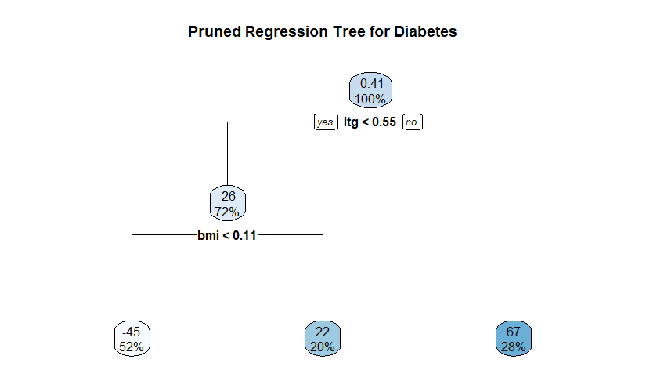
Appendix

Slide 23
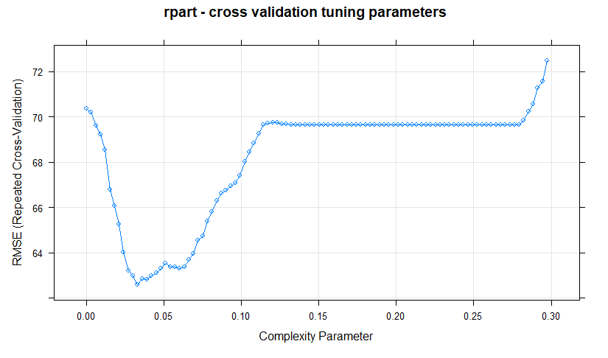
Appendix

Slide 24
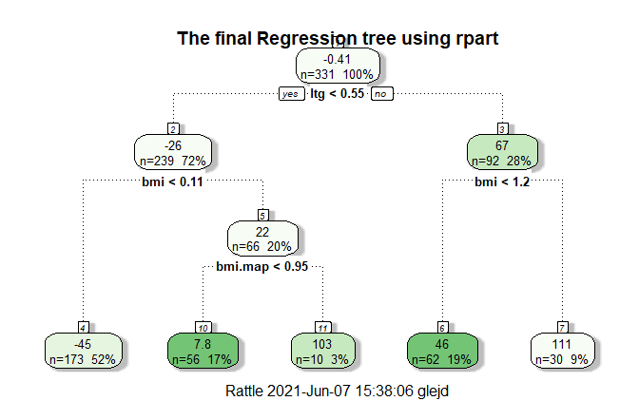
Appendix

Slide 25
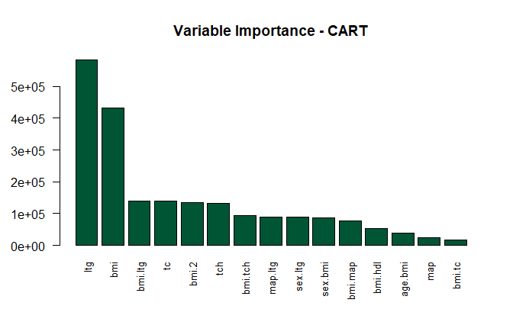
Appendix

Slide 26
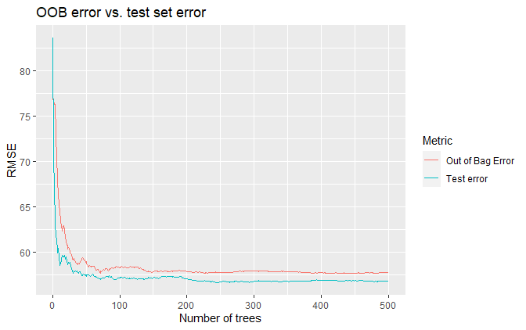
Appendix

Slide 27
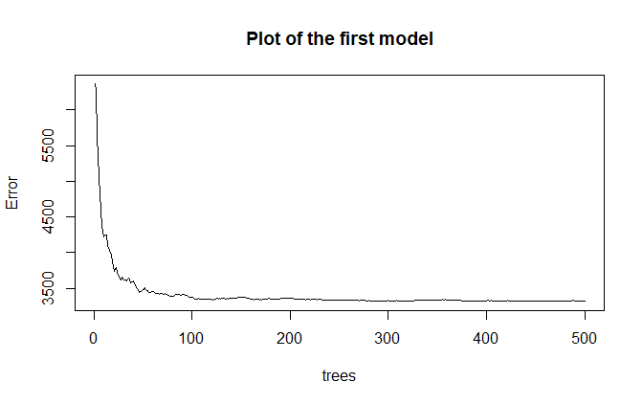
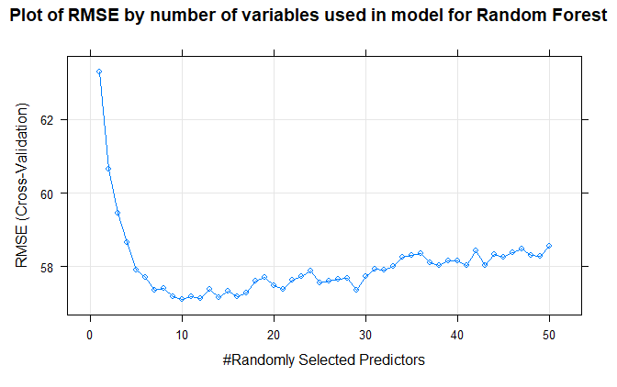
Appendix

Slide 28
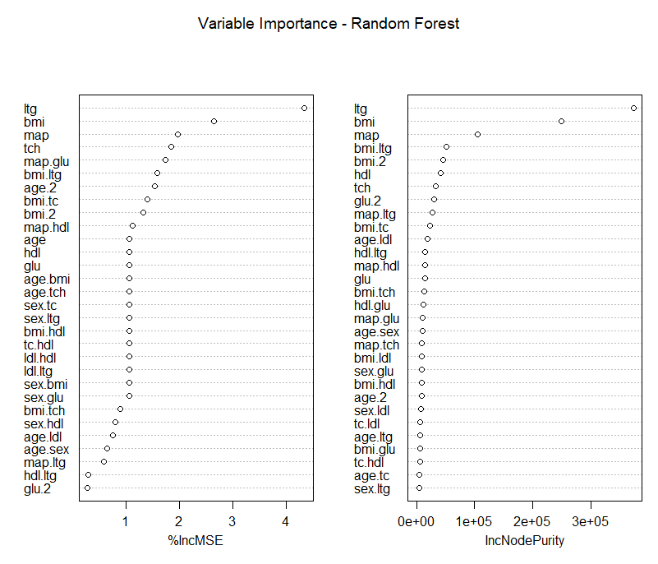
Appendix

Slide 29
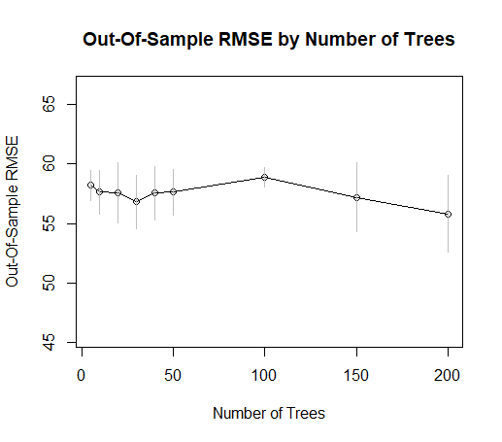
Appendix

Slide 30
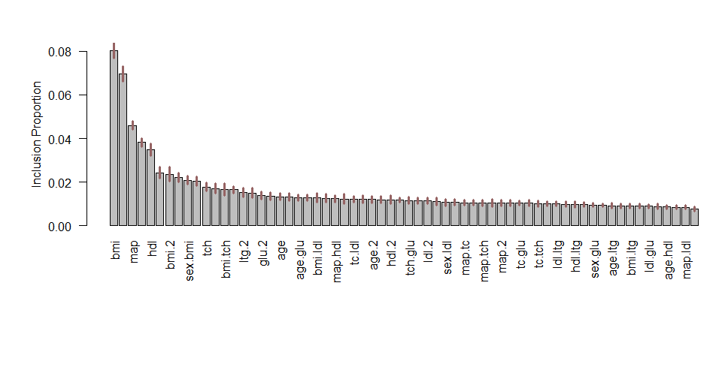
Appendix

Slide 31
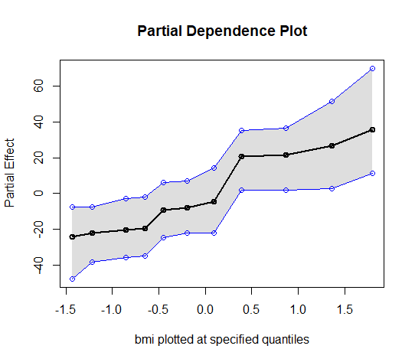
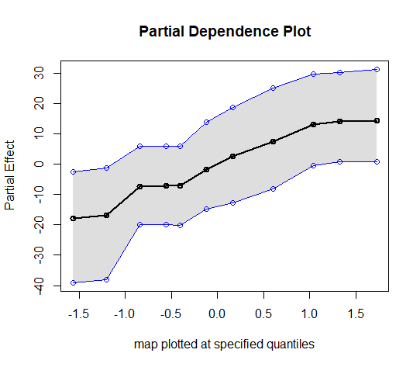
Appendix

