Slide 1

Bayesian Additive Regression Trees
An overview of applications of Bayesian methods in regression
Notes:
In our presentation we will discuss in details the Bayesian Additive Regression Trees, which apply various concepts of Bayesian inference to perform Bayesian ensemble learning of multiple tree models with added regularization effects.

Slide 2
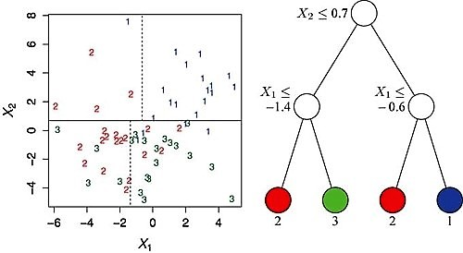
Background: CART
The algorithm starts at the root node of the tree and grows itself :
Step 1: Explore every possible split on each predictor variable. Binary questions are typically used to produce binary splits.
Step 2: Select and apply the best split (ie. selects the best feature which helps us better predicting the target class)
Step 3: Recursively proceed in this way until a stopping criterion is reached.
Notes:
Classification and Regression tree model builds a binary decision tree based on some splitting rule on the predictors. It produces rectangular sets by recursively partitioning the data set a single variable X at a time into disjoint sets, and fitting a single prediction model within each partition.
Here we have 2 features and 3 classes labeled 1,2,3 or blue, red and green. The partitions are shown in the left and the decision tree is on the right. The root node of the tree represents the entire dataset, and at each node, if the condition is satisfied, a case is assigned to the left child node.
One of the main drawback of CART Is overfitting.
This is why we are extending it to BART

Slide 3

BART: Overview
Water = data
Basins = Regression Tree
sum-of-trees model
each tree is contrained by a regularization prior to be a weak learner
prediction is achieved via an iterative Bayesian backfitting MCMC algorithm
BART is defined by a statistical model: a prior and a likelihood
Source: https://www.youtube.com/watch?v=4NIYZrL2y5g&ab_channel=SaltLakeCityRUsersGroup
Notes:
Now before explaining BART in details, I would like to build up some general sense of what BART is. I found this image from a very nice presentation on BART.
This image kinda describes how regularization prior prevents overfitting:
As data (water) flows from one basin to the next , some of the water is captured (some of the data is explained) by that basin and then the rest of it (the residual) flows to the next one … and so on until you finish your tree, and the rest is that error term in the final basin.
What the regularization prior is doing here and what the bayesian assumption is doing: is changing that shape of the basin to either capture more or less of the data and it balances it as it goes down to prevent overfitting relative to a training dataset.
BART is a Sum-of-trees model defined by a prior and a likelihood where each tree is constrained by a regularization prior in order to be a weak classifier
Fitting is done by a specialized iterative backfitting MCMC algorithm

Slide 4
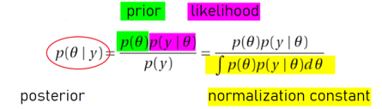
Background: MCMC
Bayes Rule
Monte Carlo
Monte Carlo simulations are just a way of estimating a fixed parameter by repeatedly generating random numbers
Monte Carlo simulations provide an approximation of a parameter where calculating it directly is impossible or prohibitively expensive
Notes:
In Bayesian statistics, one would normally propose a prior distribution of the samples and these priors are updated according to the likelihood of observations from the samples. In this way, the posterior distribution can be determined. The main formula of this update process is given here:
The integral in the denominator which represents the marginal likelihood of y can be treated as a normalizing constant of the whole expression. For very simple distributions, this normalizing constant can be determined analytically. However, in real life situations, the likelihoods obtained can get complex and impossible to evaluate this integral . We can use MCMC to approximate the posterior distribution, without the need to evaluate such complicated integrals.
IDEA of MCMC is to simulate the posterior distribution P(theta|y) , which can be treated as the target distribution, by iteratively constructing Markov Chain whose stationary distribution converges to the target posterior distribution.
Markov Chain Monte Carlo, by randomly sampling values out of a distribution, allows to describe a distribution without knowing in advance all of its mathematical properties. As it is written in the name, it combines two properties: Monte Carlo and Markov Chain.
MONTE CARLO
Estimates the probabilities of a distribution by exploring random samples from the distribution.
Rather than computing the mean of a normal distribution from its equation, in Monte Carlo approach we draw a large number of random samples from this normal distribution and then compute the mean, which is much easier than computing the mean directly from the normal distribution's equations.

Slide 5

Background: MCMC
Markov Chain
Fare clic per inserire testo
Fare clic per inserire testo
Notes:
MARKOV CHAIN
A sequence of random variables whose distribution evolves over time as a function of past realizations
Describes a sequence of possible events in which the probability of each event depends only on the state of the previous event.
Future independent Past | Present
The entire structure of Markov Chain only depends on:
The transition matrix
The initial state / initial distribution

Slide 6
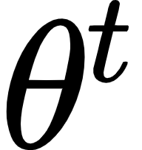
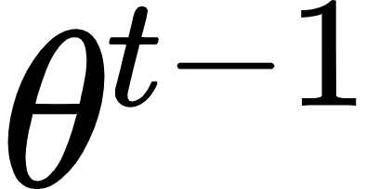
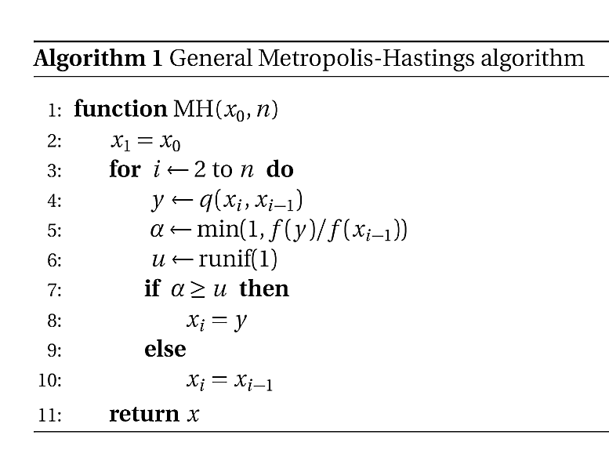
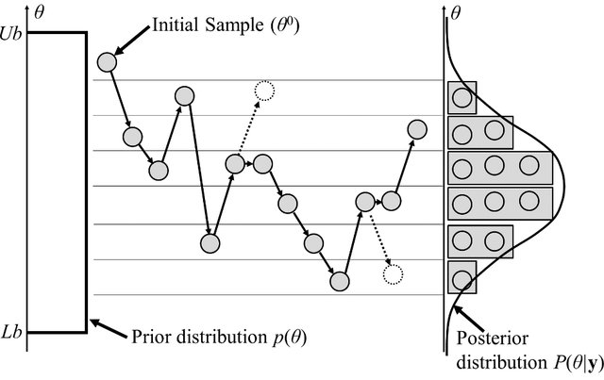
Background: MCMC
MCMC with Metropolis Hastings Algorithm
employs proposal distribution from which each state at iteration step t is proposed, eventually leading to the desired Markov chain
The proposed state depends on the state from the previous iteration
Rejected sample
Source: https://www.researchgate.net/publication/279248766_Metamodel_for_Efficient_Estimation_of_Capacity-Fade_Uncertainty_in_Li-Ion_Batteries_for_Electric_Vehicles
Notes:
The generation of Markov Chains in MCMC is done through Metropolis-Hastings algorithm.
it is one of the most widely used computational algorithm to perform MCMC
one would be able to approximate any probability density function pi(x) using only a proposal distribution function q(x) and a function f(x) which is proportional to the real probability density function pi(x)
the first state is initialized with a given initial state;
the candidate next state is proposed from the posterior distribution given the previous state;
the acceptance ratio α evaluates the probability of moving from the current state to the candidate state
If the acceptance ratio is lower than a randomly generated number 0-1 , then the candidate state is taken as the next state
Otw the next state will be the current state
This is iterated until max number of iterations is reached n
Does not suffer from curse of dimensionality (in contrast to importance and rejection sampling)
Convergence to the target distribution is guaranteed
burn-in : to ensure that the final distribution is approximate to the target distribution
i.e. the proposed states from the first n iterations are ignored as the initial distributions may not reflect true converged target distribution

Slide 7
Background: MCMC
Gibbs Sampler
Special case of Metropolis-Hastings Algorithm
Acceptance rate = 1
Only requires the conditional distributions to approximate the target distribution
High correlation states => slow convergence rate
Source: https://towardsdatascience.com/gibbs-sampling-explained-b271f332ed8d
Notes:
GIBBS SAMPLER
Special case of Metropolis-Hastings alg
Acceptance rate is always taken as 1, so you always move to the next state
Used when sampling multivariate distributions
You only require the conditional distributions to approximate the target distribution, as the acceptance rate is 1, no additional proposal distribution matching is required.
In the image here we illustrate the first 10,000 iterations of the Gibbs sampler. The blue lines are the contour lines of the target bivariate normal distribution. As it can be seen the samples are drawn from the target distribution as desired.
So wrap up: Gibbs sampling can be used to obtain draws from complicated joint distributions when we have access to the full conditionals.

Slide 8
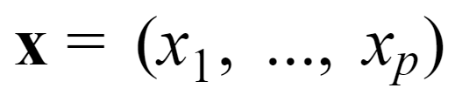

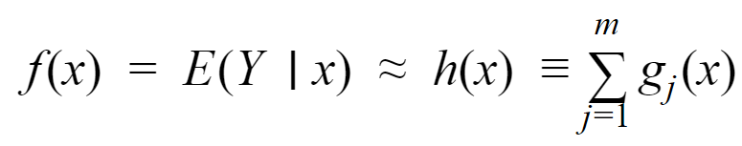
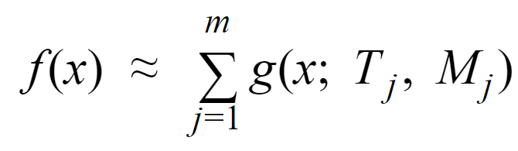
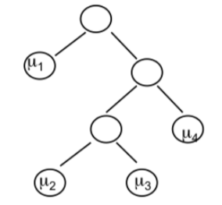

BART: Sum-of-Trees Model
Problem: dependent variable Y needs to be predicted using the input vectors :
Aim to approximate the mean of Y given x by the sum of m trees.
Each tree represented by the g_{j} function:
The sum-of-trees model can be written as:
Notes:
where T_j = j-th tree
M_j = {} = means of terminal nodes of j-th tree
b = number of terminal nodes of the corresponding tree
the value of g(x; Tj, Mj)is obtained by following observation x down the tree and returning the mean for the terminal node in which it lends.
The final sum-of-trees model is as written here:
On each of these trees a prior specification is applied, so they cannot grow very deep.
So BART is defined by a set of priors for the structure and the terminal nodes and a likelihood for the data in the terminal nodes.

Slide 9
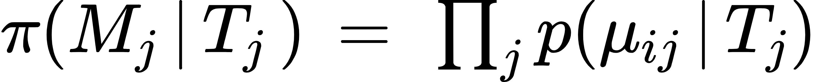
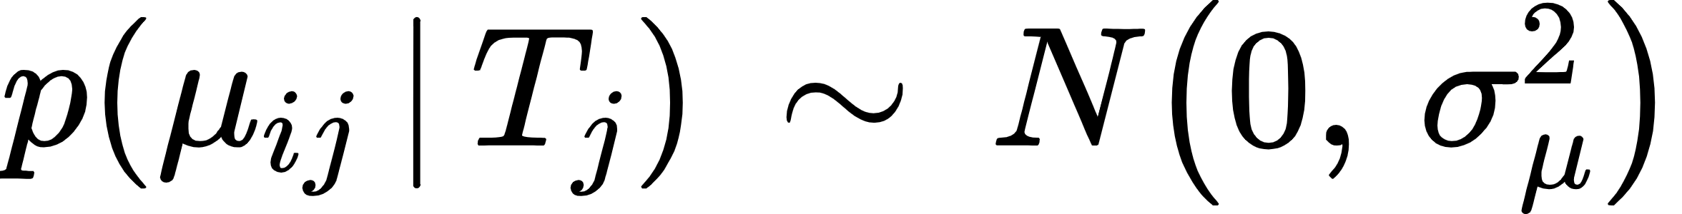
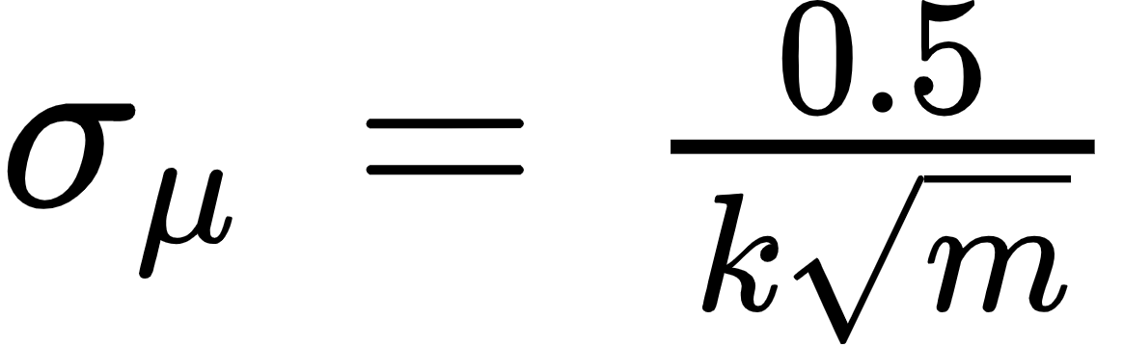
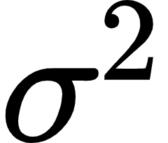
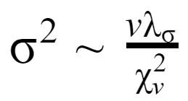
BART: Regularization Priors
Regularization prior for vector of parameters
Three components of the prior used for regularization:
1. π (T_{j}) the prior of the tree structure itself
The probability that node at depth d is not terminal:
The probability that the i-th feature of data is the decisive splitting variable for a node
The probability that for the selected i-th feature a certain value of the cut off point is used.
2. π (M_{j} | T_{j}) the prior of leaf structures given the tree (conjugate normal distribution prior)
3. p( ) the residual variance
Prior is modeled with the conjugate inverse chi-square distribution prior
Notes:
Regularization Priors:
To ensure the trees to not get too big, adapt to the data well while at the same time reduce overfitting
There are 3 priors used for regularization:
Pi(T_j) = prior of tree structure itself
Pi(M_j| T_j) = the prior of the leaf structures given the tree structure
It can be expressed as the product of all probabilities of the observed terminal nodes given the tree
K here is the hyperparameter to be tuned
This term would ensure that the leaves output gets closer to 0 (the center of the normal distribution) when the variance term gets smaller
P(sigma^2) = the residual variance
The residual variance helps to impose regularization effect on the whole term such that the model will not overfit to the training data.
This prior is modelled with the conjugate prior inverse chi square distribution, which is none other than a special case of inverse Gamma distribution

Slide 10
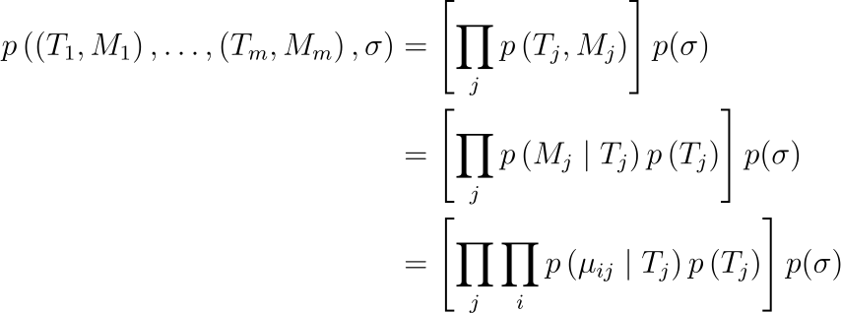

BART: Regularization Prior
Constraints the overall fit
Keeps the contribution of each tree model g(x; T_{j}, M_{j}) component small
=> reduce overfitting
Likelihood is modelled with normal distribution

Slide 11
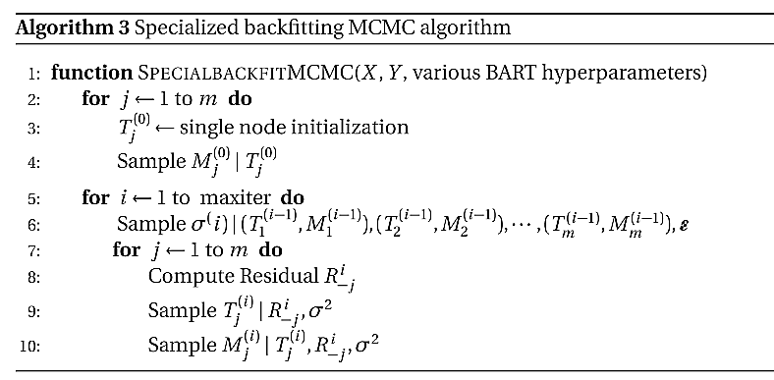
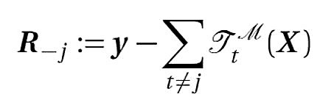

BART: Posterior Distributions
Whereby is the residual term of the remaining tree structures :
The whole residual term for the entire tree structures:
Modified version of Gibbs sampling --> sampling from posterior distribution without evaluating non-trivial integrals
Notes:
Now posterior distribution is left to be approximated. Direct analytical evaluation of the posterior is not possible, so a specialized backfitting MCMC algorithm is used.
Based on Gibbs sampling algorithm
There are 3 components that are sampled within each Gibbs sampling iteration
T_j | R_j, sigma^2
Is the conditional of the tree structure conditioned on the special residual term from the remaining trees and the residual variance. This is sampled by an additional Metropolis-within-Gibbs sampler.
M_j | T_j, R_j, sigma^2
This is the conditional of the leaves parameters conditioned on the j-th tree structure of the current Gibbs iteration, special residual term from the remaining trees and the residual variance. Since the prior and the likelihood are both of normal distributions, the conditional can be directly sampled from a conjugate normal distribution.
Sigma_j | (T1, M1), …, (Tm, Mm), error
The conditional of the residual variance conditioned on all the tree structures , the corresponding leaves parameters and the whole residual term. Since the prior is conjugate inverse chi-squared distribution, sampling from the posterior can be directly done from a conjugate inverse chi-squared distribution.
Line 6 and line 10 ---> not so hard, because they are prior conjugates so no need to use MH

Slide 12
Results and Discussions
Datasets
1. Diabetes dataset available at Hastie, Tibshirani, Wainright website
442 observations from 442 patients. For our case 3:1 test,train split
Y = quantitative measure of disease progression one year after baseline
X = 10 features ( BMI, sex, age,blood serum measurements ) + 54 codependencies of the features = 64 total covariates
2. Synthetic Friedman dataset
X = runif(0,1) for n number of covariates
For our experiments, 100 total covariates --> only the first 5 contributes to response Y
1000 observations , 500 train set and 500 test set
'bartMachine' BART implementation in R compared against classic CART and random forest
Comparison metrics : test set RMSE and R-squared

Slide 13
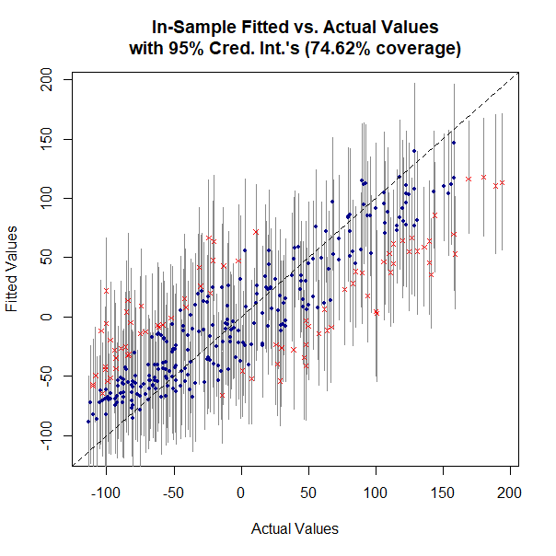
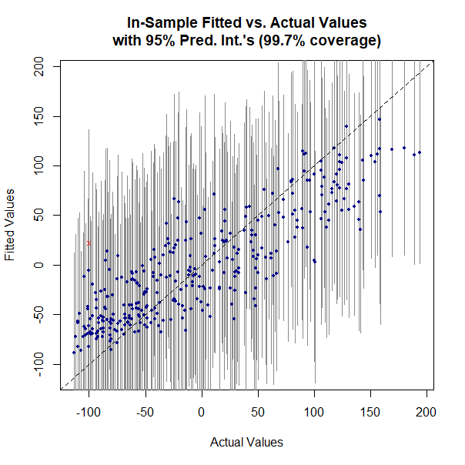
Results and Discussions
bartMachine fitting results
Credible interval doesn't take into account of regularization uncertainty!
Prediction interval with regularization uncertainty included --> reasonable fit!

Slide 14
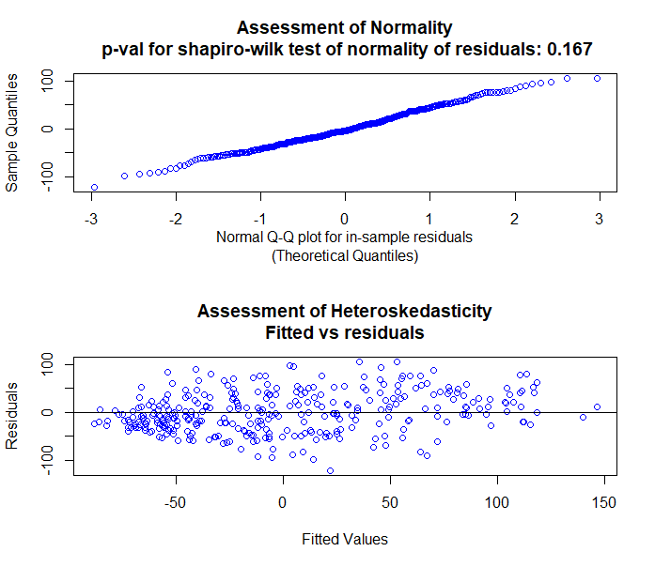
Results and Discussions
bartMachine assumption check
The p-value for shapiro-wilk test = 0.167 > 0.05 --> Null hypothesis of normality of residuals not rejected!
Visual inspection of normal Q-Q plot and heteroskedasticity plot further confirms normality of residuals!

Slide 15
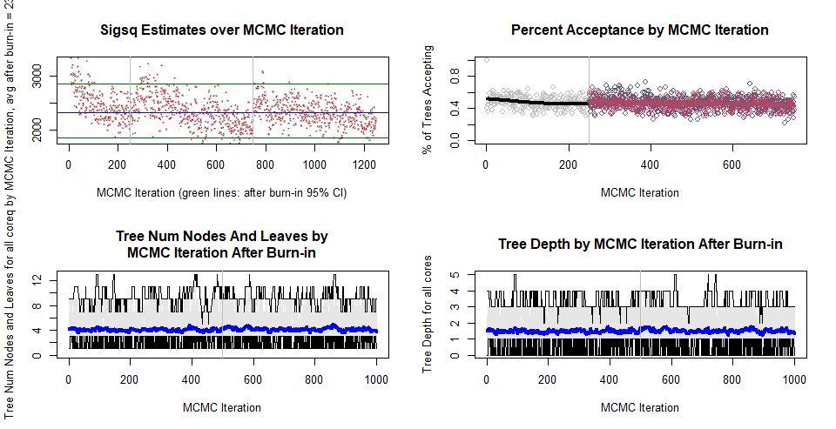
Results and Discussions
bartMachine MCMC convergence check
Overall convergence of trace plots of variance and tree parameters post burn-in

Slide 16
Results and Discussions
Overall bartMachine results for diabetes dataset
 | In-sample | 10-fold CV | Test-set
RMSE | 41.6 | 56.9 | 56.1
R-squared | 0.71 | 0.45 | 0.50
Slight overfitting in general
BART test set results against tuned regression tree and random forest models for diabetes dataset
​ | BART | Random Forest | Regression tree
RMSE​ | 56.1 | 56.8​ | 63.9
R-squared​ | 0.50​ | 0.47 | 0.33
Better performance compared to tuned random forest and regression tree models !

Slide 17
Results and Discussions
BART test set results against tuned regression tree and random forest models for synthetic Friedman dataset
​ | BART | Random Forest | Regression tree
RMSE​ | 1.61 | 2.51 | 2.93
R-squared​ | 0.88 | 0.78 | 0.62
Significantly better performance compared to tuned random forest and regression tree models !
BART accurately models non-linearity and multimodality in a high dimensional data with very large number of insignificant covariates!
Similarly observed in study by Scarpone et al. (2020) for COVID data regression in Germany and study by Kapelner and Bleich (2016).

Slide 18
Limitations and Outlook
Limitations
Overfitting is still a problem ( also observed by Kapelner and Bleich (2010)
Classic MH and Gibbs --> may result to slow mixing for high dimensional data and high memory usage
Outlook
Compare computation time and memory usage of BART against different regression models
Compare other novel posterior sampling methods used in BART such as particle Gibbs (Lakshminarayanan et. al 2015) and stochastic hill climbing algorithm used in XBart( He et. al 2020 )
Investigate different applications of BART in machine learning such as BART in causal inference ( Hahn e.t. al 2020, Hill e.t. al 2020 )

Slide 19
Thank you for your attention!

Slide 20
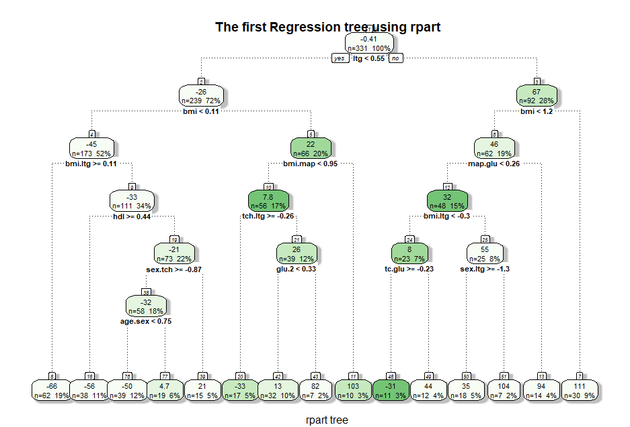
Appendix

Slide 21
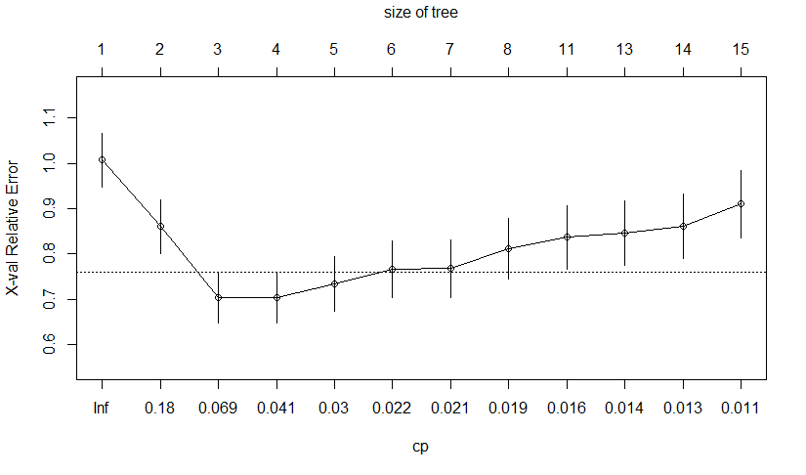
Appendix

Slide 22
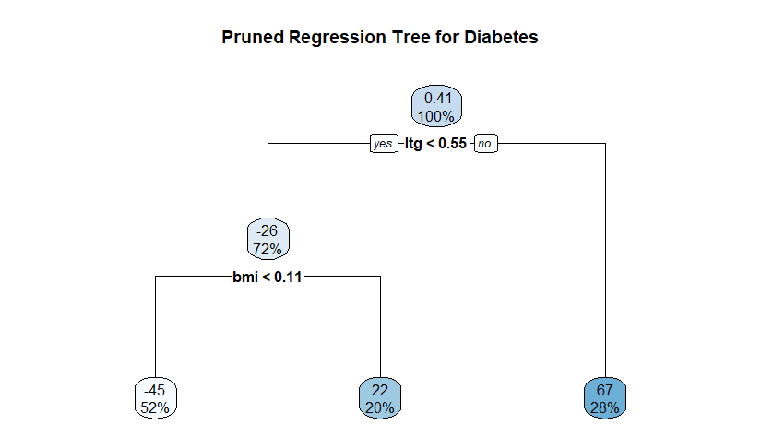
Appendix

Slide 23
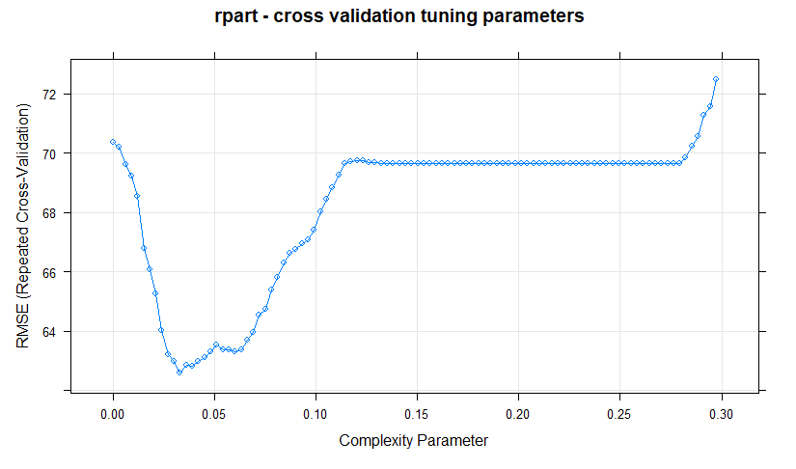
Appendix

Slide 24
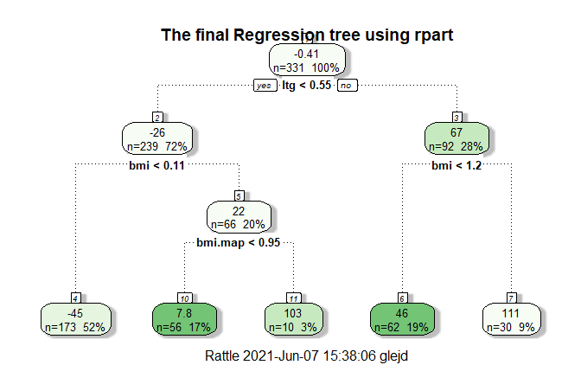
Appendix

Slide 25
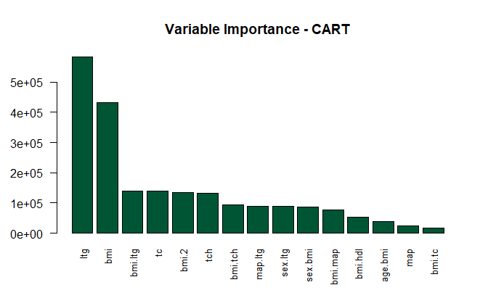
Appendix

Slide 26
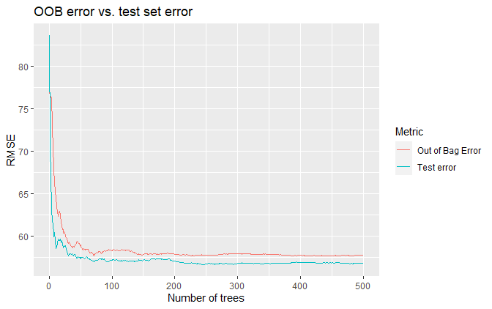
Appendix

Slide 27
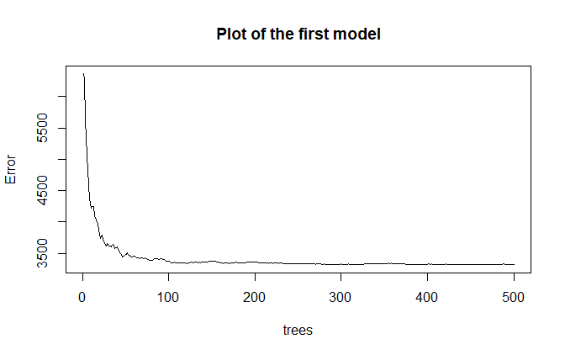
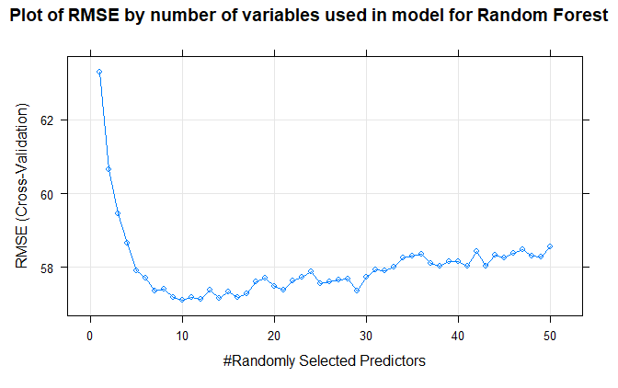
Appendix

Slide 28
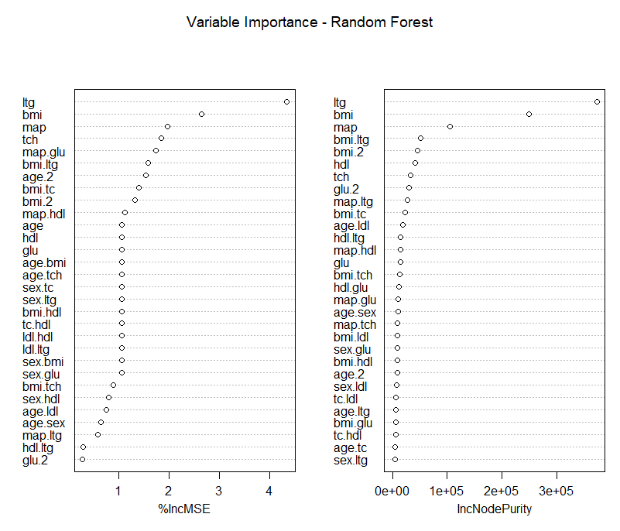
Appendix

Slide 29
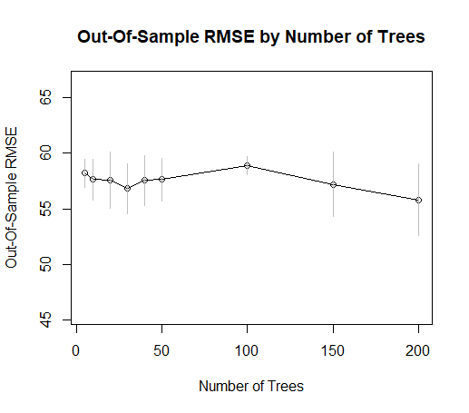
Appendix

Slide 30
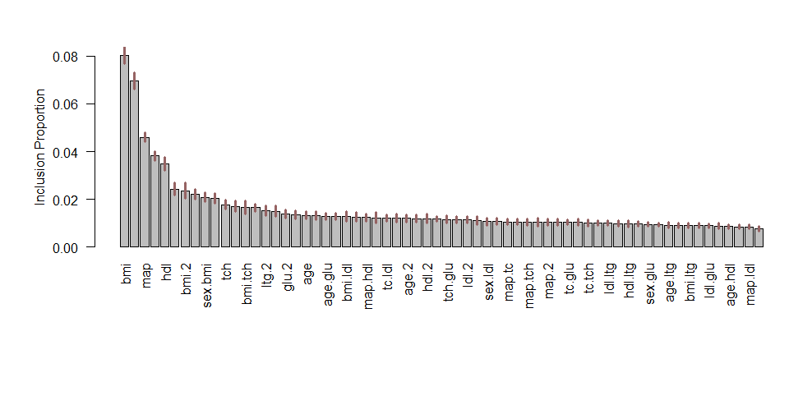
Appendix

Slide 31
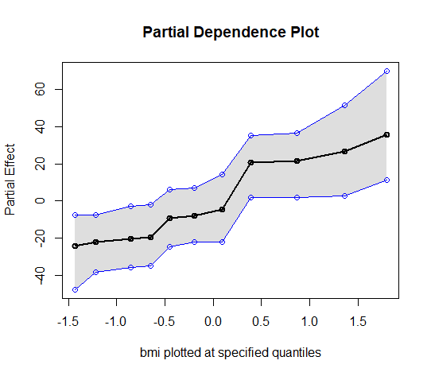
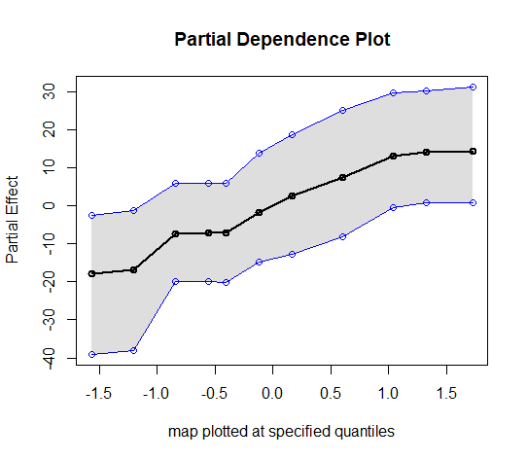
Appendix

