Slide 1
BDA104 – Final Project
Prediction of the NFL Draft
Glen Cripps

Slide 2
Background
Every year, 32 NFL football teams participate in an ordered selection of the top college football athletes in an event known as “The NFL Draft”
The goal for every team is to pick the best available college athlete when it is their turn.
The NFL team has exclusive rights to sign these players to affordable exclusive contracts for 4-5 years without interference or competition from other teams
The teams that make the best athlete selections at the draft have a large competitive advantage over other teams because of the affordability of the contracts as well as the fact that the athletes are expected to improve significantly during the 4-5 year period.

Slide 3
Background – Available Data
The eligible athletes participate in a annual event called “The NFL Combine”, where their athletic traits are measured in a series of events. NFL teams use these statistics to determine which athletes have the greatest potential.
Additionally, the athletes have accumulated statistics from their college team, these statistics also helps NFL teams determine their potential.
These statistics are available from various sources on the internet and were gathered for this presentation

Slide 4
Data Source #1 – The Combine
Every spring, eligible college athletes participate in a series of events at the combine to determine their size, speed, agility, ability to catch, and strength
A football team is composed of different athletes with different roles and physical attributes.
A good wide receiver is expected to be fast, tall, agile, with excellent catching ability.
A good offensive lineman is extremely strong with a high weight
A good quarterback prospect is typically tall and able to throw accurately and with high velocity
The combine’s events provide statistical measures to quantify these traits, however – the events themselves often have no direct relation to some traits. For example – there is no drill to measure textbook agility, however, their performance in the series of “Cone” drills can be used to infer agility.

Slide 5
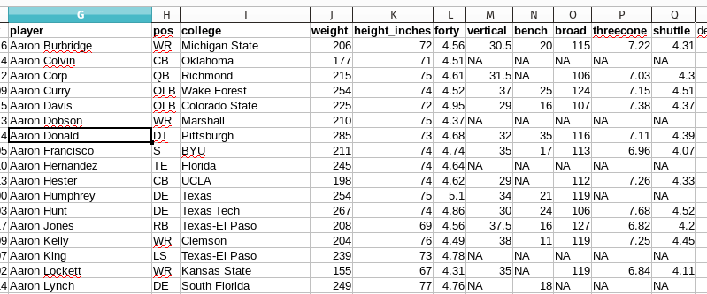
Data Source #1 – The Combine
Combine Data Snapshot!

Slide 6
Data Source #1 - Combine Data Challenges
Athletes individually choose which events they will participate in. So, missing data is a large issue with combine datasets.
Replacement of missing data with the mean/average is expected to yield some statistical challenges because of the fact that different pools of similar athletes tend to participate in the same events.
For example – the agile athletes tend to all participate in the agility drills, and the very large athletes do not.
A simple approach of applying the statistical mean to replace missing values will misrepresent the agility of the athletes who do not participate.
The athletes who avoid specific drills because they expect they will perform poorly will appear “average” using df[‘col’].fillna(mean).
A more intelligent approach for missing values should be experimented with (average by position, mice)

Slide 7
Data Source #2 – College Game Stats
An eligible athlete typically completes ~ 2-5 years of college before declaring eligibility for the NFL draft.
During those years, his statistics are available for the games he played. Examples are games played, touchdowns scored, sacks, and yards rushing the football.
The individual statistics a player accumulates can help NFL teams understand his potential in the NFL.
The recorded statistics tend to fall into 4 main categories: Passing, Rushing, Receiving (catching) and Defensive statistics.
Individual statistics are known to have high variance and positive or negative significance relative to eachother. A player who catches 20 touchdowns can be considered more skilled than one who rushes for 500 yards and 5 TDs.
Certain players have no statistics captured other than games played (eg – offensive lineman)

Slide 8
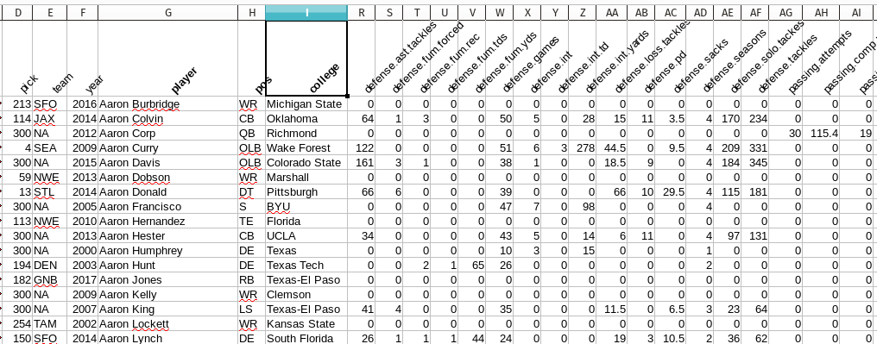
Data Source #2 – College Game Stats
The recorded statistics tend to fall into 4 main categories: Passing, Rushing, Receiving (catching) and Defensive statistics.

Slide 9
Data Source #2 – College Stats Challenges
The statistics an athlete will accumulate tend to be mutually exclusive by the previous categories (passing, receiving, etc) but it is not a 100% rule. Some players play multiple positions with combinations of stats.
A player who plays 5 full seasons will accumulate a large amount of statistics relative to one who plays only 2. However, the player who completes 5 years of college may or may not be more attractive to NFL teams for various reasons (eg – physical wear and tear)
A player’s prior season is typically considered the best indicator of their potential. A data scientist must consider how to represent this data. For example – do you include features for the recent season only and separate features for prior seasons? Is it worth the added dimensionality to do so?
College teams statistics are highly variant based on the size of the college, division, and coach. Certain teams score much larger amounts than others. This statistical variance will add a variance challenge to a machine learning algorithm.

Slide 10
Data Source #2 – College Stats Challenges
Missing data for small schools represented an additional challenge. Some eligible players do not have available game statistics. If the use case was to rank everybody, what would be the best way to include these players? Should we submit 0’s for their statistics or the mean-average of similar players?
Some individual schools (eg – Alabama, Michigan) are known to attract NFL caliber players because of their size, budget and coaching philosophy. Players from these schools may have middling statistics because of the level of talent on the team (ie – excellent players backed up by very good players).
A data scientist must decide what techniques to apply to give extra weight to these high-grade schools. Is it simple enough to include the college name as a dimension? What impact will the extra dimensionality have on the prediction?

Slide 11
Data Source #3 – Past NFL Draft selections
Each year in May, the NFL draft takes place, and all 32 teams select their future players from the available pool of athletes.
Teams use a combination of factors to determine their own “Draft Board”, which is an ordered list of the most talented players.
This board is kept highly confidential from other teams and media. There is no data available for this. However, based on whom they select when it is their turn to pick, we can use machine learning to attempt to predict the most talented players.
Teams will often build their draft board based on a set of scouting reports, player interviews, the statistics we are analyzing here, as well as the current status of their team and the role (position) where they are poorly talented.
Certain player positions are considered highly important for NFL success (eg Quarterback) and teams will regularly fixate on these positions when evaluating their board.

Slide 12
Data Source #3 – Past NFL Draft selections
Teams in the NFL hold strong levels of bias with respect to various human factors which are not measurable statistically. For example, some teams place high value on character traits, intelligence, and background.
Additionally, a large portion of the data in the historical dataset represents “old philosophies” that are now considered obsolete. Often a team will fire their general manager and replace them with a person with a much different drafting philosophy.
Many historical draft picks in the dataset were considered terrible decisions at the time. Many others were considered brilliant at the time but turned out far worse.
The machine learning experiments used in this study are predictors of draft rank, based on past data points. The algorithms in this study will not be able to differentiate the poor choices from the smart ones.
Data used for this experiment is a snapshot at the time of the draft. Future success is not relevant for this study because it was not known at the time.
Because of this bias, the NFL draft is considered something of a biased crapshoot that cannot be reasonably predicted.

Slide 13
Data Source #3 – Data Science Prediction Challenges
Key challenges for Data Science:
- Prediction is not really a prediction of success or talent. It’s more of a repetition of whatever happened in the past. This experiment will re-predict past draft busts given similar inputs. This is largely a communication challenge for data scientists.
- Overfitting – players with irregular ‘data fingerprints’, such as the small subset who played multiple positions in college, will be theoretically bagged together in the small subset of historical players with similar stats. This is expected to result in poor predictions
- The ML algorithms must overcome the large human bias which exists in reality, as well as the large statistical variance that we know exists in the college statistics, as well as the missing/imputed data from the combine.
- Is this best framed as a classification or continuous ranking? We will test both. A first round selection 1/0 for classification and the draft selection (1...300) for continuous.

Slide 14
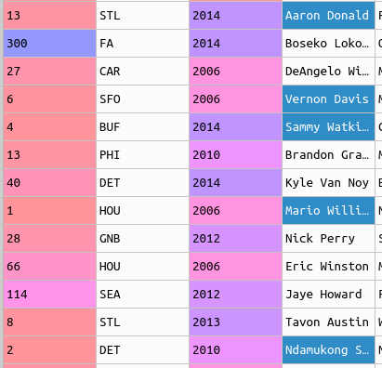
Prediction - Regression
Using the draft rank (1…300) as a continuous prediction field, the following results were observed:
Linear Regression:
Variance Score – 0.199 (poor)
RMS Score – 94 (poor).
The predicted rank however does show
interesting and valuable results at the top
and bottom of the rankings when viewed
In order

Slide 15
Prediction - Regression
Other Methods used:
Regression Trees: Results were poor.
The “tree” overfits to the training set and groups bunches of somewhat similar statistical players together into the average of their rank.
Variance Score -0.13 (very poor)
RMS - 112
Lasso Regression: Results were similar to Linear Regression
Variance Score - .20
RMS - 93

Slide 16
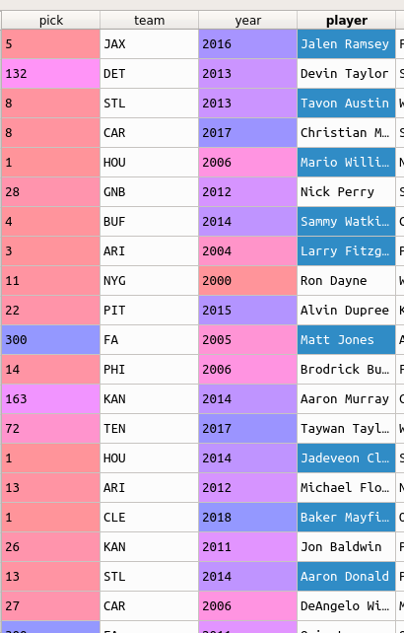
Prediction - Classification
To test classification algorithms, the
predictor was set to 1/0 with 1 representing
a 1st round draft selection
Logistic Regression:
Results were interesting but still poor.
precision recall f1-score support
0 0.91 1.00 0.95 1285
1 0.80 0.11 0.20 143
avg / total 0.90 0.91 0.88 1428
Confusion Matrix
[[1281 4]
[ 127 16]]
Similarly, the records predicted at the top were
fairly predicted and valuable information

